Slide 1
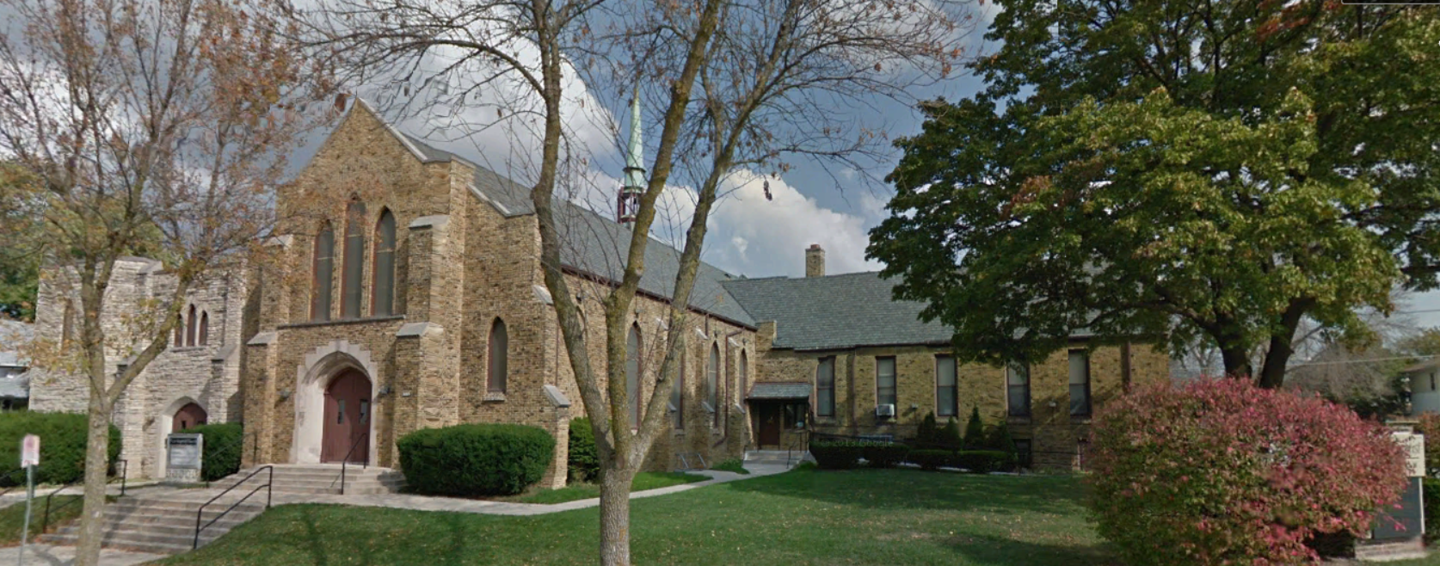
Our Story:
First Baptist Church of West Allis
6. Early Honey Creek Settlement

Slide 2
Northern United States
foot

Slide 3
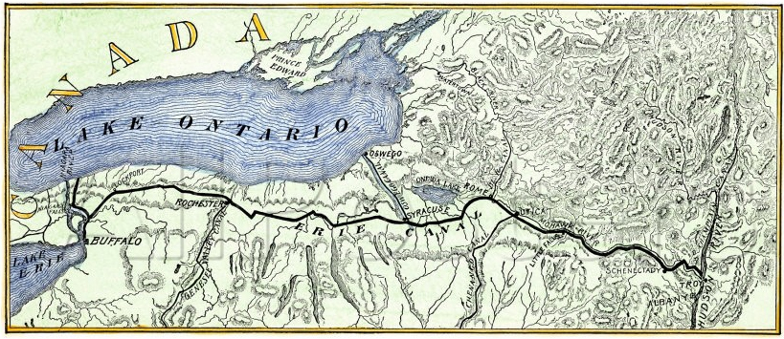
New York’s Erie Canal

Slide 4
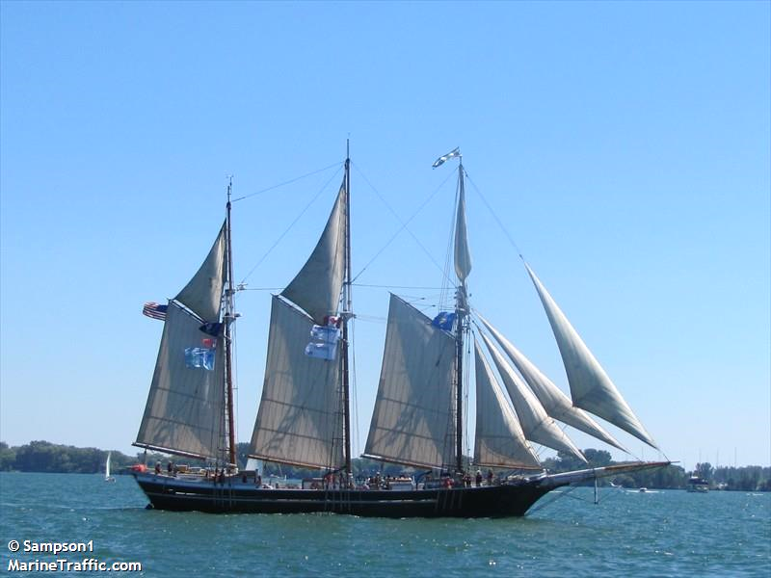
Northern United States (water route)
Schooner

Slide 5
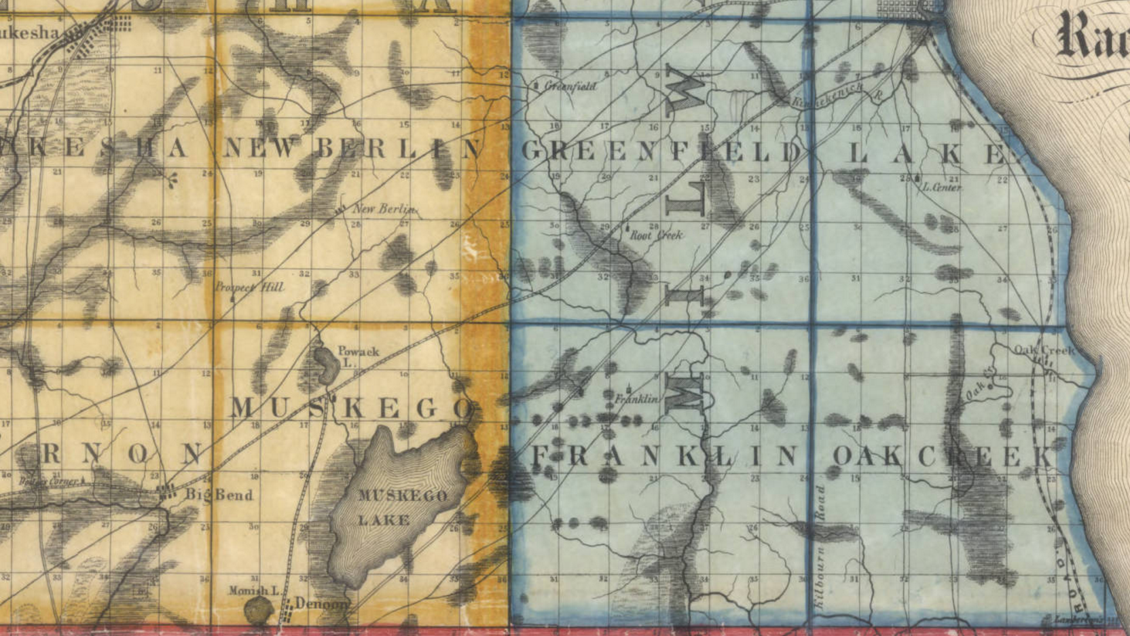
Southern Milwaukee
& Waukesha Counties
Milwaukie
Honey Creek
Muskego Lake

Slide 9
Township 6 North (Greenfield) Section 21 SW
1858
2016
I-894 & I-41

Slide 11
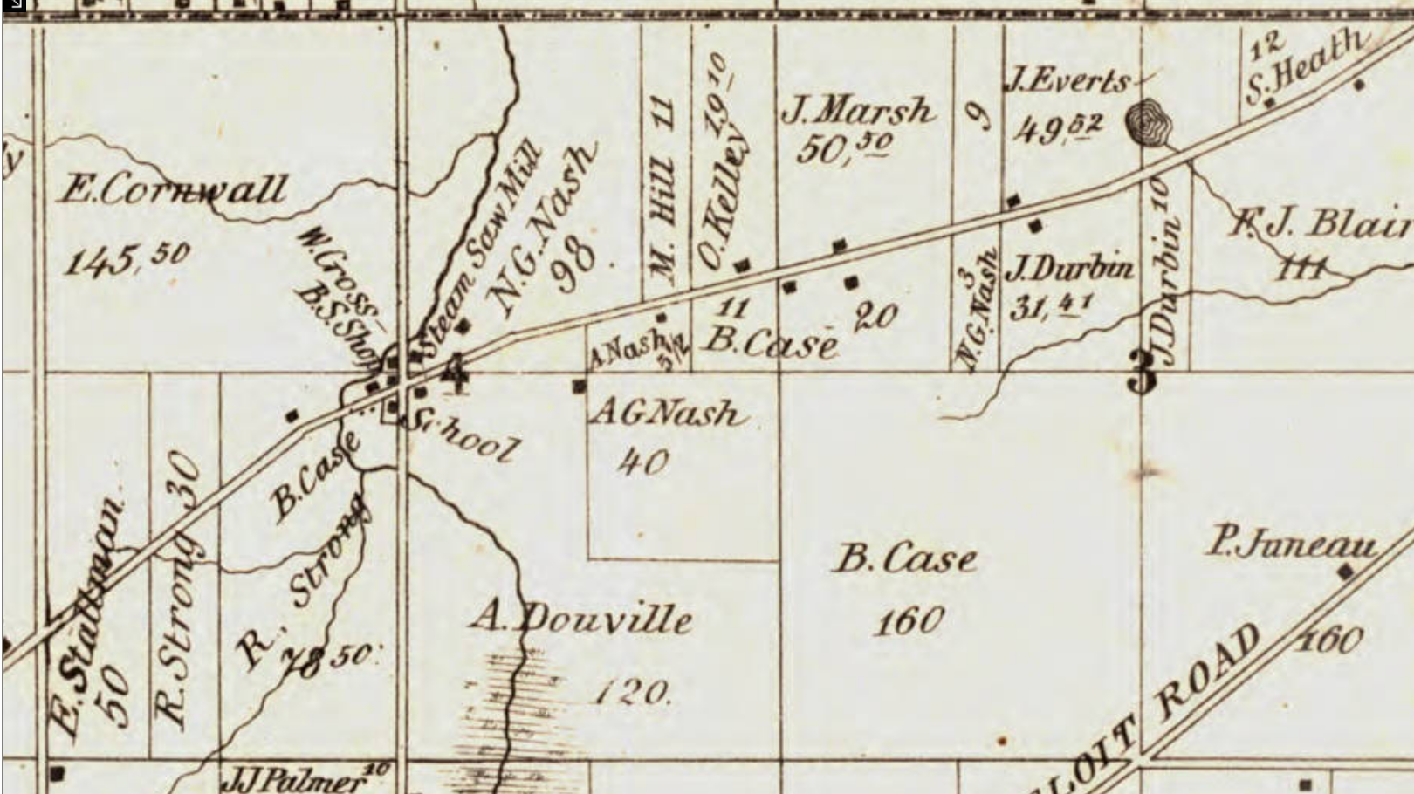
Honey Creek/North Greenfield in 1858

Slide 12
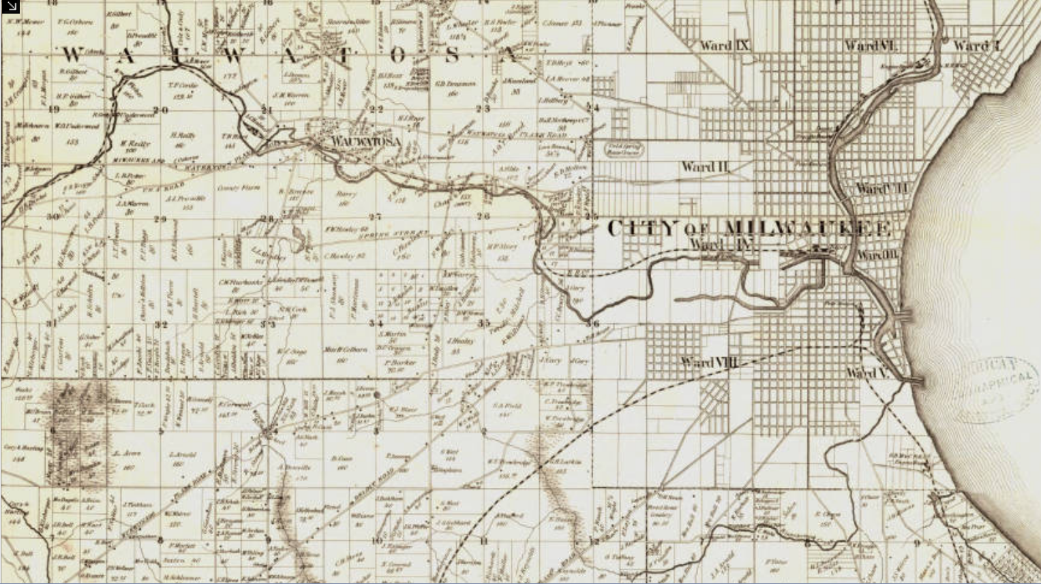
Some Old Indian Trails in Milwaukee County 1859
Wauwatosa
Mukwonago Rd (National Ave)
Old Five Points
Townline Rd (Greenfield Ave)
Honey Creek/North Greenfield

Slide 13
Honey Creek/North Greenfield in 1858

Slide 14
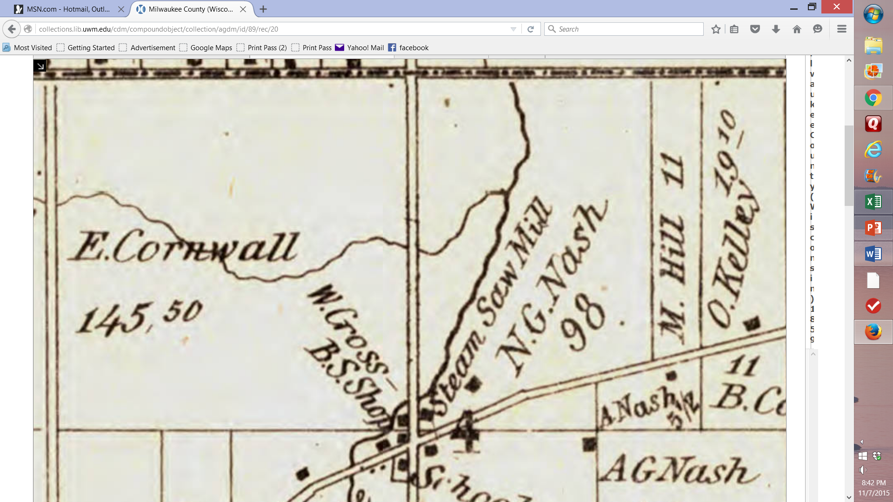
Honey Creek/North Greenfield

Slide 15
Douvalle
Mansion

Slide 16
Honey Creek/North Greenfield

Slide 17
Honey Creek/North Greenfield

Slide 18
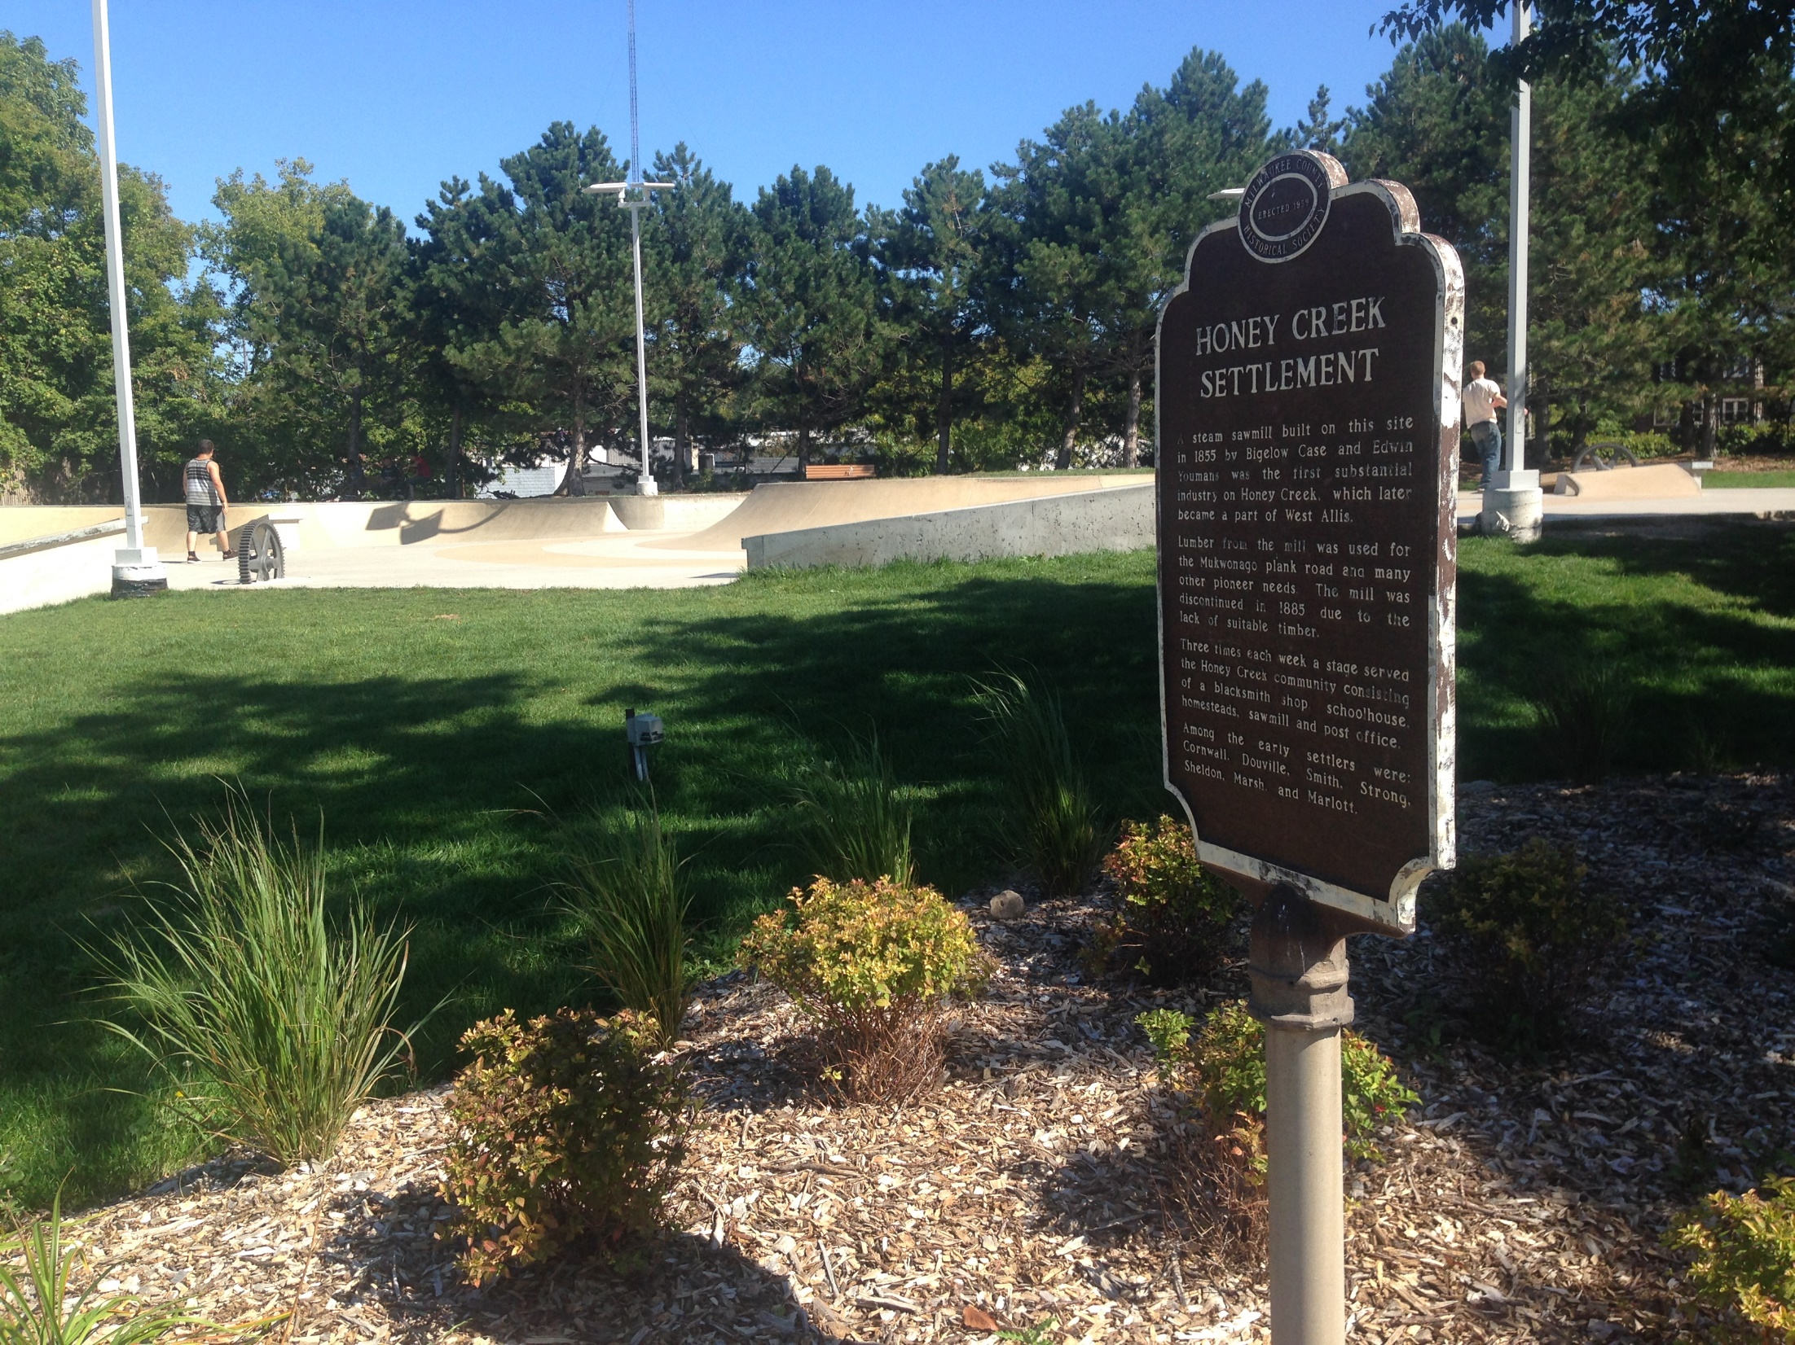
2016
The mill area is a skate park
(NE corner of 84th & National)

Slide 19
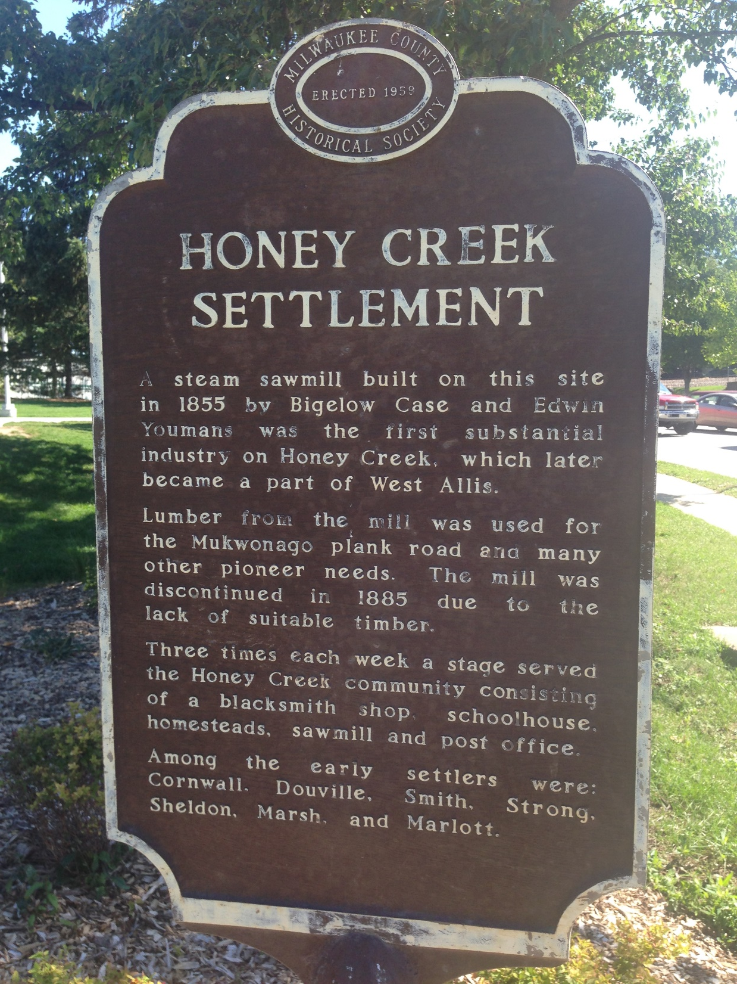
A steam sawmill built on this site in 1855 by Bigelow Case and Edwin Youmans was the first substantial industry on Honey Creek, which later became part of West Allis. Lumber from the mill was used for the Mukwonago plank road and many other pioneer needs. The mill was discontinued in 1885 due to the lack of suitable timber. Three times each week a stage served the Honey Creek community consisting of a blacksmith shop, schoolhouse, homesteads, sawmill and post office. Among the early settlers were: Cornwall, Douville, Smith, Strong, Sheldon, Marsh, and Marlott.

Slide 20
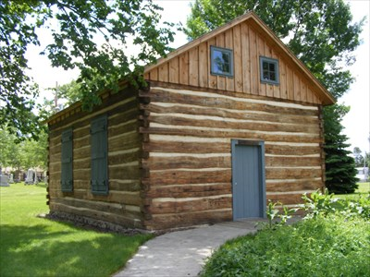
Log Cabin School Replica

Slide 21
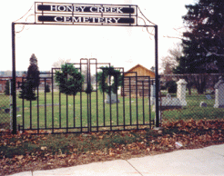

Slide 22
Our Story:
First Baptist Church of West Allis
End of history 6

