Slide 1
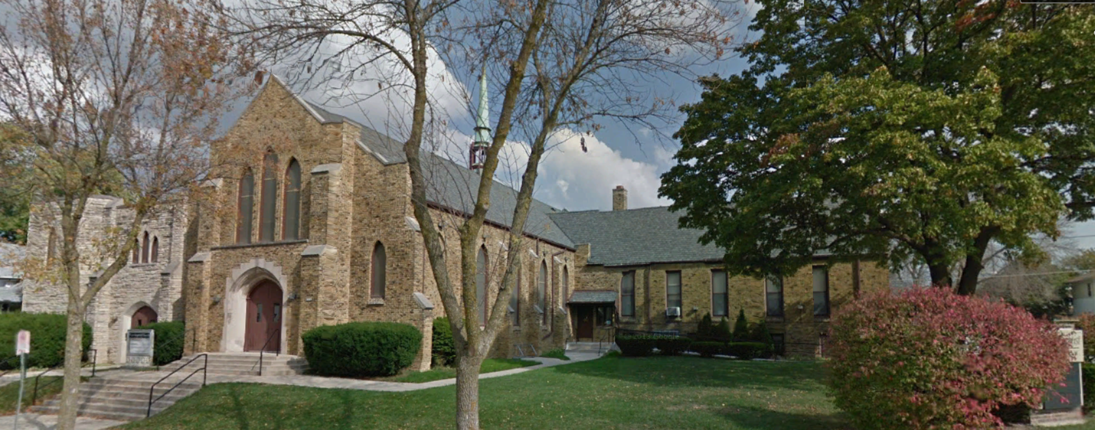
Our Story:
First Baptist Church of West Allis
1. Settling in Wisconsin Territory in 1830s

Slide 2
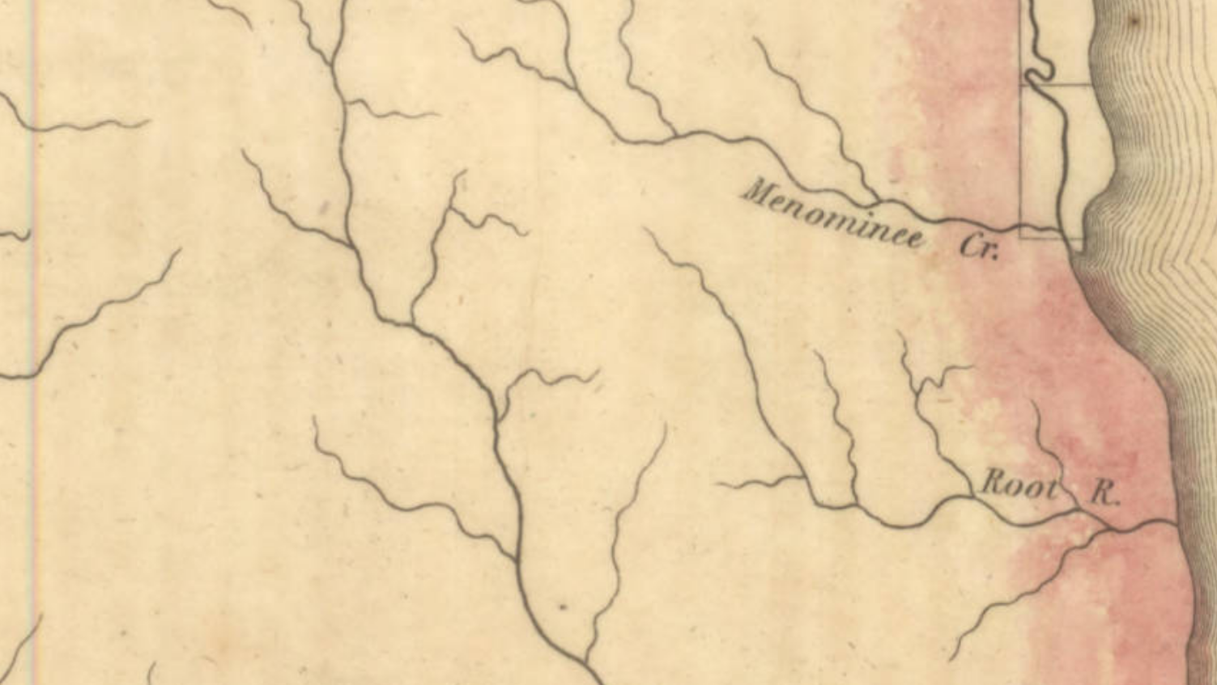
Eastern Wisconsin Territory 1830
Milwaukee R.

Slide 3
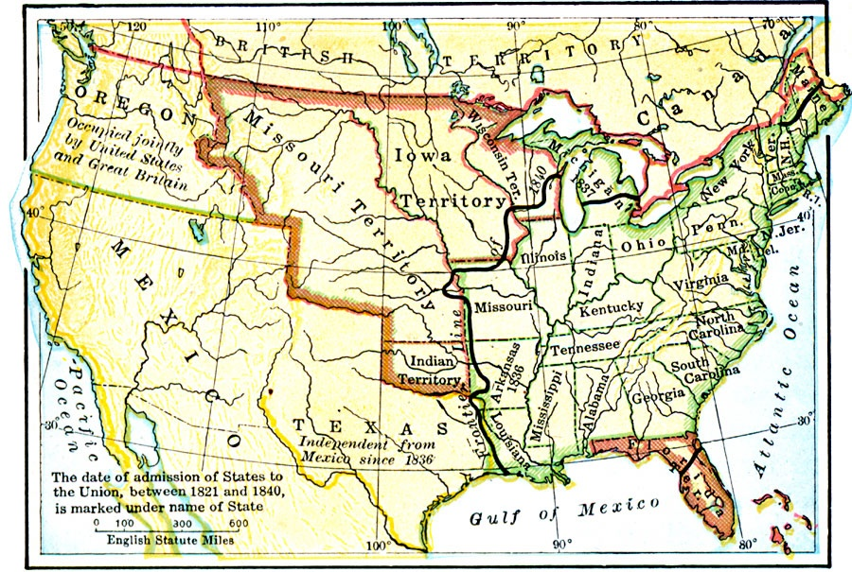
United States in 1840

Slide 4
United States in 1840

Slide 5
United States in 1840
Erie Canal

Slide 6
United States in 1840
Erie Canal
Horse, ox, wagon, foot

Slide 7
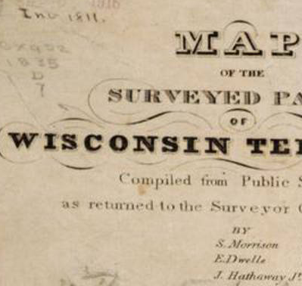
1835
Milwaukee County

Slide 8
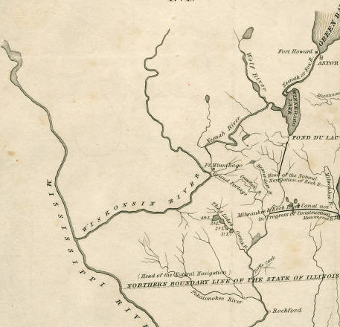
1836

Slide 9
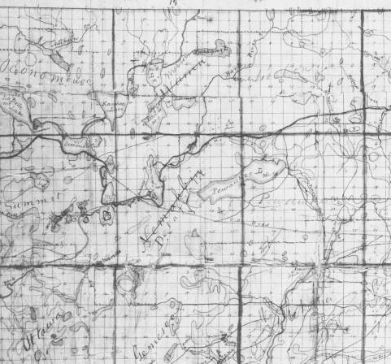
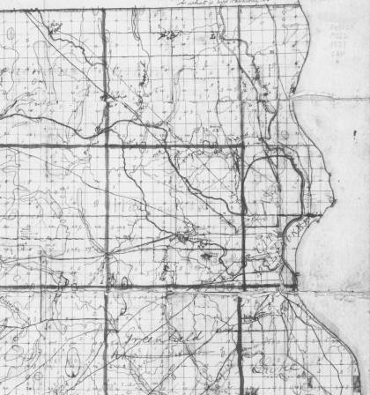
1837
Oconomowoc
Harts Mills (Wauwatosa)
Milwaukee
Honey Creek
Prarieville(Waukesha)

Slide 10
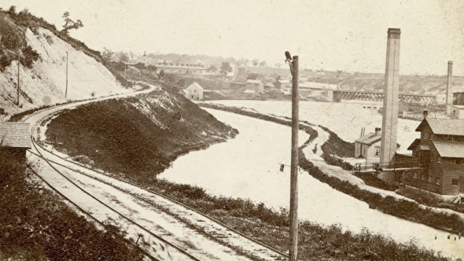
Canal in Milwaukee in 1860s looking Northeast

Slide 11
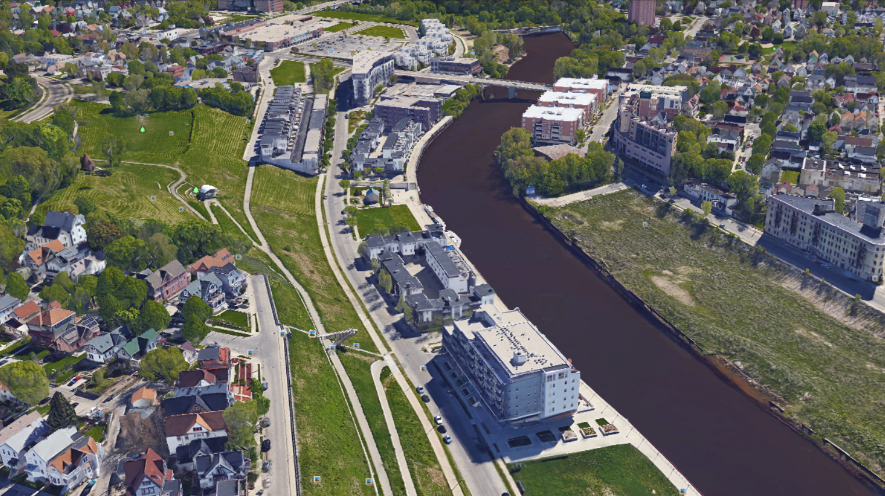

Slide 12
Plat of the Milwaukee and Rock River Canal (1838)
Rock River
Pistaka
River
Menomonee
River
Pewaukee
Lake
Nagowicka
Lake
Harts Mill
Milwaukee
Prairie Village
Honey Creek
Atkinson

Slide 13
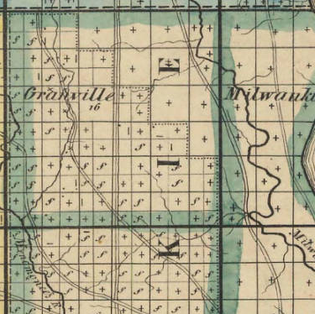
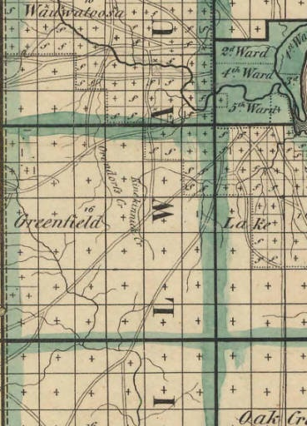

Slide 15
MILWAUKEE COUNTY TOWNSHIPS (1842)
Granville
Wauwatosa
Honey Creek
Greenfield
Franklin
Lake
Oak Creek
Hampton Ave
Greenfield Ave
College Ave
27th Street
Milwaukee
Village of Milwaukee

Slide 16
Our Story:
First Baptist Church of West Allis
End of history 1

