Slide 1
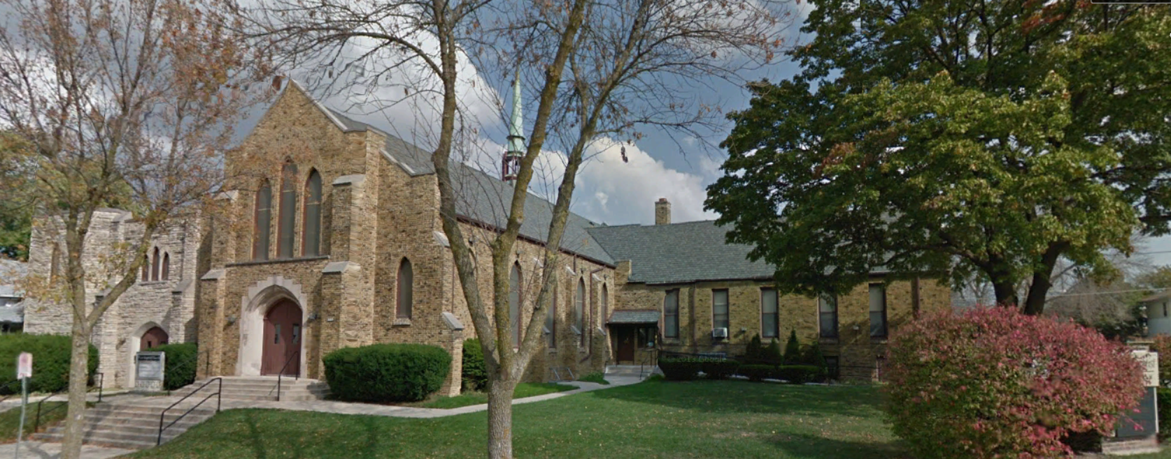
Our Story:
First Baptist Church of West Allis
3. First Baptist Church of Milwaukie (1836)

Slide 2
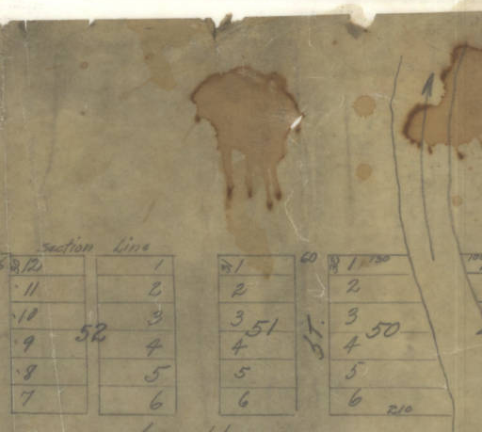
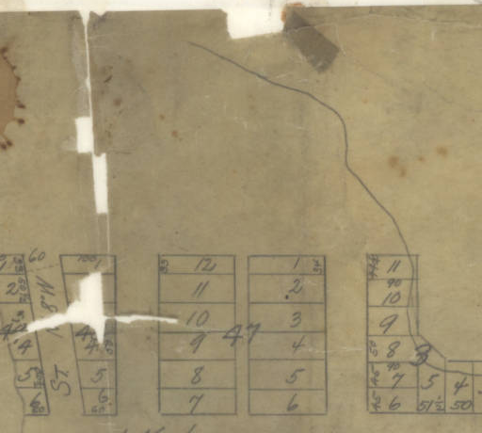
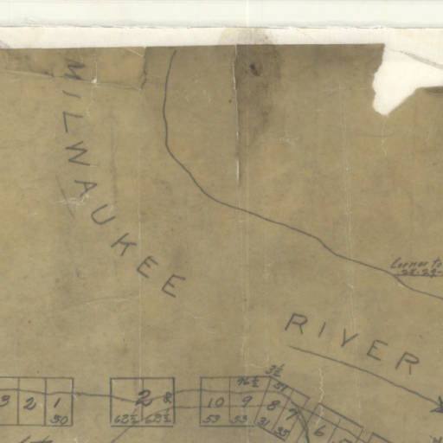
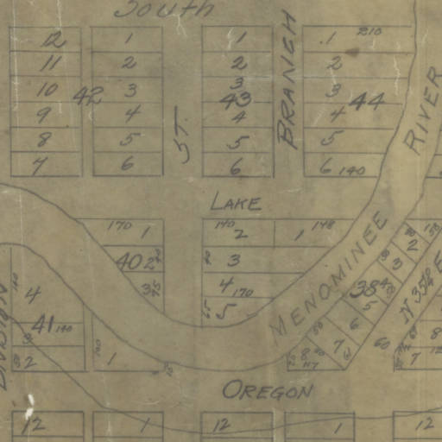
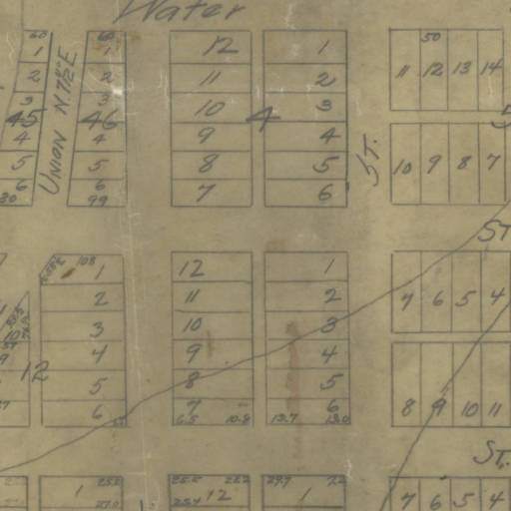
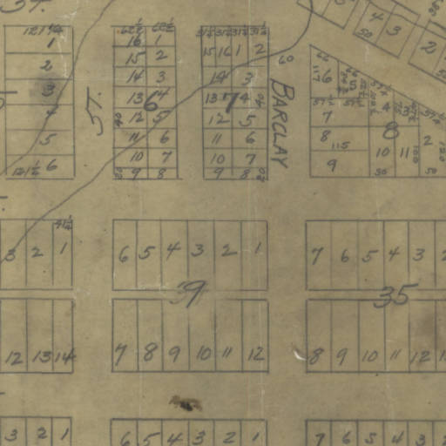
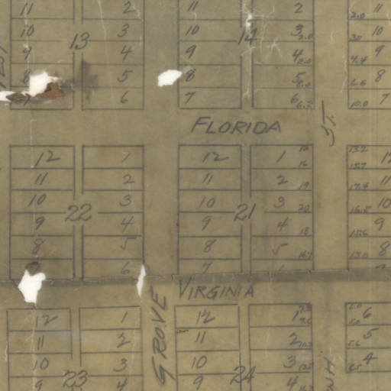
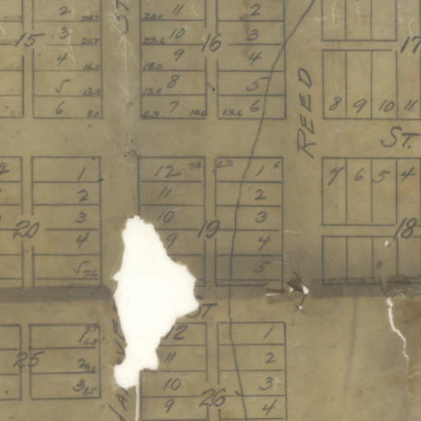
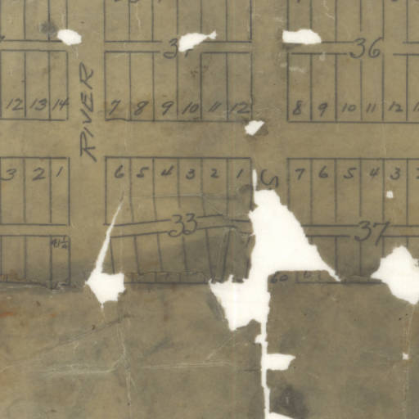
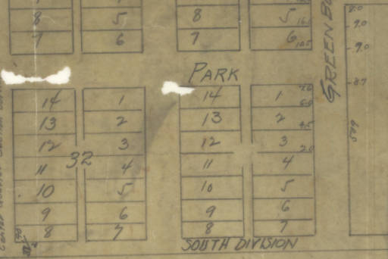
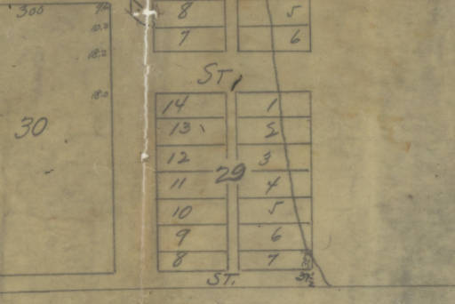
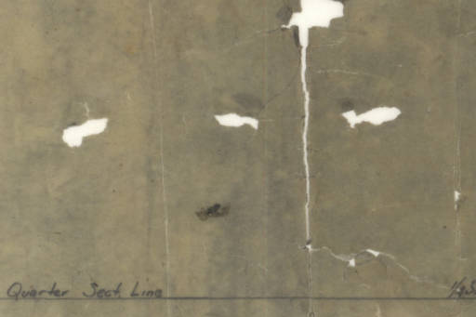
Walkers Point Milwaukee (Wisconsin) 2016
Walkers Point Milwaukee (Wisconsin) 1842
George S. West, Surveyor; I.A. Lapham, Engineer
Seeboth St (Water St)
Seeboth St (Water St)
Pittsburgh Ave (Lake St)
Pittsburgh Ave (Lake St)
Oregon St
Oregon St
Florida St
Florida St
Virginia St
Virginia St
Bruce St (Park St)
Bruce St (Park St)
Milwaukee River
Pierce St (South Division St
Pierce St (South Division St
2nd St
2nd St
4th St
3rd St
4th St
3rd St
5th St
6th St
5th St
6th St
Greenfield Ave
David S Hollister home
Greenfield Ave

Slide 3
318 Hanover Street; now 724 South 3rd Street
NOW:
Junior House Lofts
NOW: Bradley Tech
David S Hollister

Slide 4
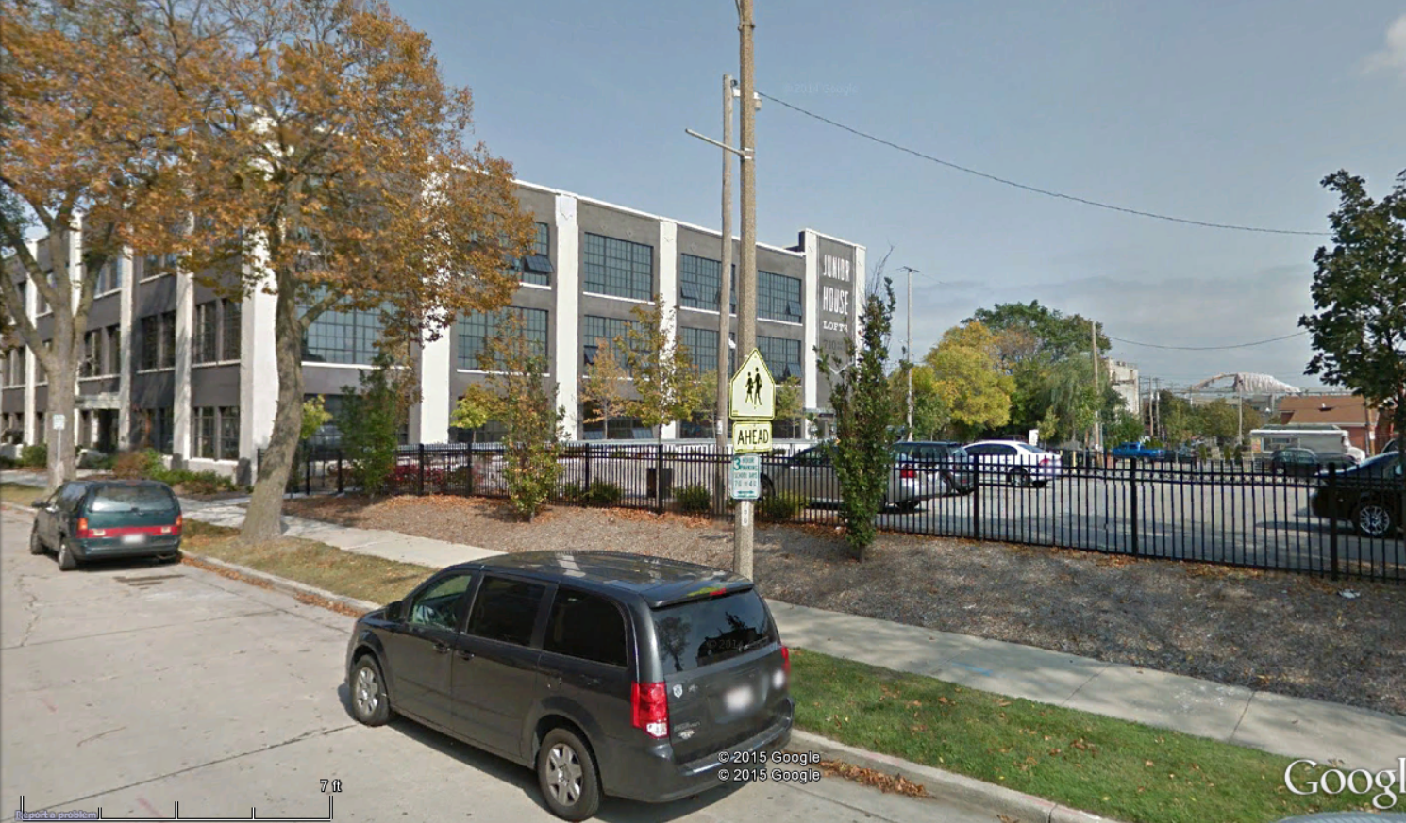
Now Junior House Loft’s parking lot

Slide 5
Meeting locations in Walkers Point
Seeboth St (Water St)
Seeboth St (Water St)
Pittsburgh Ave (Lake St)
Pittsburgh Ave (Lake St)
Oregon St
Oregon St
Florida St
Florida St
Virginia St
Virginia St
Bruce St (Park St)
Bruce St (Park St)
Milwaukee River
Pierce St (South Division St
Pierce St (South Division St
2nd St
2nd St
4th St
3rd St
4th St
3rd St
5th St
6th St
5th St
6th St
Greenfield Ave
Greenfield Ave

Slide 6
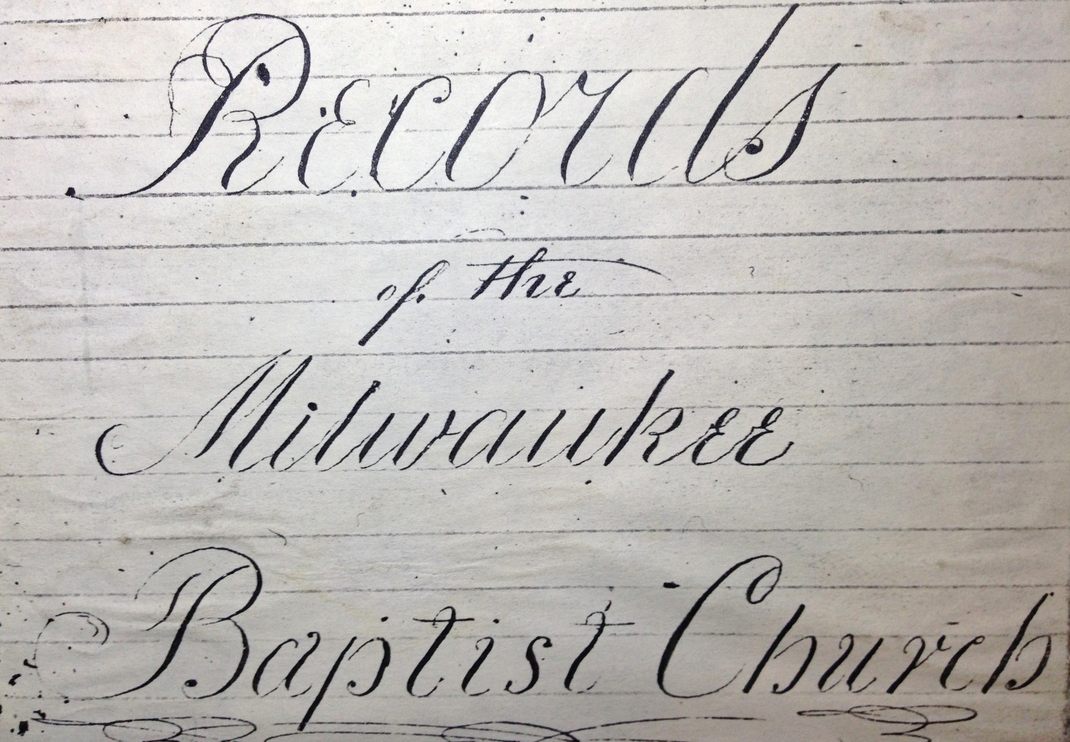

Slide 7
CHURCH MEETING AT CORNWALL HOME: May 1, 1841
“Voted that considering the situation of the church, we dissolve for the purpose of reorganizing in North Greenfield and give to each a letter of Dismission.”

Slide 8
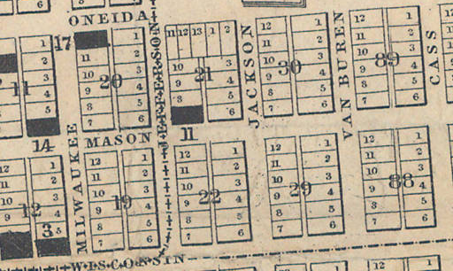
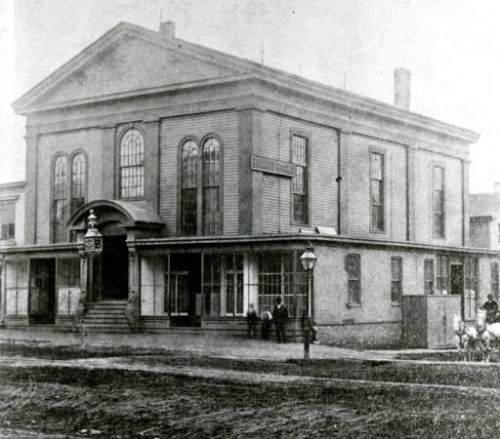
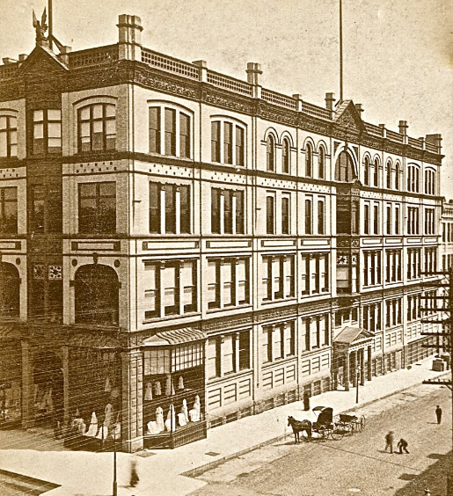
SE corner of N Milwaukee and E Wisconsin Ave
Church 1845-63
Today
Milwaukee
411
Wisconsin
Chapman’s Department Store to 1987

Slide 9
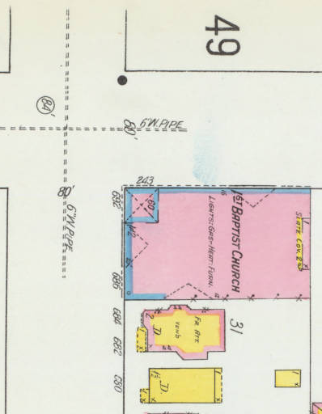
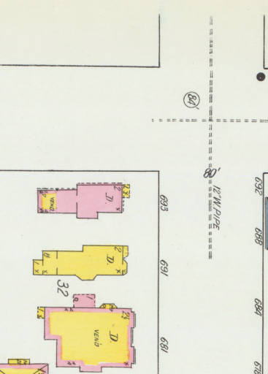
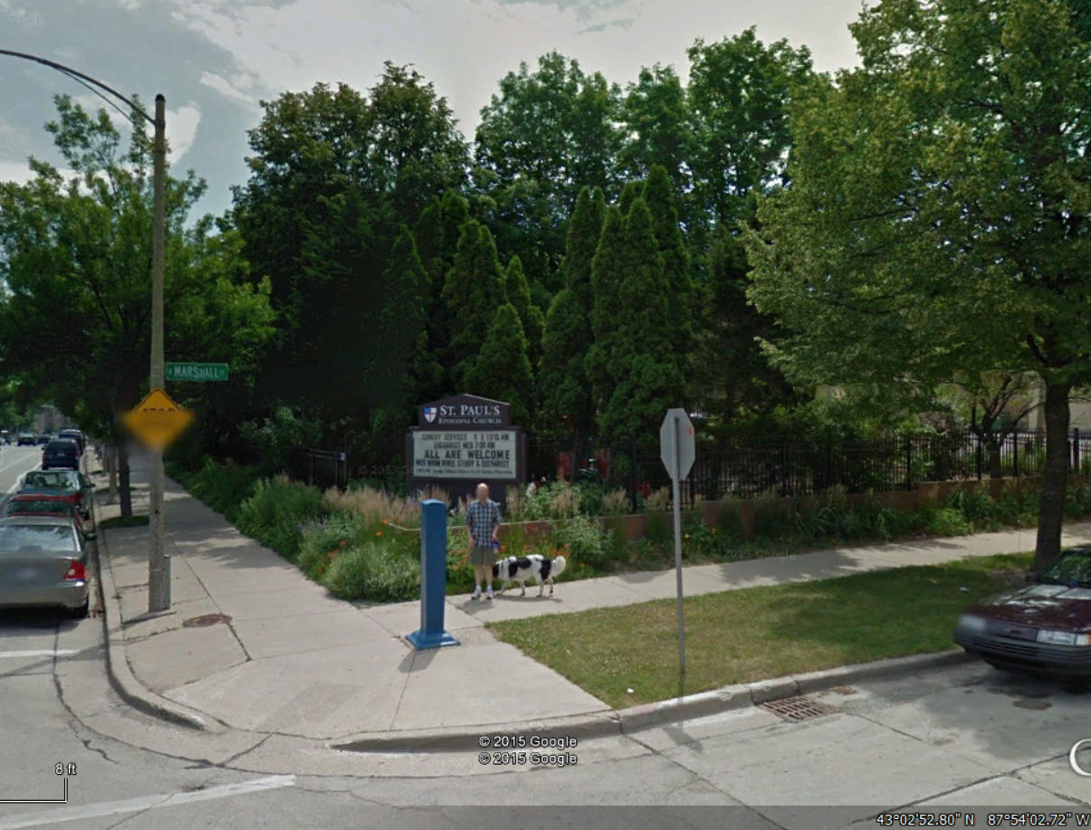
MILWAUKEE 1894
Astor
Ogden Ave
SE corner of Ogden & Marshall today
St Paul’s Episcopal Church’s Park
Marshall

Slide 10
Our Story:
First Baptist Church of West Allis
End of history 3

