Slide 1
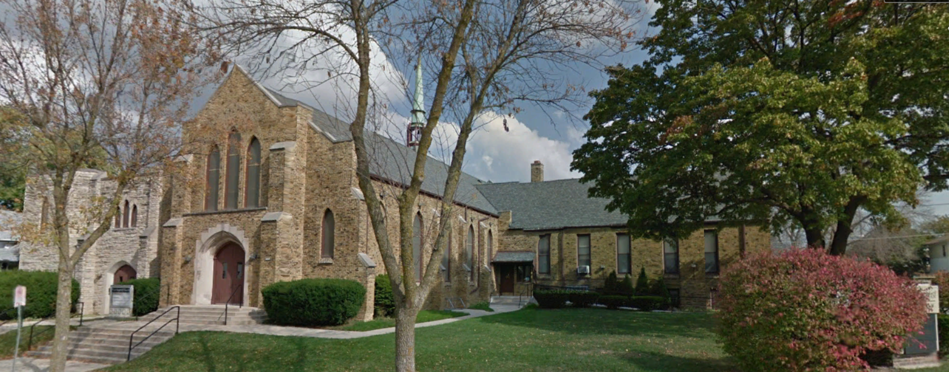
Our Story:
First Baptist Church of West Allis
4. Early Milwaukee County; the Ancient Works

Slide 2
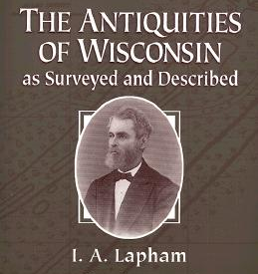

Slide 3
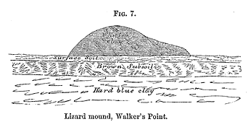
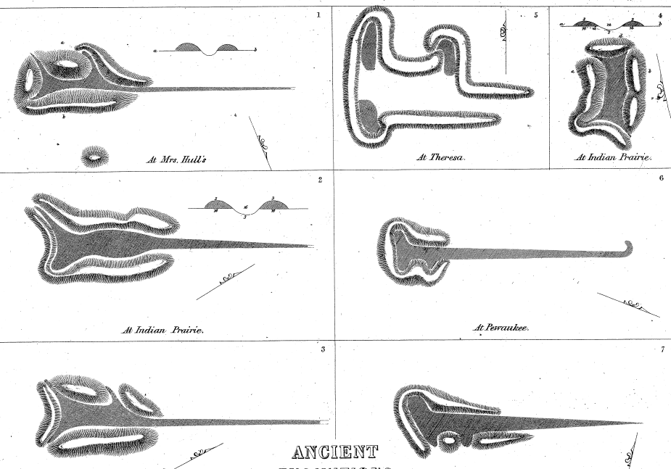

Slide 6
Walnut St
6th Street
5th Street

Slide 7
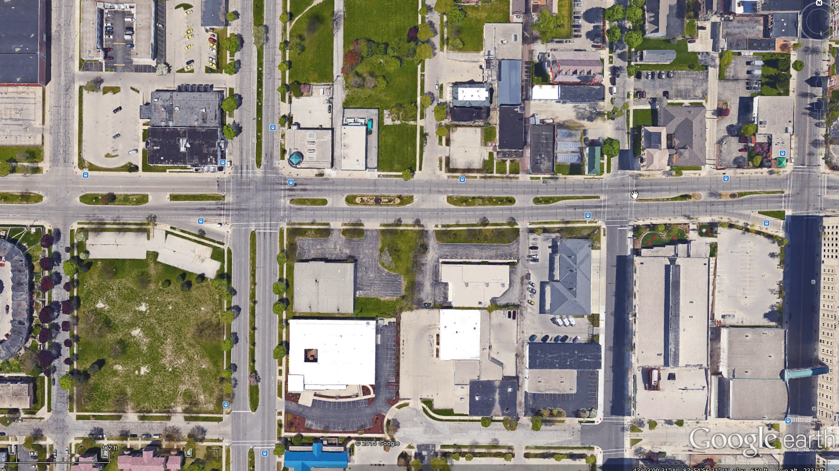
Walnut Street
6th Street
5th Street

Slide 8
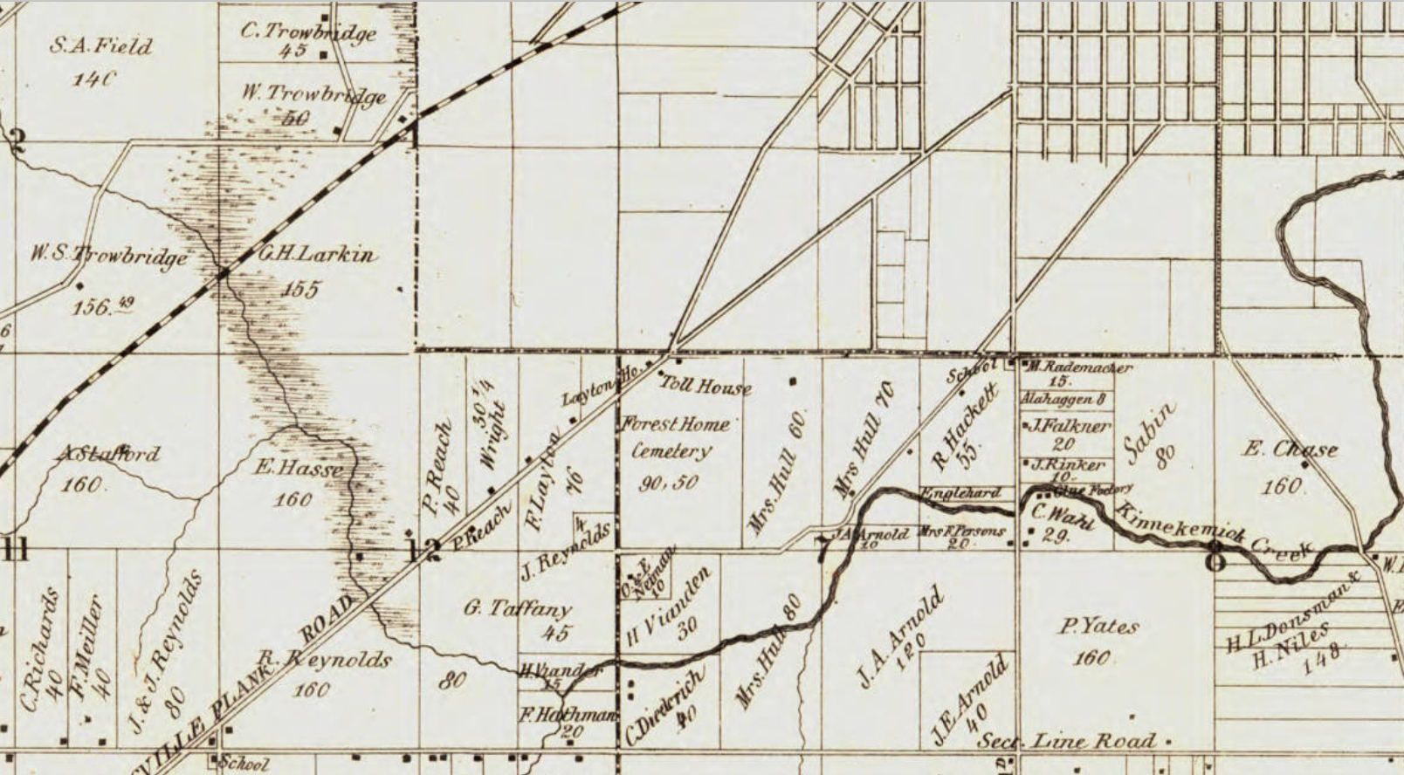
Forest Home Cemetery
35th Street
27th Street
Forest Home Cemetery
Janesville Plank Road (Forest Home Ave)
Lincoln Ave
Cleveland Ave
Section Line Road (Oklahoma Ave)

Slide 9
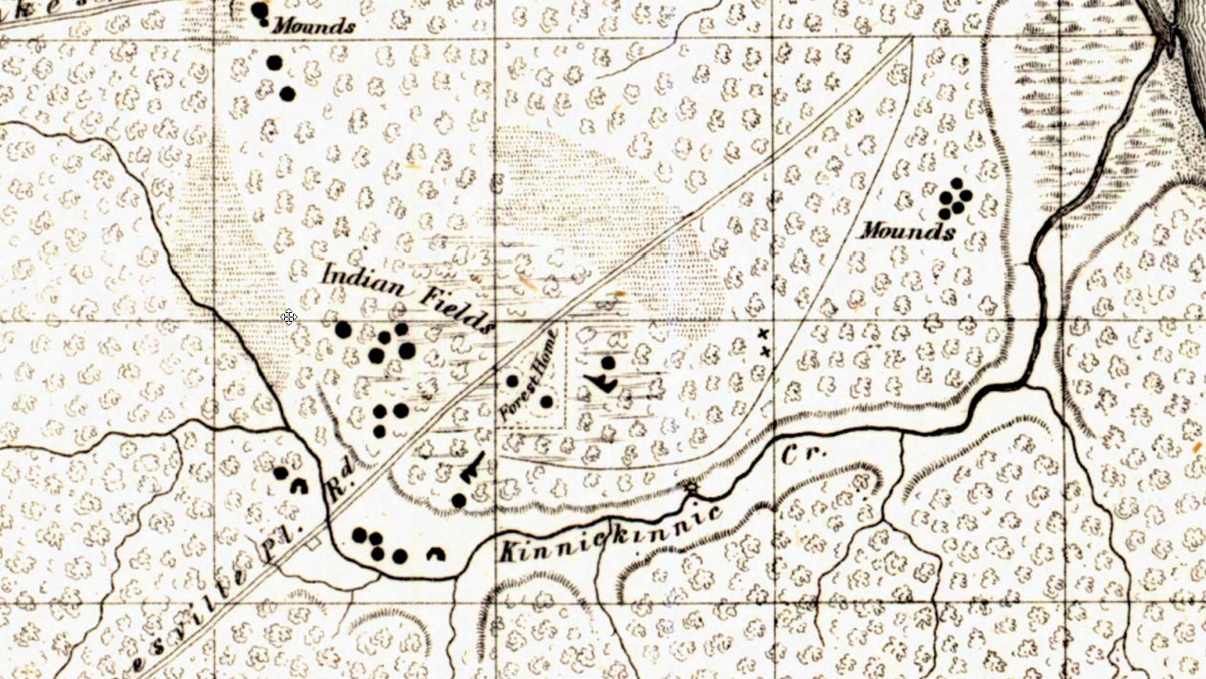
Janesville Plank Rd
(Forest Home Ave)
Kinnickinnic Creek

Slide 10
Forest Home Ave
27th Street

Slide 11
Forest Home Ave
27th Street

Slide 12
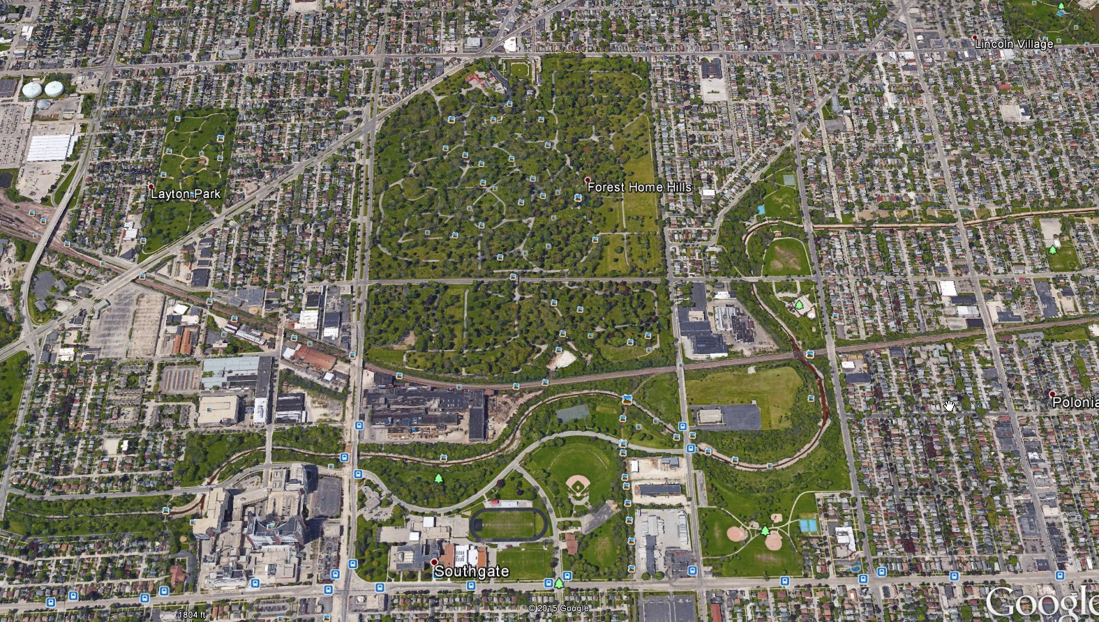
Lincoln Ave
Forest Home Cemetery
27th St
Forest Home Ave
35th St
Raiplroad
KK Creek
Oklahoma Ave

Slide 13
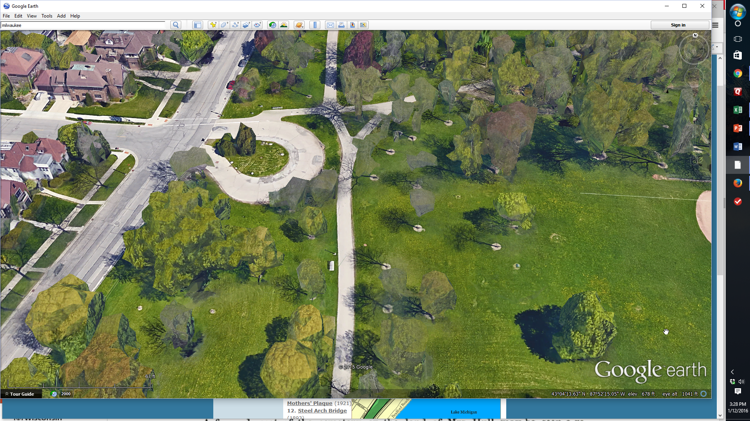
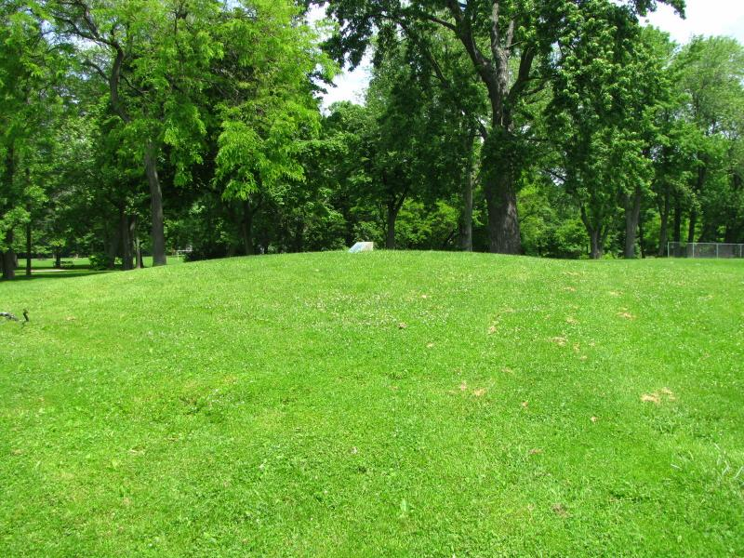
Lake Drive
Locust St

Slide 14
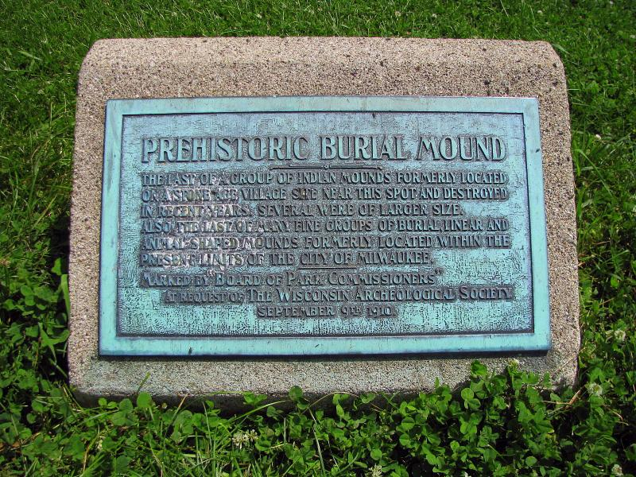

Slide 15
The last of a group of Indian mounds formerly located on a stone age village site near this spot and destroyed in recent years. Several were of large size. Also, the last of several fine groups of burial, linear, and animal shaped mounds formerly located in the present limits of the City of Milwaukee. Marked by the Board of Park Commissioners At the request of The Wisconsin Archeological Society September 9th 1910

Slide 16
Lake Park

Slide 17
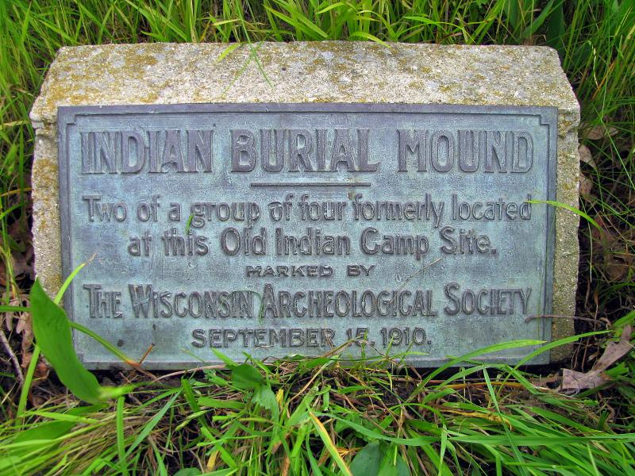

Slide 18
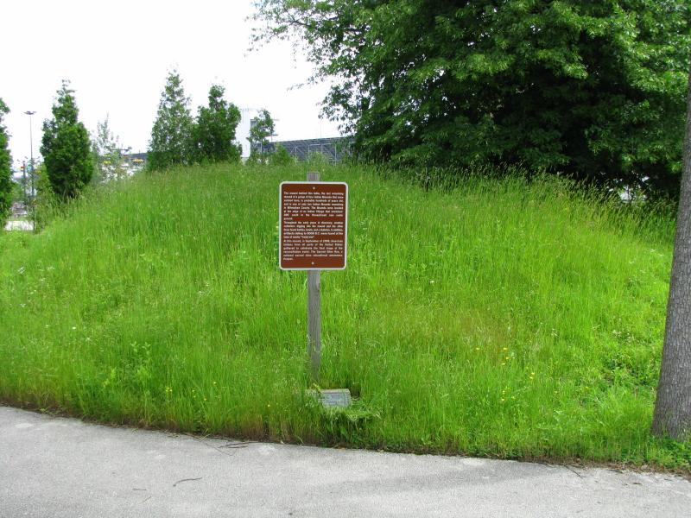
State Fair Park

Slide 20
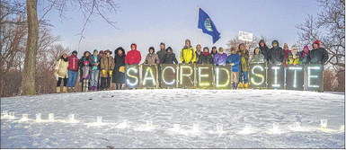
January 17, 2016
As Lapham himself put it in an 1836 newspaper editorial: “Let us hope in Wisconsin, the case will be different …. will not have to regret the loss of those records of an ancient people.”
Native Americans at Lake Park

Slide 21
Our Story:
First Baptist Church of West Allis
End of history 4

