Slide 1
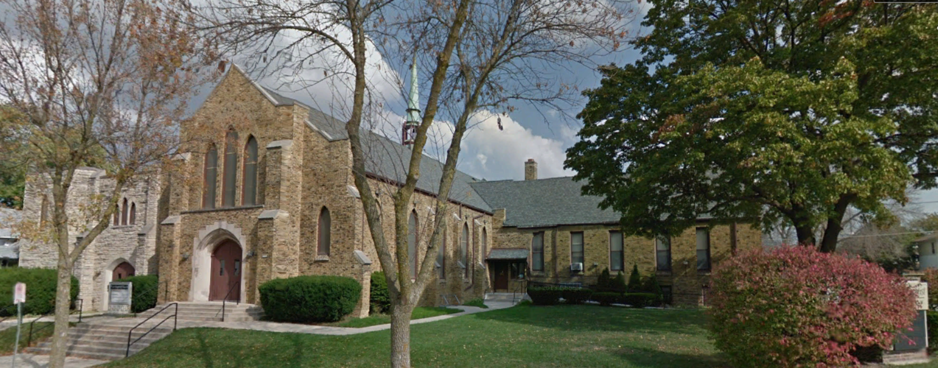
Our Story:
First Baptist Church of West Allis
PROLOGUE

Slide 2
Township 6 North (Township of Greenfield) Section 4

Slide 3
What do these West Allis pictures have in common?

Slide 4
Our Story:
First Baptist Church of West Allis
End of Prologue

