Slide 1
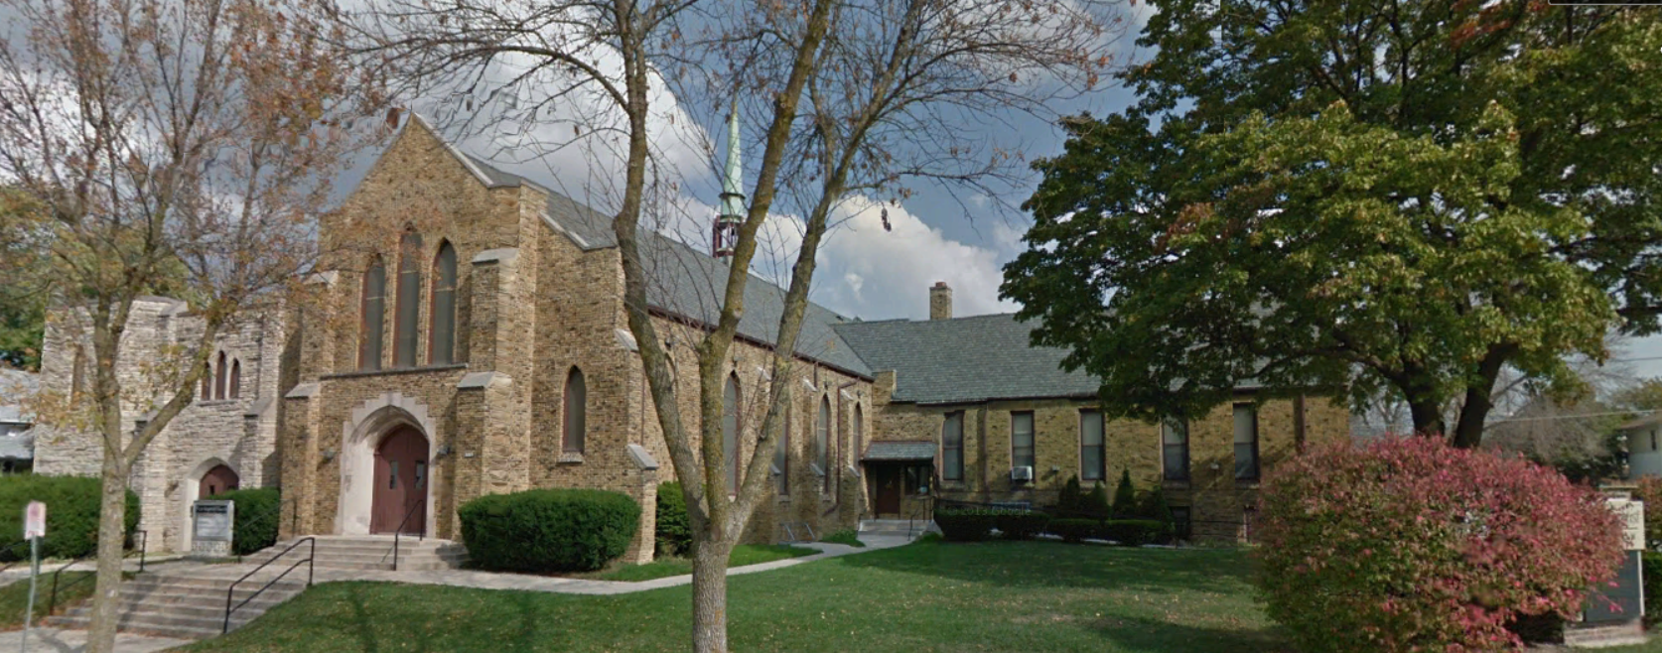
Our Story:
First Baptist Church of West Allis
7. Greenfield Baptist Church Begins (1841)

Slide 2
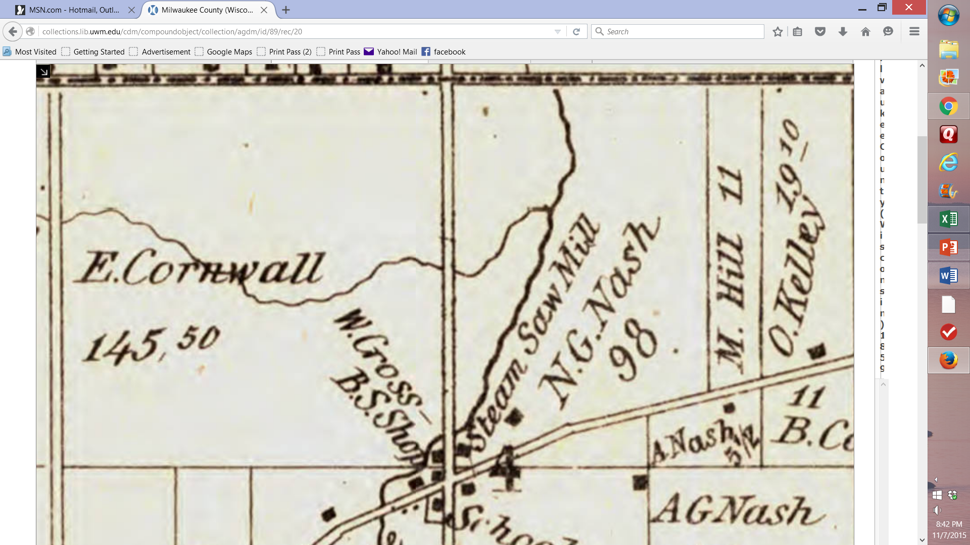
Cornwall Land

Slide 3
The Cornwall ¼ Section in 1850 and Today
1850
Today

Slide 4
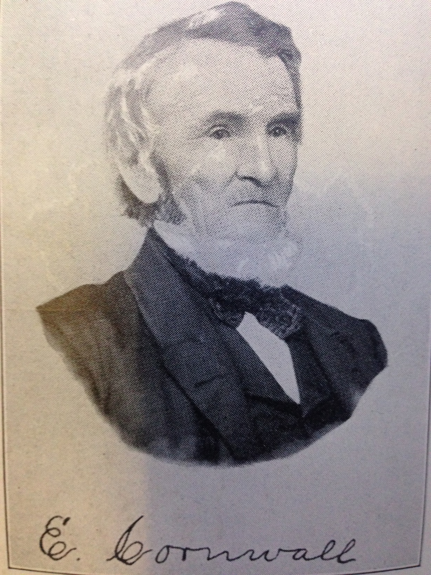

Slide 5
Honey Creek/North Greenfield

Slide 6
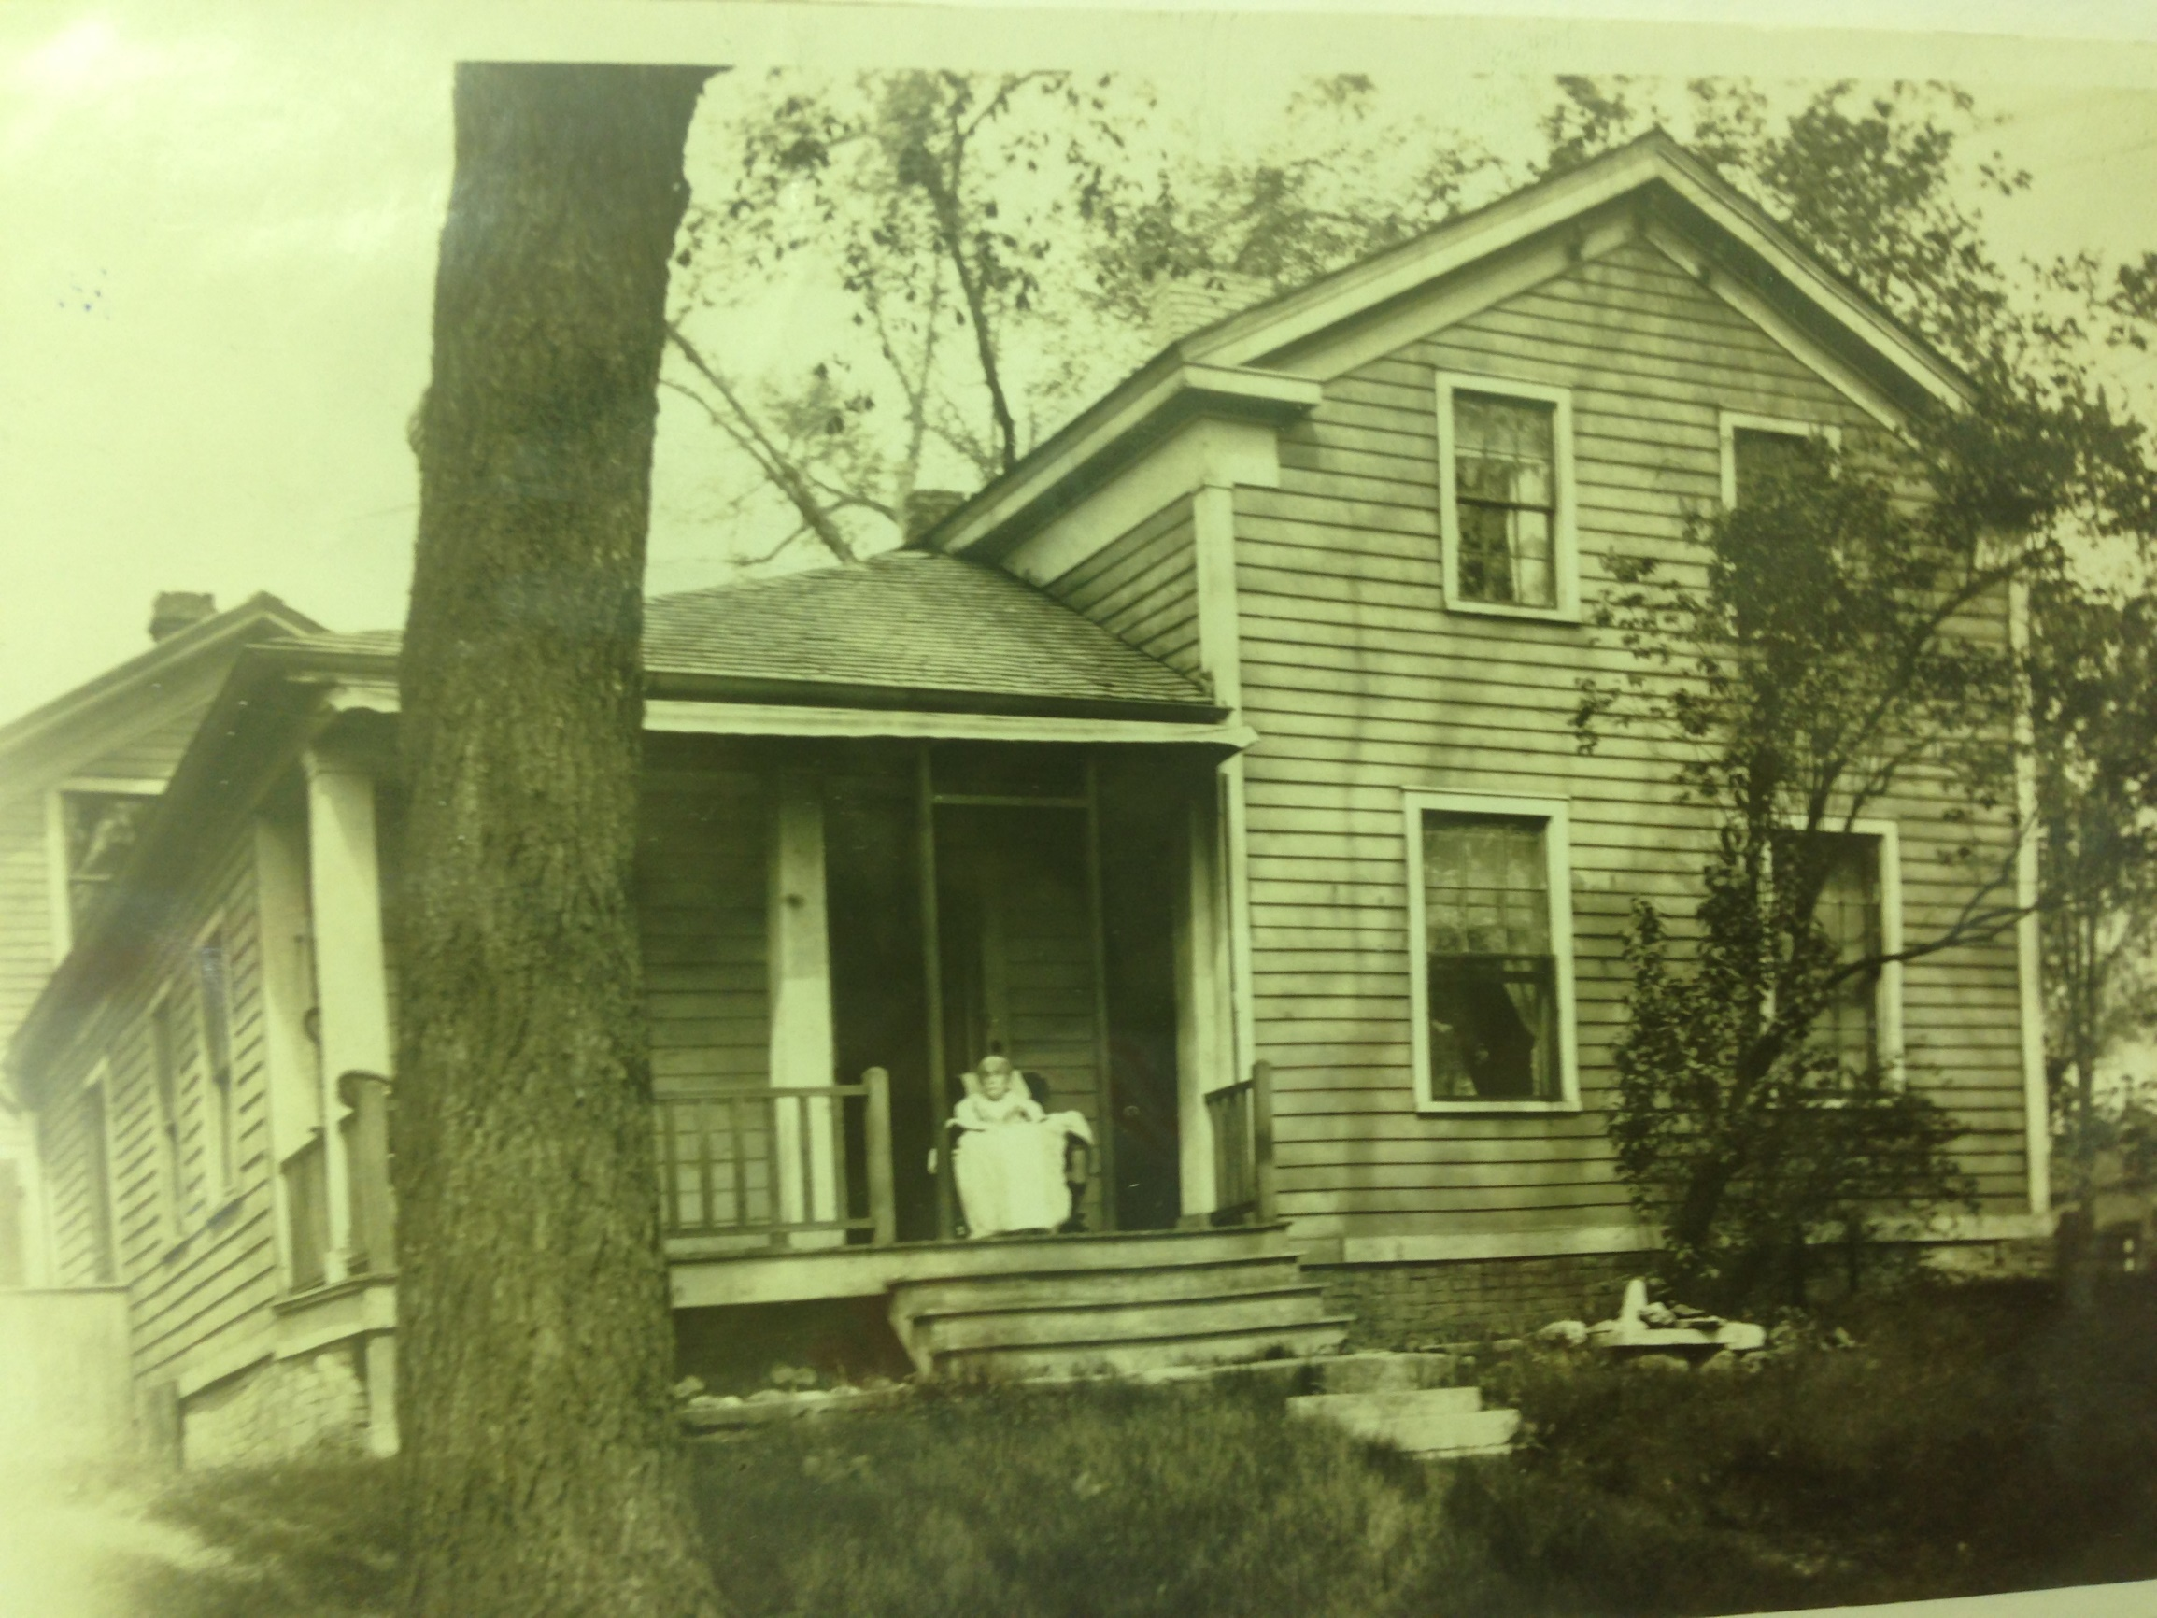
Cornwall Home

Slide 7
Greenfield Ave
Cornwall Home in 1910
77th Ave (84th St)
1910

Slide 8
Southwest Corner of Greenfield Ave & 84th St Today
Greenfield Ave
84th St

Slide 9
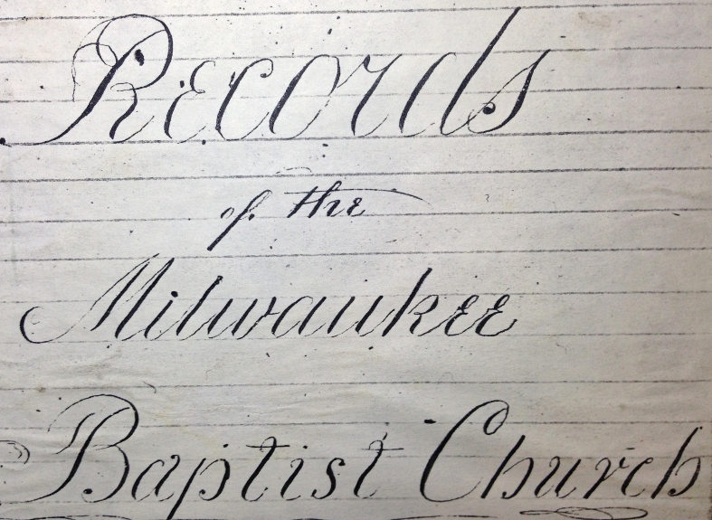
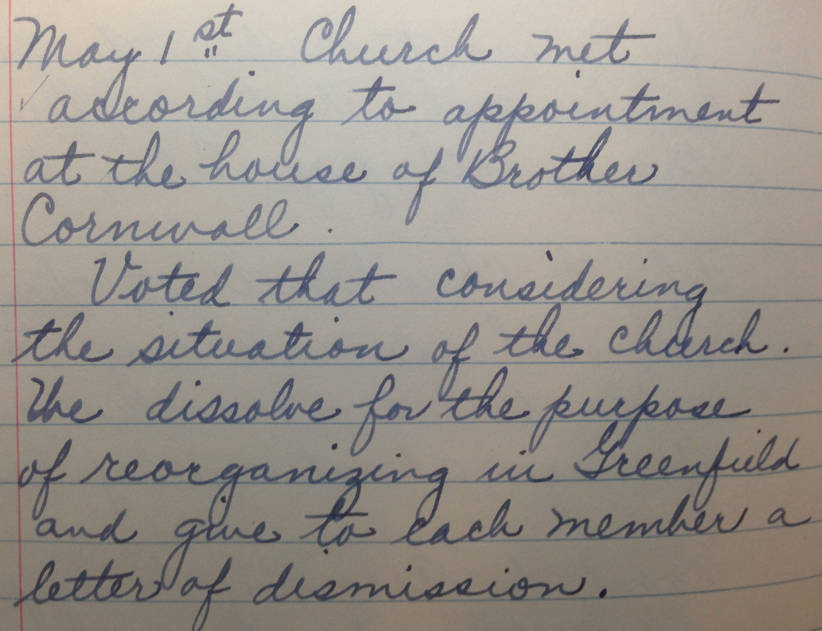

Slide 10
Southern Portions of old Milwaukee County in 1837
Harts Mills (Wauwatosa)
Milwaukee
Brookfield
Prarieville
(Waukesha)
Honey Creek
Genesee
Greenfield Township
Mukwonago

Slide 11
Cornwall Home

Slide 12
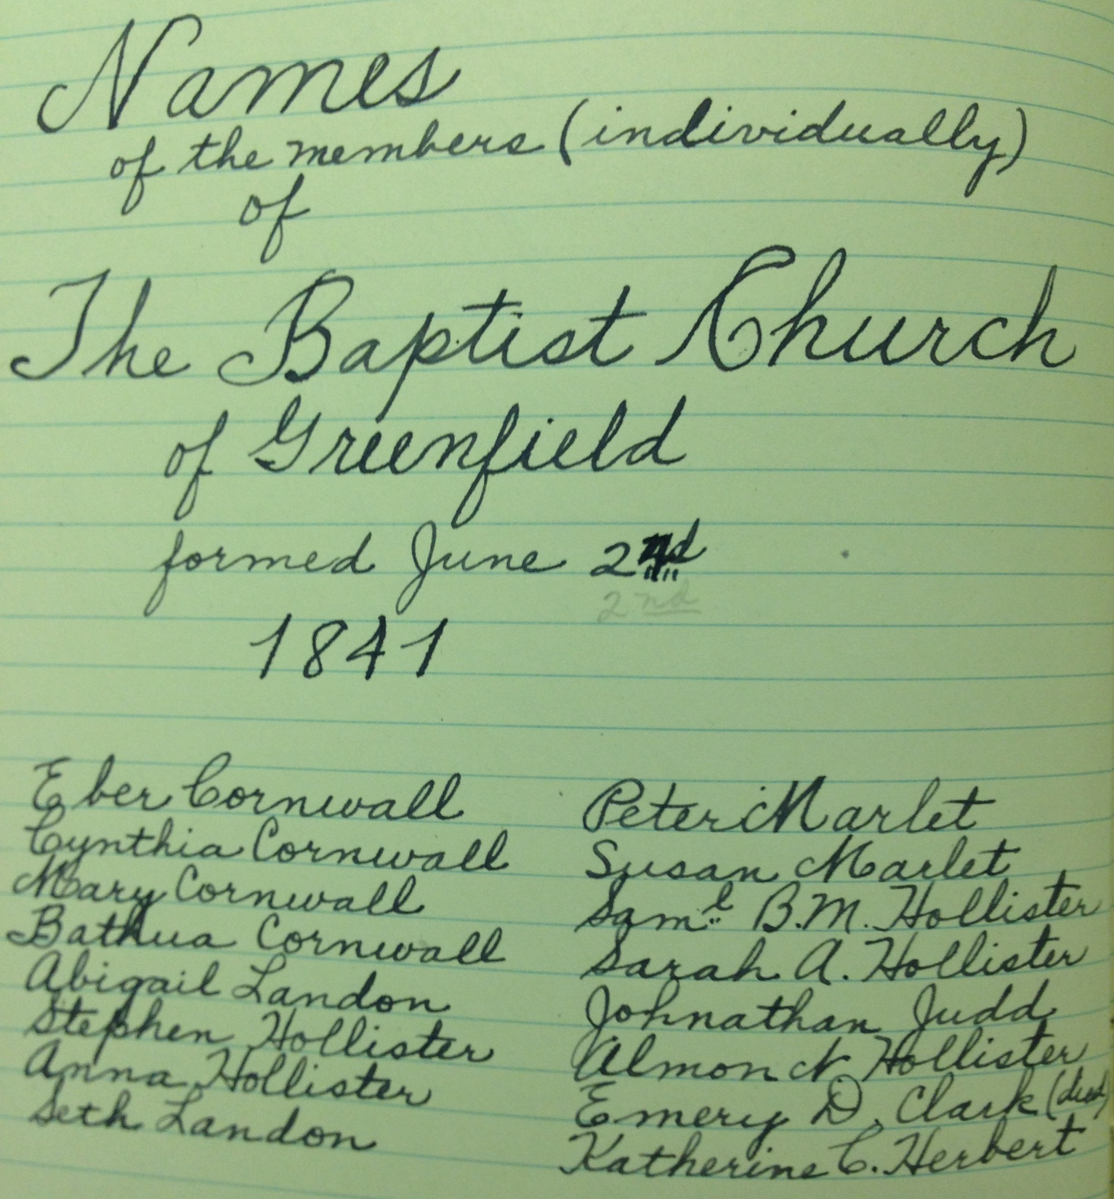
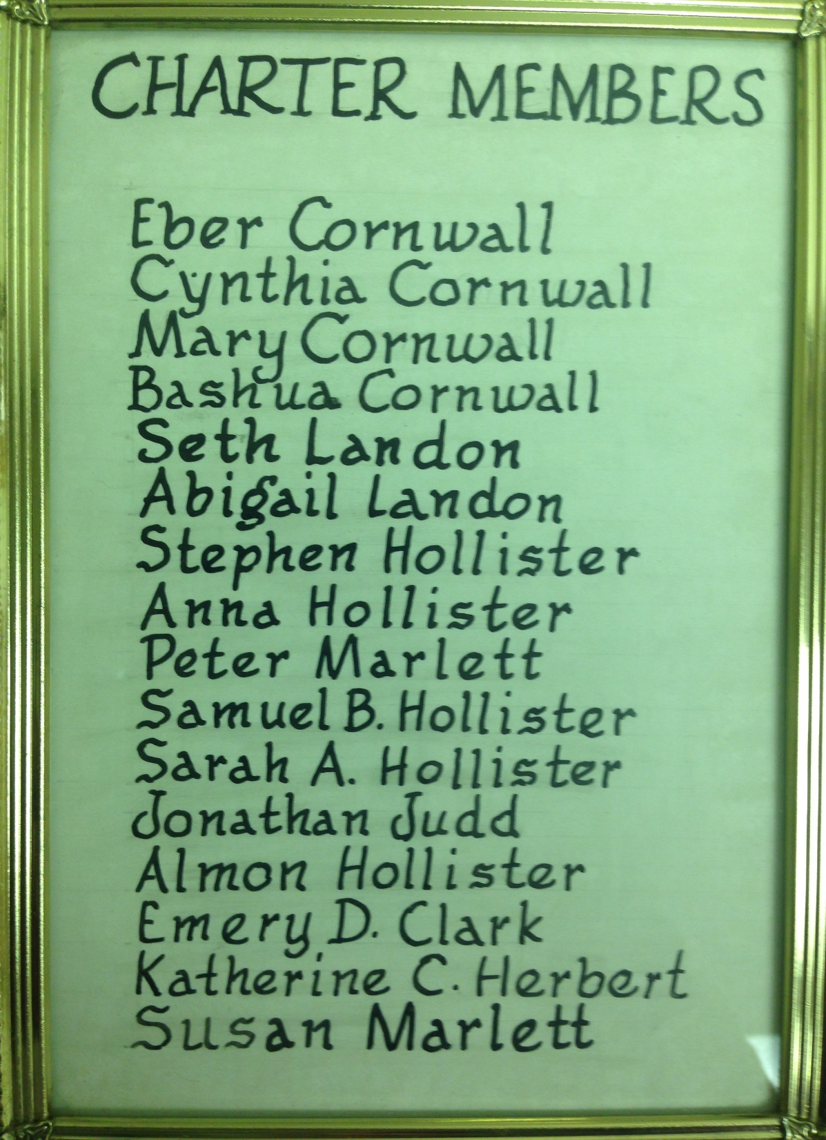

Slide 13
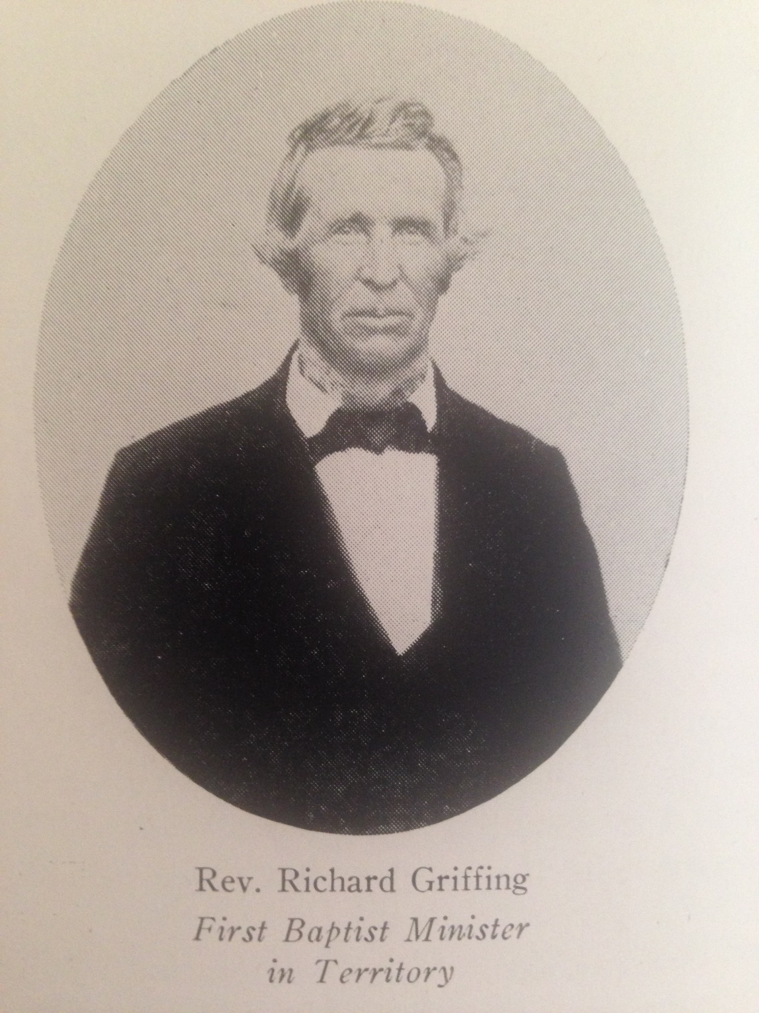
Rev Richard Griffing
First Baptist Minister in Wis Territory

Slide 14
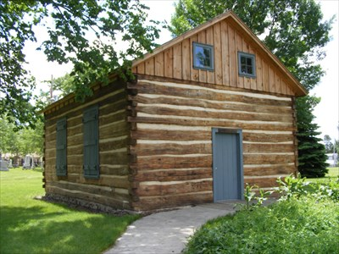
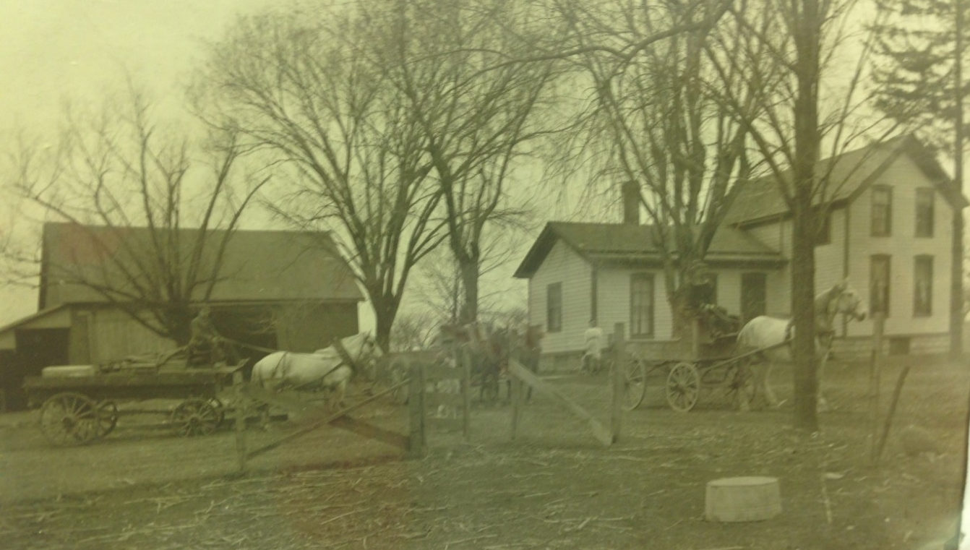
Eber Cornwall
Ruben Strong
Charles Nobles
School

Slide 15
Our Story:
First Baptist Church of West Allis
End of history 7

