Slide 1
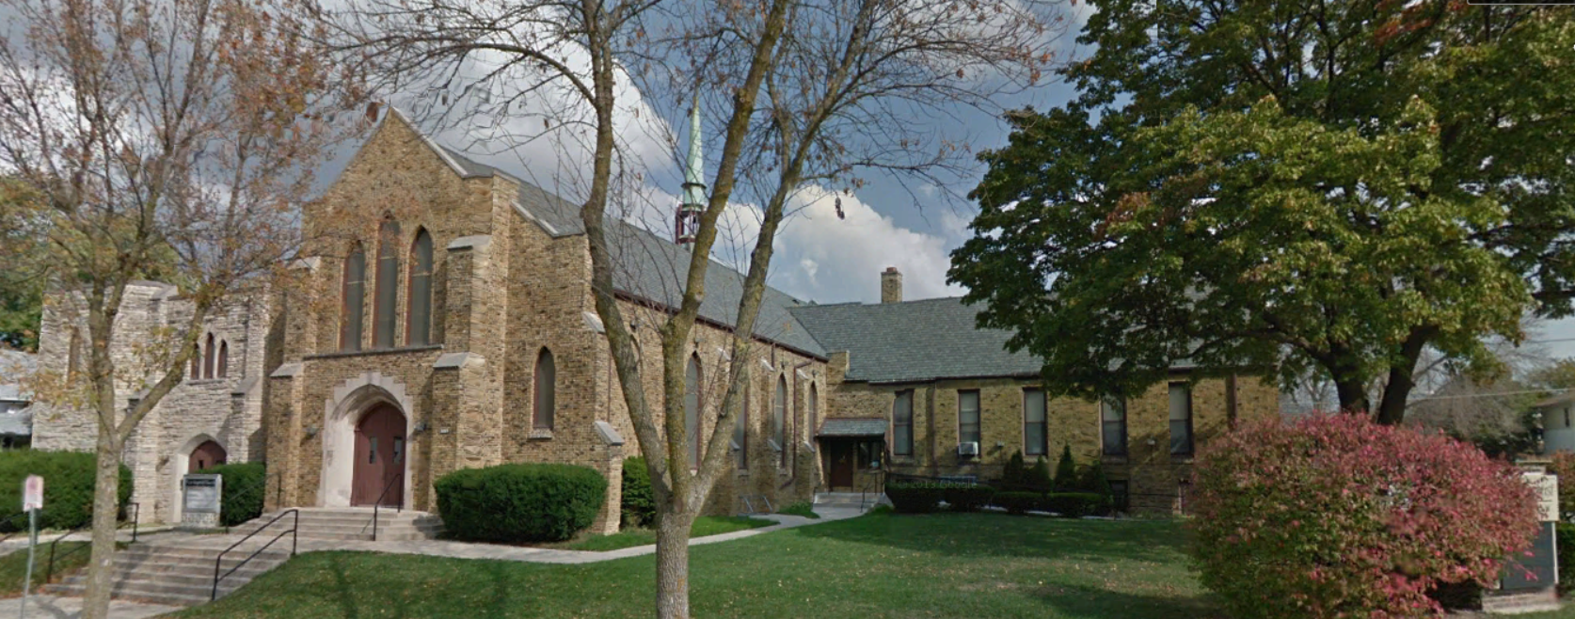
Our Story:
First Baptist Church of West Allis
30. New use of land; new mission?

Slide 2
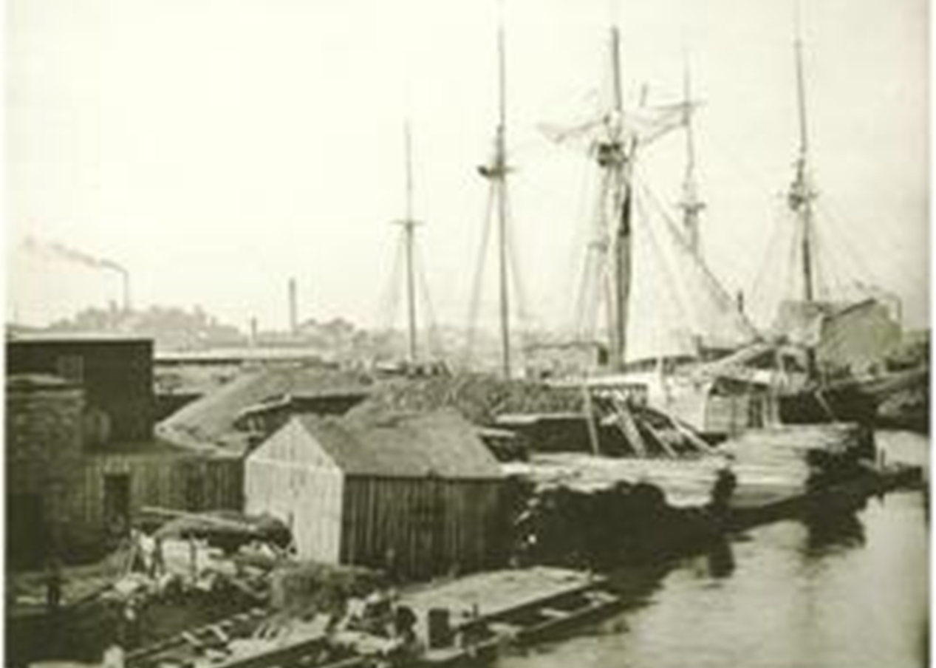
Milwaukee Lakefront Land Use Over Time
Homes; commerce; piers; fishing

Slide 3
Milwaukee Lakefront Land Use Over Time
Homes; commerce; piers; fishing
Chicago & NW Railroad
1870-1966

Slide 4
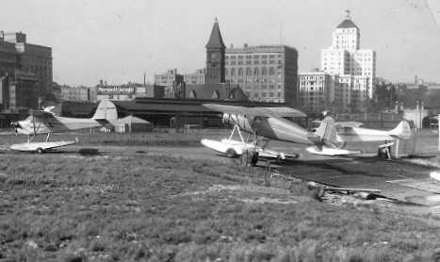
Milwaukee Lakefront Land Use Over Time
Homes; commerce; piers; fishing
Chicago & NW Railroad
Maitland Field

Slide 5
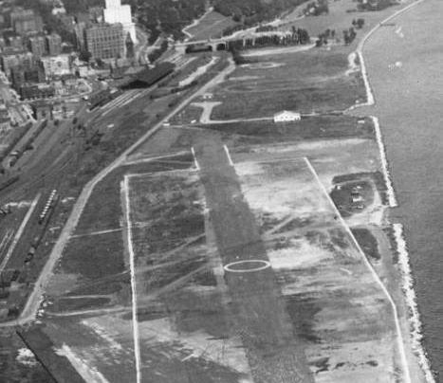
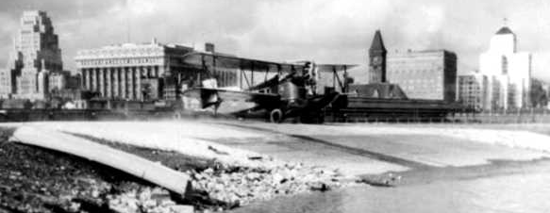
1927-1957

Slide 6
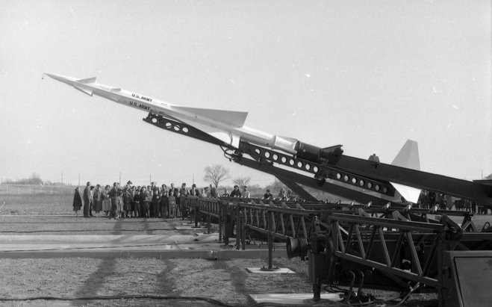
Milwaukee Lakefront Land Use Over Time
Homes; commerce; piers; fishing
Chicago & NW Railroad
Maitland Field
NIKE Missile Base

Slide 7
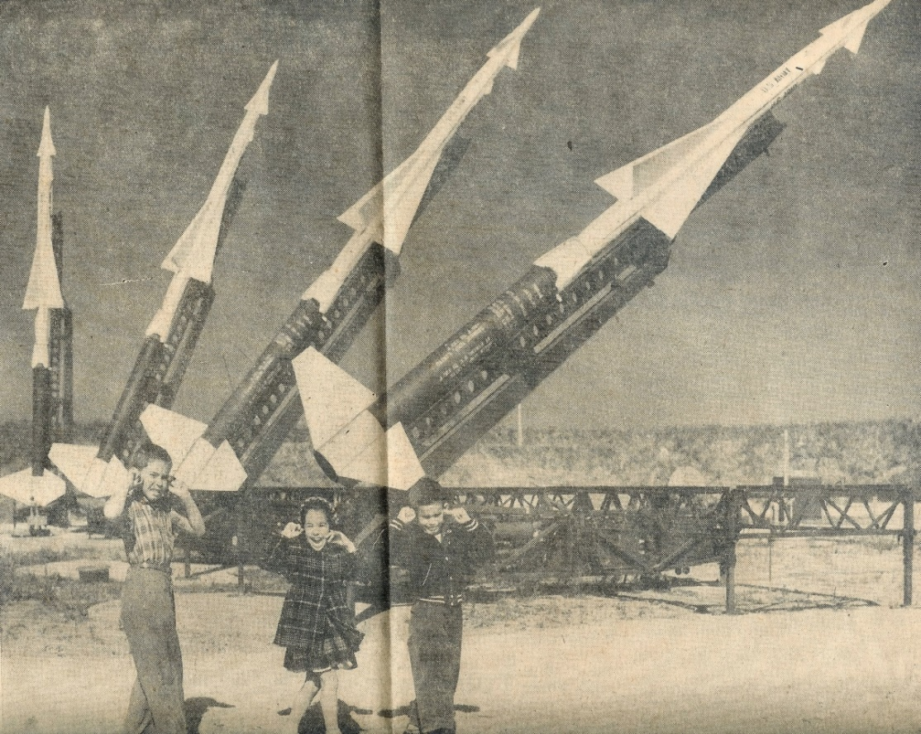
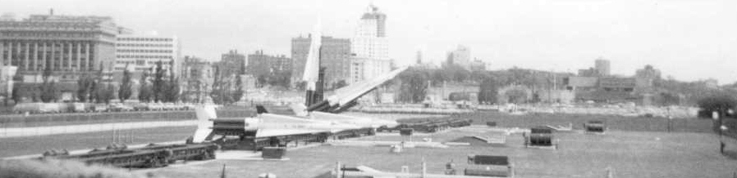
1957 - 1969

Slide 8
Milwaukee Lakefront Land Use Over Time
Homes; commerce; piers; fishing
Chicago & NW Railroad
Maitland Field
NIKE Missile Base
Henry Maier Festival Park

Slide 9
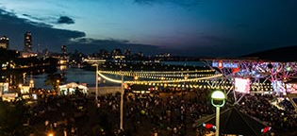
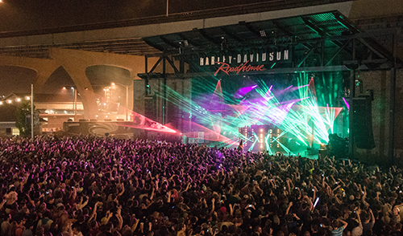
Since 1970

Slide 10
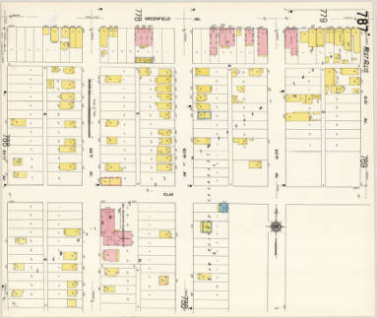
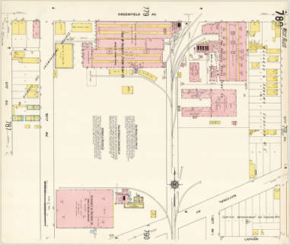
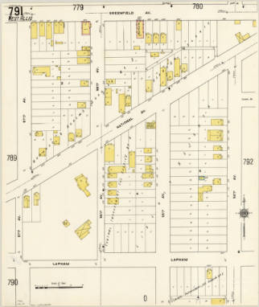
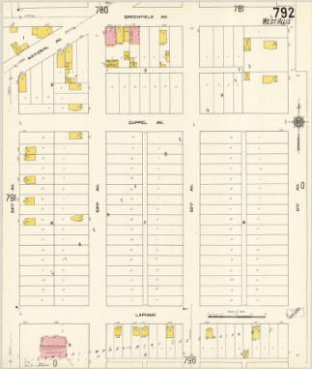
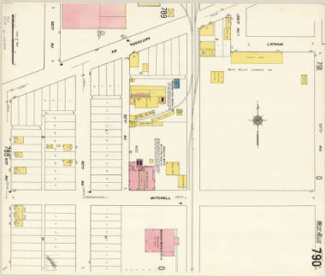
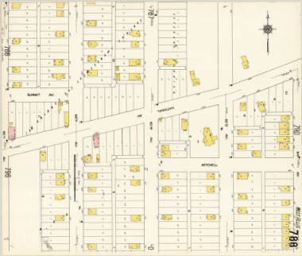
Greenfield Ave
National Ave

Slide 11
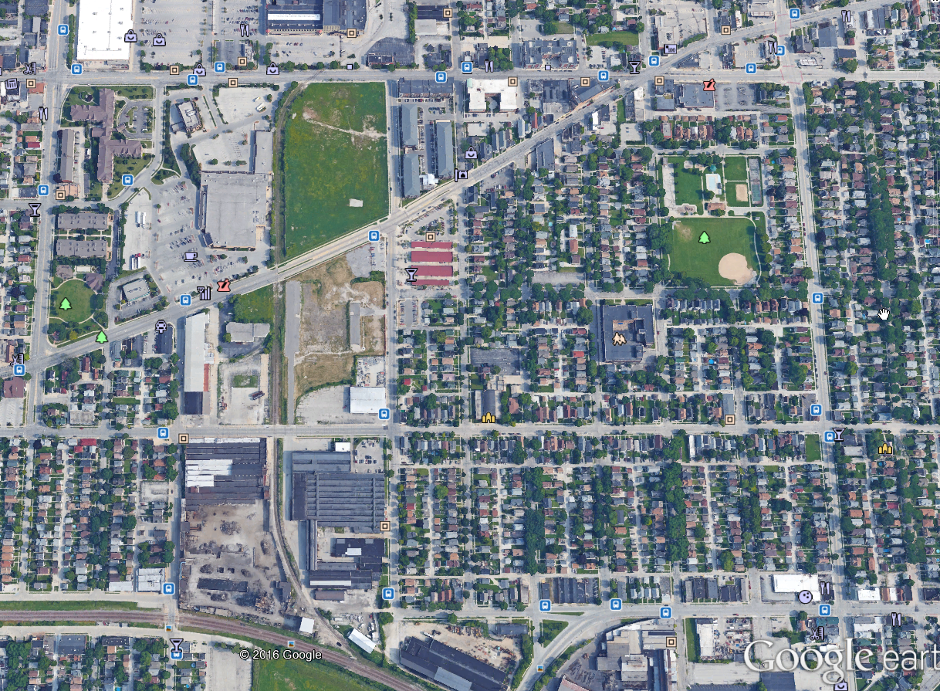
Apartments, brew pub planned in West Allis
MJS 2/21/2016

Slide 12
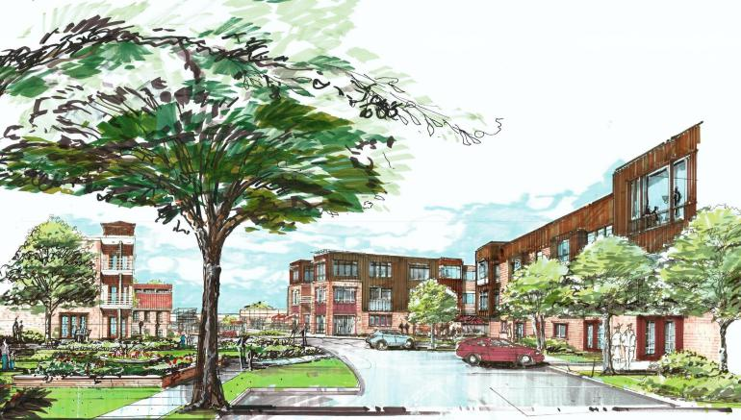
The Market at Six Points
46,250 sq ft commercial
40,000 sq ft office
eight townhomes
200 apartments

Slide 13
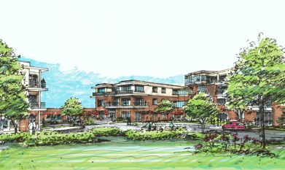
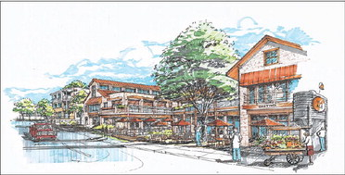
MJS 2/23/2016

Slide 14
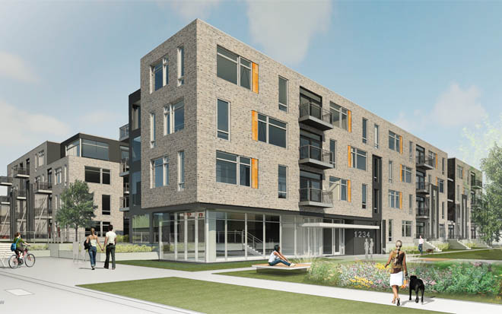
“Element 84” proposal
84th Street ground level commercial
Four 4-5 story buildings
216-230 apartments

Slide 15
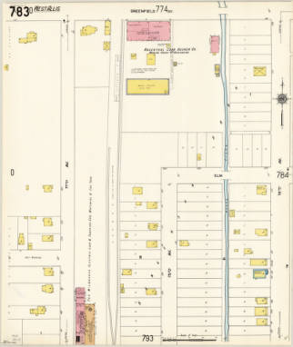
1910
1937
2013
Greenfield Ave
Elm St (Orchard St)
77th Ave (84th St)
76th Ave (83th St)
75th Ave (82th St)
Summit Ave (Lapham St)

Slide 16
1910
1937
2013
Greenfield Ave
Elm St (Orchard St)
77th Ave (84th St)
76th Ave (83th St)
75th Ave (82th St)
Summit Ave (Lapham St)

Slide 17
1910
1937
2013
Greenfield Ave
Elm St (Orchard St)
77th Ave (84th St)
76th Ave (83th St)
75th Ave (82th St)
Summit Ave (Lapham St)

Slide 18
1910
1937
2013
Greenfield Ave
Elm St (Orchard St)
77th Ave (84th St)
76th Ave (83th St)
75th Ave (82th St)
Summit Ave (Lapham St)

Slide 19
1910
1937
2013
Greenfield Ave
Elm St (Orchard St)
77th Ave (84th St)
76th Ave (83th St)
75th Ave (82th St)
Summit Ave (Lapham St)

Slide 20
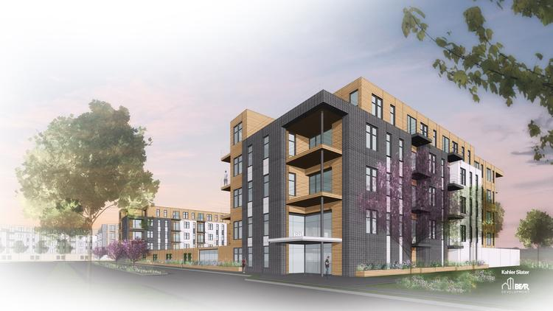

Slide 21
Our Story:
First Baptist Church of West Allis
End of history 30

