Slide 1
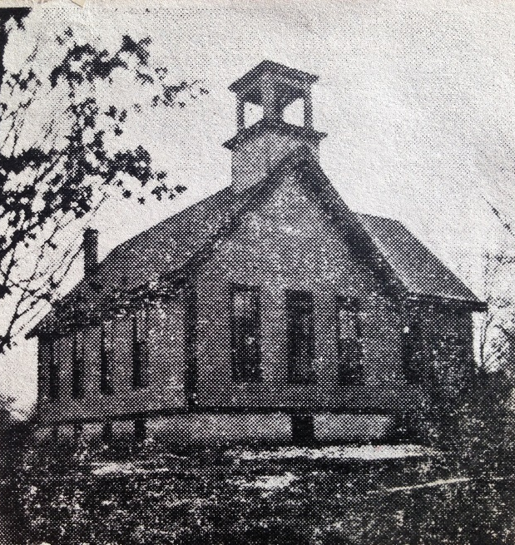
Our Story:
First Baptist Church of West Allis
22. New Church Building (1929)

Slide 3
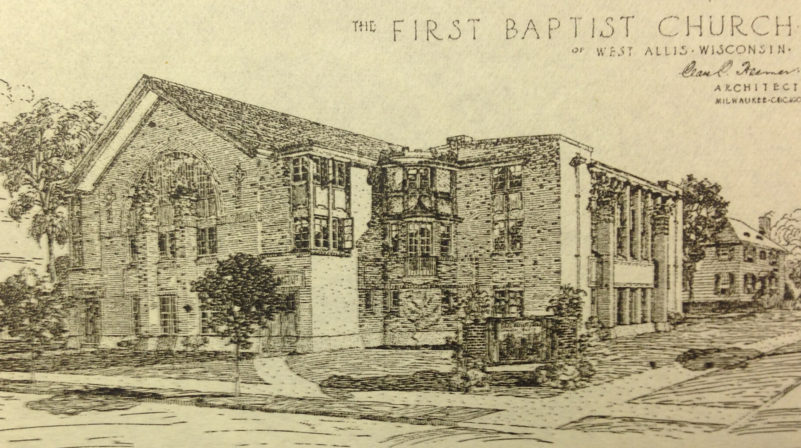

Slide 6
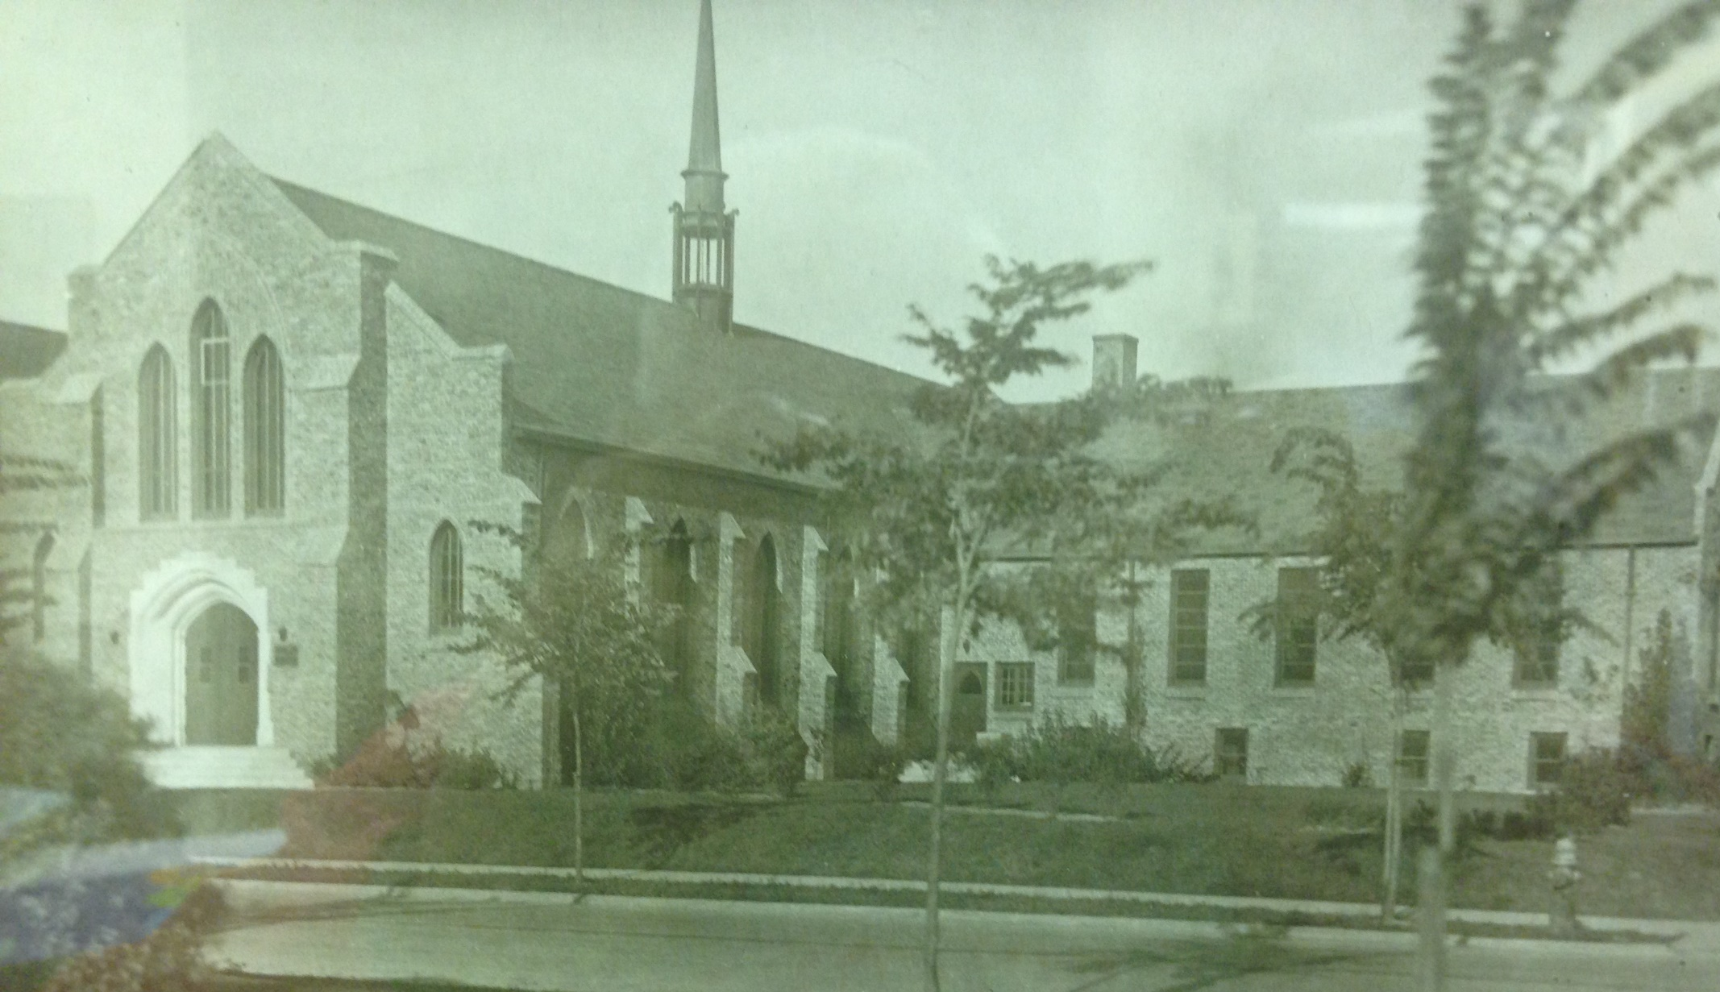

Slide 7
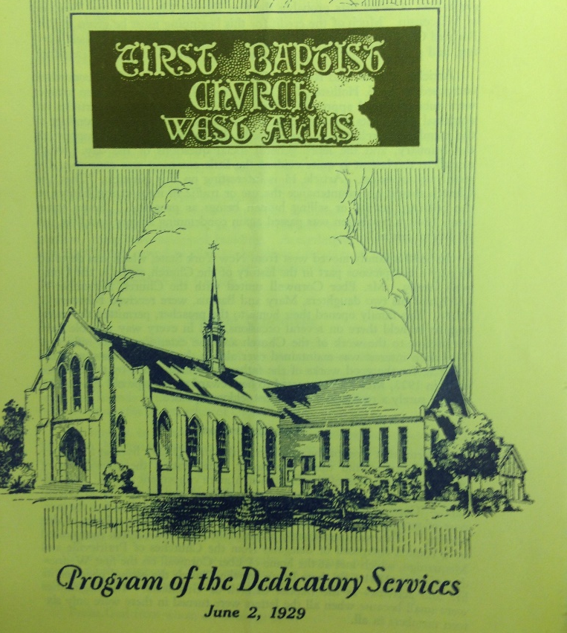
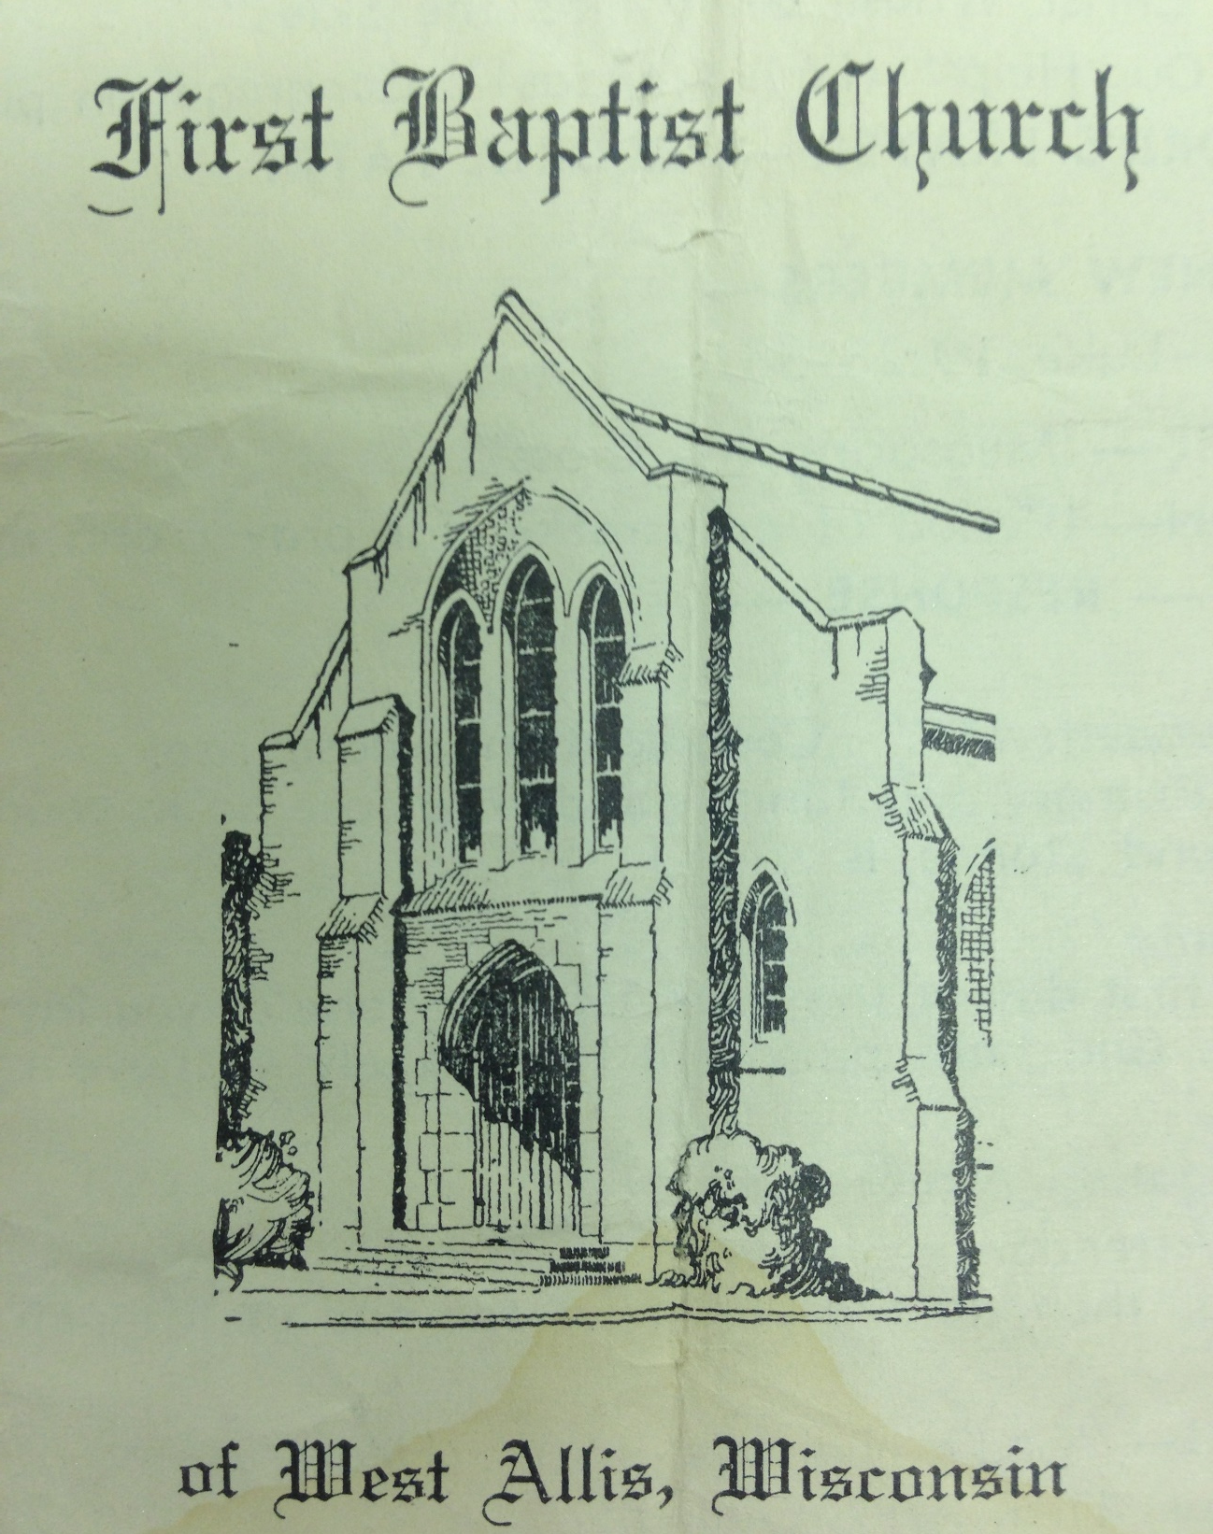

Slide 8
568 Maple/1472 S 90th St

Slide 9
1940 CENSUS

Slide 10
1940 CENSUS

Slide 11
Our Story:
First Baptist Church of West Allis
End of history 22

