Slide 1
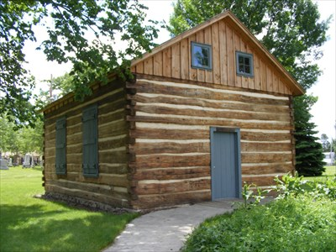
Our Story:
First Baptist Church of West Allis
11. Constructing a church building (1869)

Slide 2
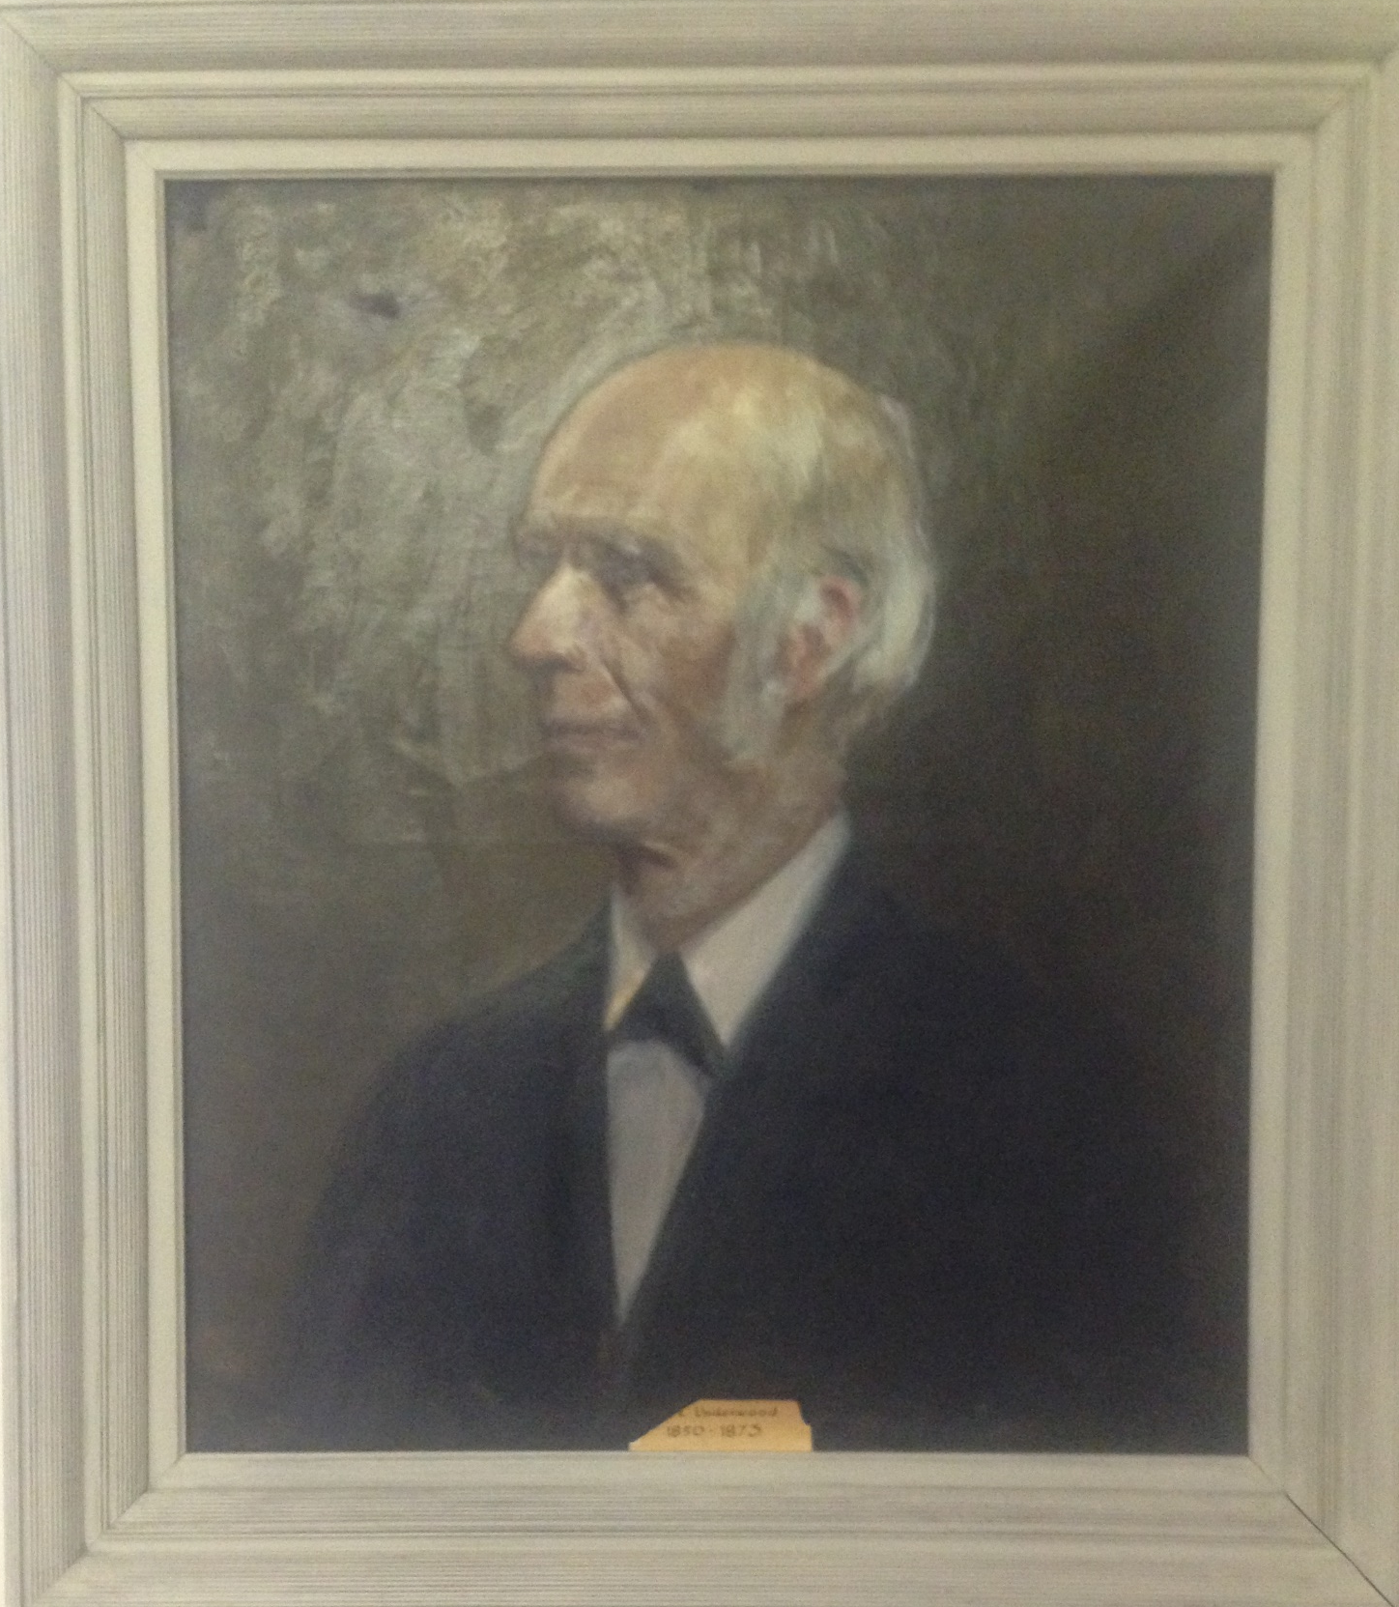
Rev Enoch Underwood
Pastor: 1850-1873

Slide 3
North Greenfield (1869)
76th Avenue (83rd Street)
Mukwonago Road
(National Avenue)

Slide 4
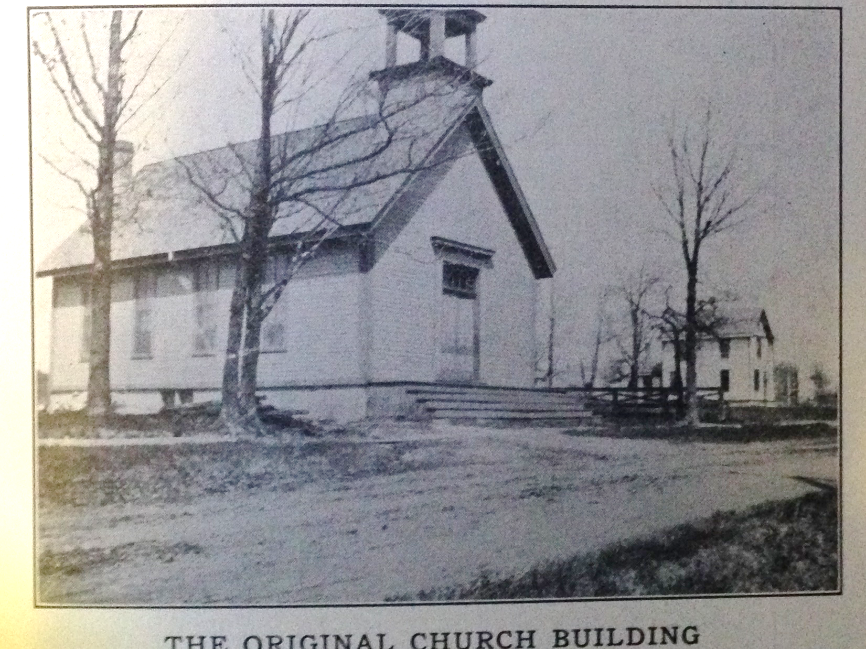
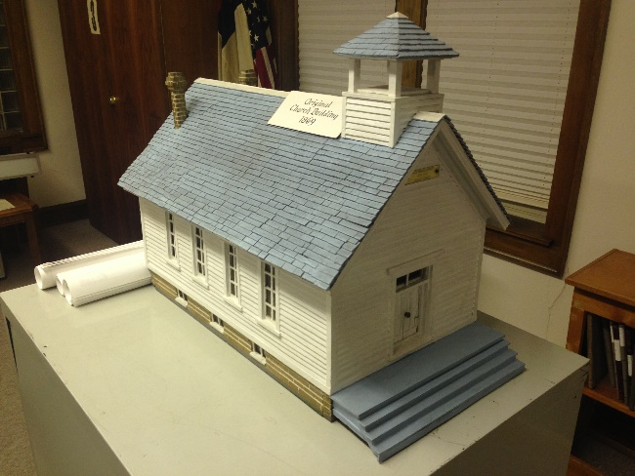
Initial Church Building

Slide 5
Milwaukee Sentinel 1/29/1869

Slide 6
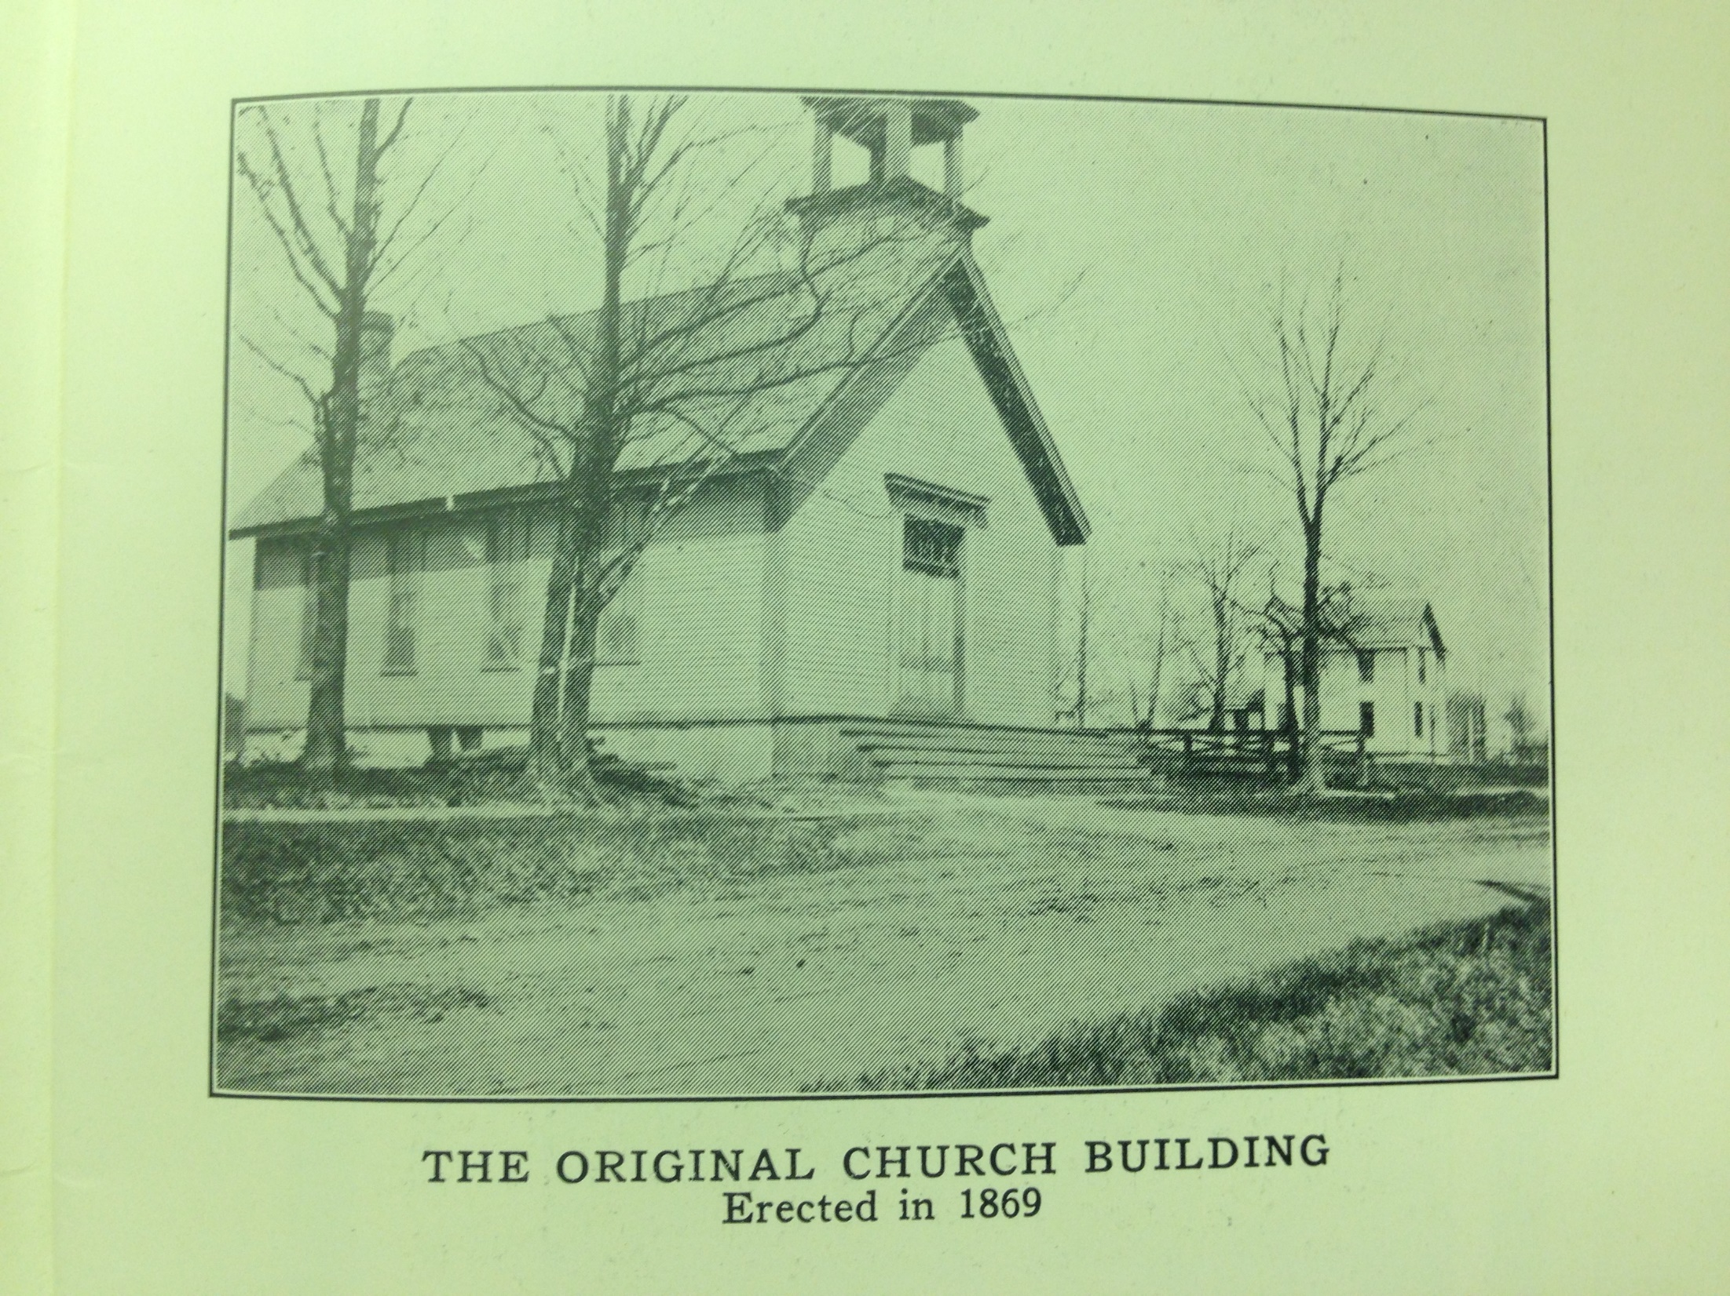

Slide 7
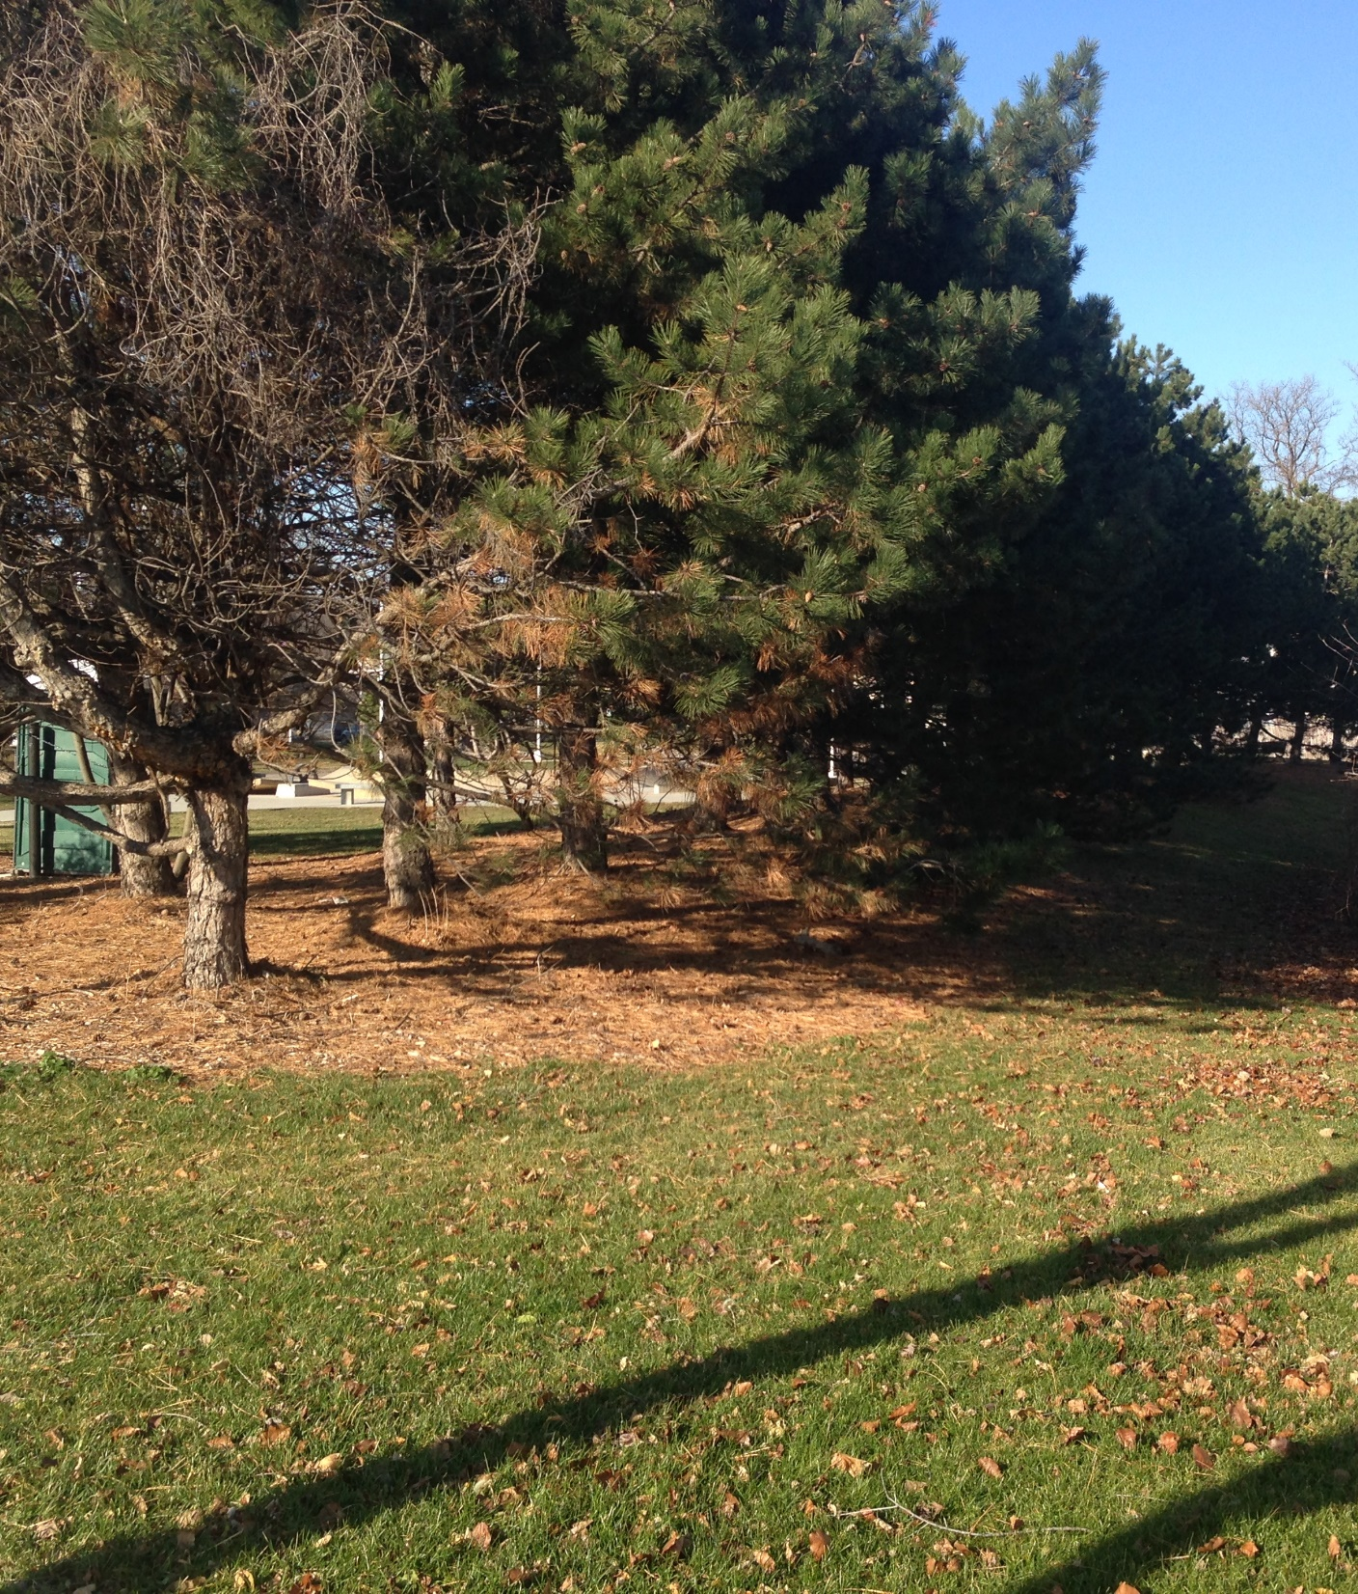
Looking out the front door
Looking SW at pine trees on spur railroad bed

Slide 8
Pastors of Greenfield Baptist Church
Rev Conrad 1841-1842
Rev J Murphy 1842-1843
Rev W. R Manning 1843-1847
Rev Raymond 1847-1850
Rev W. Clack 1850
Rev E Underwood 1850-1873
Rev W Fenton
Rev Caldwell 1873-1891
Rev E. O. Smith (supplies)
Rev D. W. Hulburt
}

Slide 9
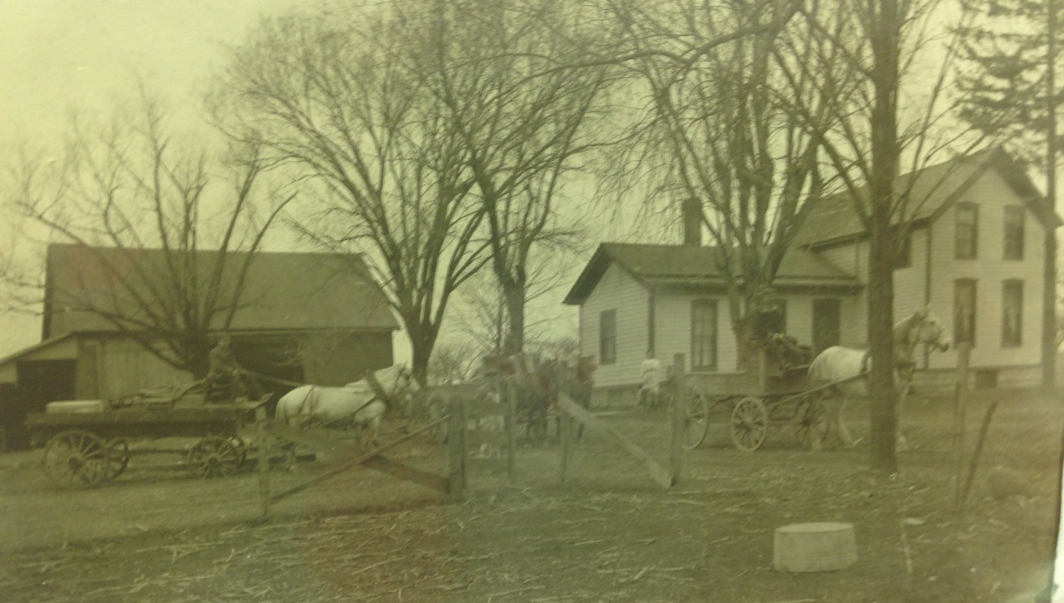
Wauwatosa
Township
Nobles Farm
Greenfield
Township
Honey Creek

Slide 10
1859
Wauwatosa
Township
Greenfield
Township
1876
1900
Honey Creek

Slide 11
Nobles 40 Acres Today

Slide 12
Our Story:
First Baptist Church of West Allis
End of history 11

