Slide 1
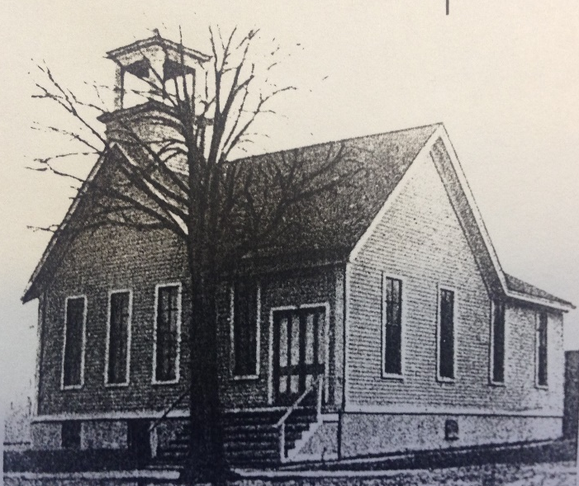
Our Story:
First Baptist Church of West Allis
15. Growth in Milwaukee County;
State Fair in Town of Wauwatosa

Slide 2
Central Milwaukee County in 1899

Slide 3
Central Milwaukee County in 1899

Slide 4
Map of Future Fair Park
(1876 )

Slide 6
Settled Area or planned streets

Slide 7
1899
North Greenfield Town limits
Settled Area or planned streets

Slide 8
North Greenfield and State Fair in 1899

Slide 9
North Greenfield and State Fair in 1899

Slide 10
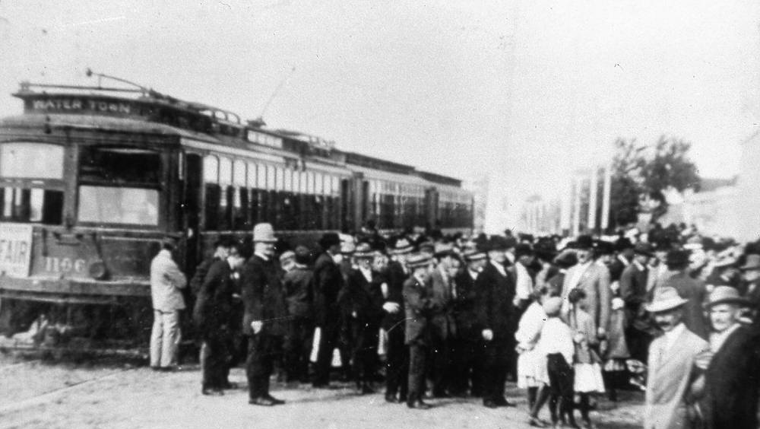

Slide 11
North Greenfield and State Fair in 1899

Slide 12
Wauwatosa in 1899

Slide 13
Our Story:
First Baptist Church of West Allis
End of history 15

