Slide 1
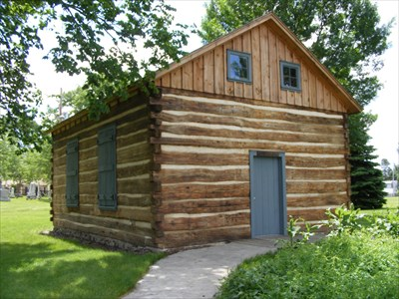
Our Story:
First Baptist Church of West Allis
9. Hard Times: Rev Clack (1850)

Slide 2
Pastors of Greenfield Baptist Church
Rev R. Griffing 1836-1838
Rev E Matthews 1838-1840
Rev R. Griffing 1840-1841
Rev Conrad 1841-1842
Rev J Murphy 1842-1843
Rev W. R Manning 1843-1847
Rev Raymond 1847-1850
Rev W. Clach 1850-1850
1850-

Slide 3
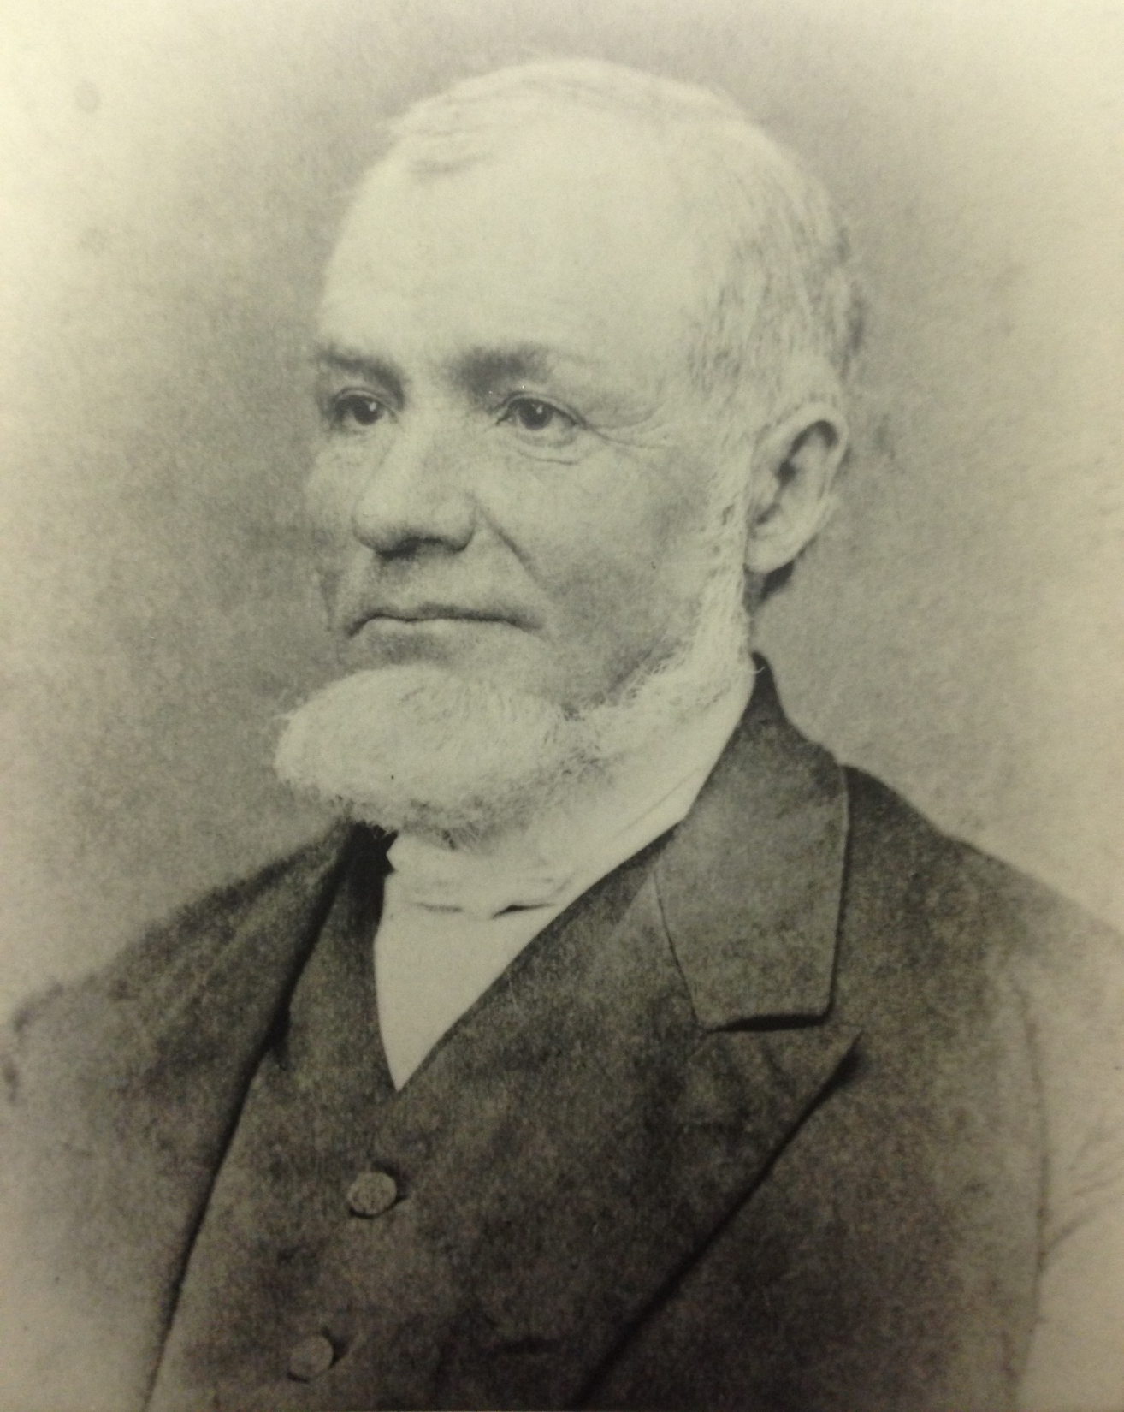
Rev William Clack

Slide 4
Northern United States in 1840

Slide 5
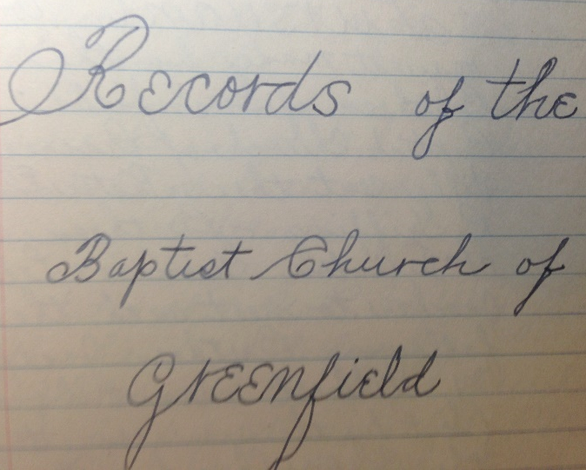

Slide 6
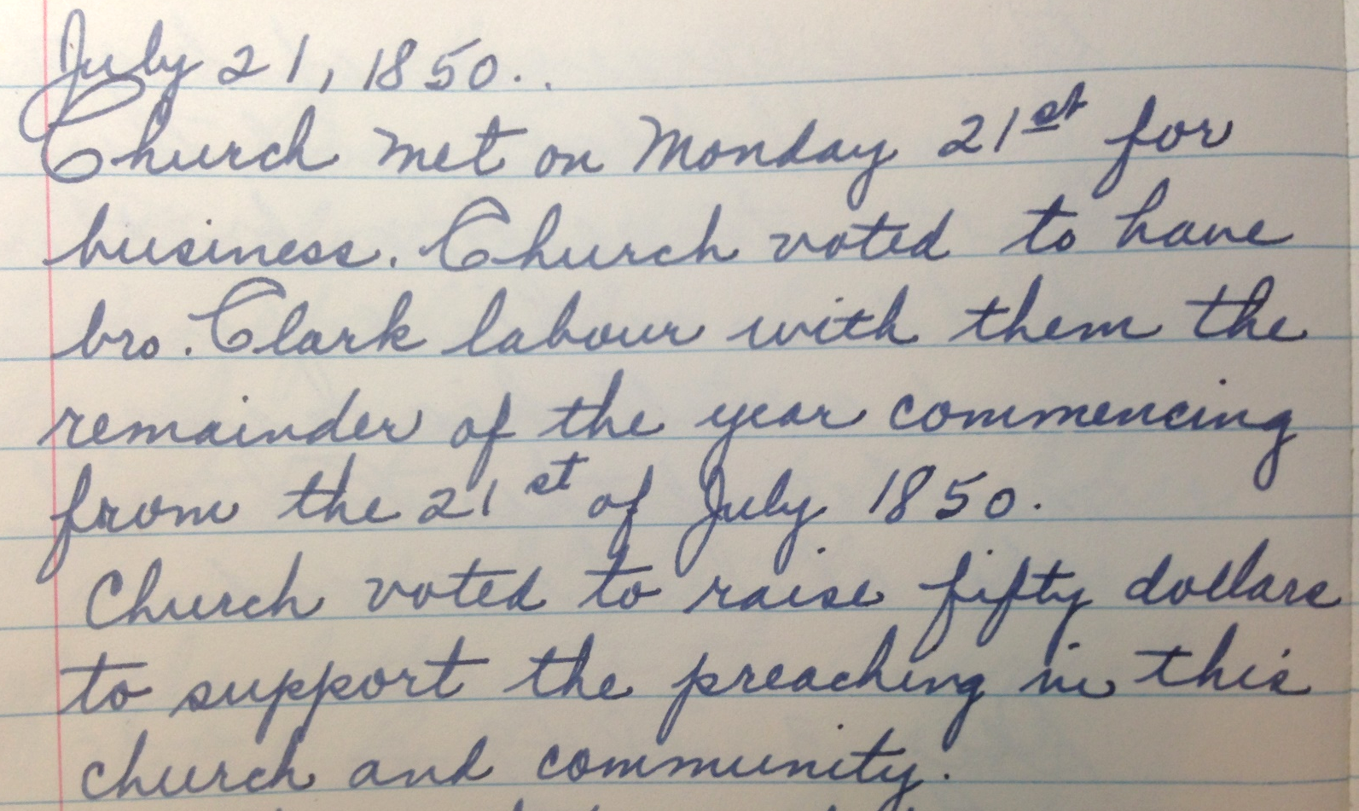

Slide 7
Oak Creek/South Milwaukee in 1859

Slide 8
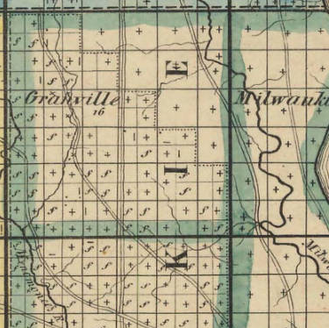
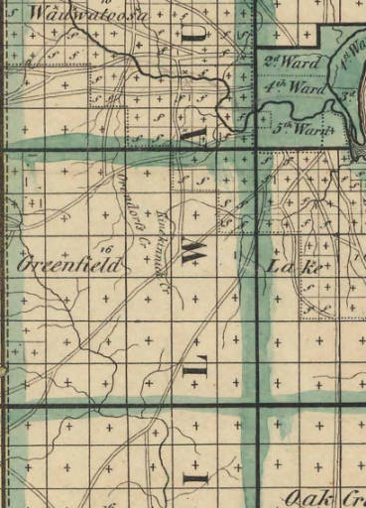
MILWAUKEE COUNTY TOWNSHIPS (1842)
Granville
Wauwatosa
Honey Creek
Greenfield
Franklin
Lake
Oak Creek
Hampton Ave
Greenfield Ave
College Ave
27th Street
Milwaukee
Village of Milwaukee
Oak Creek (South Milwaukee)

Slide 9
Rev William Clack

Slide 10
Our Story:
First Baptist Church of West Allis
End of history 9

