Slide 1
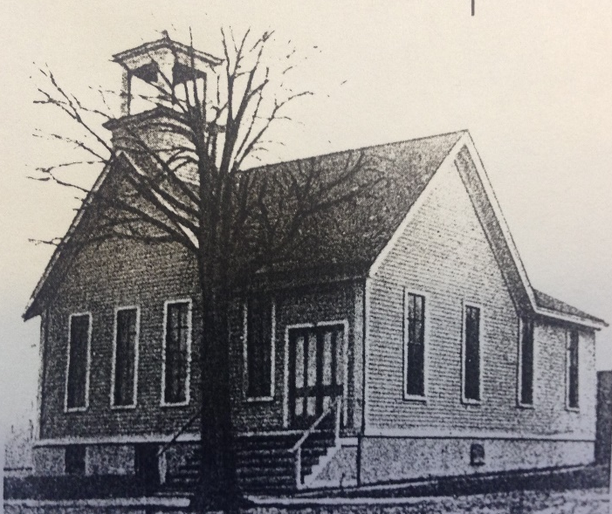
Our Story:
First Baptist Church of West Allis
18. Transportation’s Impact on West Allis

Slide 2
Western North Greenfield Town limits (1899)

Slide 3
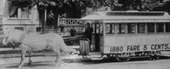
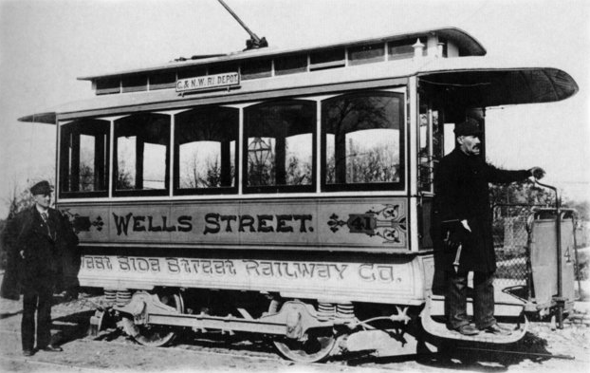
Public Transportation and West Allis (1892)
17 Walnut/Lloyd
60rd St
16 Vliet
Harwood
10 Wells
Interurban
Milwaukee
76th St
Vets Home
18 National Ave
70th St
19 Greenfield/
Burnham/Becher
Lapham
35th Street
27th Street

Slide 4
Public Transportation and West Allis (1917)
17 Walnut/Lloyd
60rd St
16 Vliet
Harwood
10 Wells
xxxx
xxxxxxx
Interurban
X
Vets Home
76th St
18 National Ave
70th St
XXXXXXXX
X
19 Greenfield/
Burnham/Becher
To Waukesha/
Watertown
Lapham
35th Street
27th Street
To Burlington & East Troy

Slide 5
Public Transportation and West Allis (1938)
XXXXXXXX
XX
17 Walnut/Lloyd
XXX
60rd St
16 Vliet
XXXXXXXXxxxxx
Harwood
10 Wells
xxxx
xxxxxxx
Interurban
X
Vets Home
76th St
18 National Ave
70th St
XXXXXXXX
X
19 Greenfield/
Burnham/Becher
To Waukesha/
Watertown
Lapham
35th Street
27th Street
To Burlington & East Troy

Slide 6
About 10th Street Near St Paul Avenue
1930
Today
St. Paul Ave
St. Paul

Slide 7
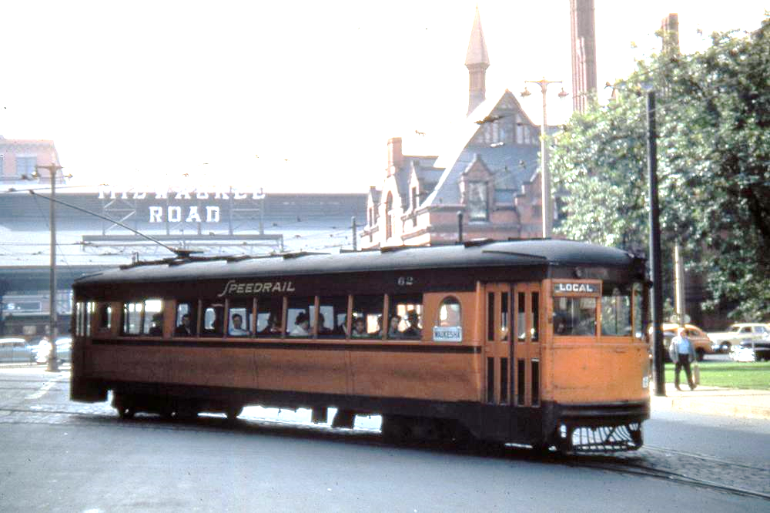
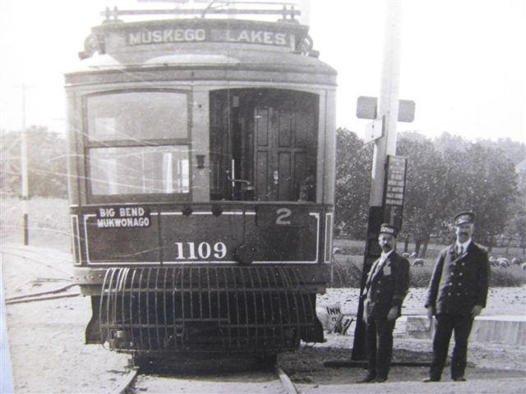

Slide 8
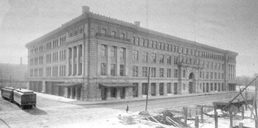
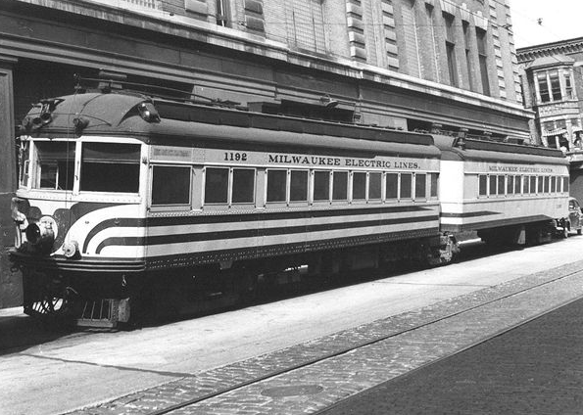
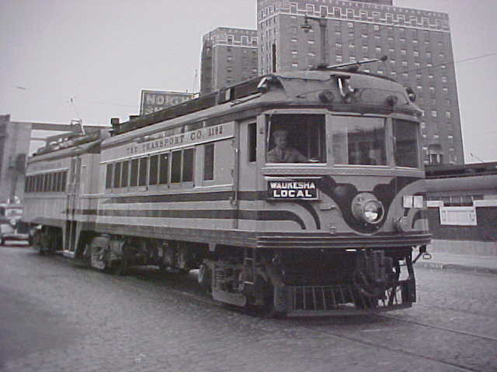
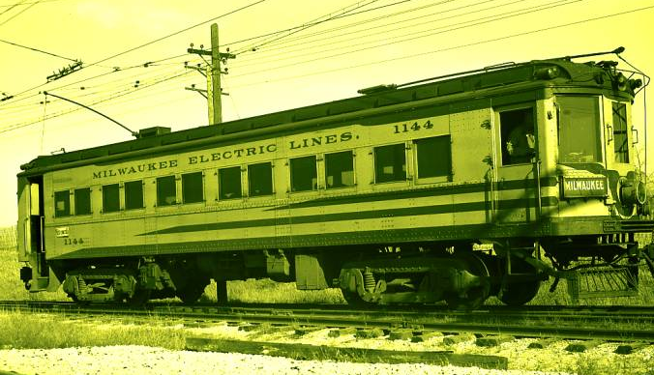
Public Service Building (looking SW in 1905)

Slide 9
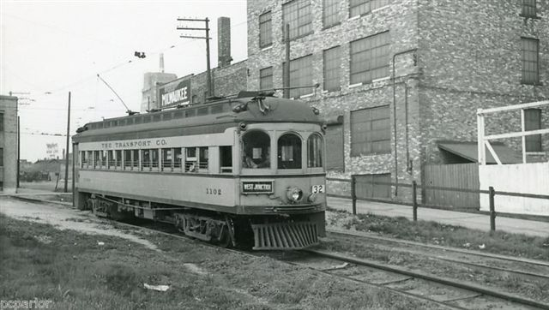
Where was this car Headed????

Slide 10
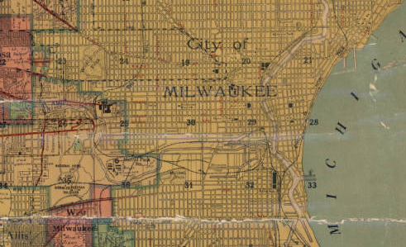
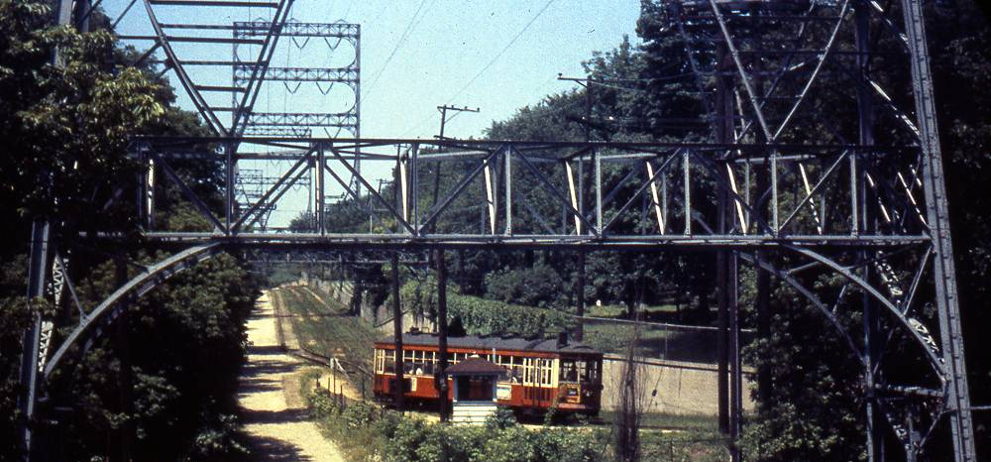
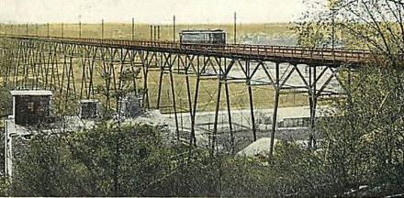
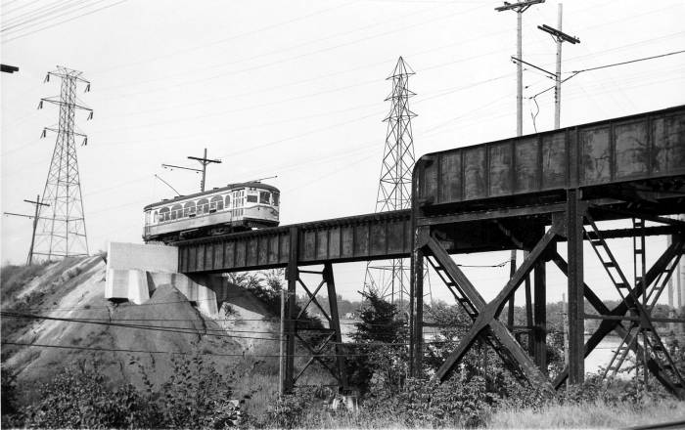
Central Milwaukee County in 1916
C

Slide 11
Central Milwaukee County in 1916
C

Slide 13
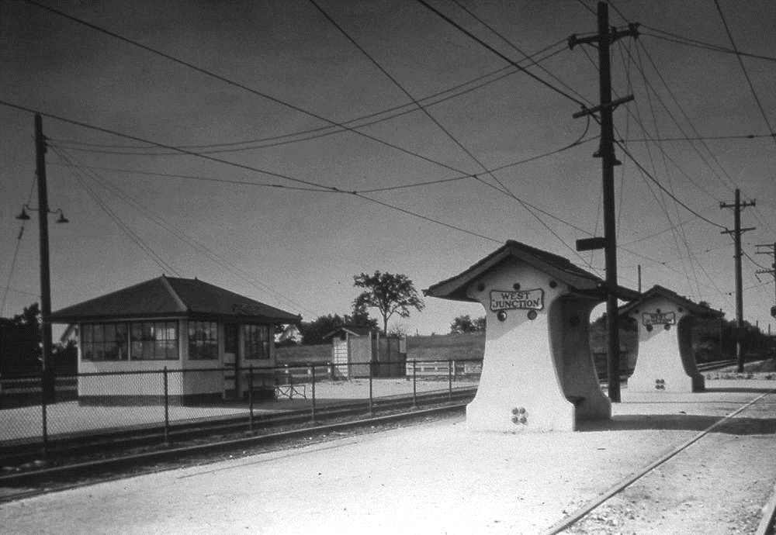

Slide 14
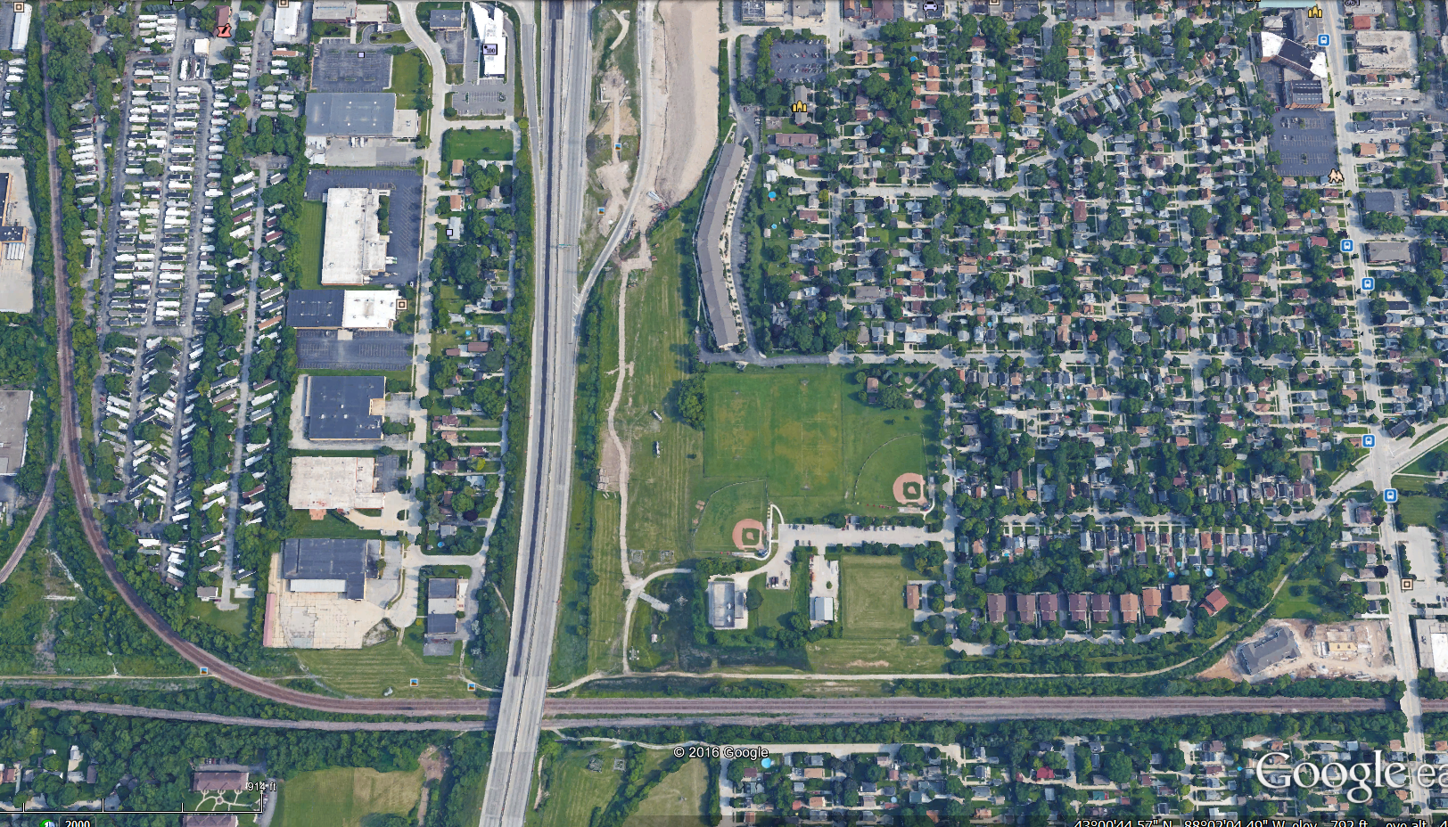

Slide 15
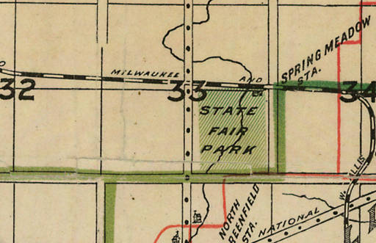
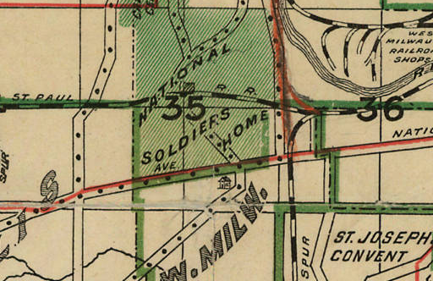
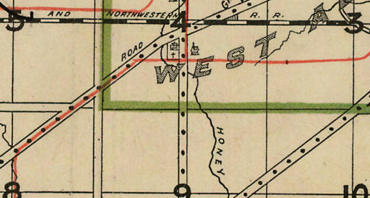
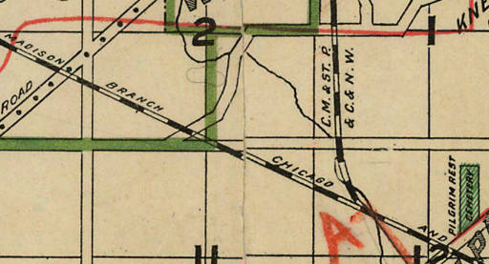
Allis Chalmers Manufacturing Company
1903
C

Slide 16
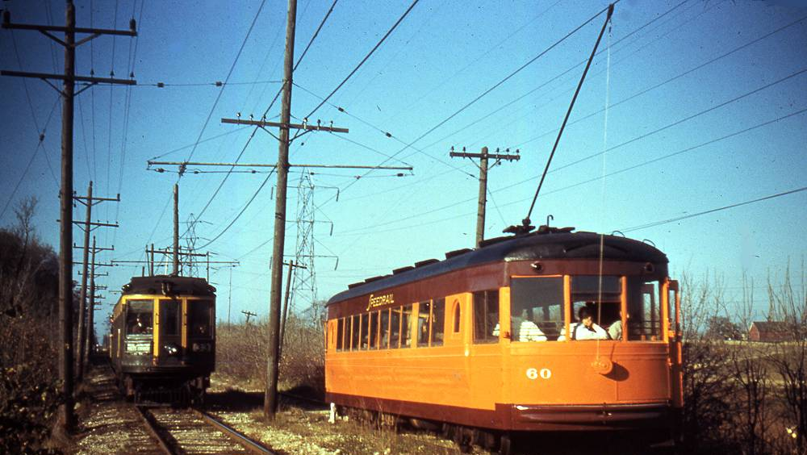

Slide 17
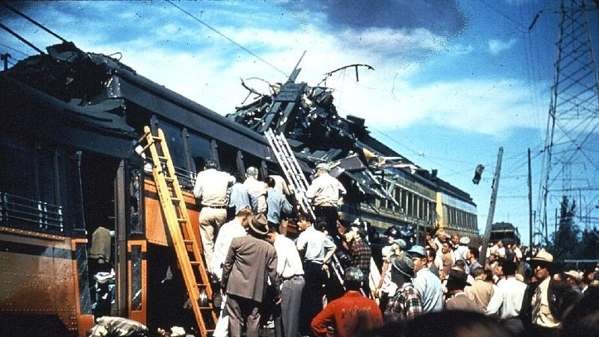
9/2/1950

Slide 18
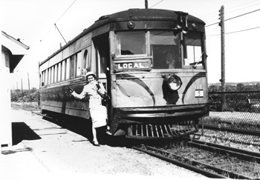
Safety Concerns + More Autos = End of Service
6/30/1951

Slide 19
Speedrail ROW Became Zoo Interchange
1950
Today

Slide 20
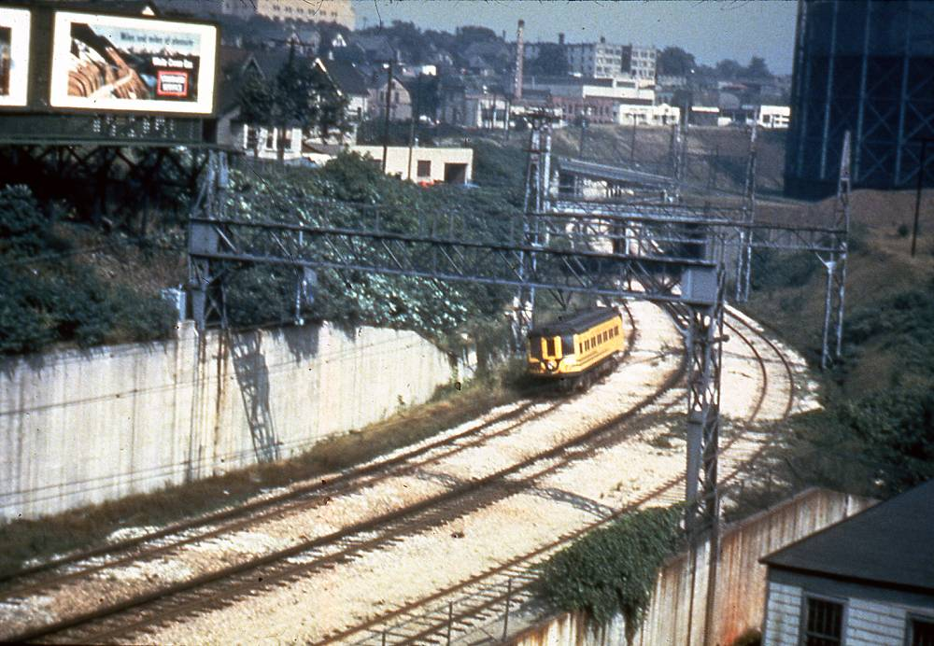
1950
Rapid Transit Right-Of-Way
To
I-94 Right-Of-Way
Today

Slide 21
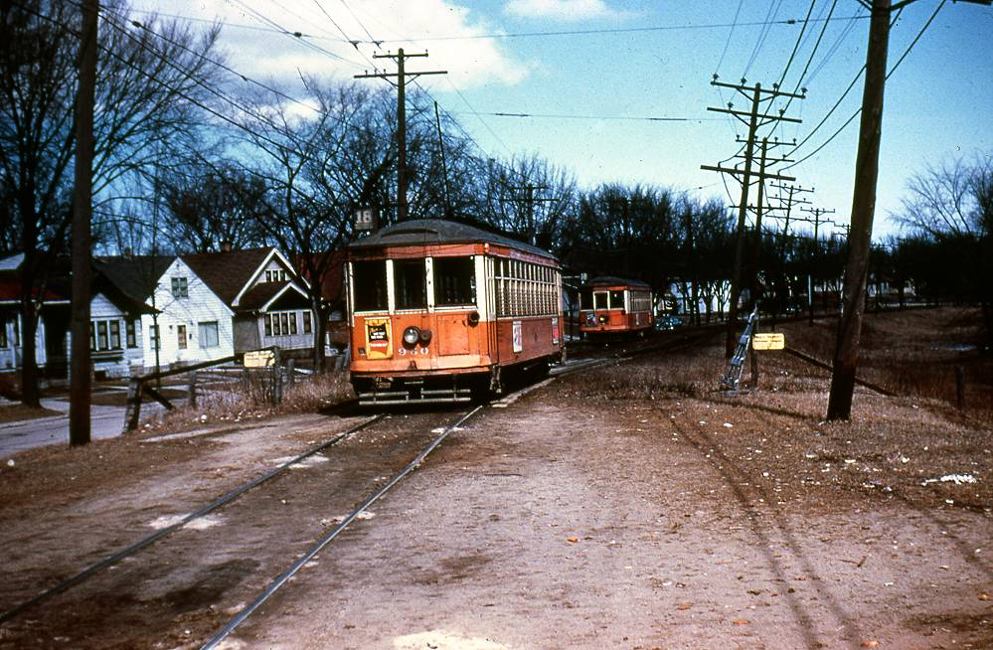
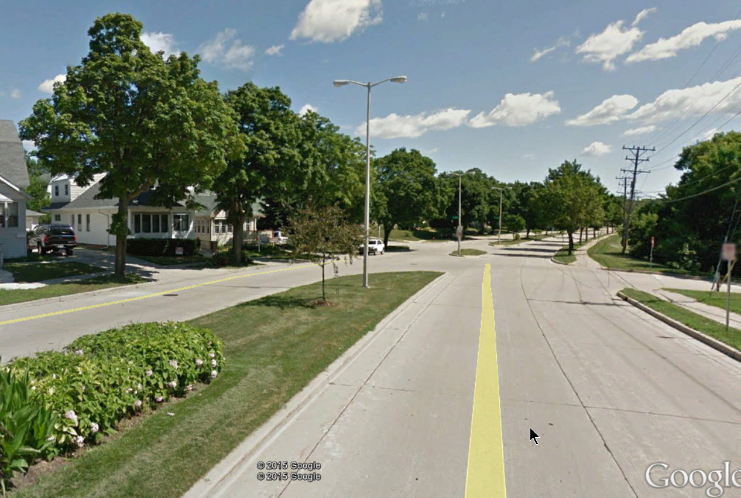
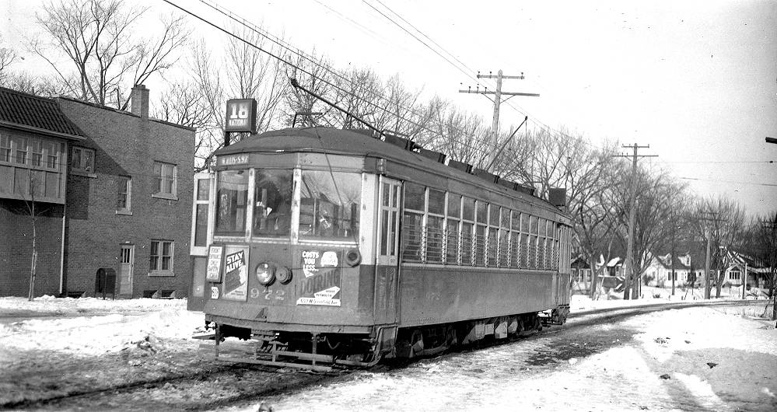
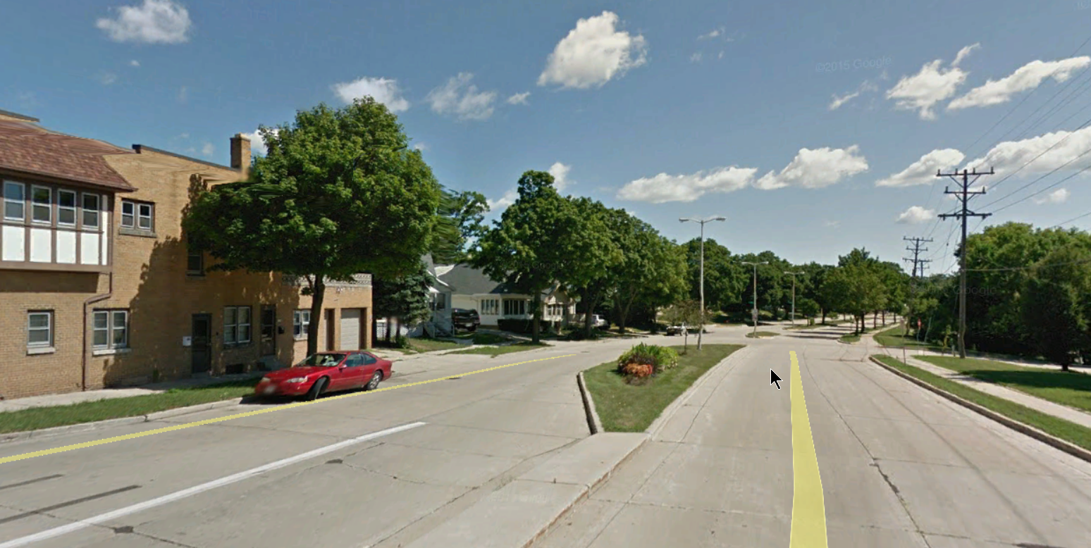
Pre 1958
Looking East from 92nd and Lapham
Today

Slide 22
Our Story:
First Baptist Church of West Allis
End of history 18

