Slide 1
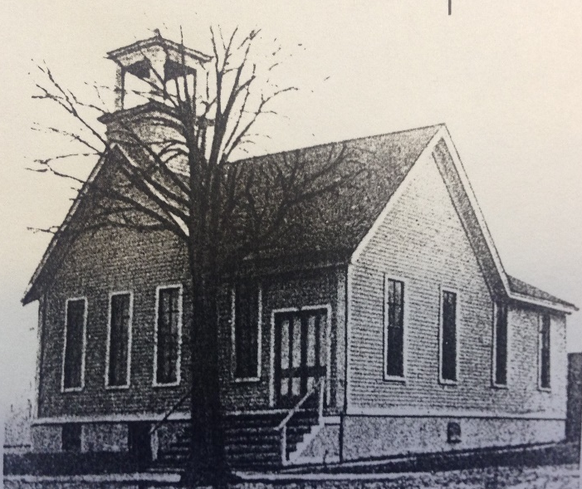
Our Story:
First Baptist Church of West Allis
19. Wisconsin State Fair Baptist Dining Hall

Slide 2
Pastors of Greenfield Baptist Church
Rev Henry Dee Brown 1904-1905
Rev R. E. Cody 1905-1906
Rev W. E. Risinger 1907-1908
Rev David B. Cheney 1909-1912
Rev F. F. Parsons 1912-1922
Rev A. L. MacMillan 1922-1925
Rev Andrew. B . Martin 1925-1930
Rev Earl Foster 1931-1931
Rev Ralph Compere 1931-1932
Rev Fred Erion 1934-1945

Slide 3
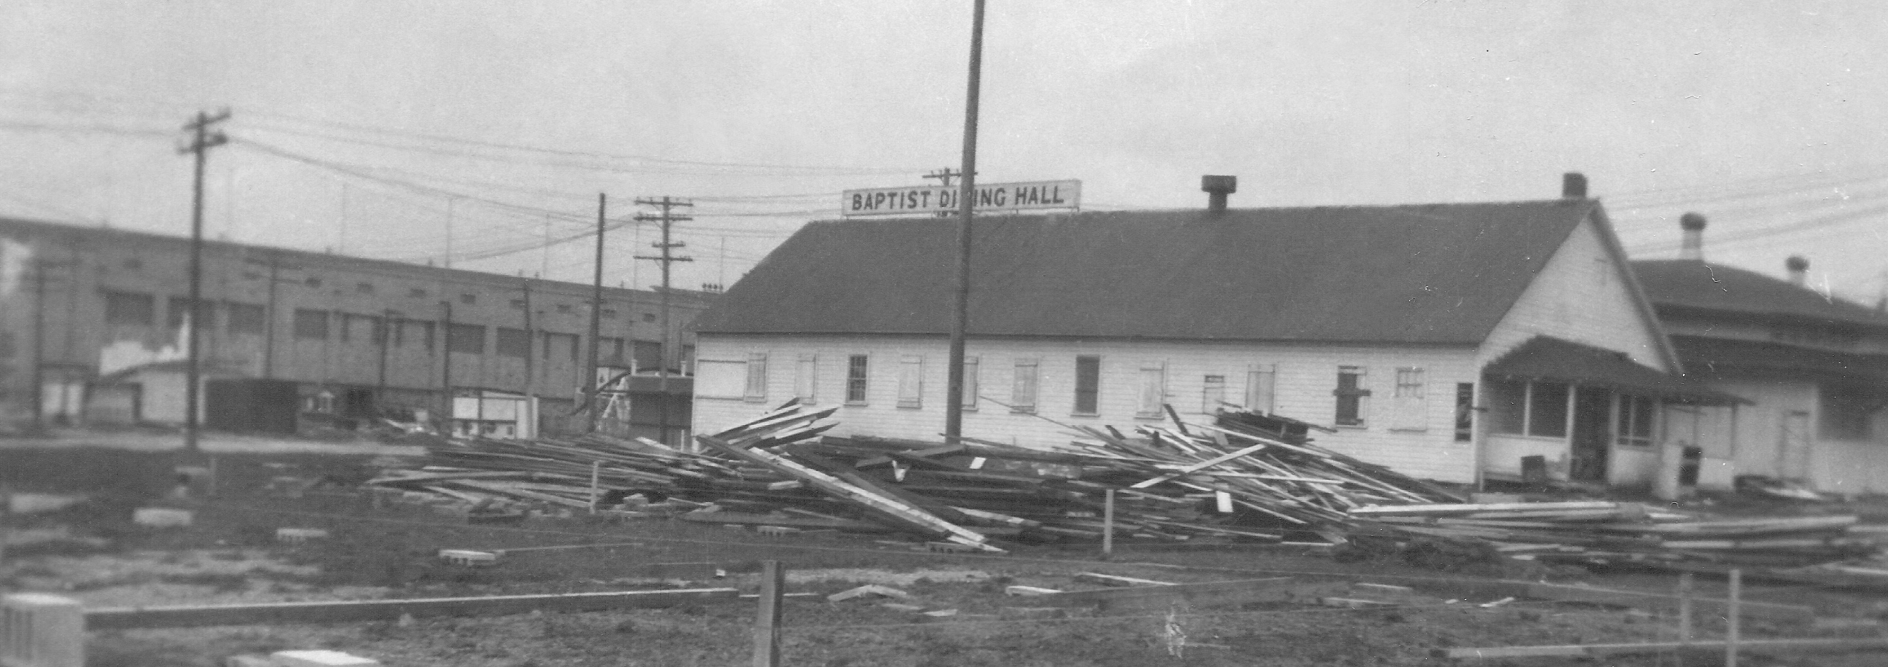
BAPTIST DINING HALL

Slide 4
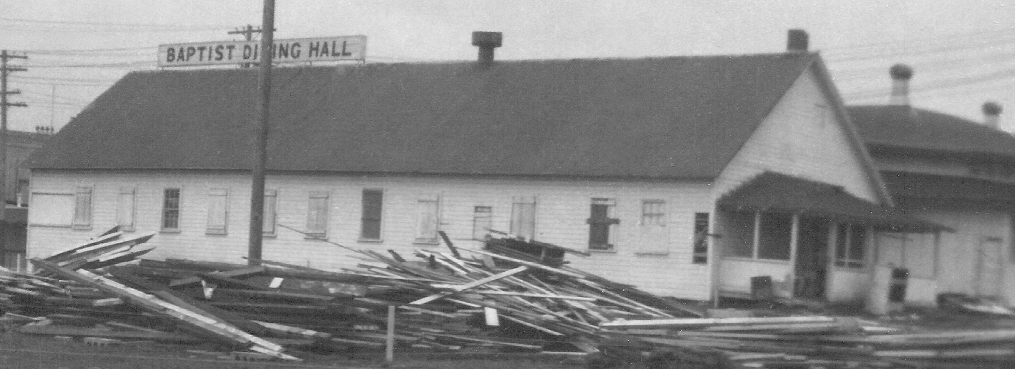

Slide 5
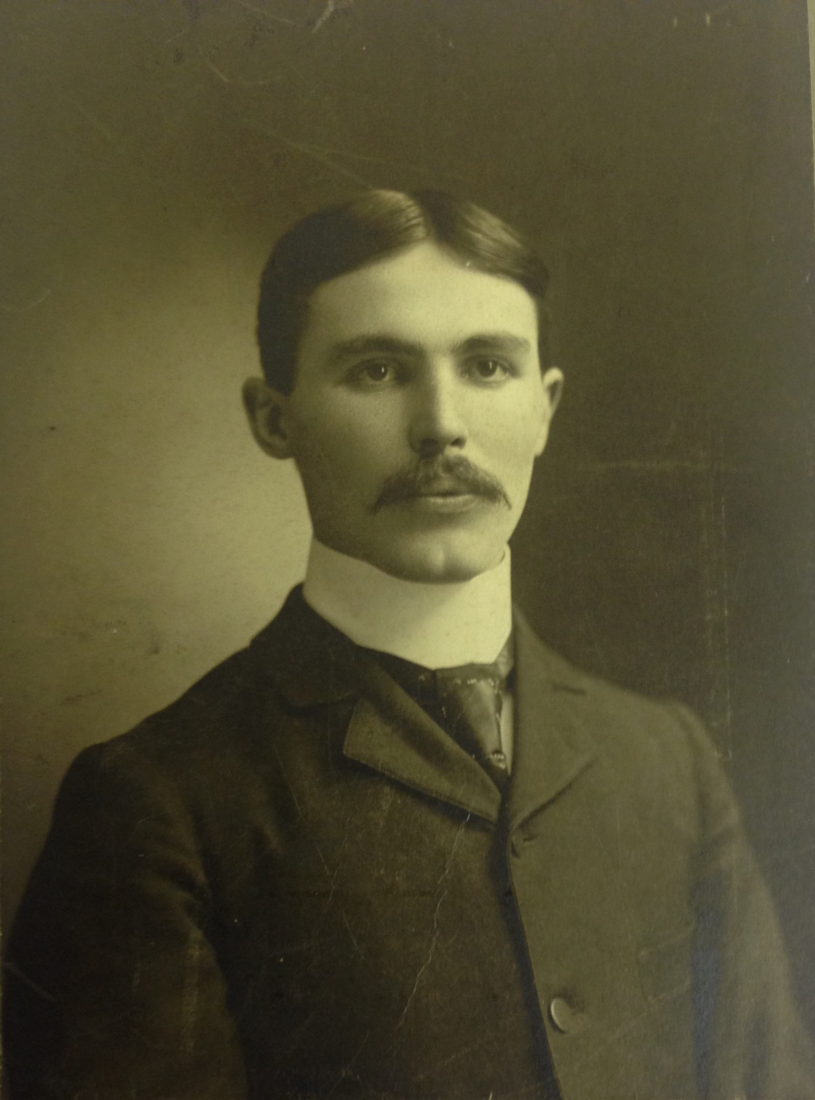
Doctor Henry Strong

Slide 6
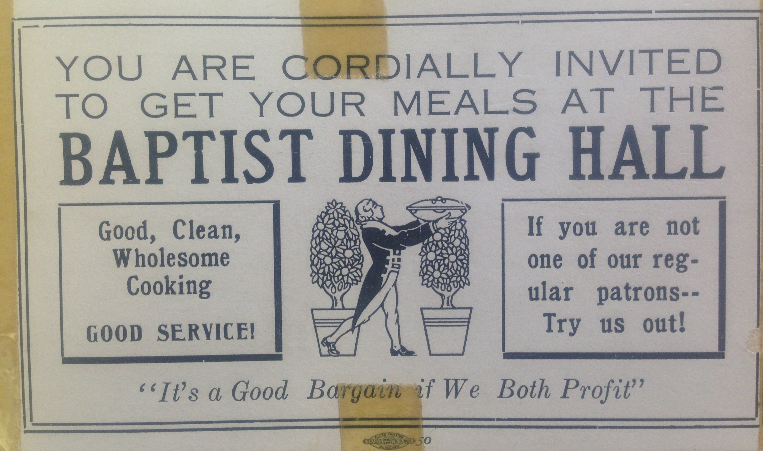

Slide 7
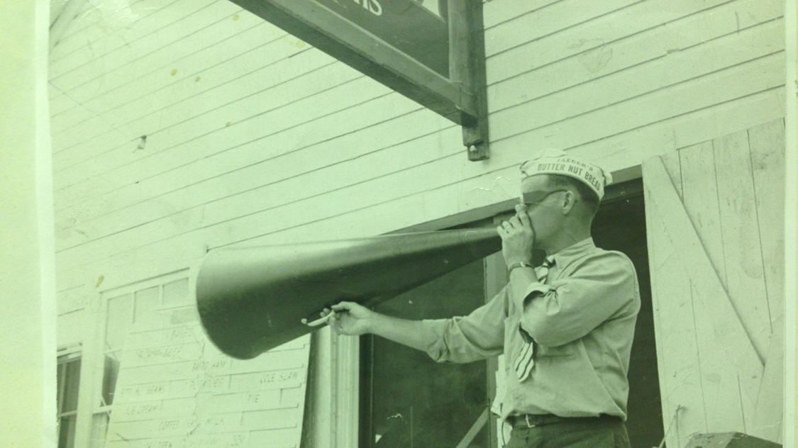
“Barker” Charles Olmstead
father of Charlotte Jaeck

Slide 8
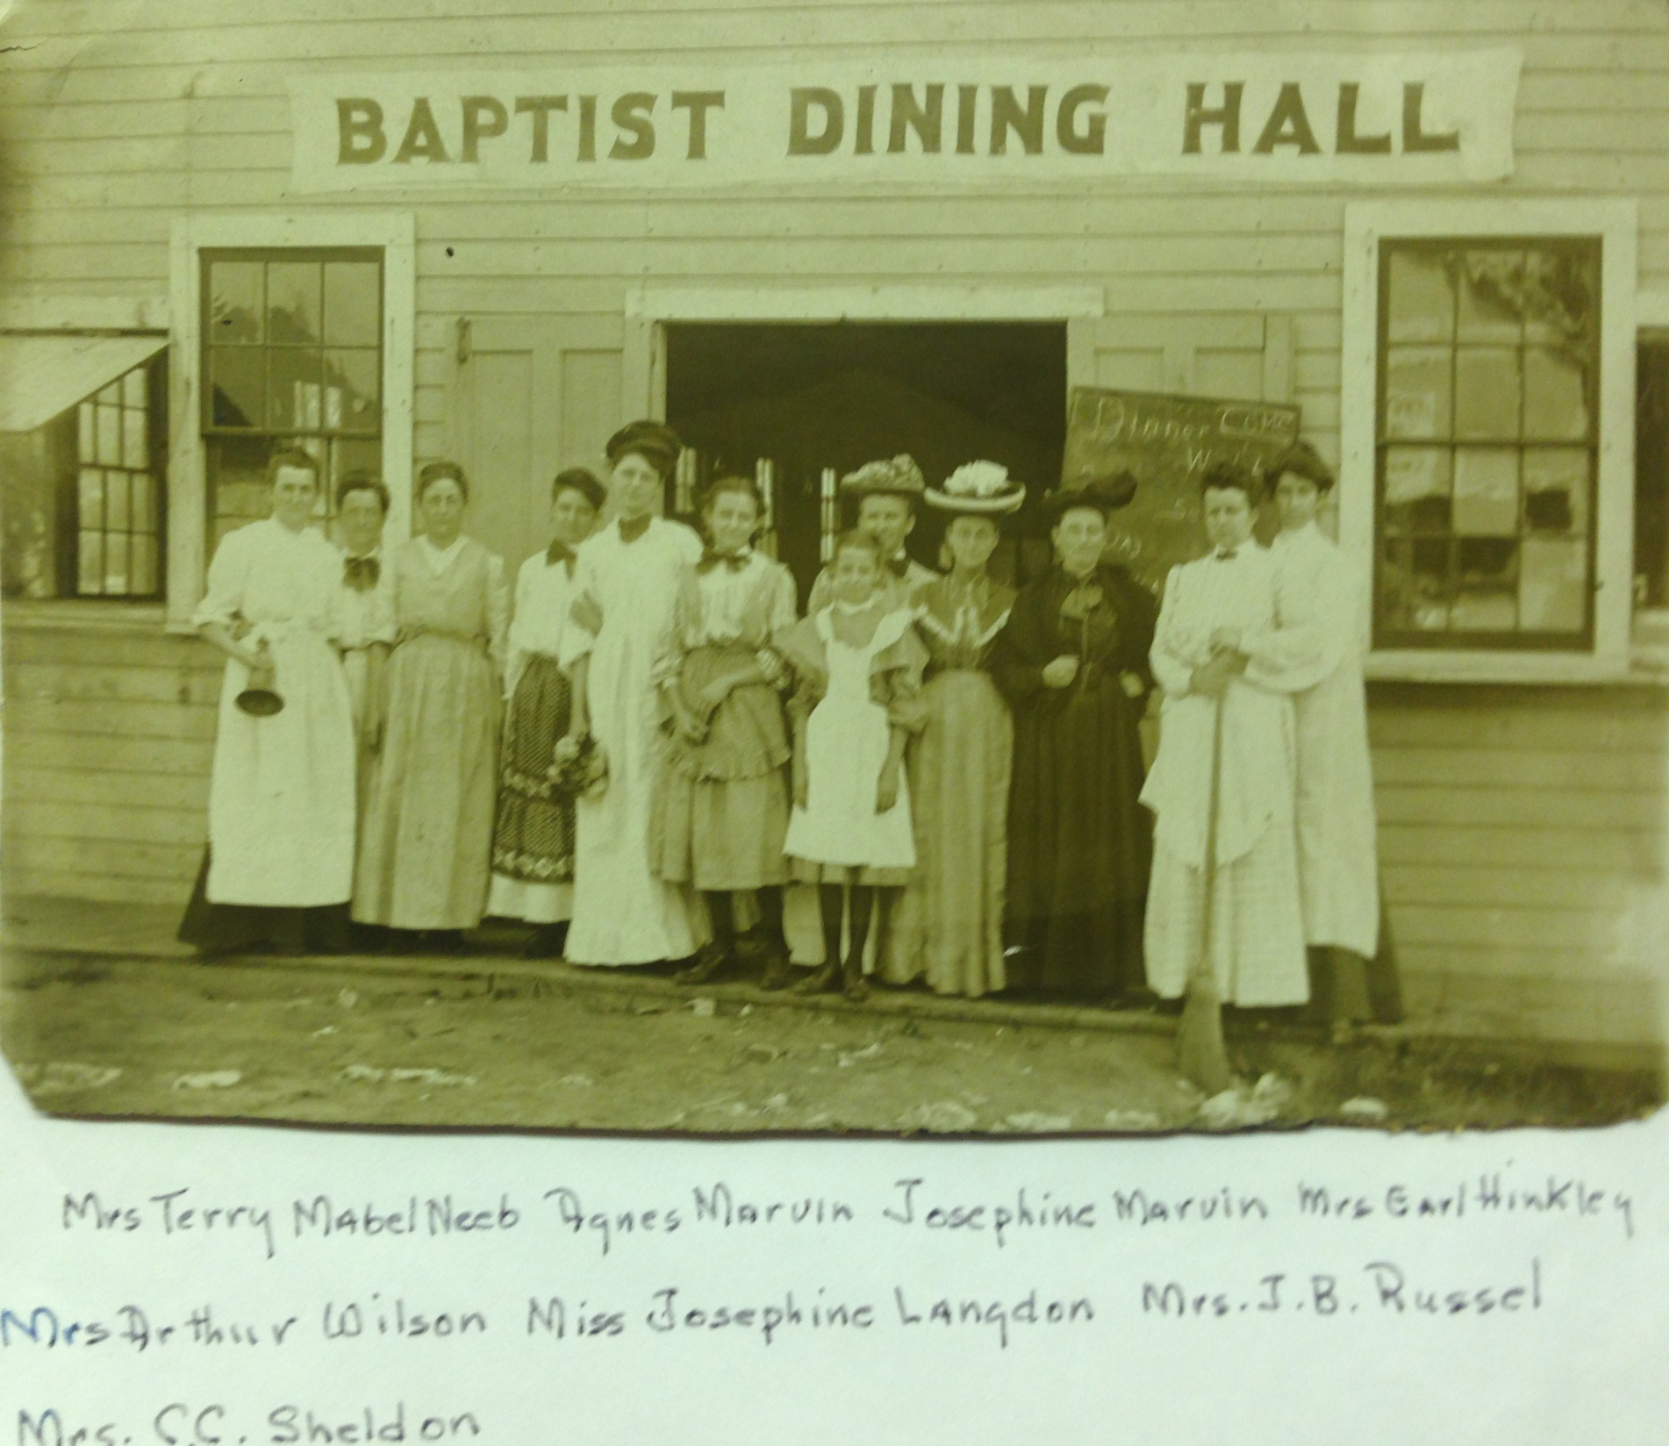

Slide 9
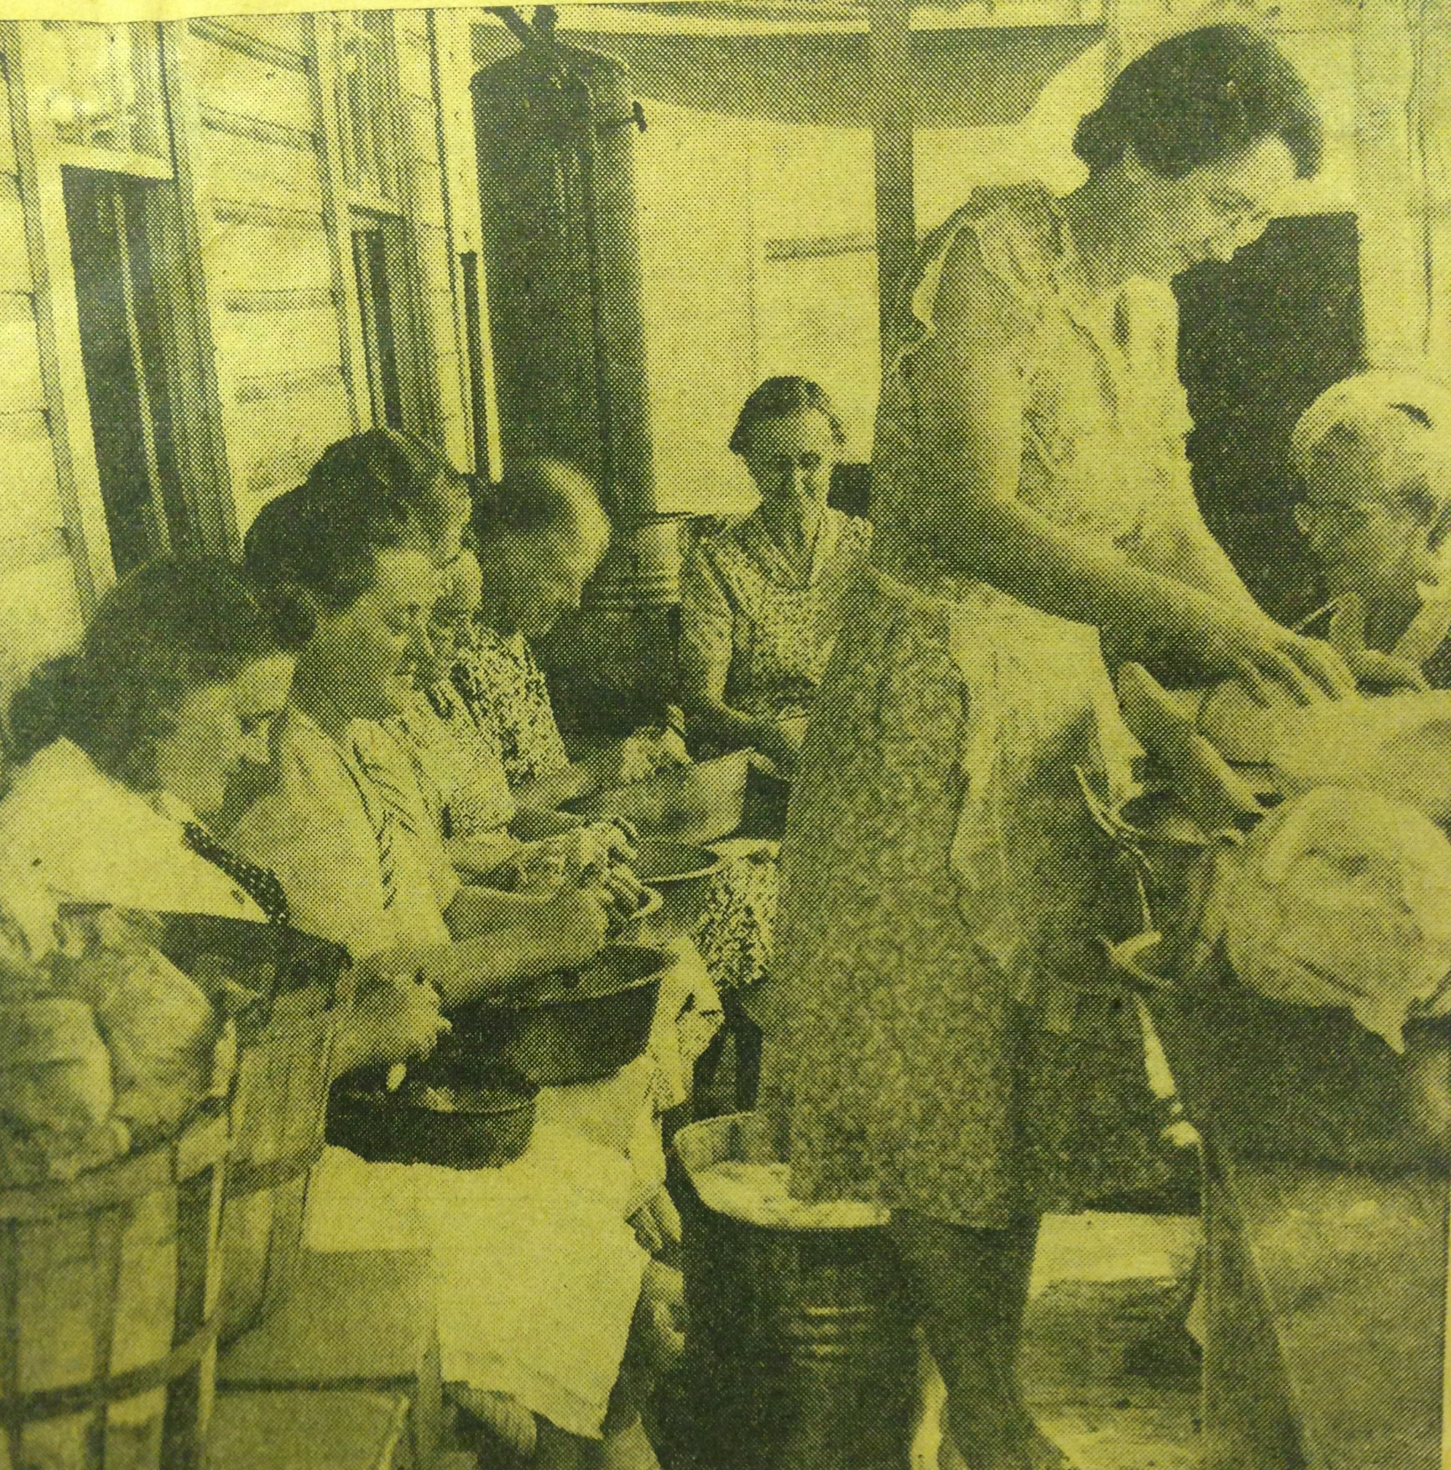

Slide 10
DNR Photo
July 1937

Slide 11
1910 Insurance Map

Slide 13
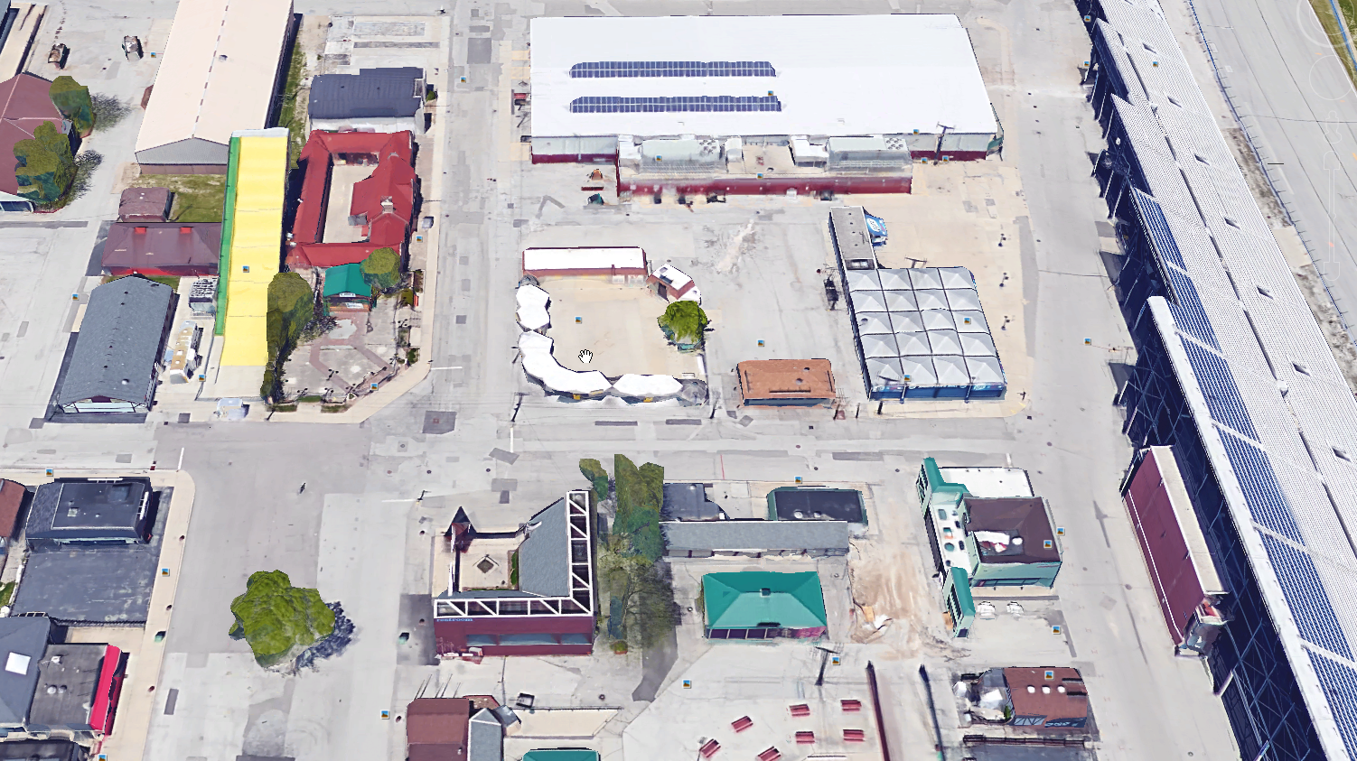
Baptist Dining Hall Location
Central Ave
2nd Street

Slide 14
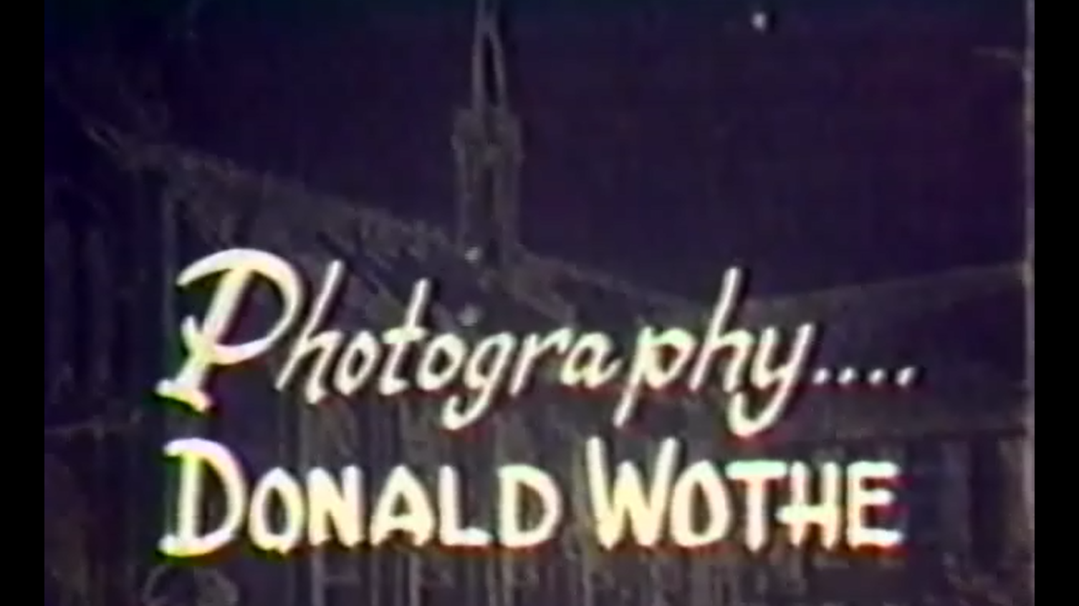

Slide 16
Our Story:
First Baptist Church of West Allis
End of history 19

