Slide 1
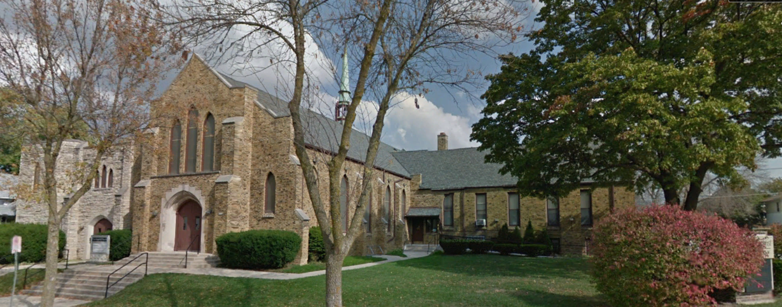
Our Story:
First Baptist Church of West Allis
POSTLOGUE

Slide 3
Township 6 North (Township of Greenfield) Section 4

Slide 4
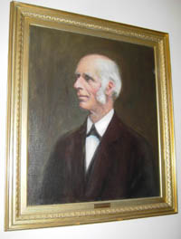
Rev Enoch Underwood
Pastor, Greenfield
Baptist Church,
1850-1873
Historically,
Our longest serving pastor

Slide 5
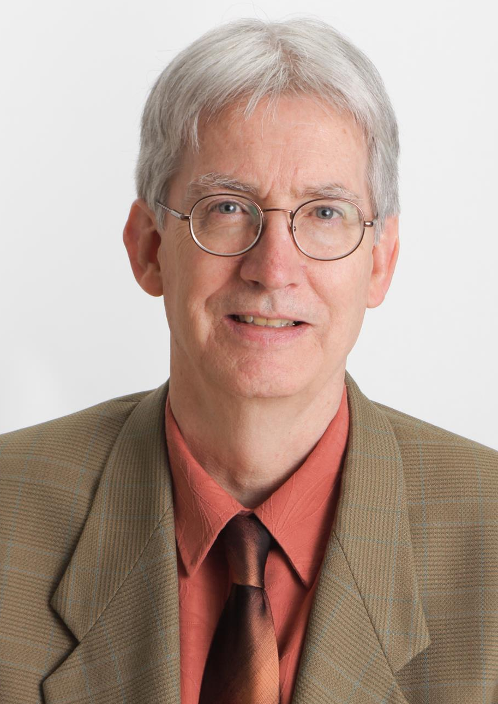
Rev Mark Weisser
Pastor, First Baptist
Church of West Allis,
1992-2016
Our new longest
serving pastor

Slide 6
Rev Mark Weisser
Now Then

Slide 9
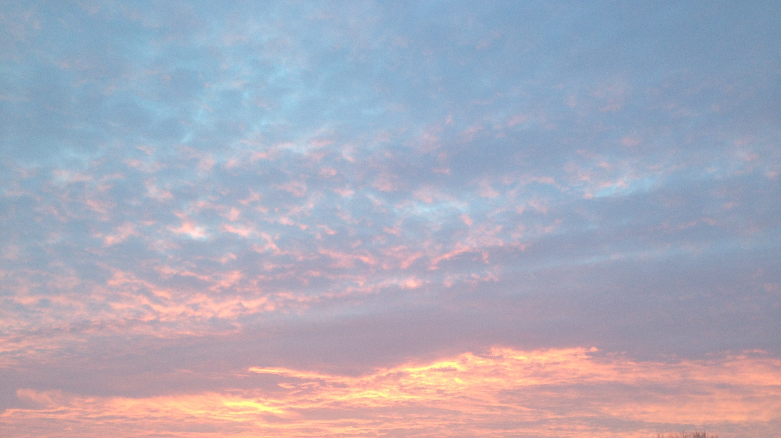

Slide 10
The future is not yet written;
“….your future hasn't been written yet. No one's has. Your future is whatever you make it.”

Slide 11
Future: May we do well in our:
Homes
Church
Communities
Country
World

Slide 13
Our Story:
First Baptist Church of West Allis
End of history Postlude

