Slide 1
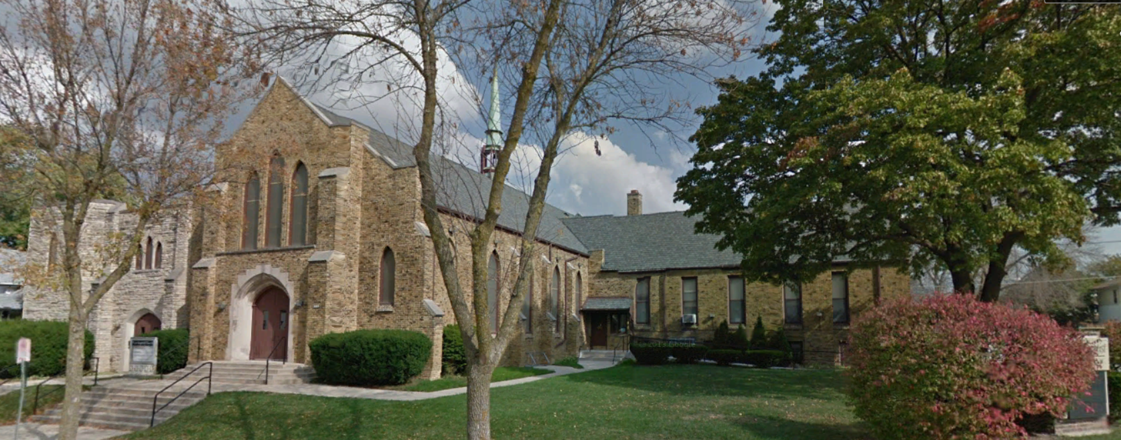
Our Story:
First Baptist Church of West Allis
5. Early Milwaukee County; Harts Mills

Slide 2
Wauwatosa
City of Milwaukee
Greenfield

Slide 3
Wauwatosa
Milwaukee
Harts Mills
Honey Creek
Greenfield

Slide 5
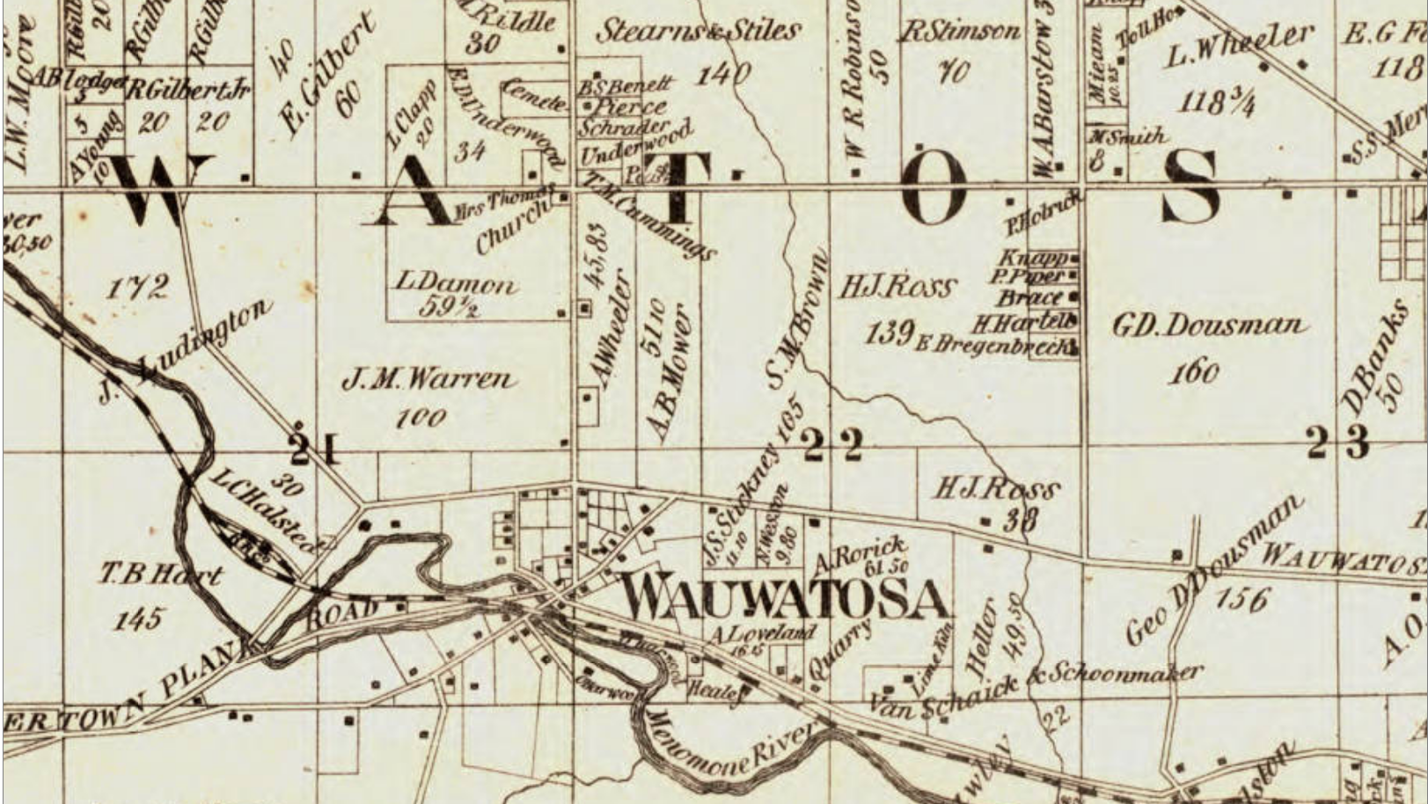
Harts Mills/Village of Wauwatosa
School

Slide 6
Harts Mills/Village of Wauwatosa
School

Slide 7
Harts Mills/Village of Wauwatosa
School

Slide 8
Harts Mills/Village of Wauwatosa
School

Slide 9
Harts Mills/Village of Wauwatosa
School

Slide 10
Harts Mills/Village of Wauwatosa
School

Slide 11
Harts Mills/Village of Wauwatosa
School

Slide 12
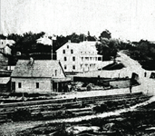
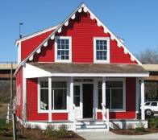
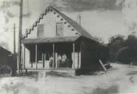
1870
1905

Slide 13
Harts Mills/Village of Wauwatosa
School

Slide 14
Harts Mills Road
(77th Avenue)
(84th Street/
Glenview Ave)
Harts Mills/Wauwatosa
Spring St (Bluemound Rd)
Mukwonago Road (National Ave)
Town Line Road (Greenfield Ave)
Honey Creek/North Greenfield

Slide 15
Bee Hives in Trees

Slide 17
Our Story:
First Baptist Church of West Allis
End of history 5

