Slide 1
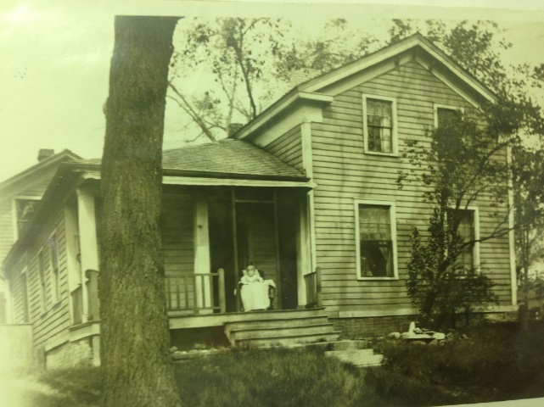
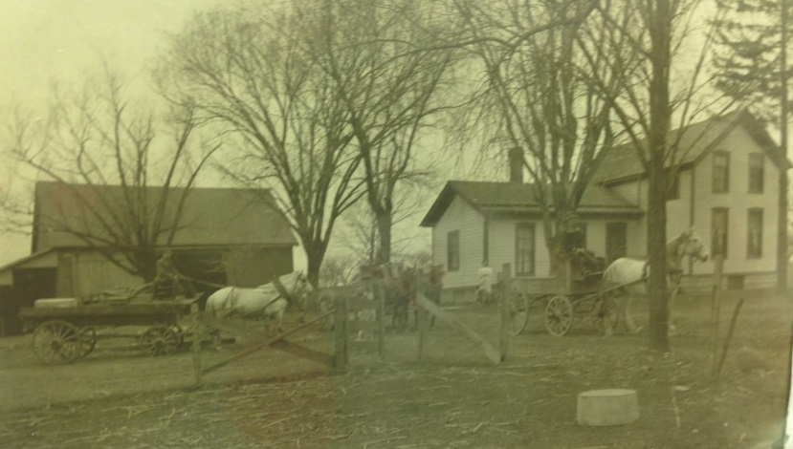
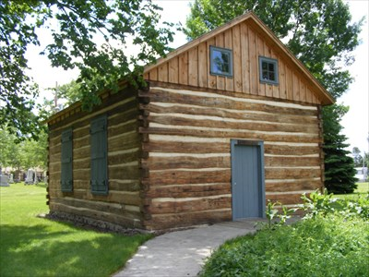
Our Story:
First Baptist Church of West Allis
8. The Early Years of Greenfield Baptist Church

Slide 2
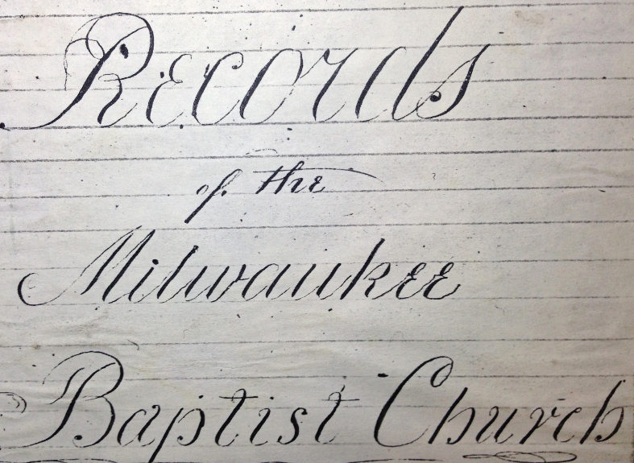

Slide 3
11/2/1839

Slide 4
1/12/1839

Slide 5
1/12/1839

Slide 6
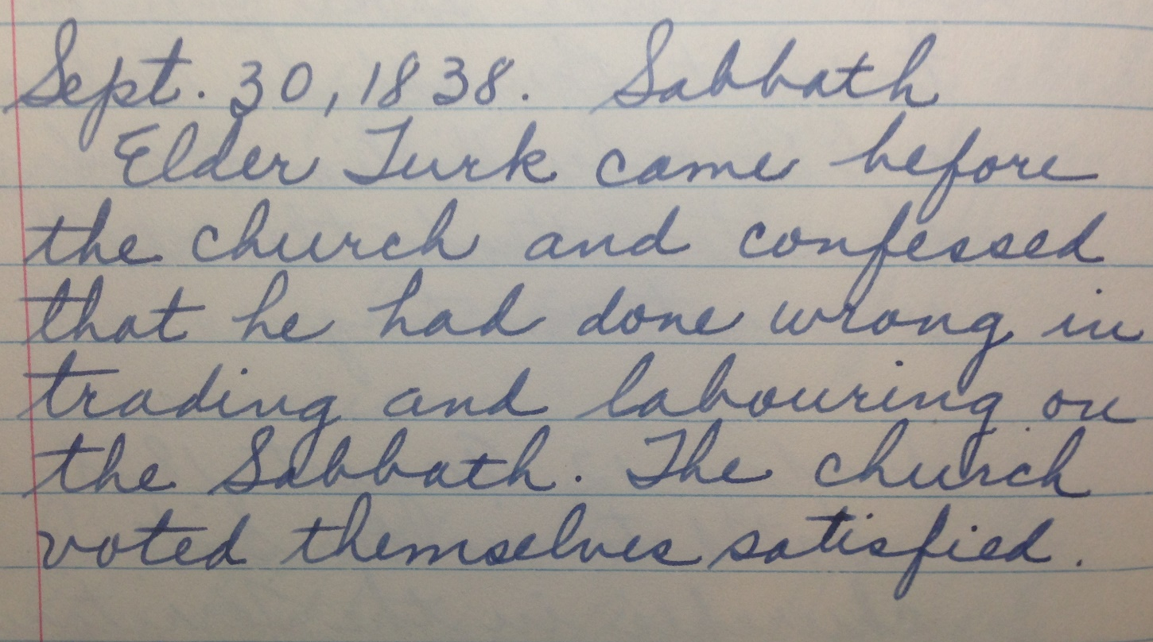

Slide 7
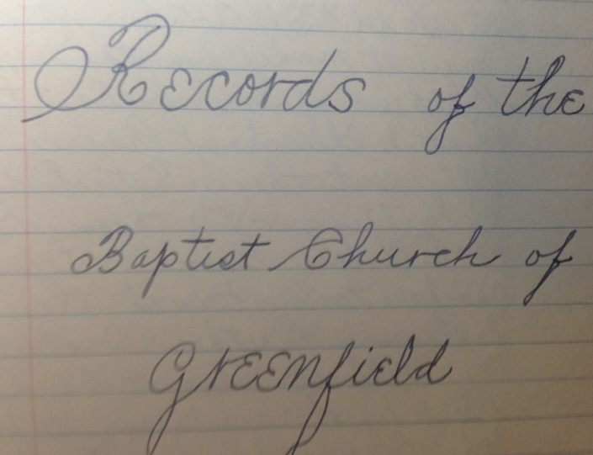

Slide 8
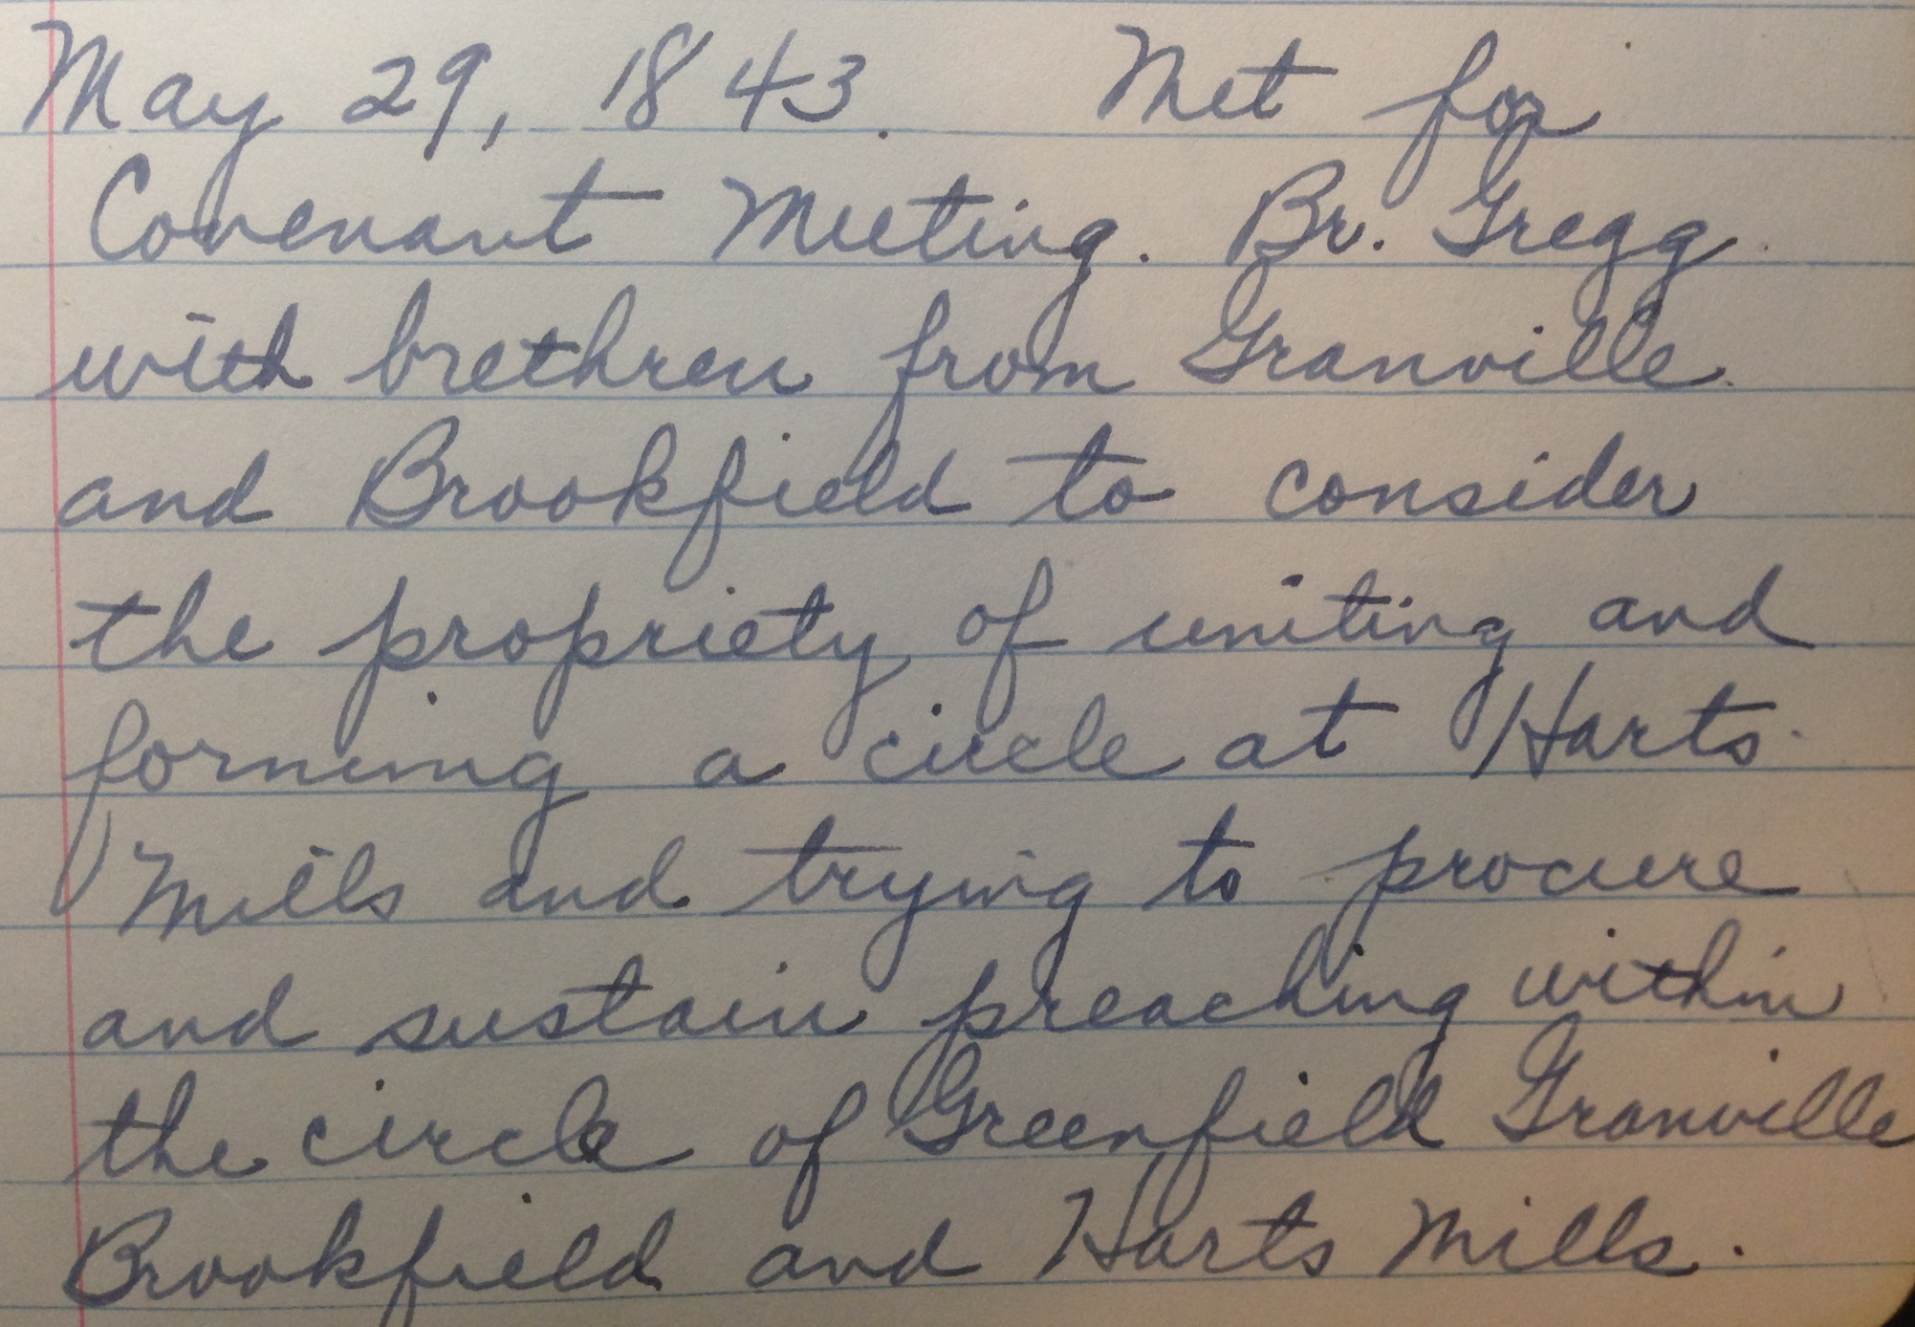

Slide 9
1844 Milwaukee County Plus Brookfield Township
Baptist “Church” Locations
Granville
Wauwatosa
Brookfield
Greenfield
Milwaukee

Slide 10
1859
Barker Road
Goerke's Corners
Brookfield Road
Bluemound Road

Slide 11
11/24/1844 Resolutions
Name: Baptist Church of Greenfield and Brookfield.

Slide 12
11/24/1844 Resolutions
Name: Baptist Church of Greenfield and Brookfield.
Harts Mills is the center for all covenant meetings.

Slide 13
11/24/1844 Resolutions
Name: Baptist Church of Greenfield and Brookfield.
Harts Mills is the center for all covenant meetings.
Brethren may hold as many prayer experiences, communications, and conference meetings as they choose and as many places as deemed proper.

Slide 14
11/24/1844 Resolutions
Name: Baptist Church of Greenfield and Brookfield.
Harts Mills is the center for all covenant meetings.
Brethren may hold as many prayer experiences, communications, and conference meetings as they choose and as many places as deemed proper.
Preaching is proportioned based on wants and funding.

Slide 15
11/24/1844 Resolutions
Name: Baptist Church of Greenfield and Brookfield.
Harts Mills is the center for all covenant meetings.
Brethren may hold as many prayer experiences, communications, and conference meetings as they choose and as many places as deemed proper.
Preaching is proportioned based on wants and funding.
Building committee named to purchase or build a parsonage.

Slide 16
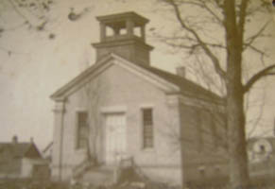
Wauwatosa (1858)
North Ave
Wauwatosa Ave

Slide 17
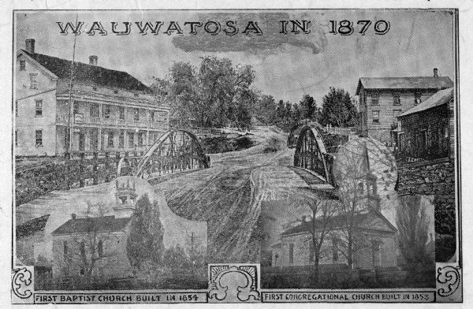

Slide 18
Wauwatosa (1858)
North Ave
Wauwatosa Ave

Slide 19
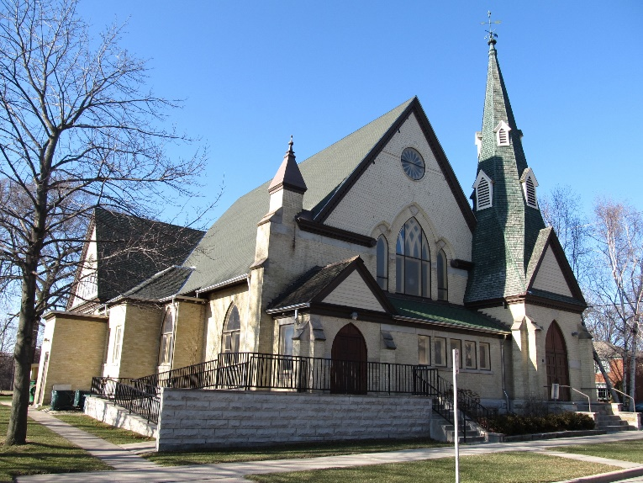
North Ave
(1876)

Slide 20
North Ave
(1876)

Slide 21
Our Story:
First Baptist Church of West Allis
End of history 8

