Slide 1
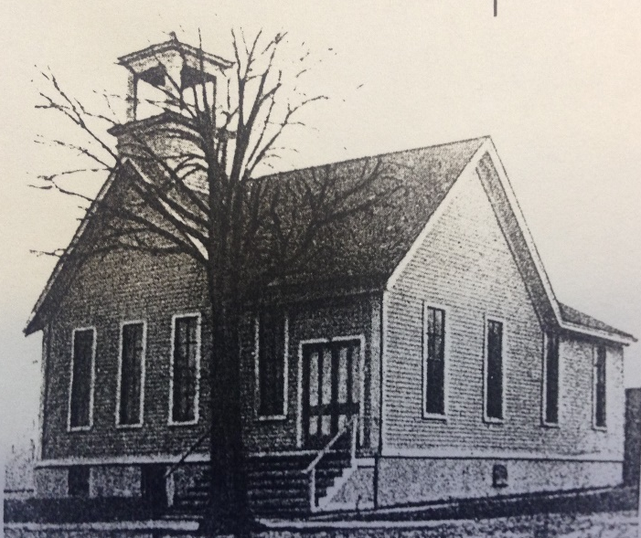
Our Story:
First Baptist Church of West Allis
17. Surge in growth;
North Greenfield becomes West Allis

Slide 2
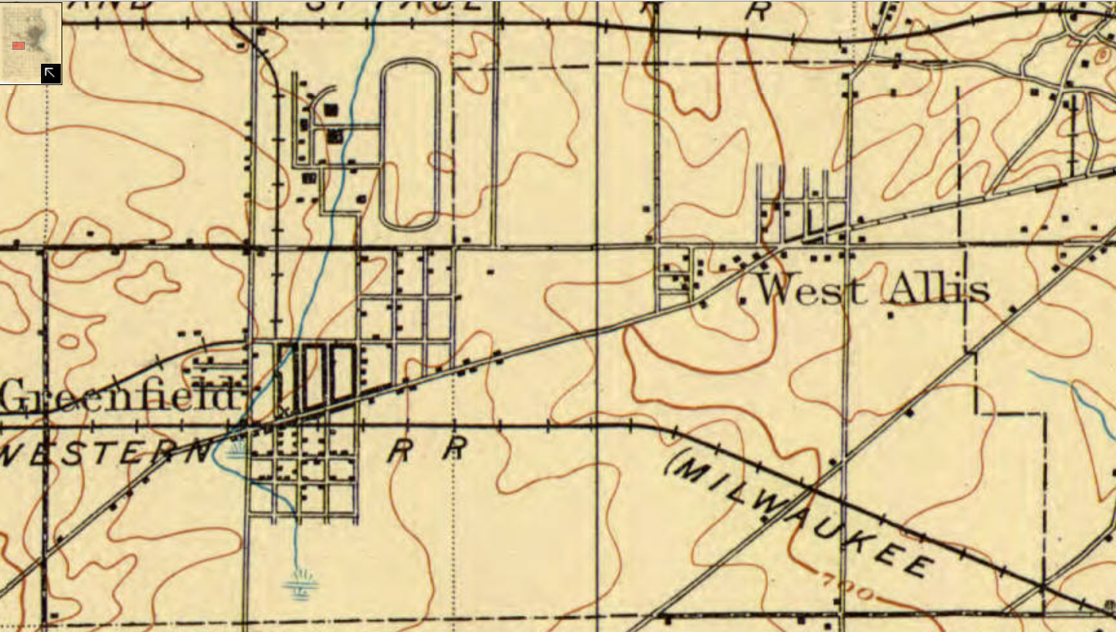
U.S. Geological Atlas (West Allis) 1906
4 Early Milwaukee County

Slide 3
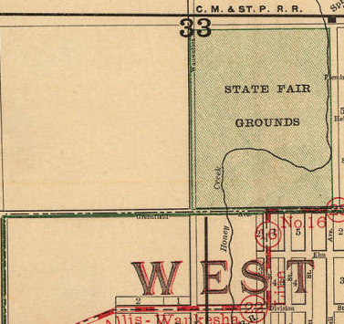
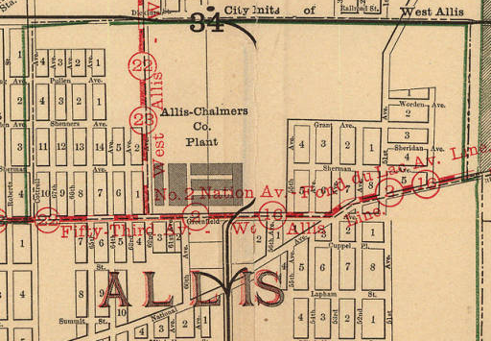
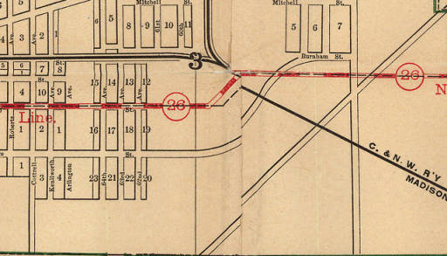
1905

Slide 4
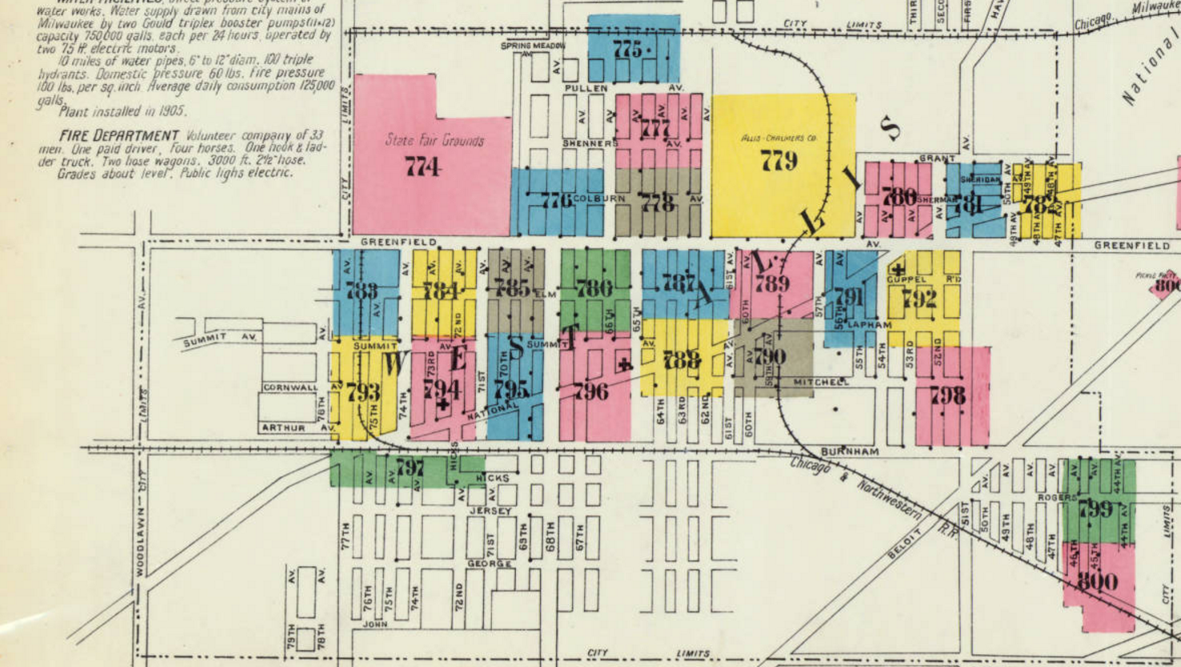
West Allis
Insurance
Map (1910)
National Ave
Greenfield Ave
77th Ave (84th St)
National Ave

Slide 5
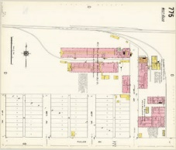
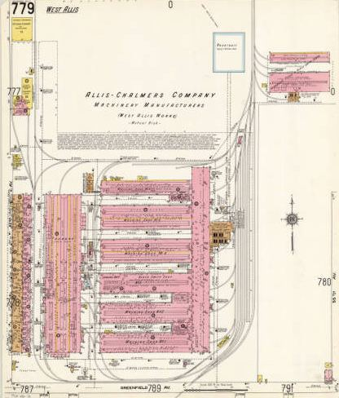
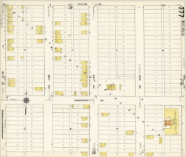
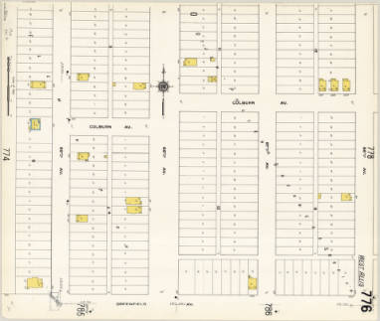
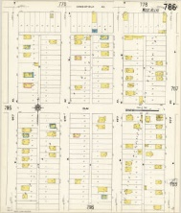
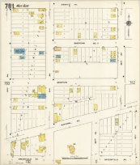
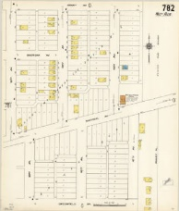
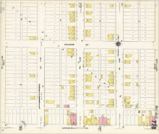
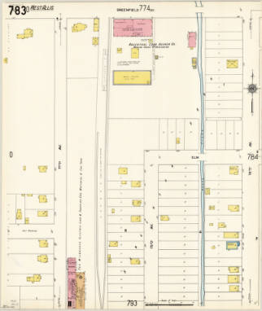
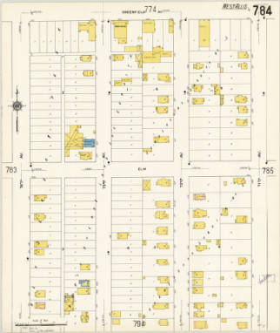
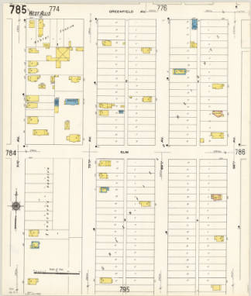
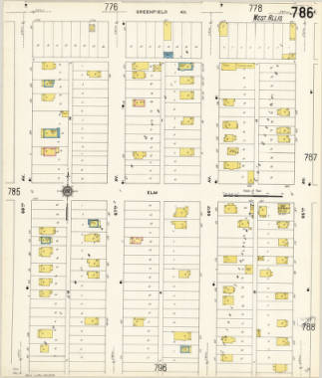
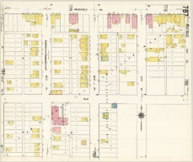
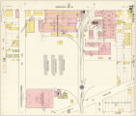
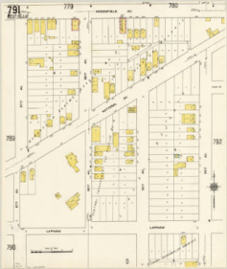
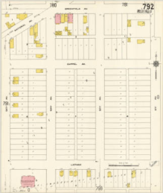
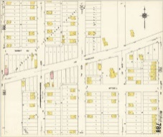
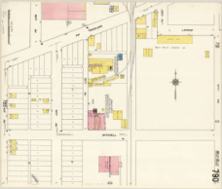
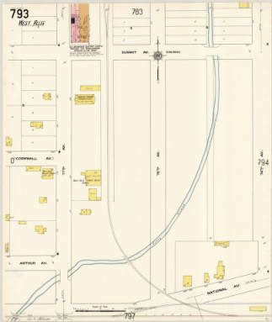
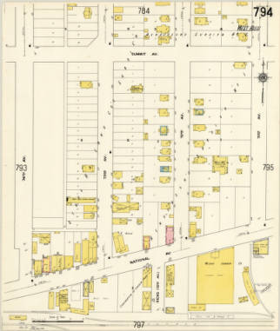
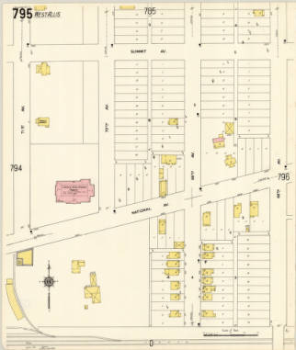
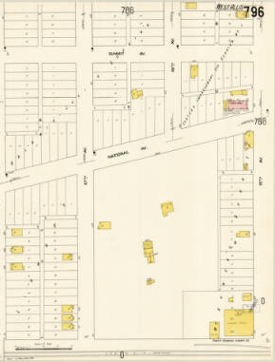
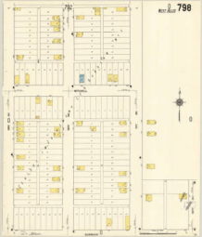
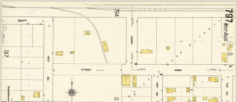
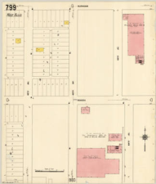
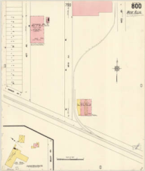
West Allis
Insurance Map (1910)
National Ave
Greenfield Ave
77th Ave (84th St)
National Ave
68th Ave (76th St)

Slide 6
1904

Slide 7
1904

Slide 8
Pastors of Greenfield Baptist Church
Rev H. E. Hoare 1891-1892
Rev George H. Ferris 1892-1892
Rev D. W. Hulbert 1892-1896
Rev C. B. Williams 1896-1897
Rev A. Goodwin 1897-1899
Rev James Blake 1899-1904
Rev Henry Dee Brown 1904-1905
Rev R. E. Cody 1905-1906
Rev W. E. Risinger 1907-1908
Rev David B. Cheney 1909-1912

Slide 9
Dec. 25, 1904
In taking up the work of this pastorate, it was with the hope of leading the church in a forward movement which would put it in a position of a large spiritual influence and serving in this growing community. There seems to be need for some church to take a decided forward step in full recognition of the new forces and opportunities which have in the last few years come to West Allis. I have however become convinced that the large vision and spiritual power necessary to such a forward movement is not in the church. I therefore resign the pastorate….

Slide 10
Dec 30th 1908
Dear Brethren and Sisters
I have tried to serve you as chairman of your Pulpit Committee for some weeks past. The time, anxiety, and prayerful labor I have experienced in this service you will never know, but as differences among us have multiplied and misunderstanding – even misinterpretation has become general, I herewith definitely and finally resign……… Very Fraternally,

Slide 13
Our Story:
First Baptist Church of West Allis
End of history 17

