Slide 1
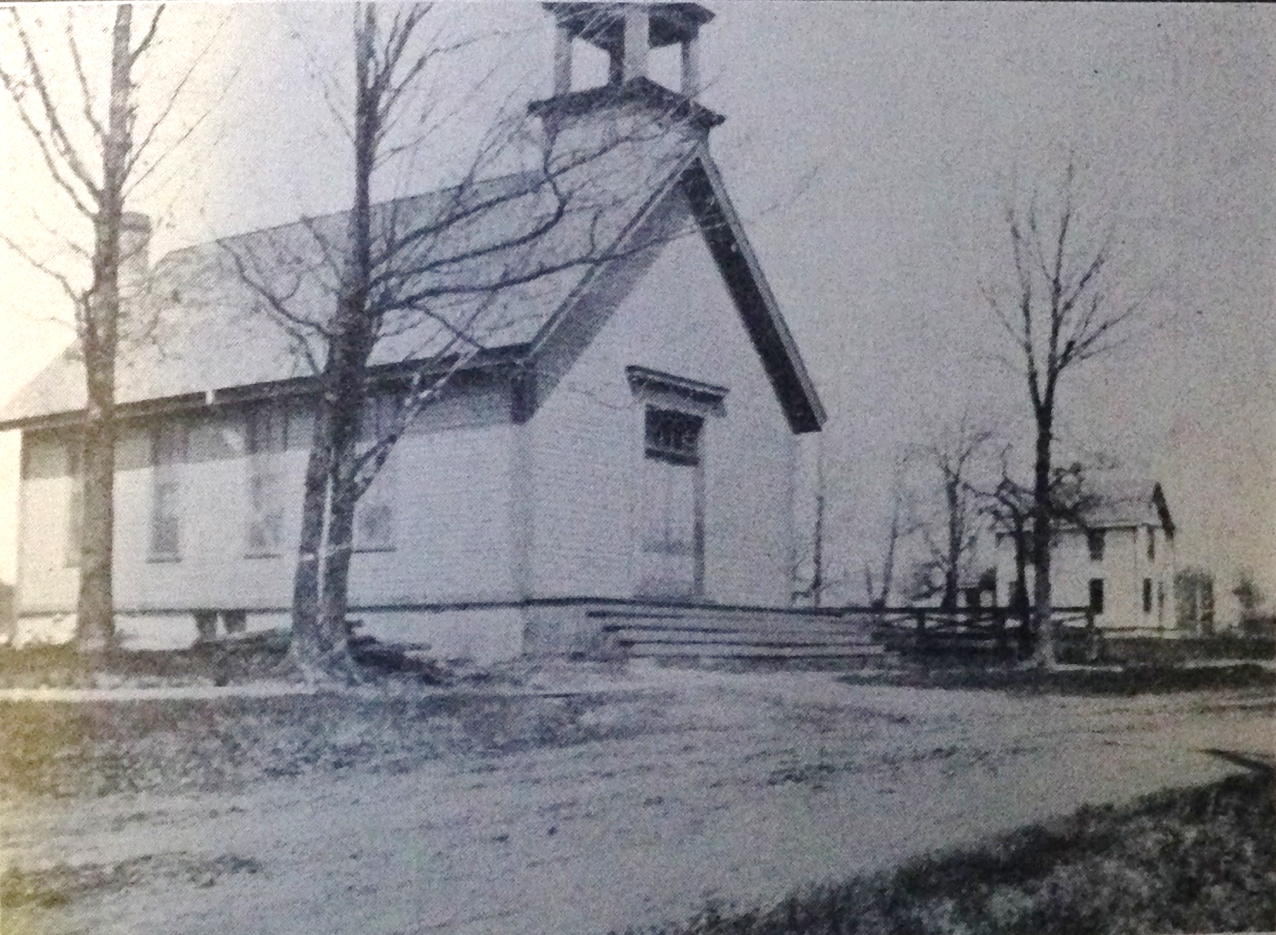
Our Story:
First Baptist Church of West Allis
13. The Strong Family connection
15th to 19th Centuries

Slide 2
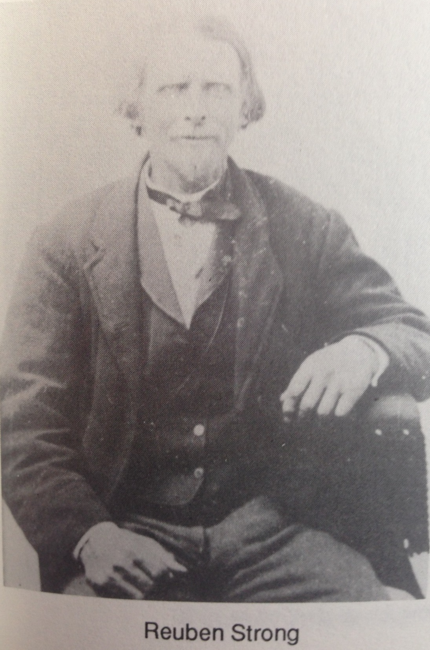
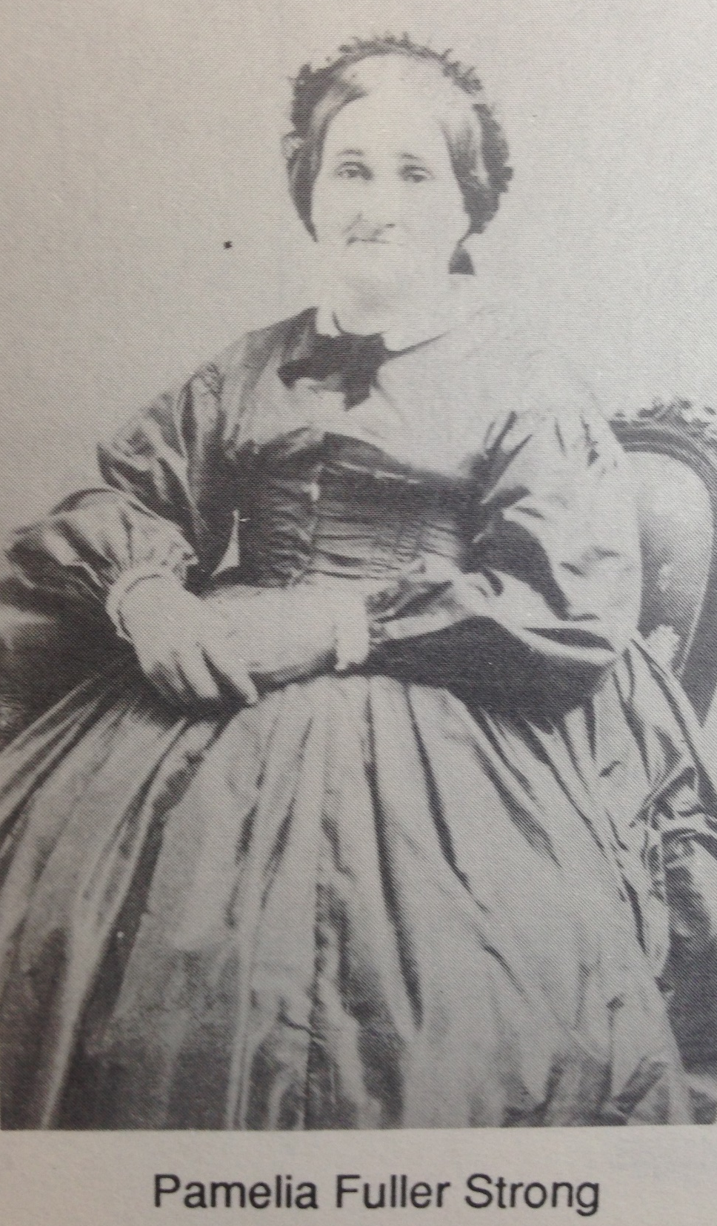

Slide 3
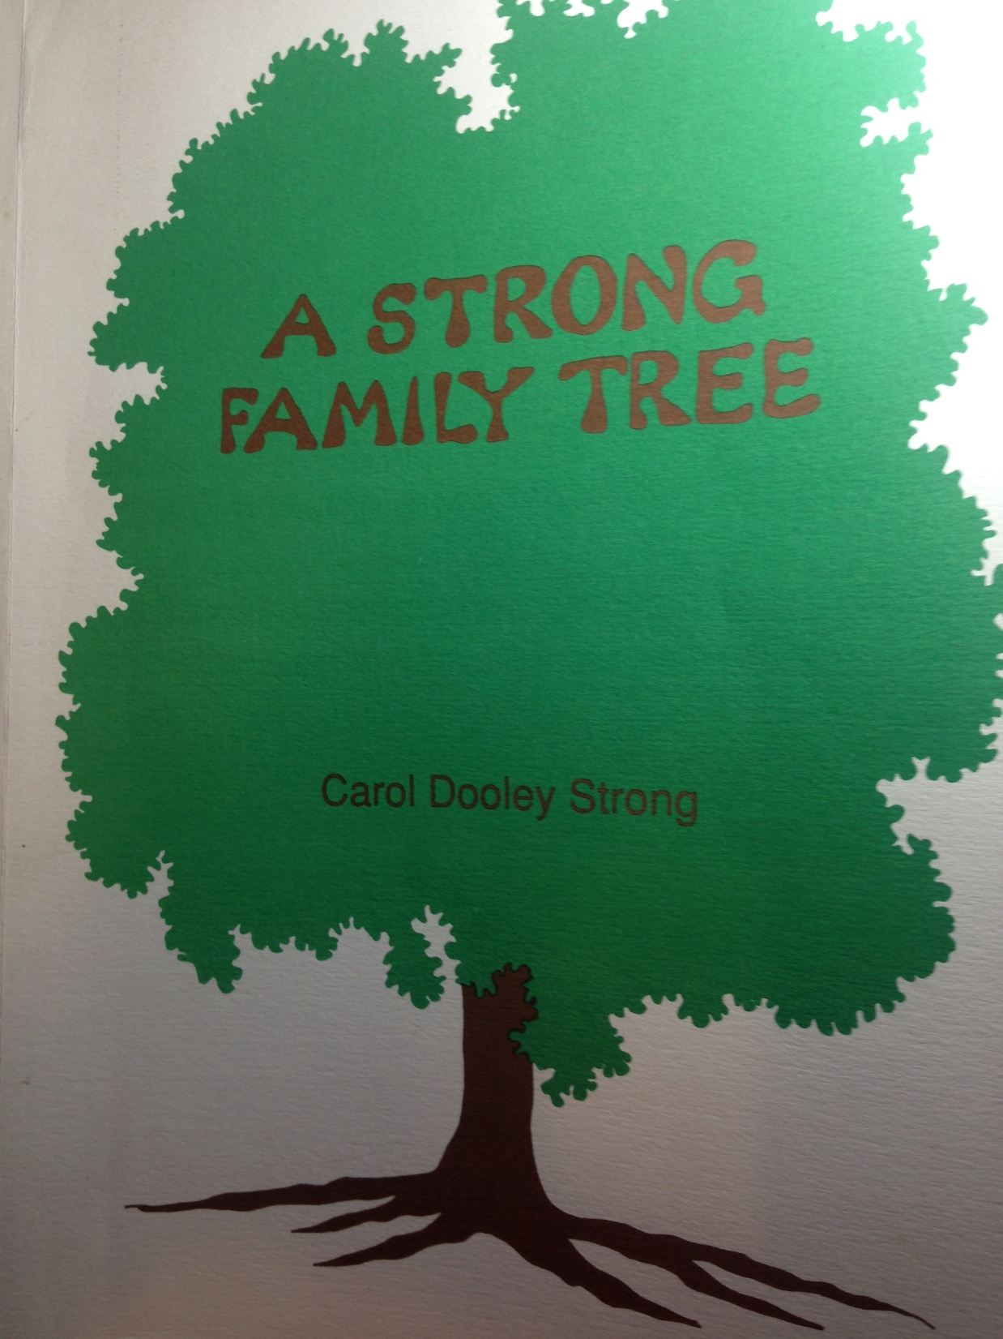

Slide 4
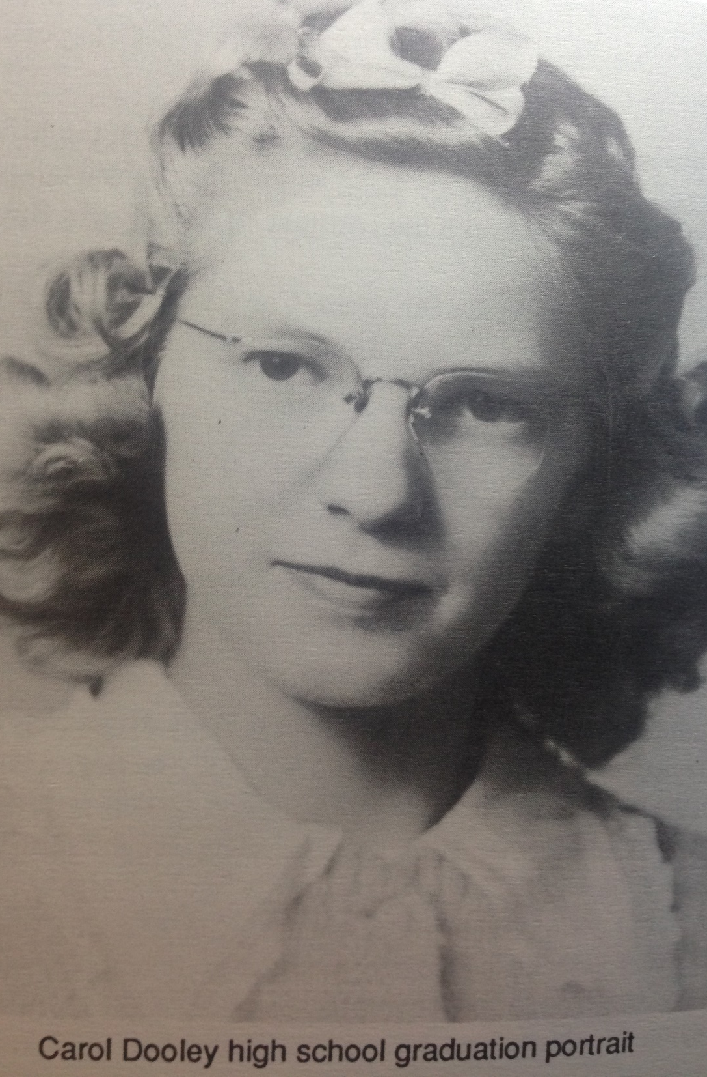

Slide 5
Male Lineage of the West Allis Strong Family
Forefather Strong
1460–1520
Birth 1460 • … England
Death 1520 • … England
John Strong
1585–1613
Birth • Chard, Somerset, England
Death • Wotton Courtnye, Somerset, Eng
Josiah Strong Jr
1709–1778
Birth • Colchester, New London, CT, USA
Death • Colchester, New London, CT, USA
Robert Strong
1490–1519
Birth • Berminster,Dorset,England
Death • Somerset, , England
John Strong Sr
1605–1699
Birth • Taubton or Chard, Somerset, Eng
Death • Northampton, Hampshire Cty, MA
Benjamin Strong
1759–1817
Birth • Colchester, New London, CT, USA
Death • Chatham, Middlesex, CT, USA
John Strong
1515–1534
Birth • Taunton,Somerset,England
Death • Sommersetshire, , , England
John Strong Jr
1626–1697
Birth • Keynsham or Chard, Somerset, Eng
Death • Windsor, Hartford, CT, US
Ansel (Ansyl) Strong
1789–1871
Birth • Chatham, Middlesex, CT, USA
Death • Otisco, Onondaga, NY, USA
George Strong
1556–1636
Birth • Chardstock, Somerset, England
Death • Chard, Somerset, , England
Josiah Strong
1678–1759
Birth • Windsor, Hartford, CT, USA
Death • Colchester, New London, CT, USA
Reuben Beecher Strong
1815–1889
Birth • Vesper, Onondaga, New York, USA
Death • No Greenfield, Milwaukee Cty, WI

Slide 6
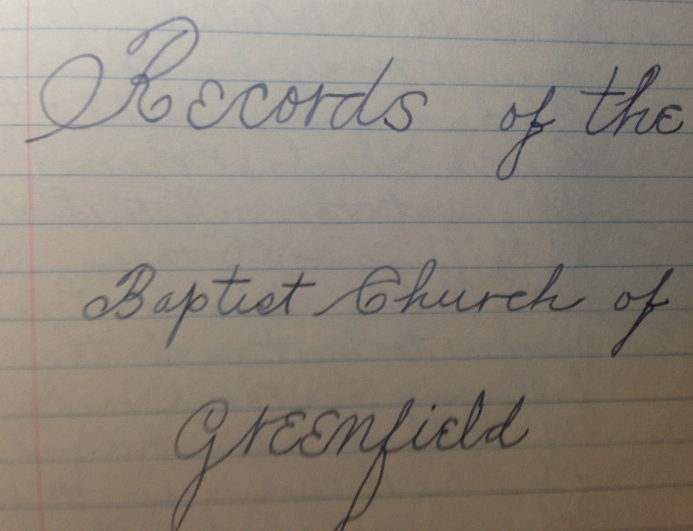
9/15/1849

Slide 7
North Greenfield, Wis. — There seems to be an unusual scarcity of birds here, tho I have not been able to be out in the field much. The usual flocks of Nighthawks and Whippoorwills went thru in August. Bluebirds seem to be common. A few Bob-whites are reported now. There is a close season for a few years, and sportsmen have been "planting" them in this vicinity and out thru the state. They were practically extinct here a few years ago.

Slide 8
Dividing the SW 1/4 of Section 4(Strong’s 160 Acres)
1858

Slide 9
Dividing the SW 1/4 of Section 4(Strong’s 160 Acres)
1858
1876

Slide 10
Dividing the SW 1/4 of Section 4(Strong’s 160 Acres)
1858
1876
1889
Ansel
Jane
Harriet
Coley
Myron

Slide 11
RUBEN STRONG’s FARM TODAY
Railroad
Burham St
Becher St
89th St
84th St
National Ave
92nd St
Lincoln Ave

Slide 12
Our Story:
First Baptist Church of West Allis
End of history 13

