Slide 1
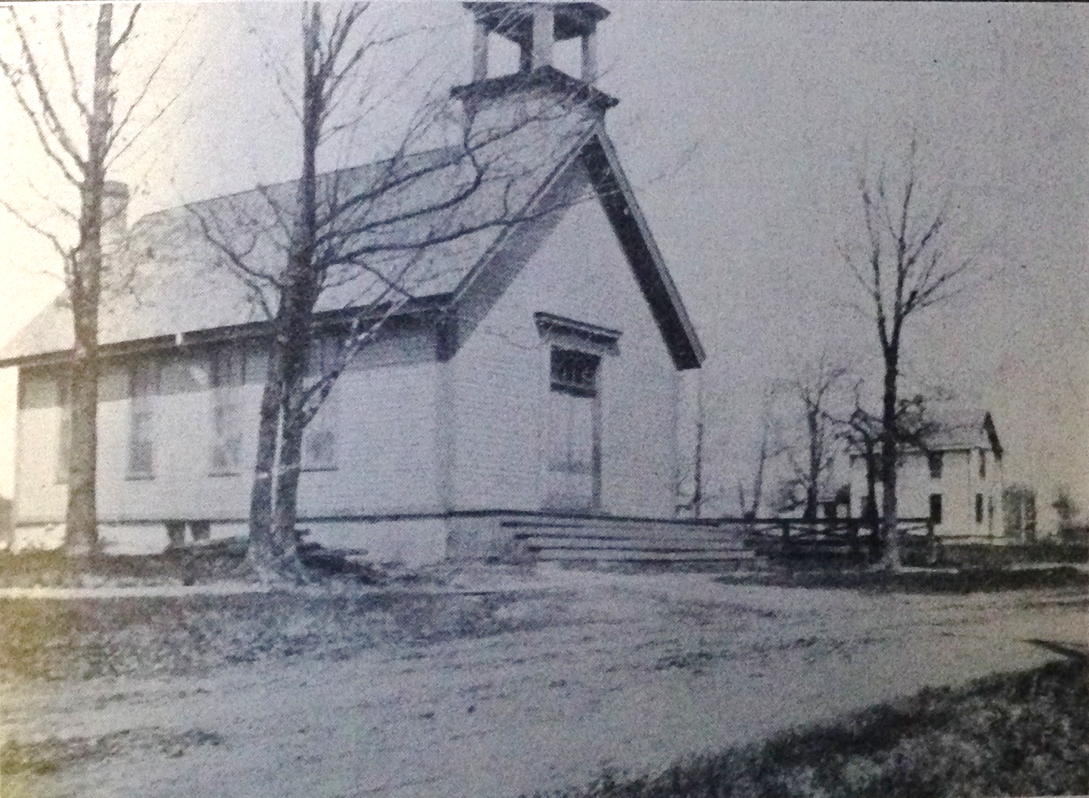
Our Story:
First Baptist Church of West Allis
14. The CNW Railroad Spur Track Forces the Church to Move (1886)

Slide 2
Milwaukee is Growing
1853
1880

Slide 3
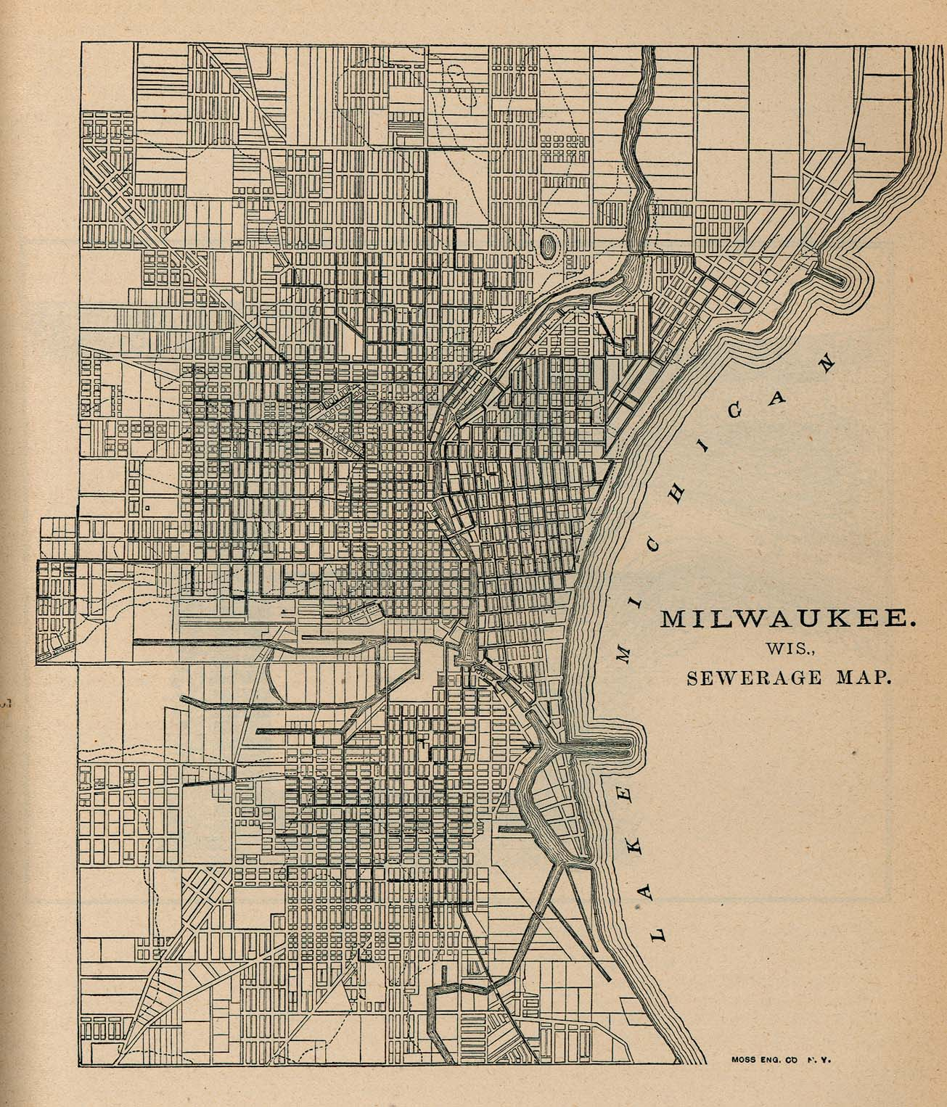
Milwaukee Sewers (1880)

Slide 4
North Greenfield Sewers (1880)

Slide 5
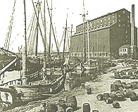

Slide 6
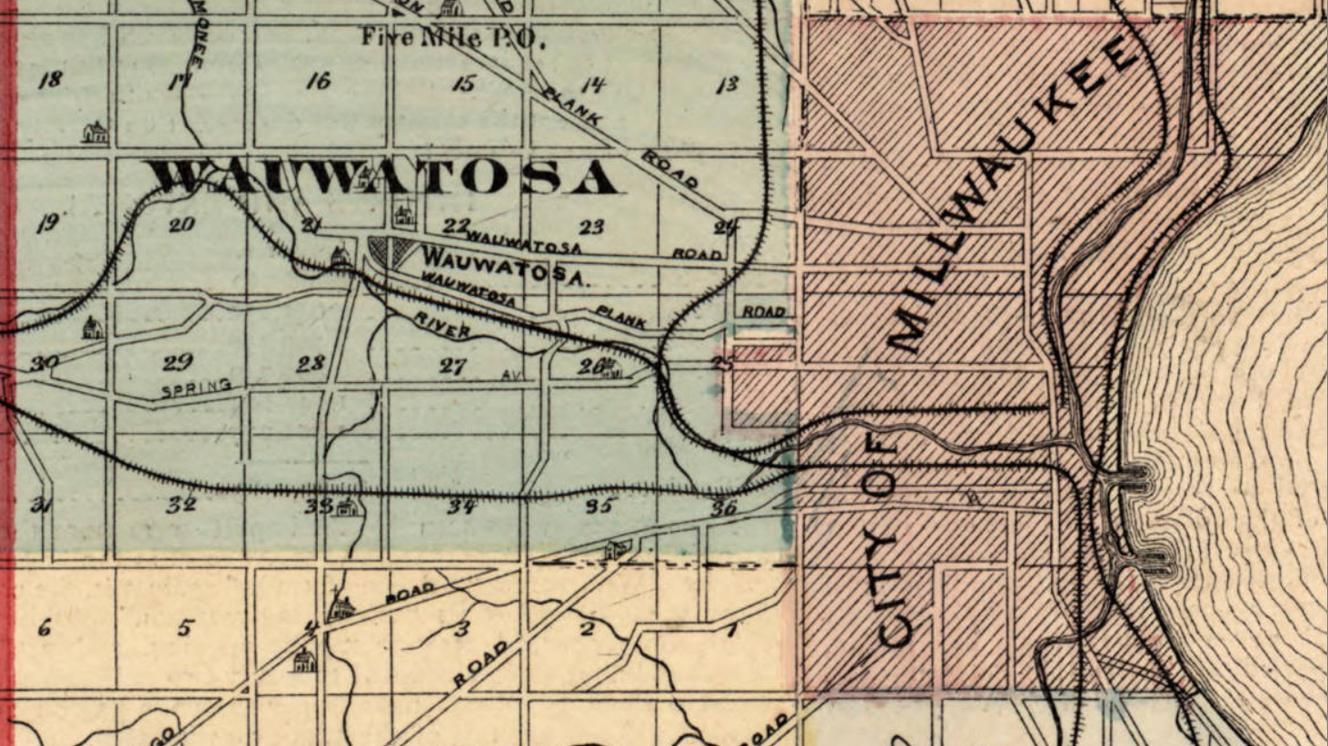
1876
North Greenfield

Slide 7
1876
Honey Creek/North Greenfield

Slide 8
1891 Map Showing
North Greenfield
Post Office and Station

Slide 9
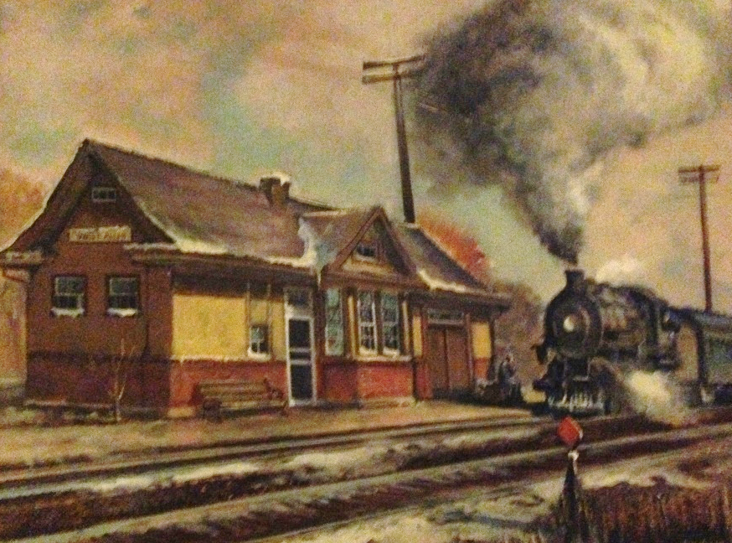

Slide 10
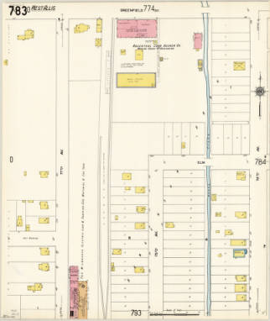
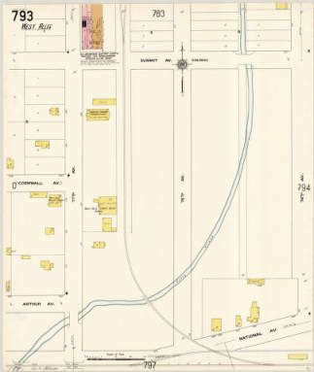
Rail Siding Forces Move
Greenfield Ave
Elm St (Orchard St)
76th Ave (83th St)
77th Ave (84th St)
Summit Ave (Lapham St)
Cornwall Ave (Mitchell St)
National Ave
C&NW RR
North Greenfield

Slide 11
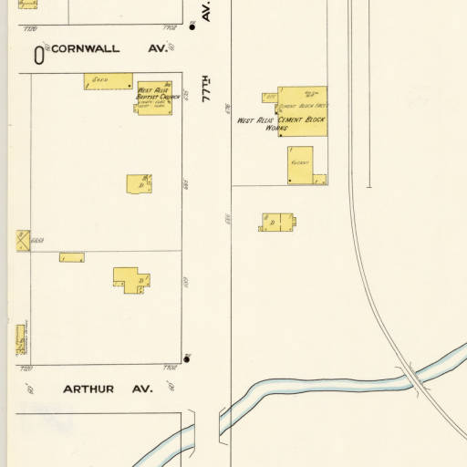
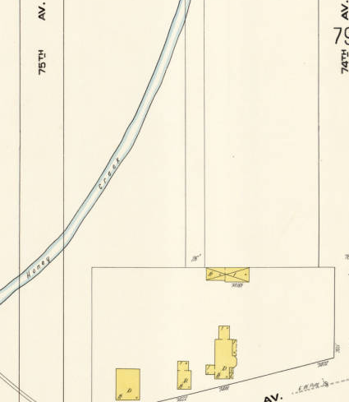
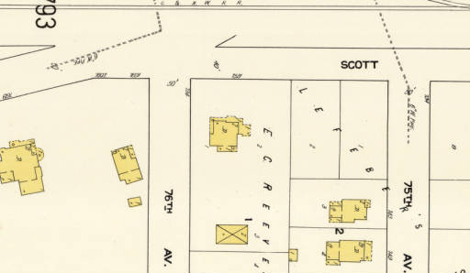
“The Move”
Cornwall Ave (Mitchell St)
National Avenue
77th Ave (84th St)
1910 map of 1886 move

Slide 12
Pastors of Greenfield Baptist Church
}
Rev W Fenton
Rev Caldwell 1873-1891
Rev E. O. Smith (supplies)
Rev D. W. Hulburt
Rev H. E. Hoare 1891-1892
Rev G. H. Ferris 1892-1892
Rev D. W. Hulbert 1892-1896
Rev C. B. Williams 1896-1897
Rev A. Goodwin 1897-1899
Rev James Blake 1899-1904

Slide 13
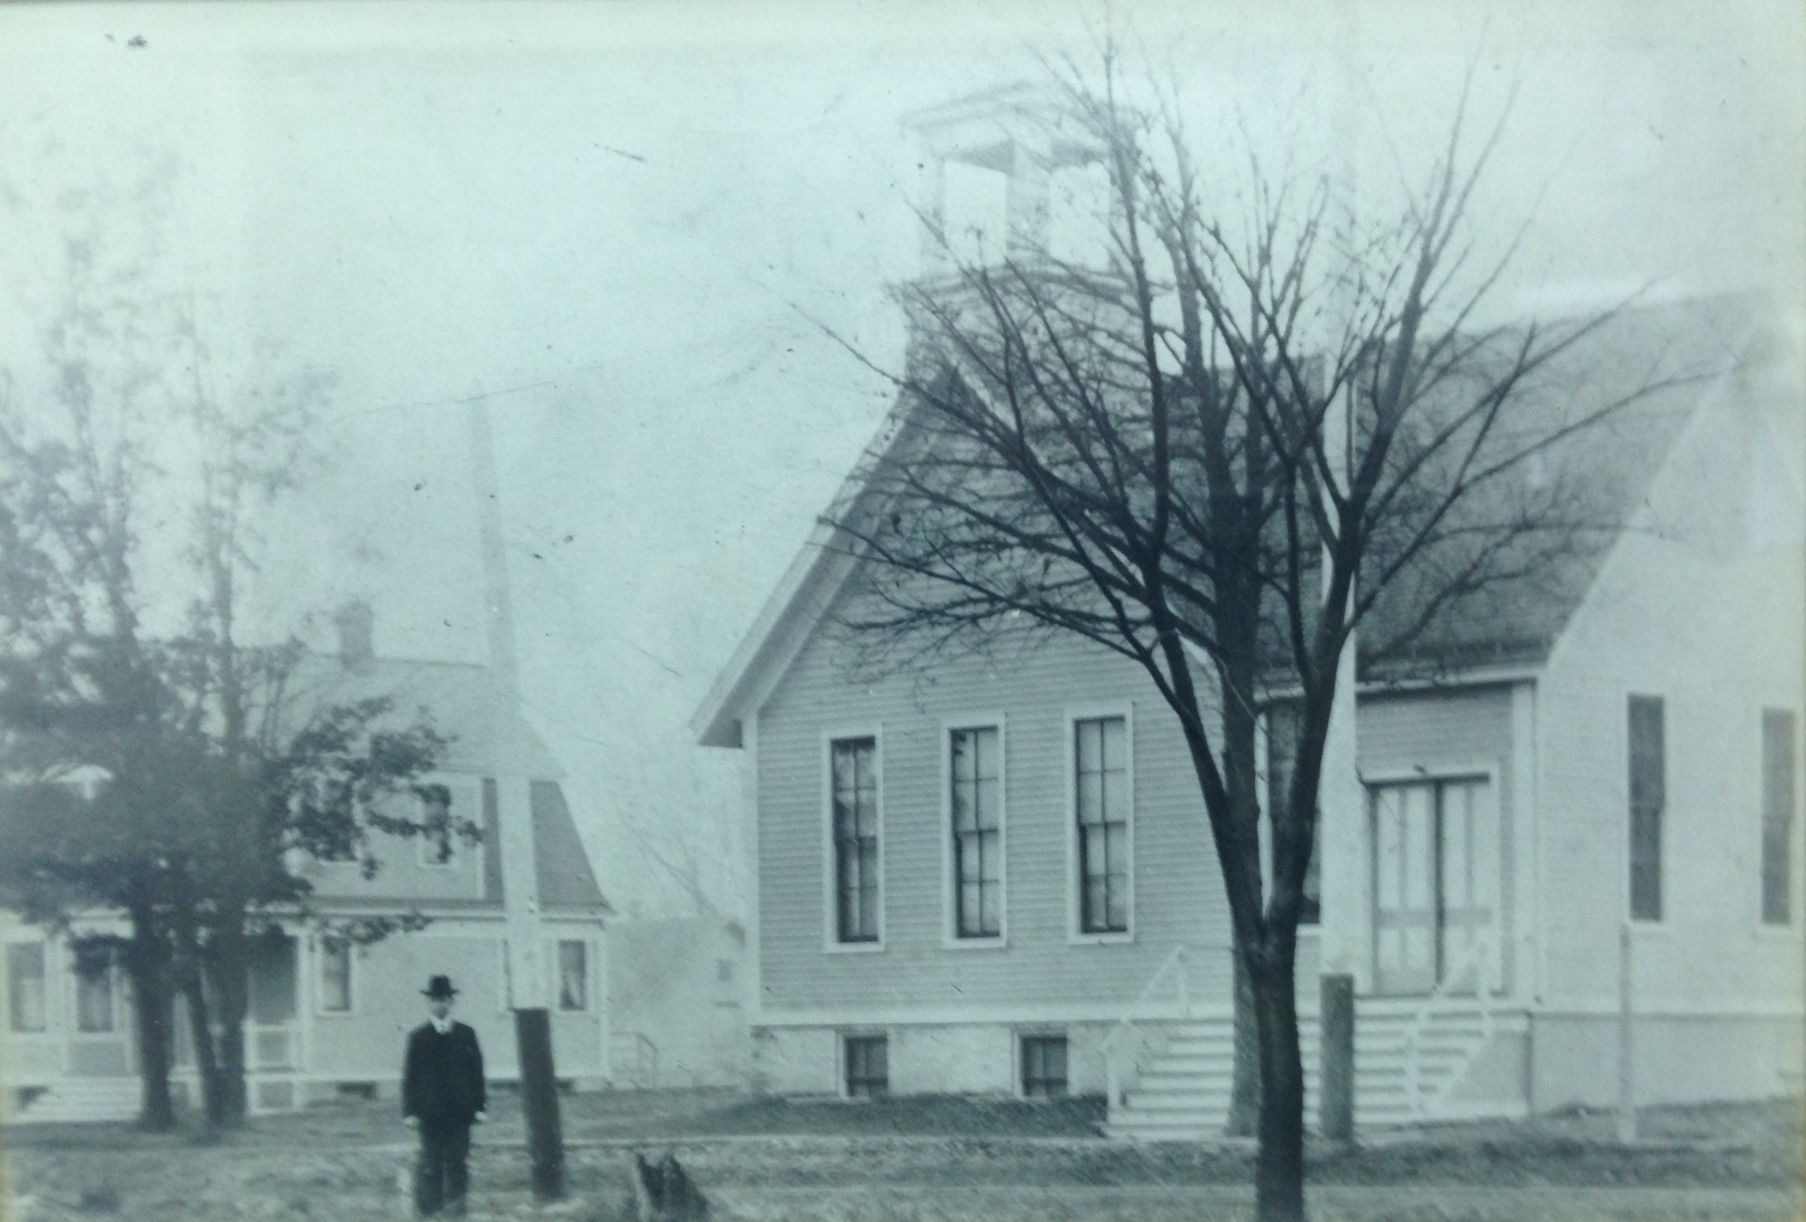
The Church about 1910

Slide 14
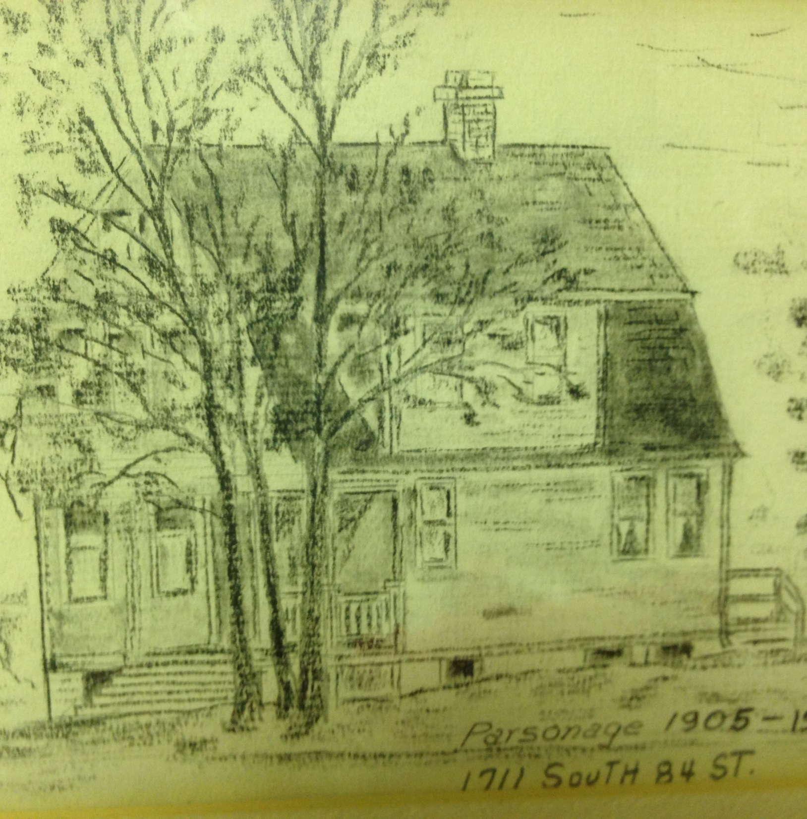
Parsonage
77th Avenue (84th Street)

Slide 15
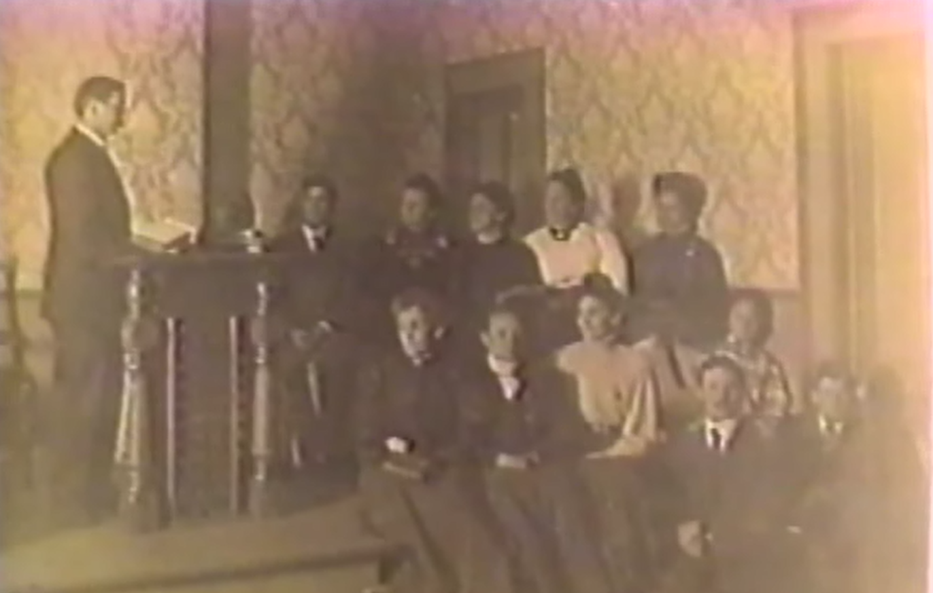

Slide 16
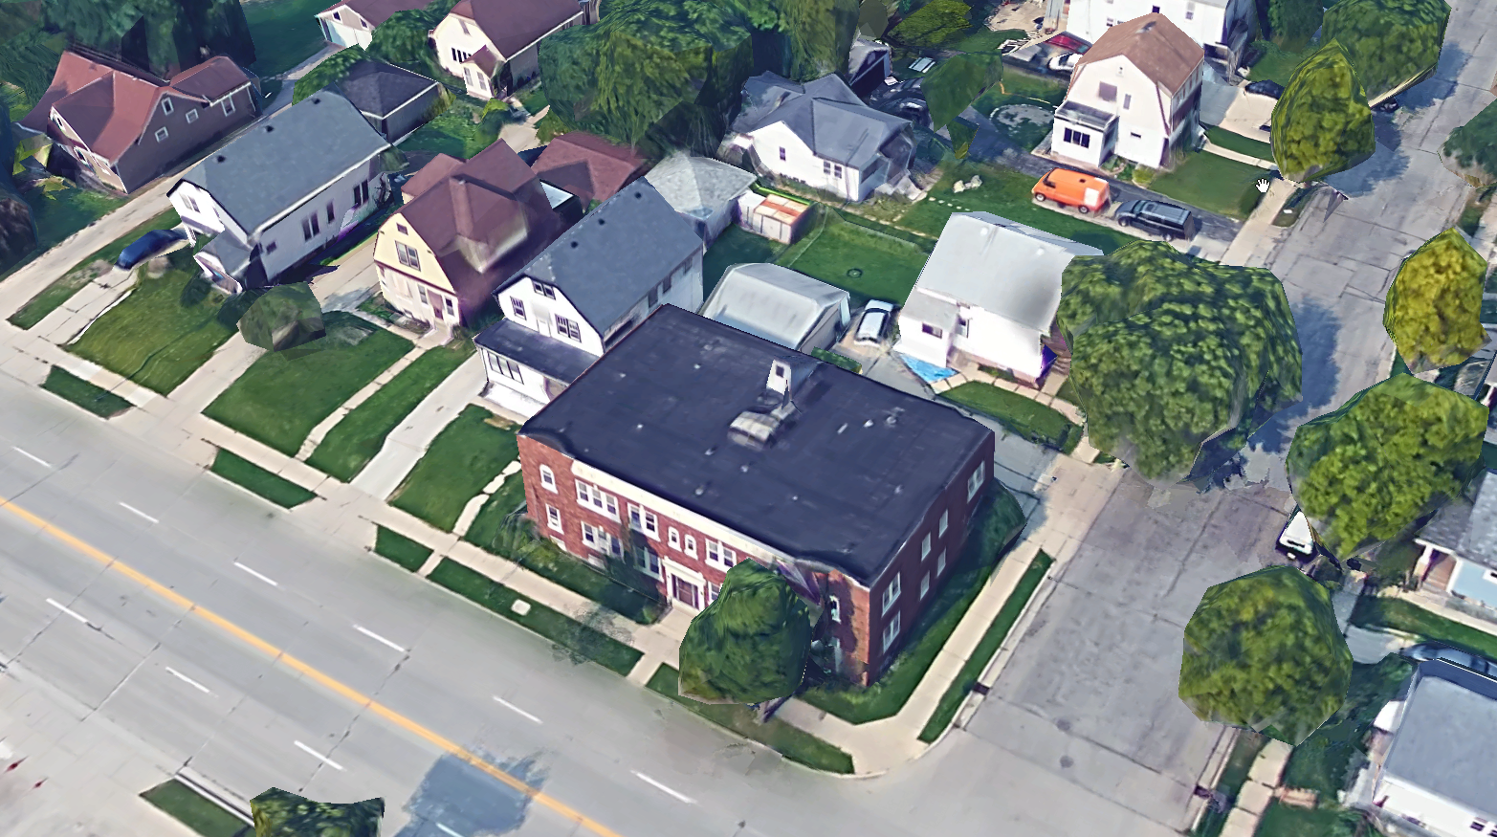
Parsonage
84th St
Mitchell St
Church

Slide 17
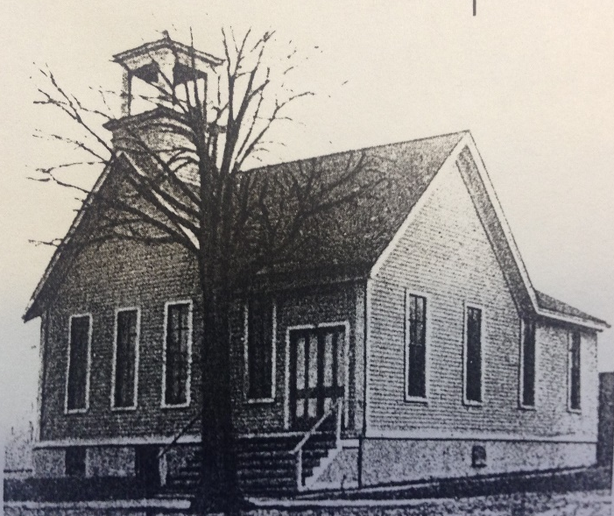
Our Story:
First Baptist Church of West Allis
End of history 14

