Slide 1
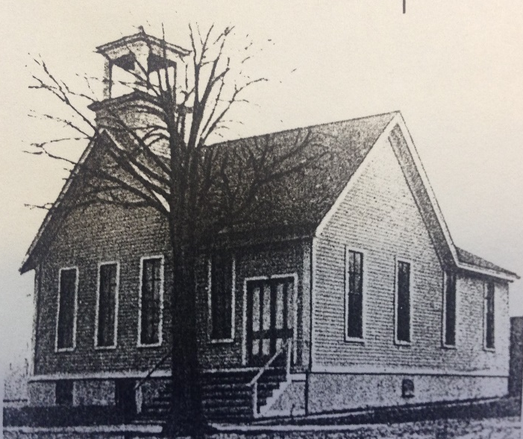
Our Story:
First Baptist Church of West Allis
16. Allis Chalmers needs a new home (1901)

Slide 3
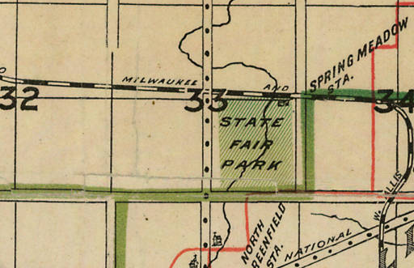
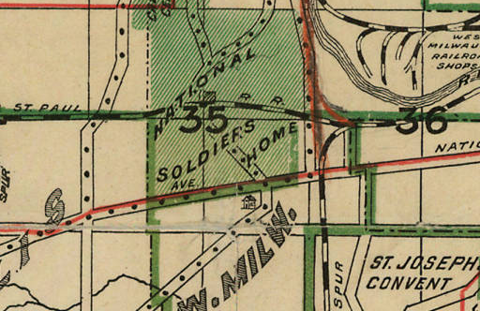
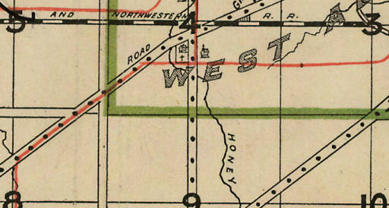
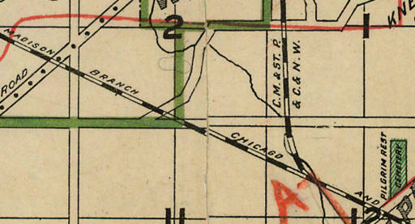
Allis Chalmers Manufacturing Company
1903

Slide 4
Allis Chalmers Manufacturing Company
1903

Slide 5
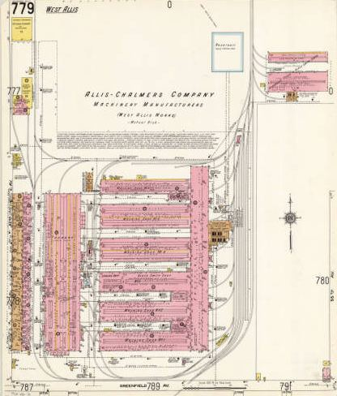
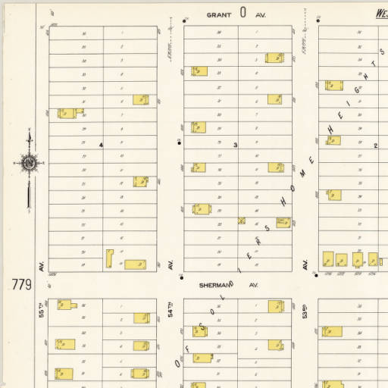
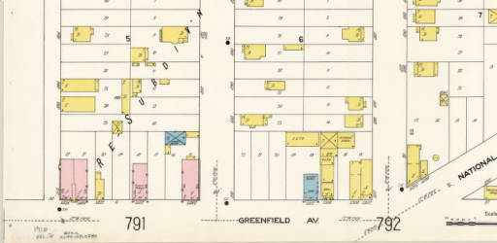
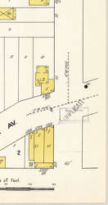
1910
62nd Avenue (70th Street)
Greenfield Avenue

Slide 6
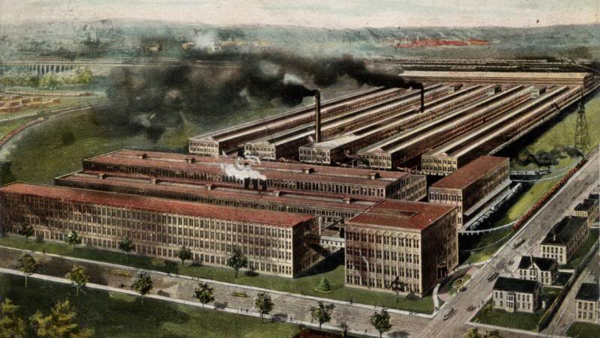
Allis-Chalmers Co., West-Allis Plant, Milwaukee, Wis
Greenfield Ave
62nd Ave (70th St)

Slide 7
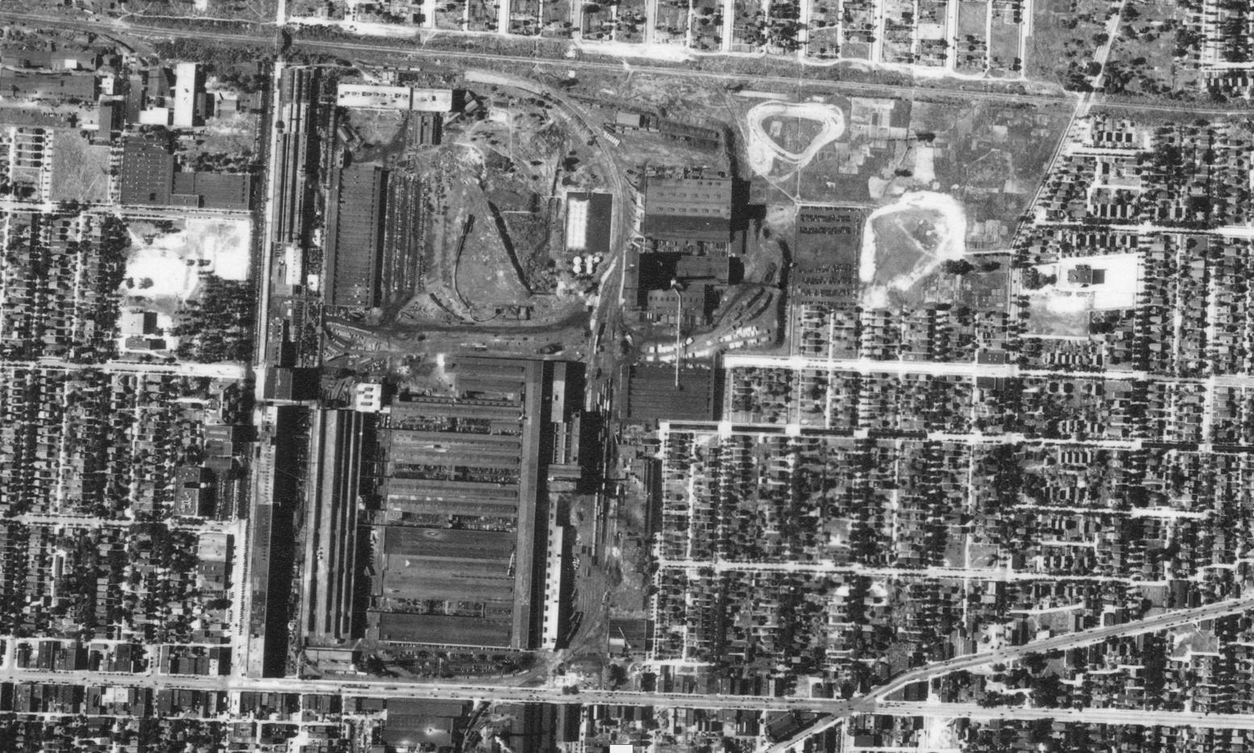
Milwaukee Road RR
Hawley Rd
A-C Complex (1937)
National Ave
70th St
Greenfield Ave

Slide 8
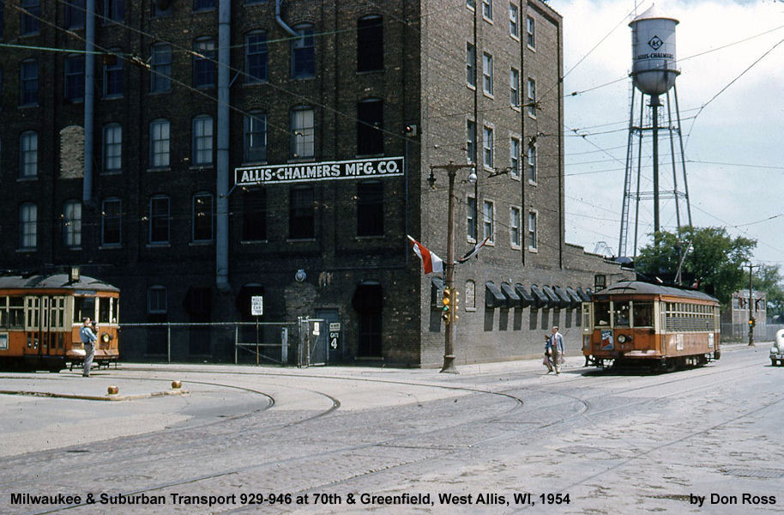
70th & Greenfield in 1956

Slide 9
70th & Greenfield in 1976

Slide 10
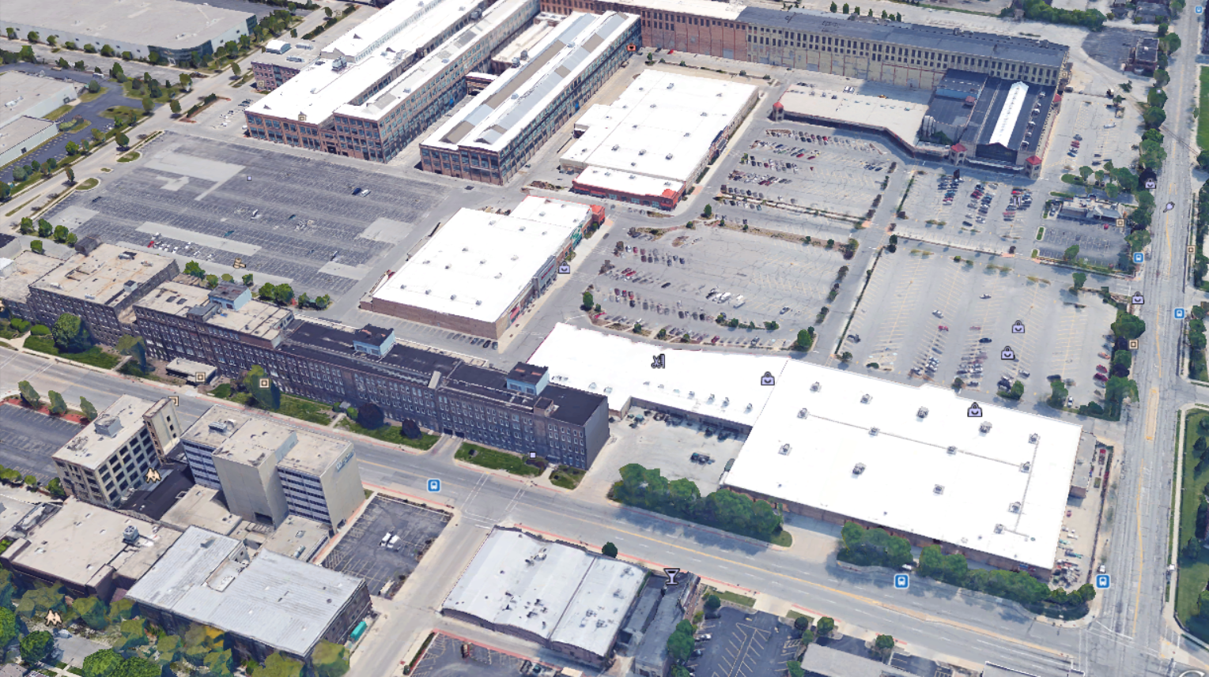
2016
Greenfield Ave
70th St

Slide 11
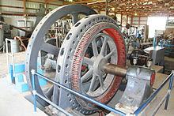
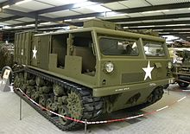
Allis-Chalmers
BIG time manufacturer

Slide 12
Our Story:
First Baptist Church of West Allis
End of history 16

