Slide 1
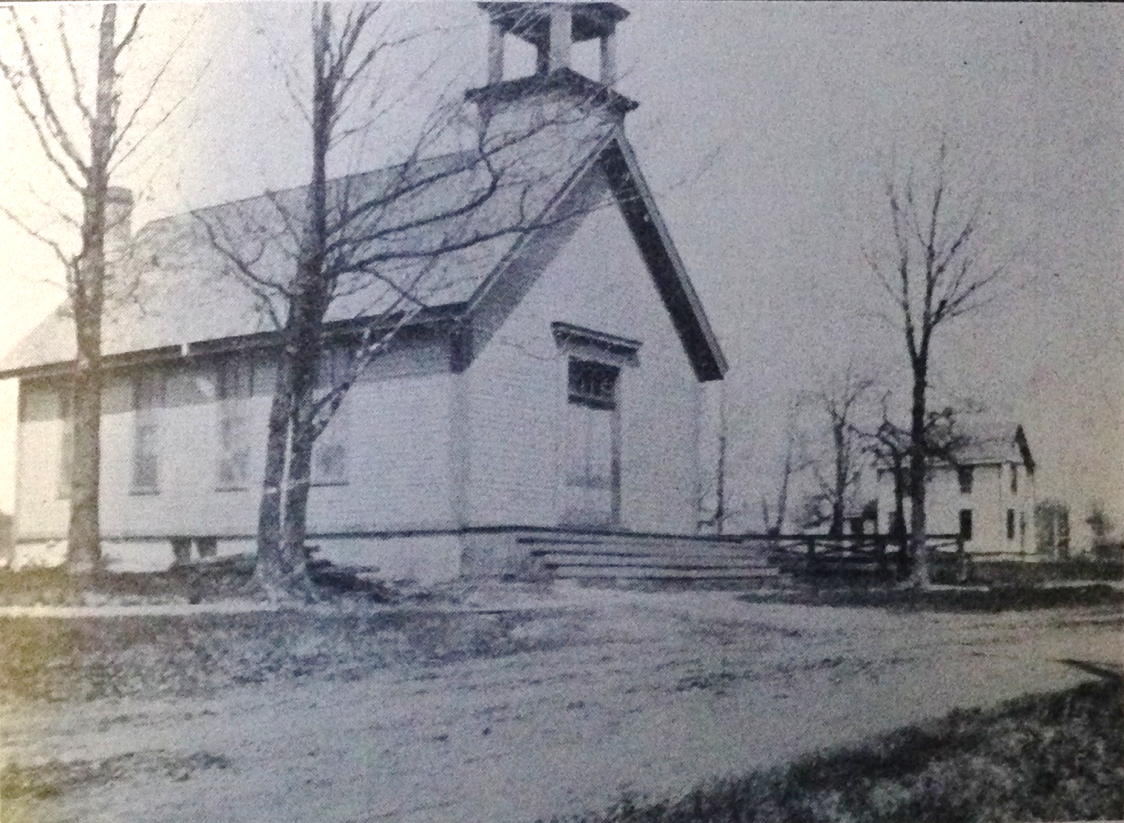
Our Story:
First Baptist Church of West Allis
12. Growth in The Area

Slide 2
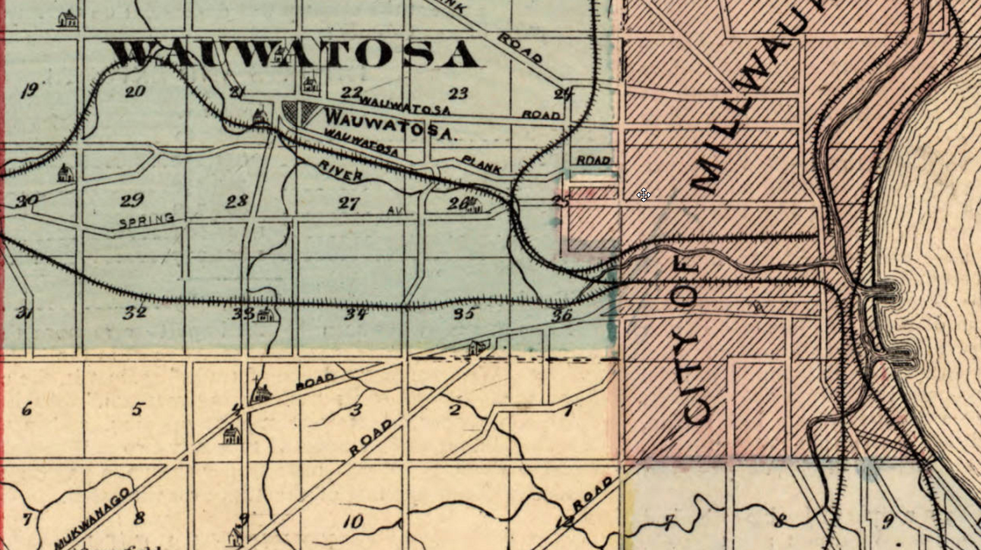
Milwaukee Area in 1854

Slide 3
1853

Slide 4
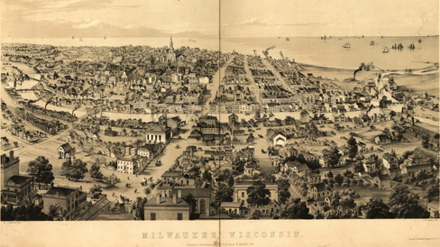
MILWAUKEE in 1854
Lake Michigan
Wisconsin St
Milwaukee River

Slide 5
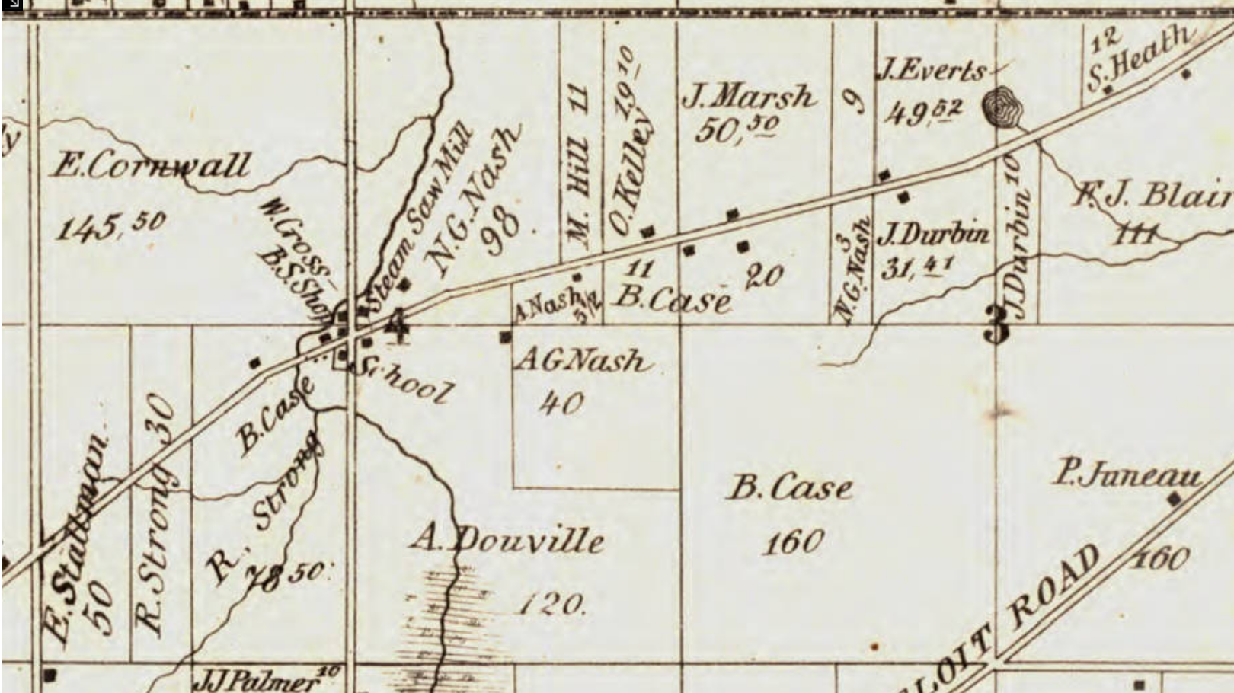
Honey Creek/North Greenfield in 1858

Slide 6
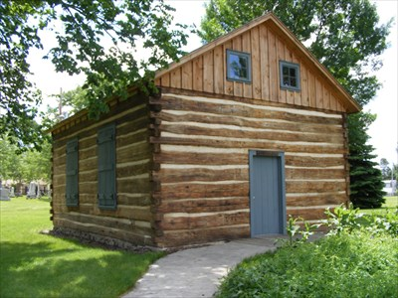
Log Cabin School Replica

Slide 7
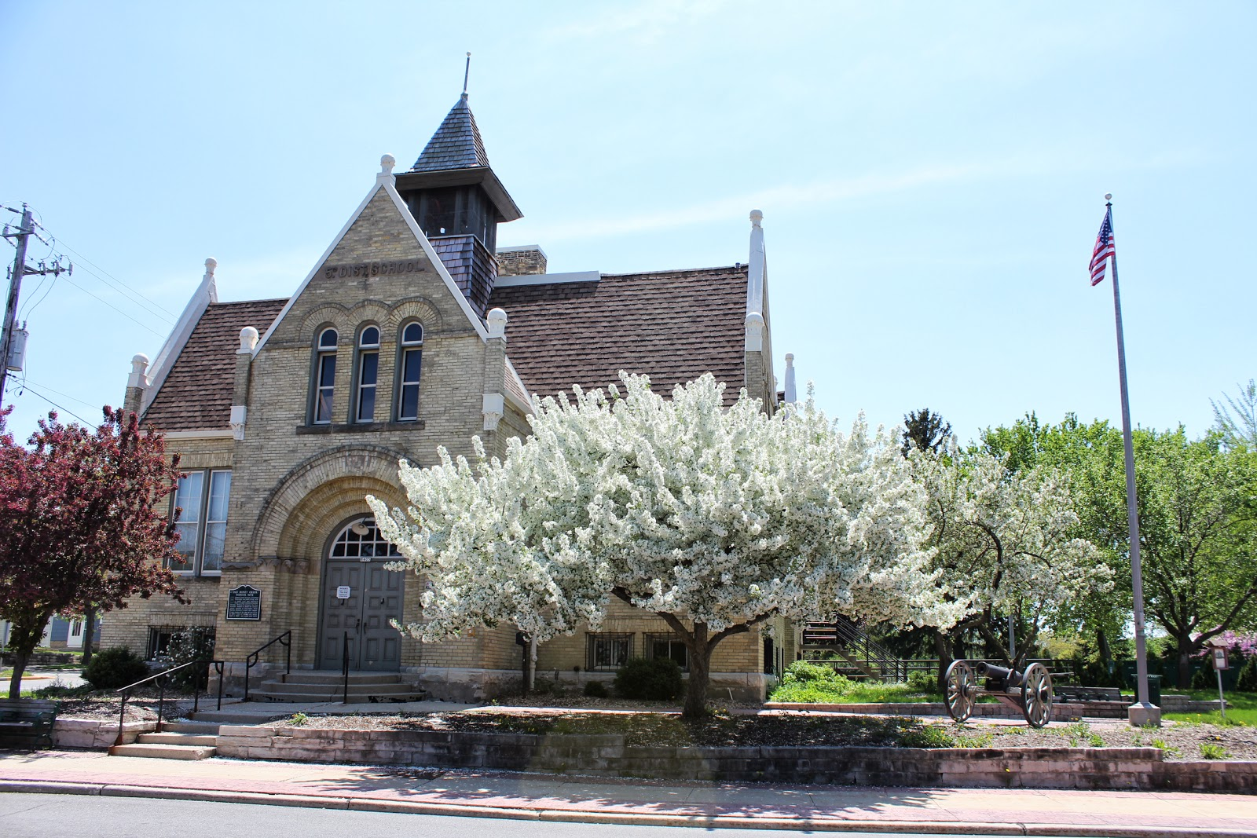
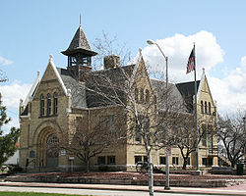
Former Garfield School

Slide 8
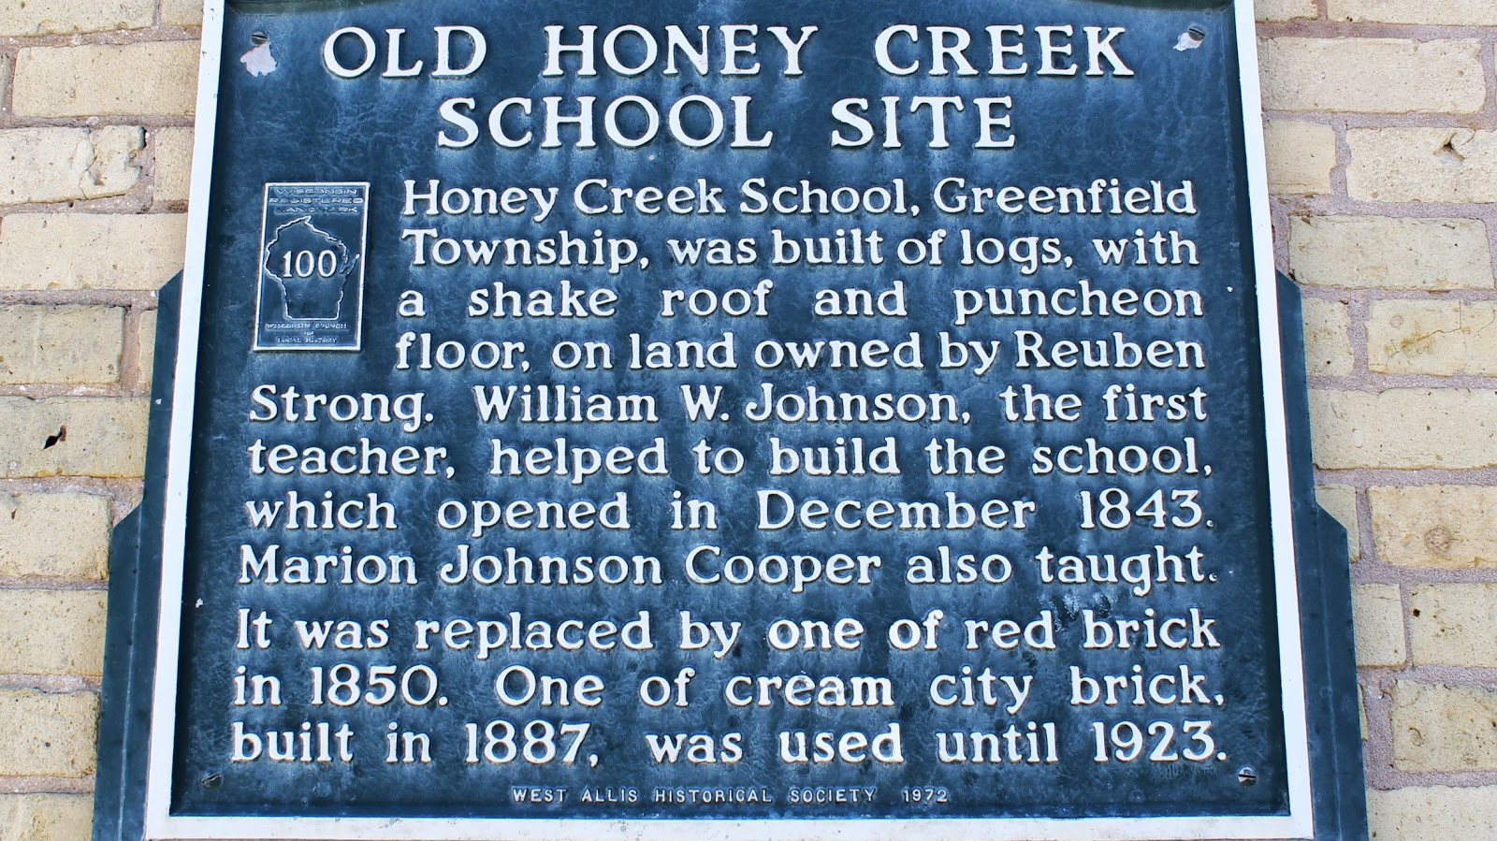

Slide 9
RUBEN STRONG’s FARM (1876)
77th Ave (84th St)
Mukwanago Road (National Ave)
77th Ave
Mukwanago Road

Slide 10
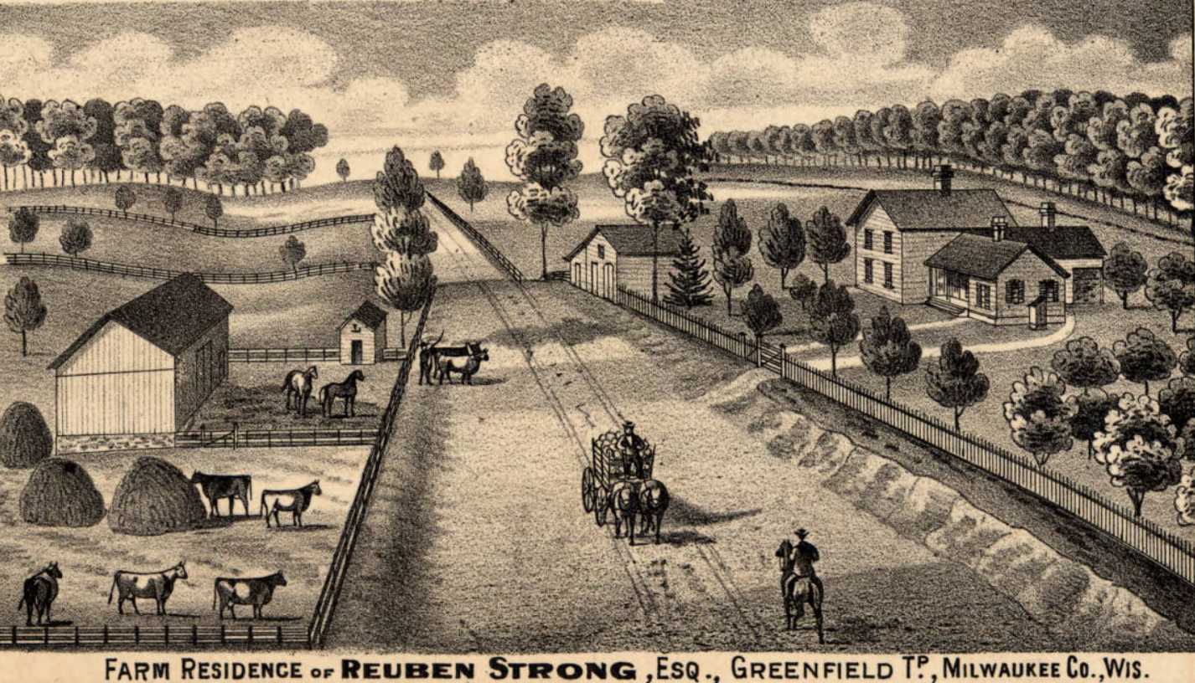
RUBEN STRONG’s FARM
1876

Slide 11
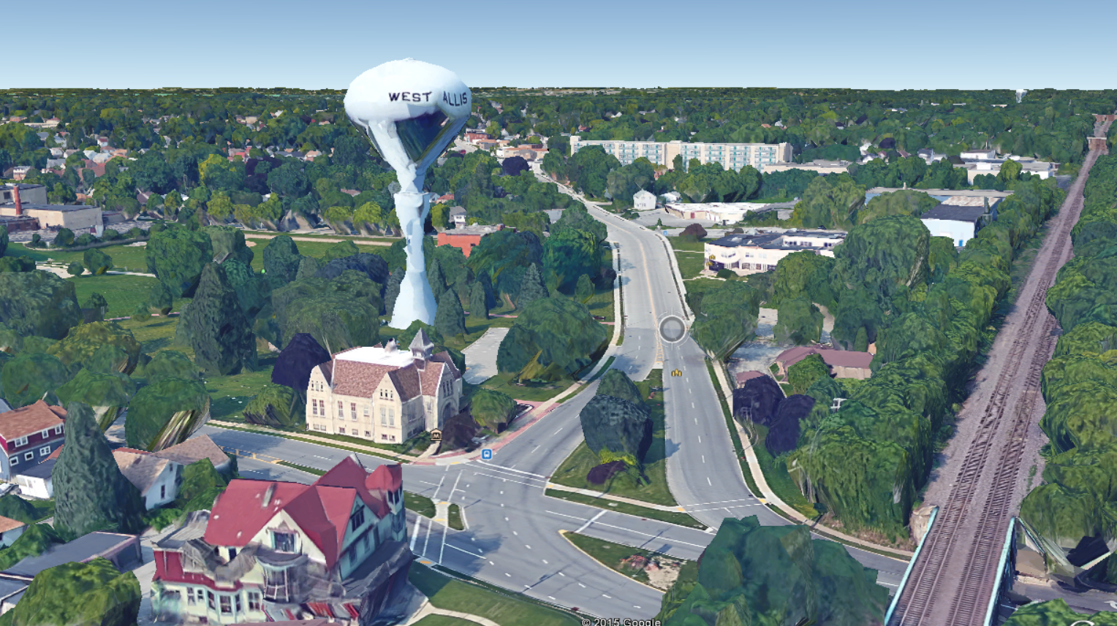

Slide 12
RUBEN STRONG’s FARM TODAY
Railroad
Burham St
Becher St
84th St
National Ave
92nd St
Lincoln Ave

Slide 13
Our Story:
First Baptist Church of West Allis
End of history 12

