Slide 1
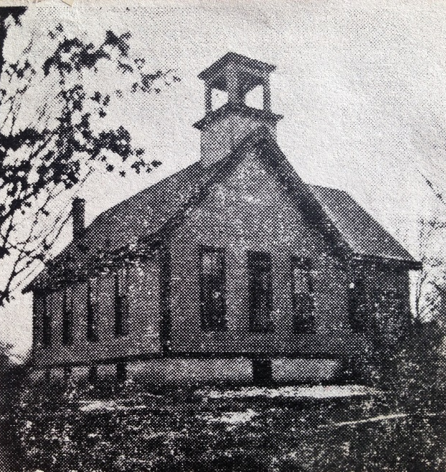
Our Story:
First Baptist Church of West Allis
21. Mission church

Slide 2
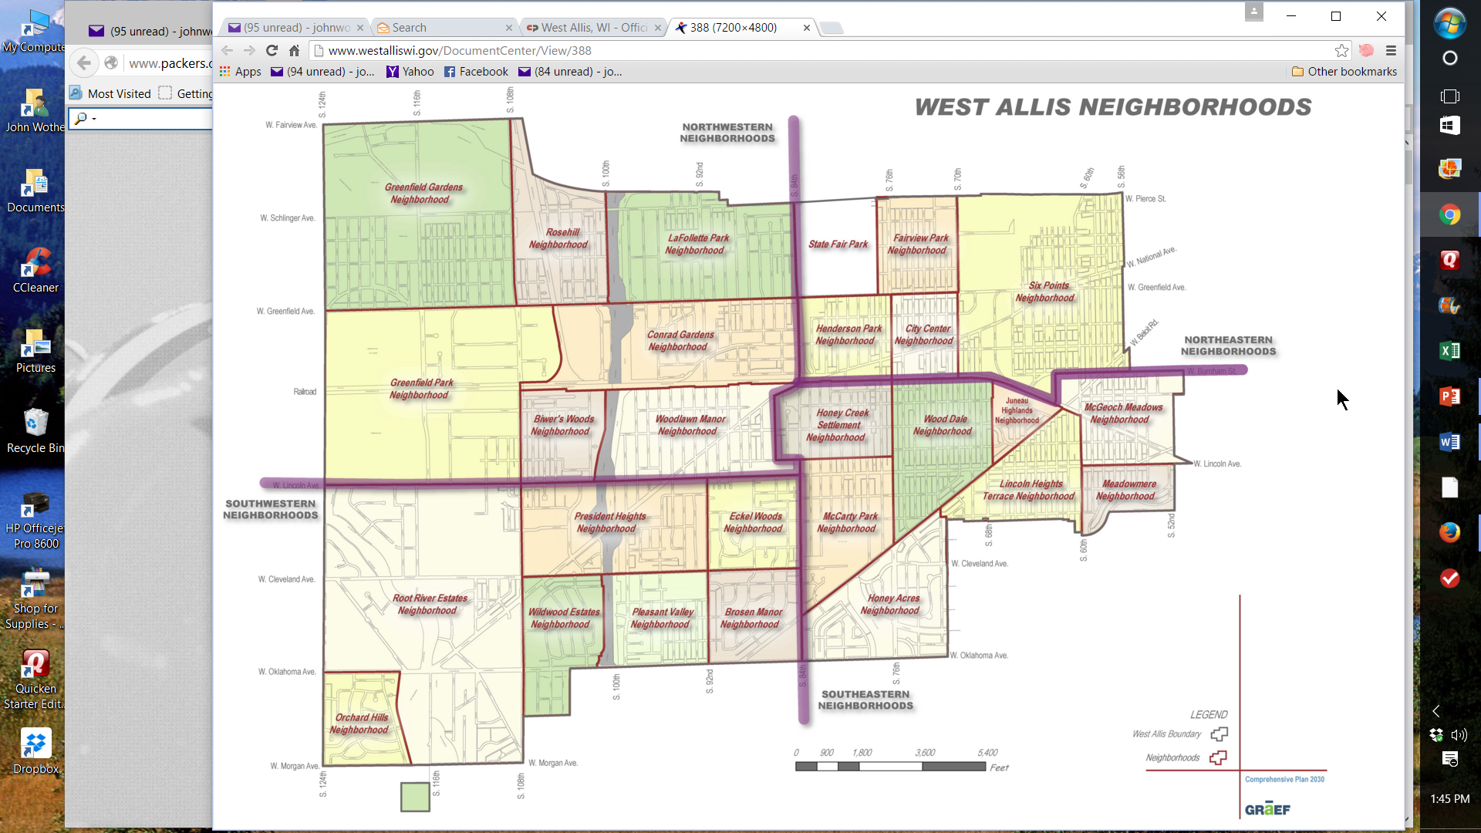
West Allis Neighborhoods 2016
National Ave
84th Street

Slide 3
West Allis Neighborhoods
Greenfield Ave
84th St
National Ave
92nd St
I-894/I-41
Lincoln Ave

Slide 4
West Allis Neighborhoods
Greenfield Ave
84th St
National Ave
92nd St
I-894/I-41
Lincoln Ave

Slide 5
West Allis Neighborhoods
Greenfield Ave
Becher
84th St
National Ave
92nd St
93rd Street
I-894/I-41
National Ave
Lincoln Ave

Slide 6
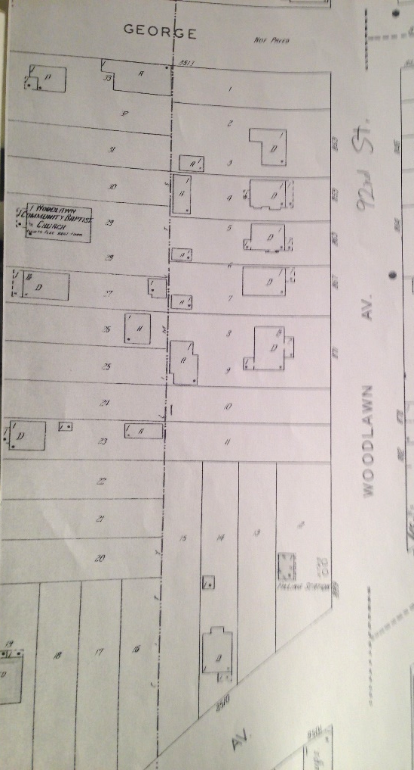
Woodlawn Community Baptist Church
Becher
93rd St
92nd St
National

Slide 8
Becher
93rd St
National

Slide 9
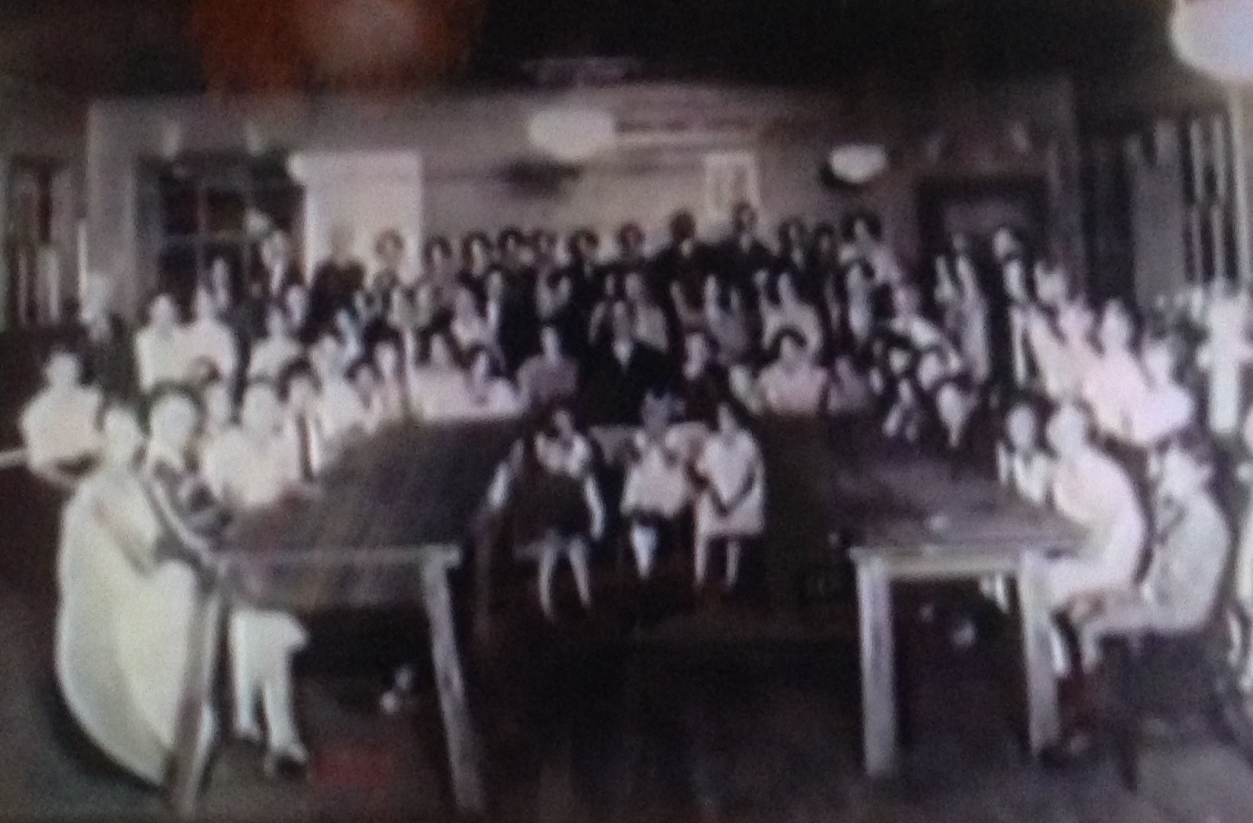

Slide 10
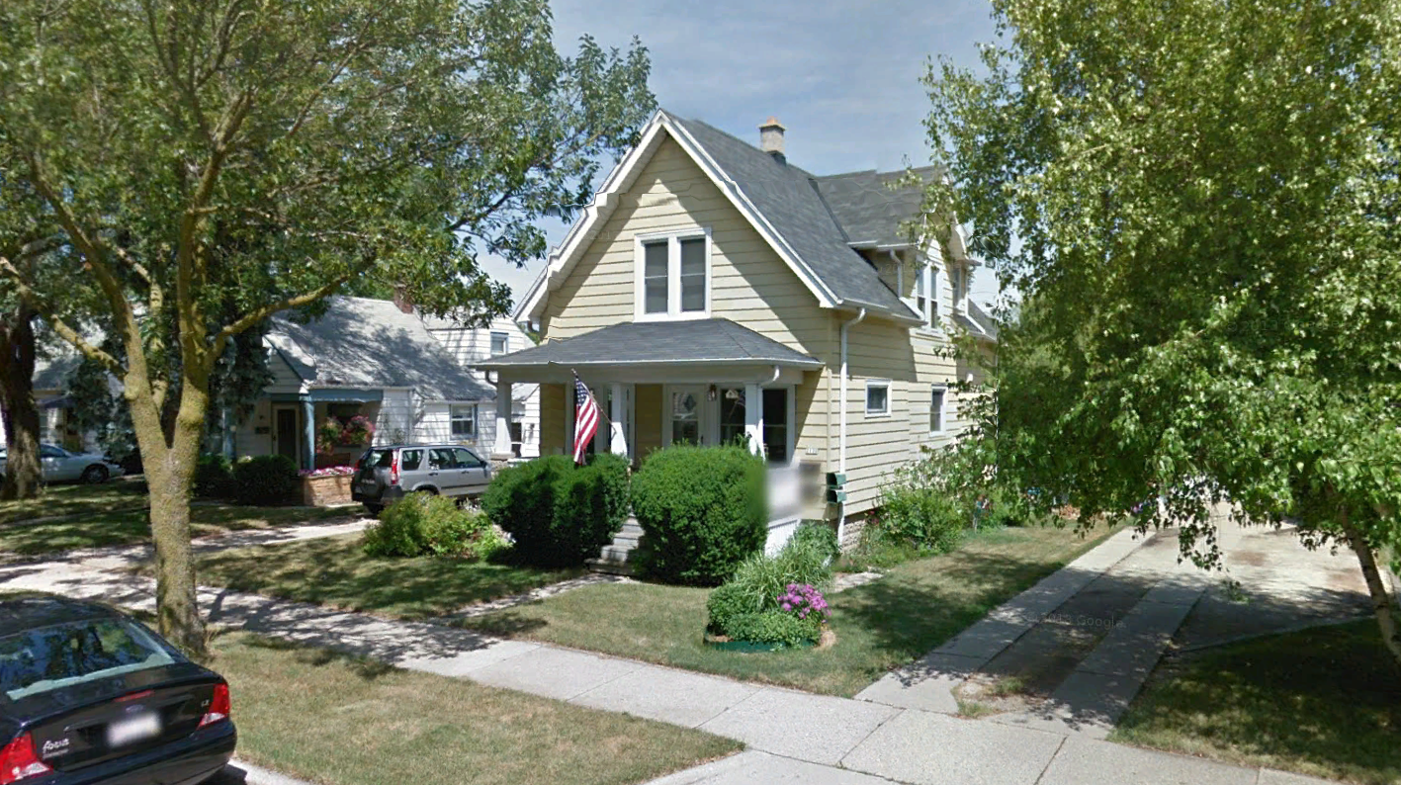

Slide 11
Our Story:
First Baptist Church of West Allis
End of history 21

