Slide 1
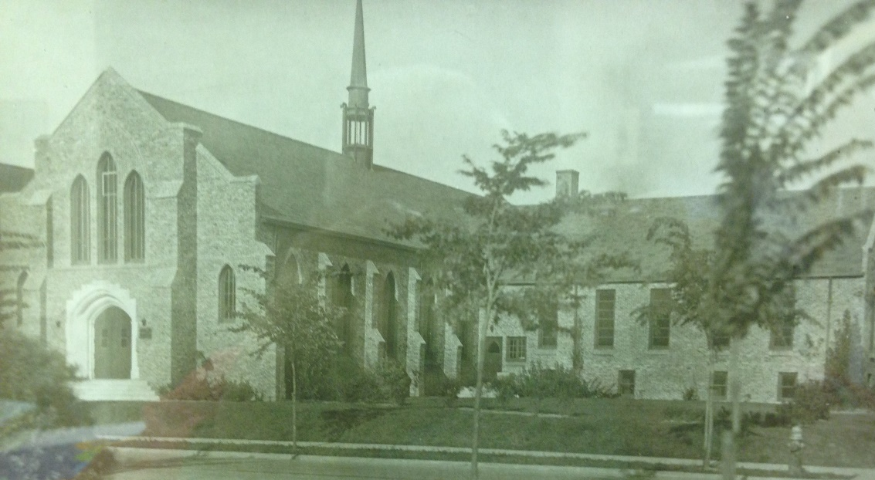
Our Story:
First Baptist Church of West Allis
24. Our Church During 1941-1945

Slide 2
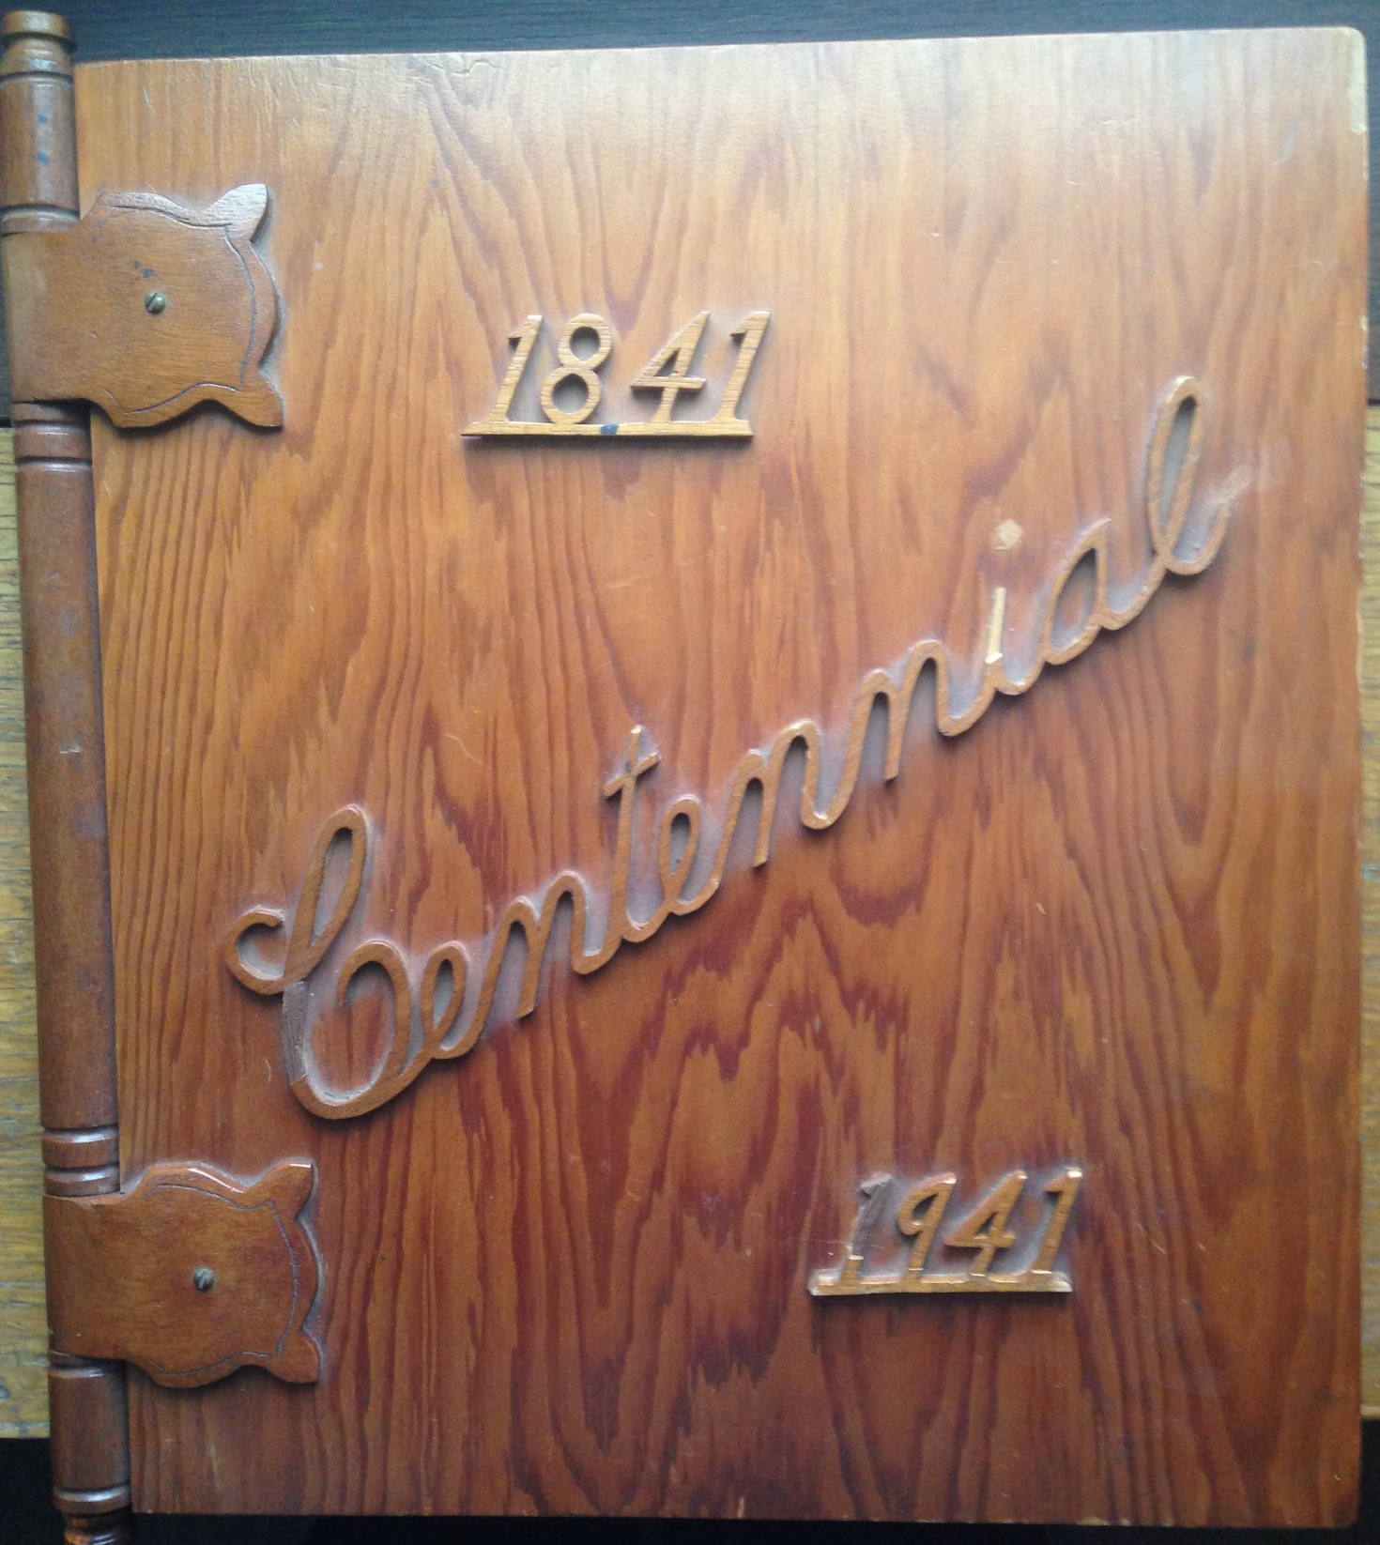

Slide 3
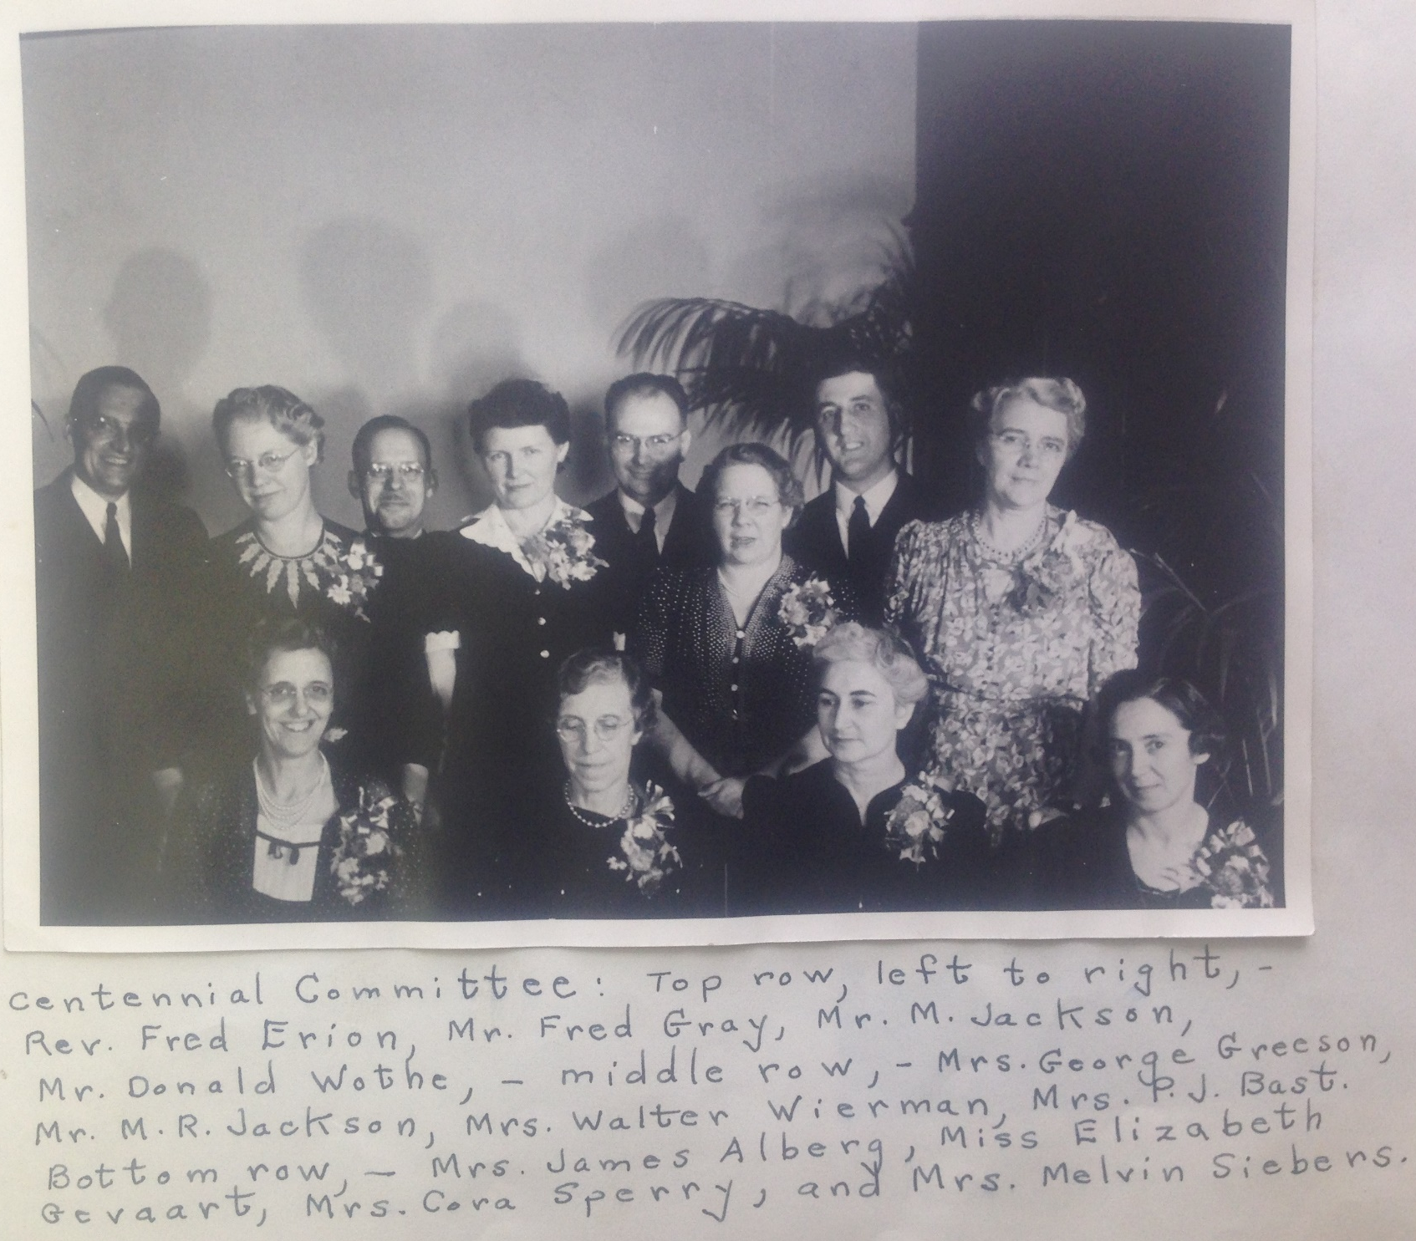
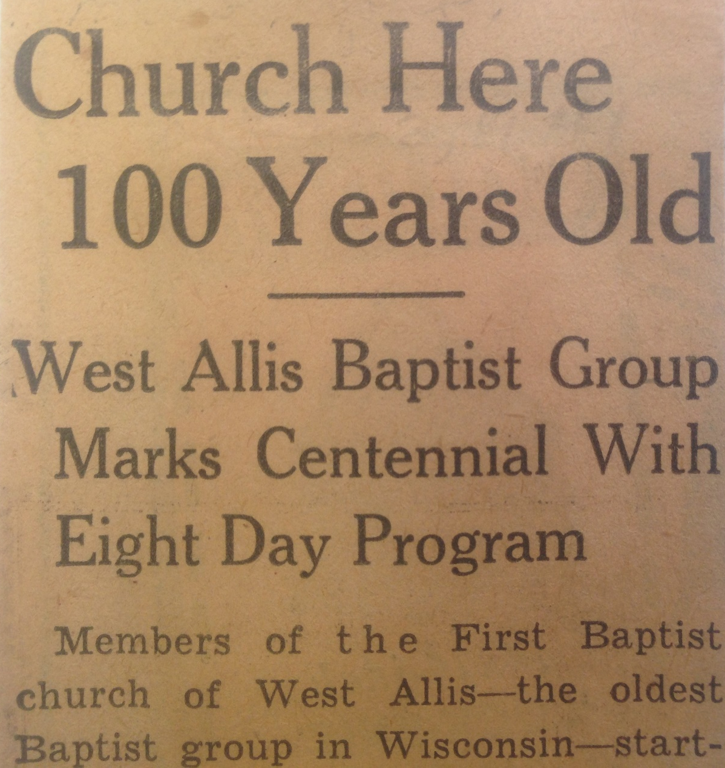

Slide 4
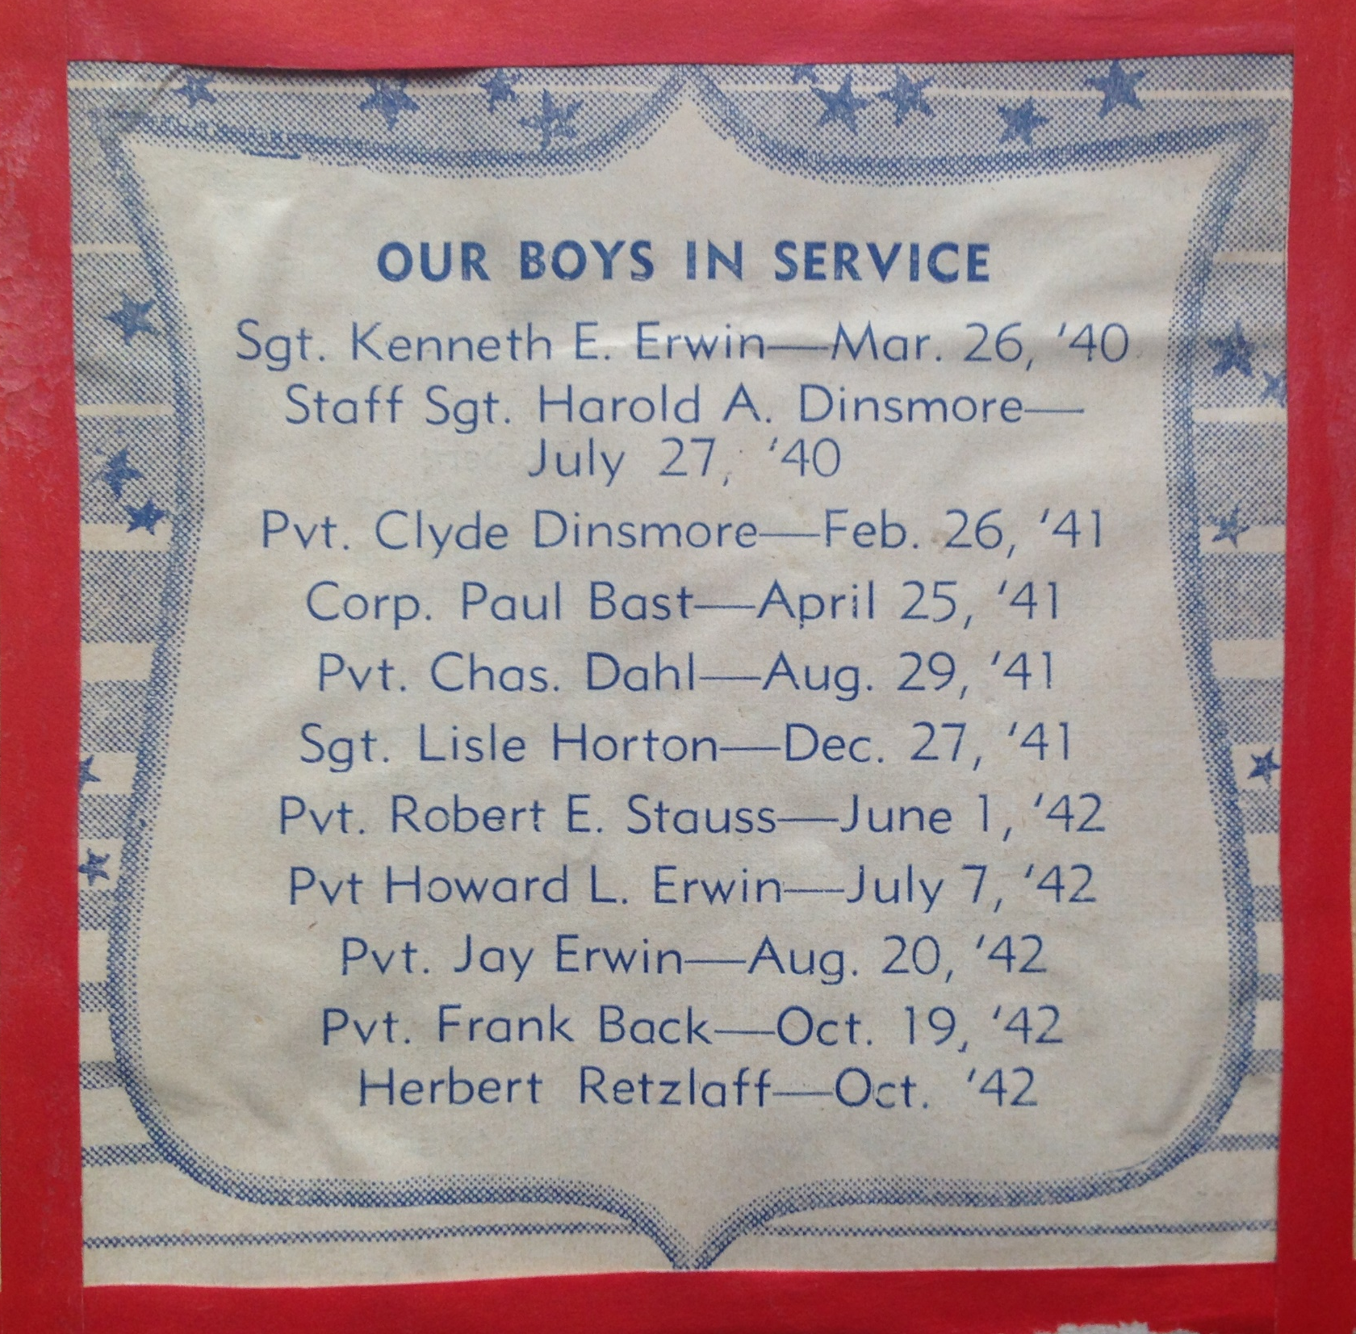
World War II Called

Slide 5
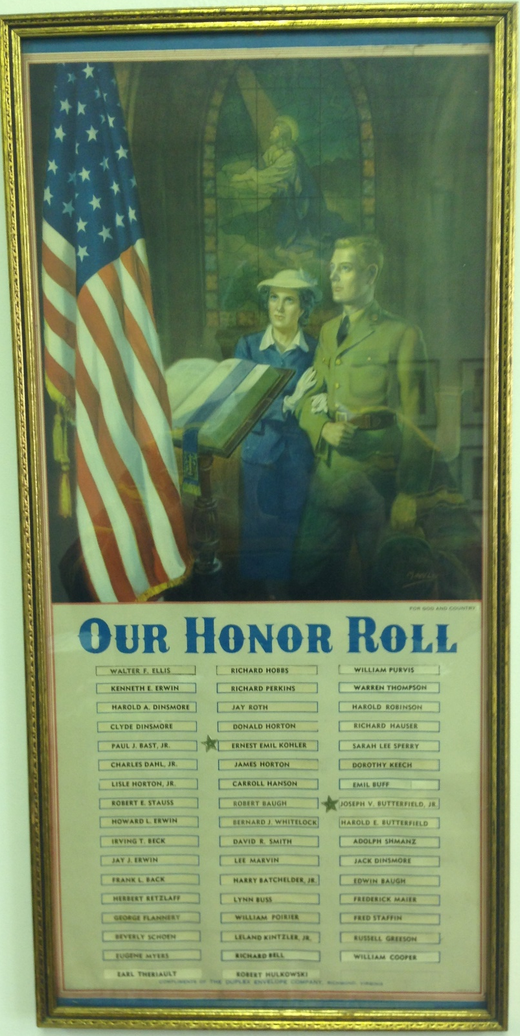
World War II Called

Slide 6
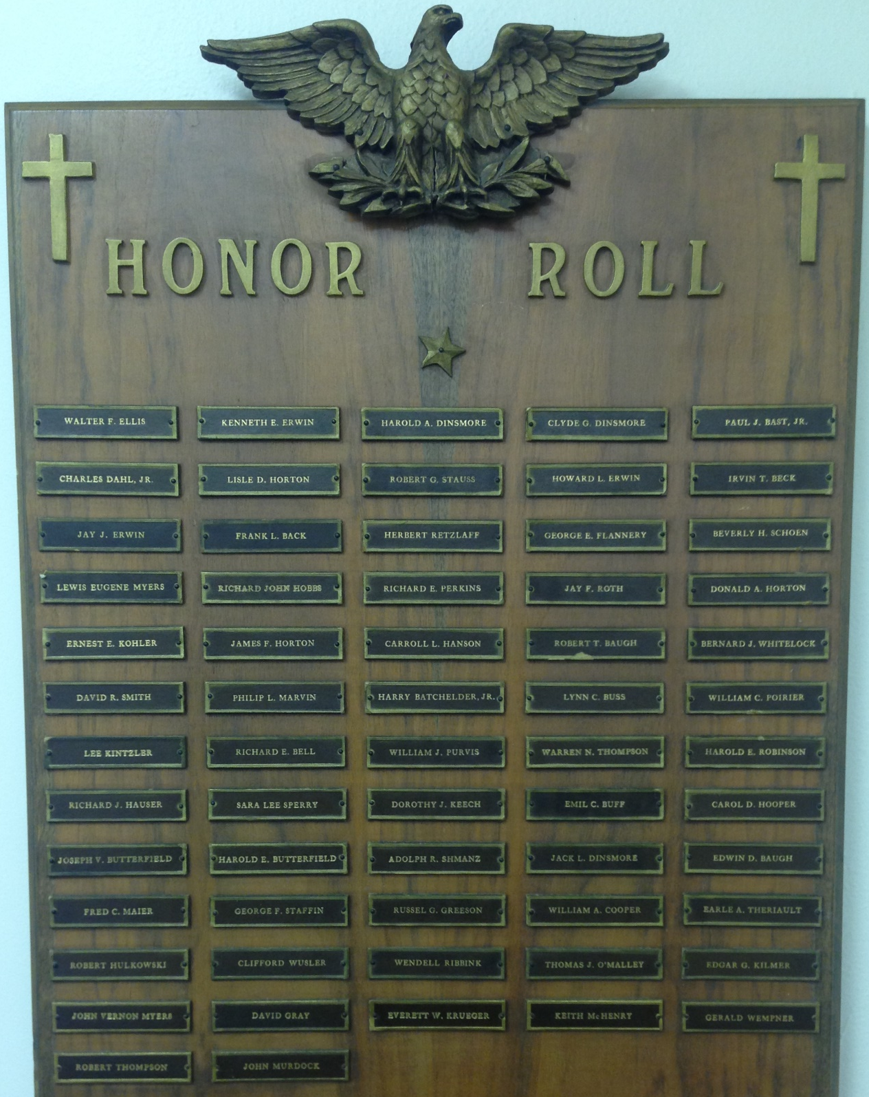
World War II Called

Slide 9
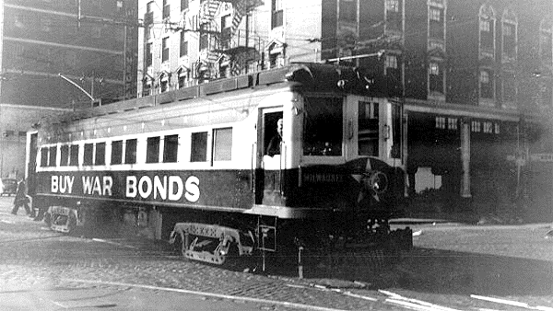

Slide 11
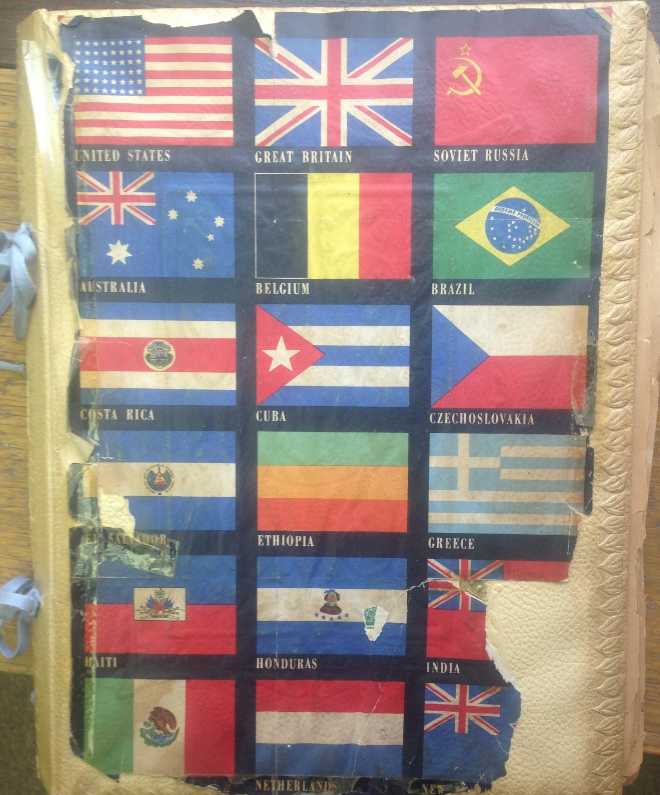
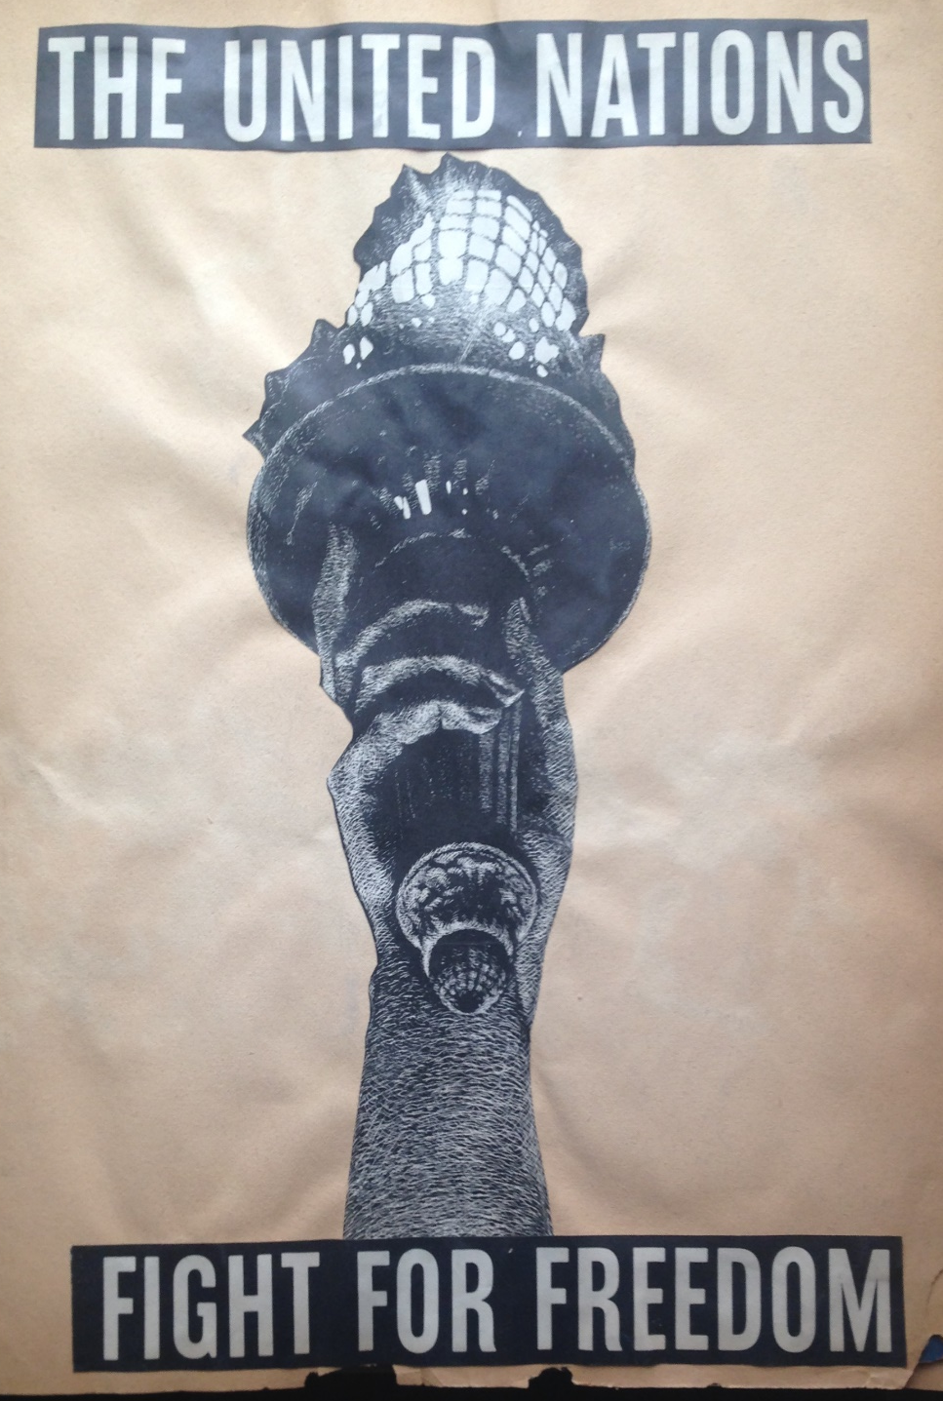
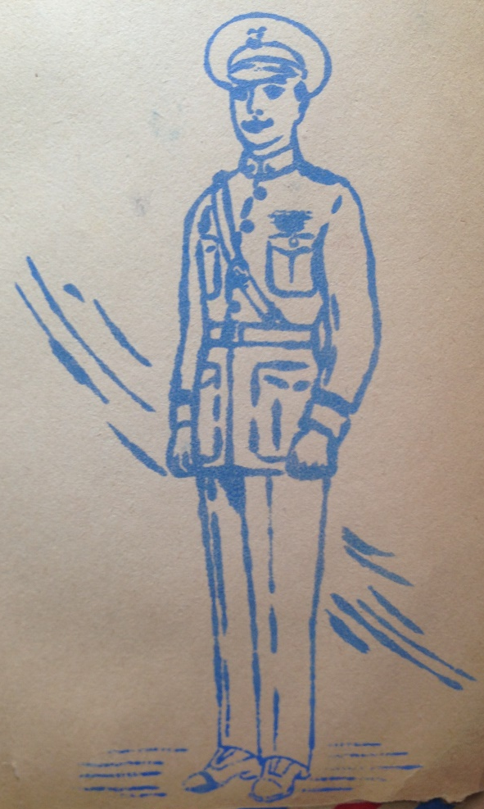
WW II Memory Book

Slide 12
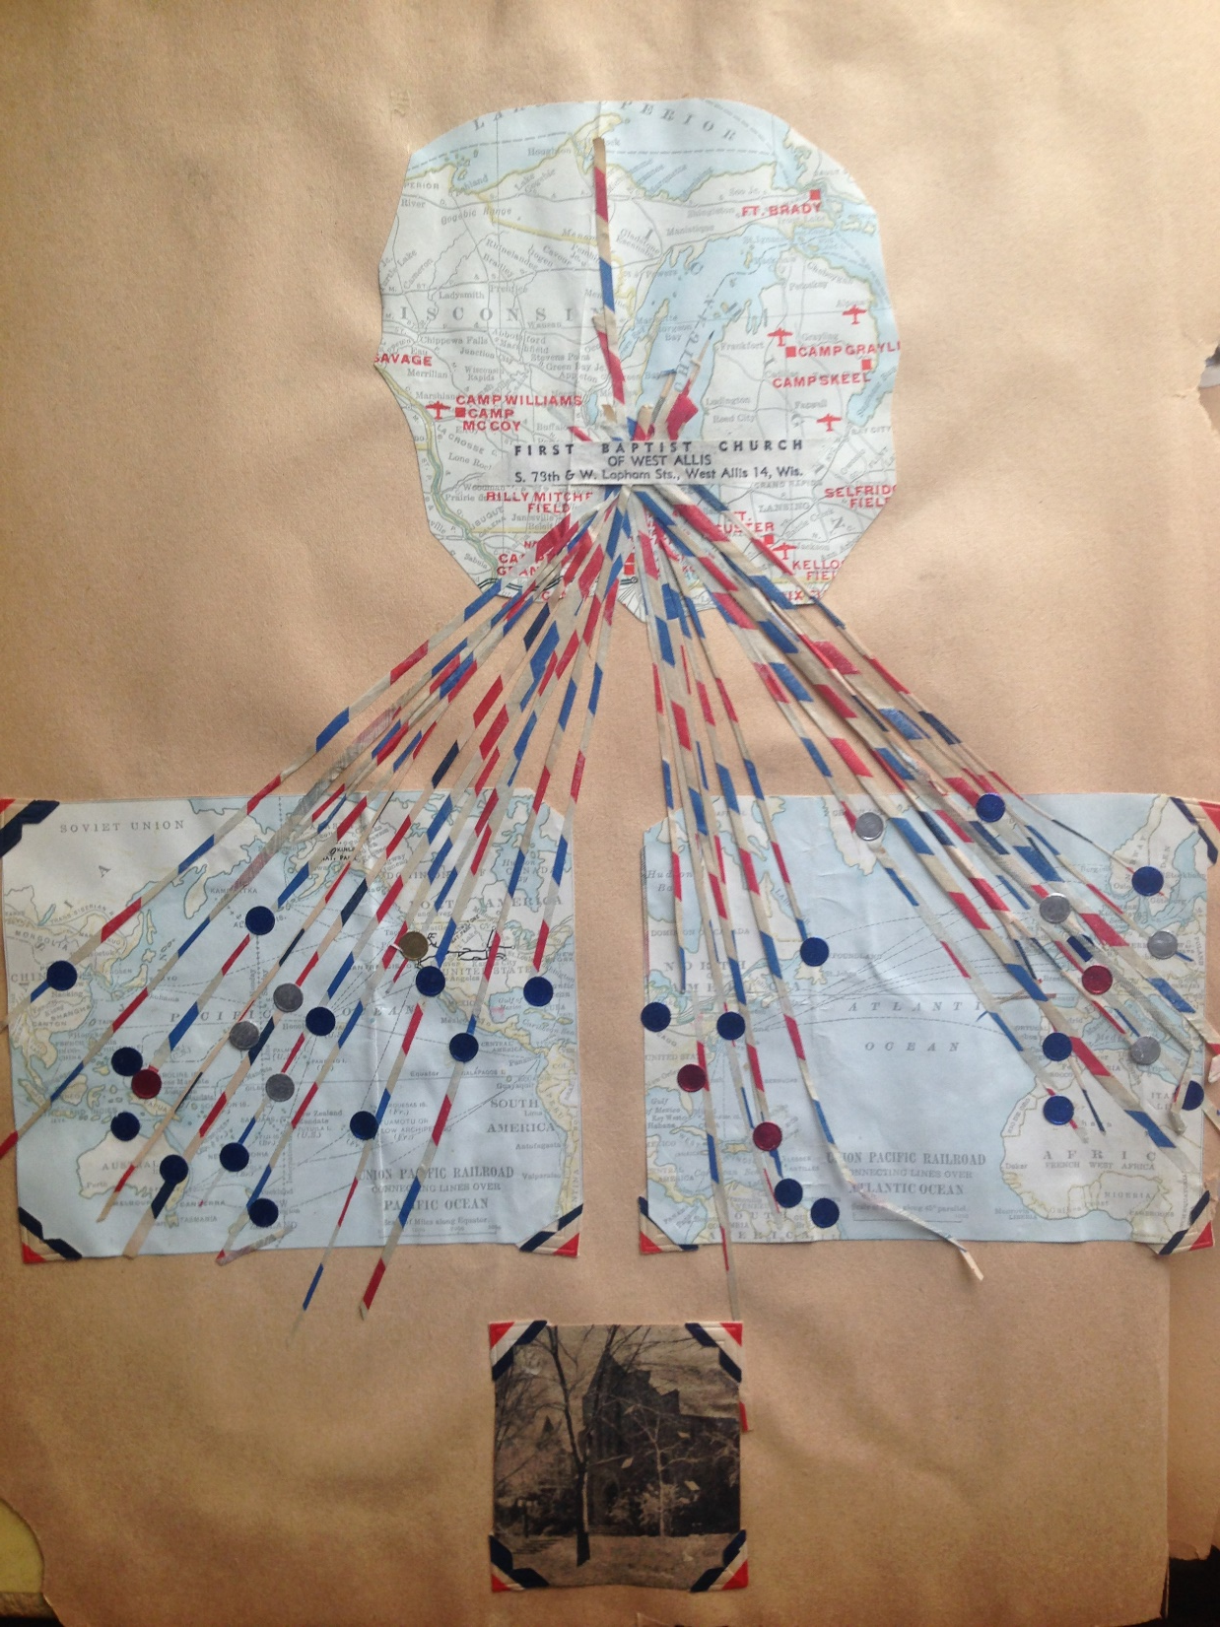

Slide 13
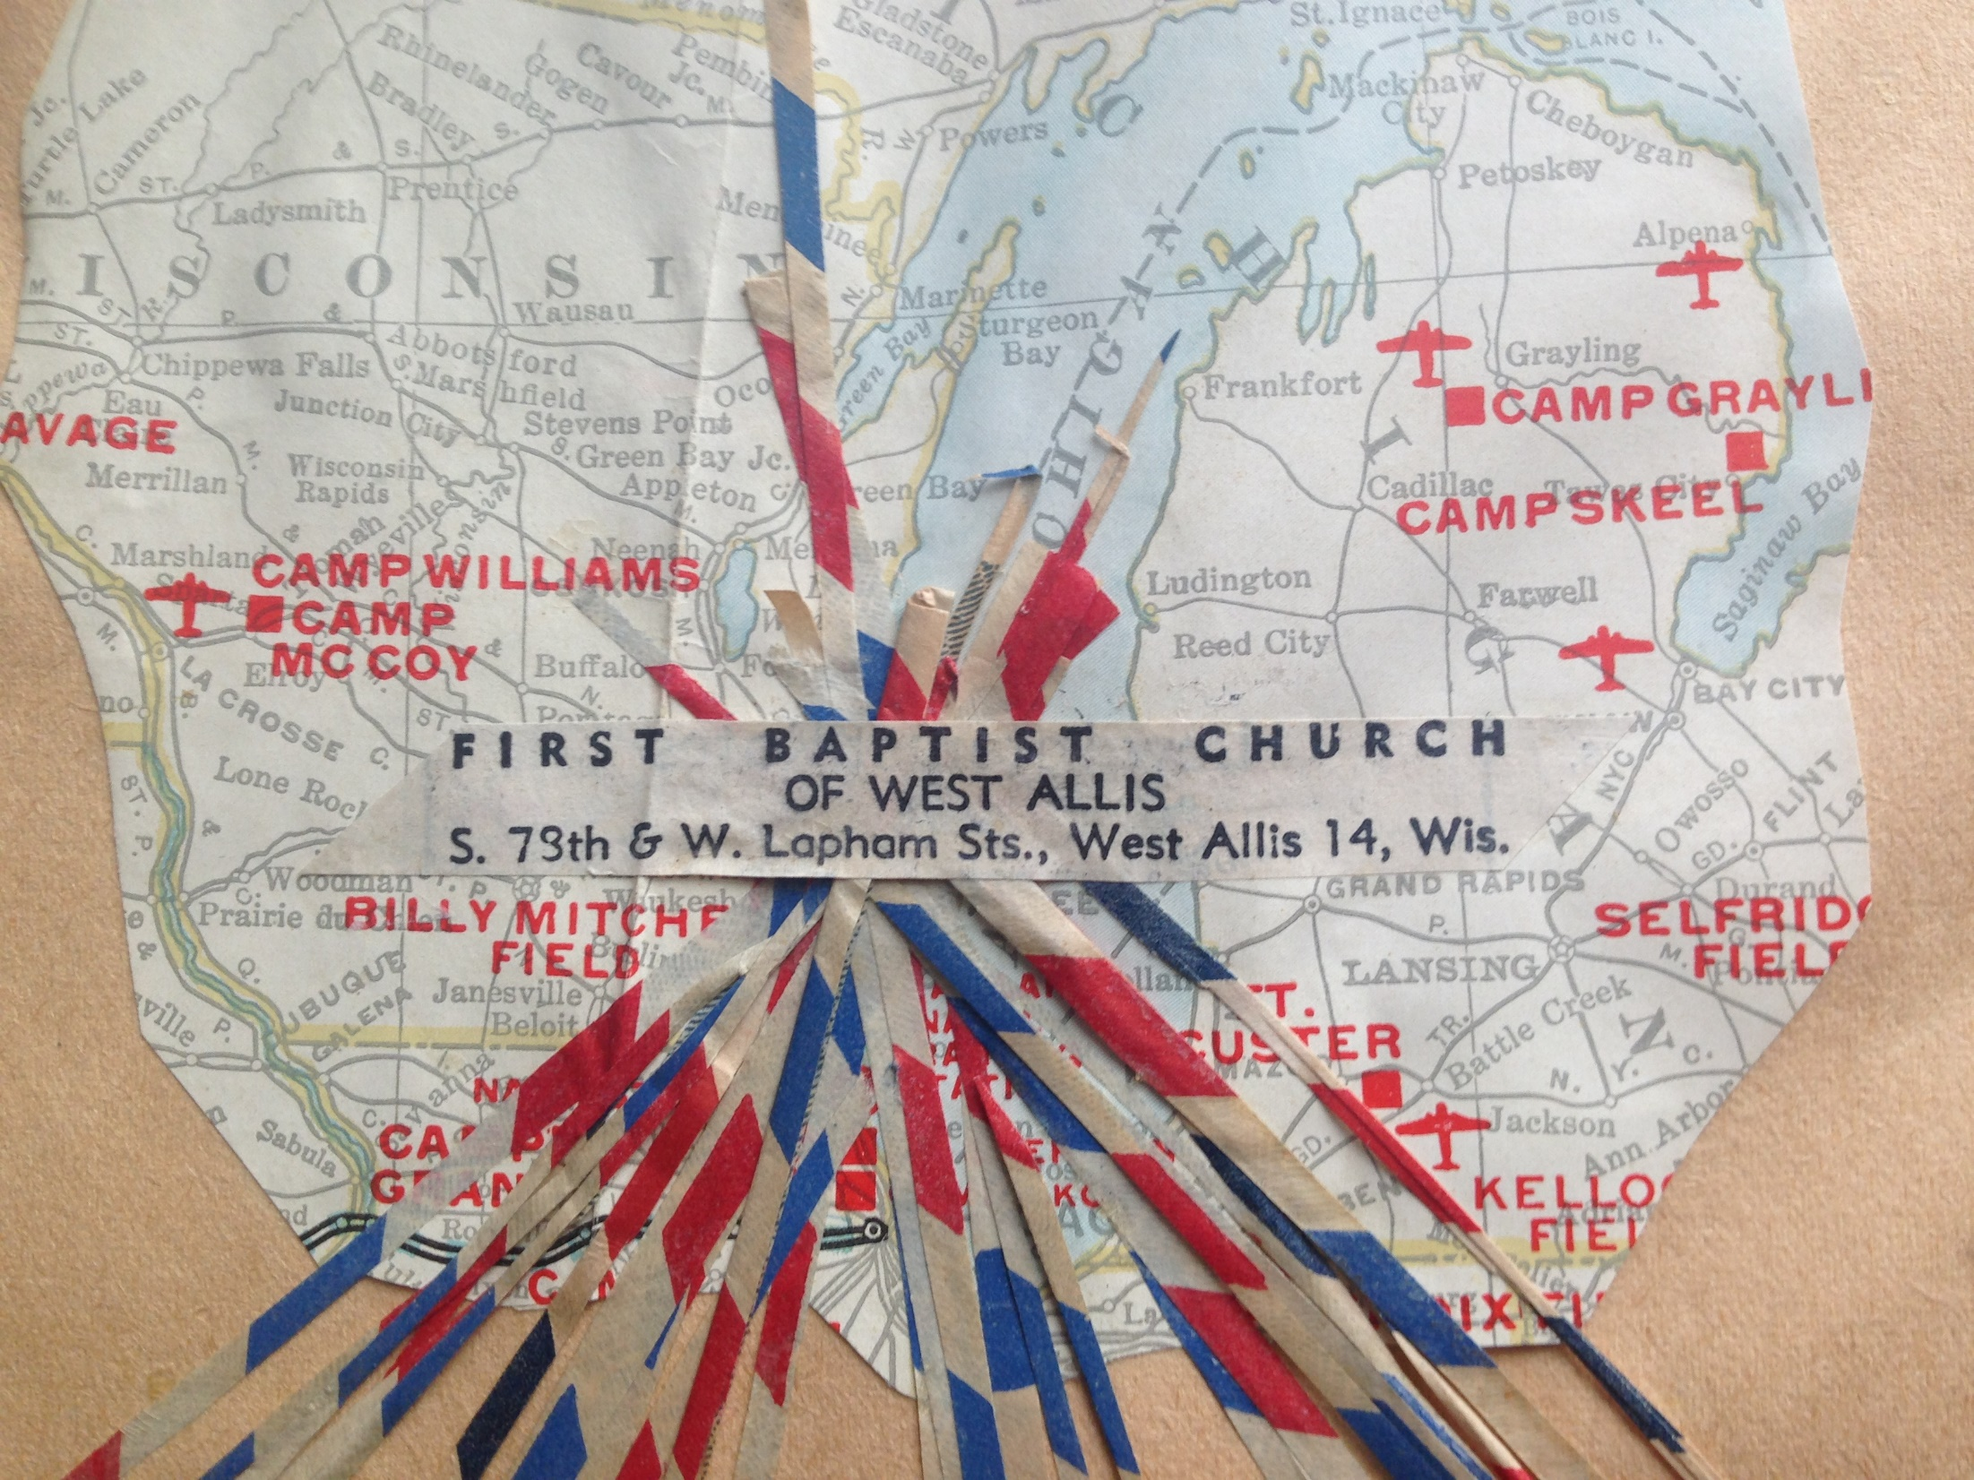

Slide 14
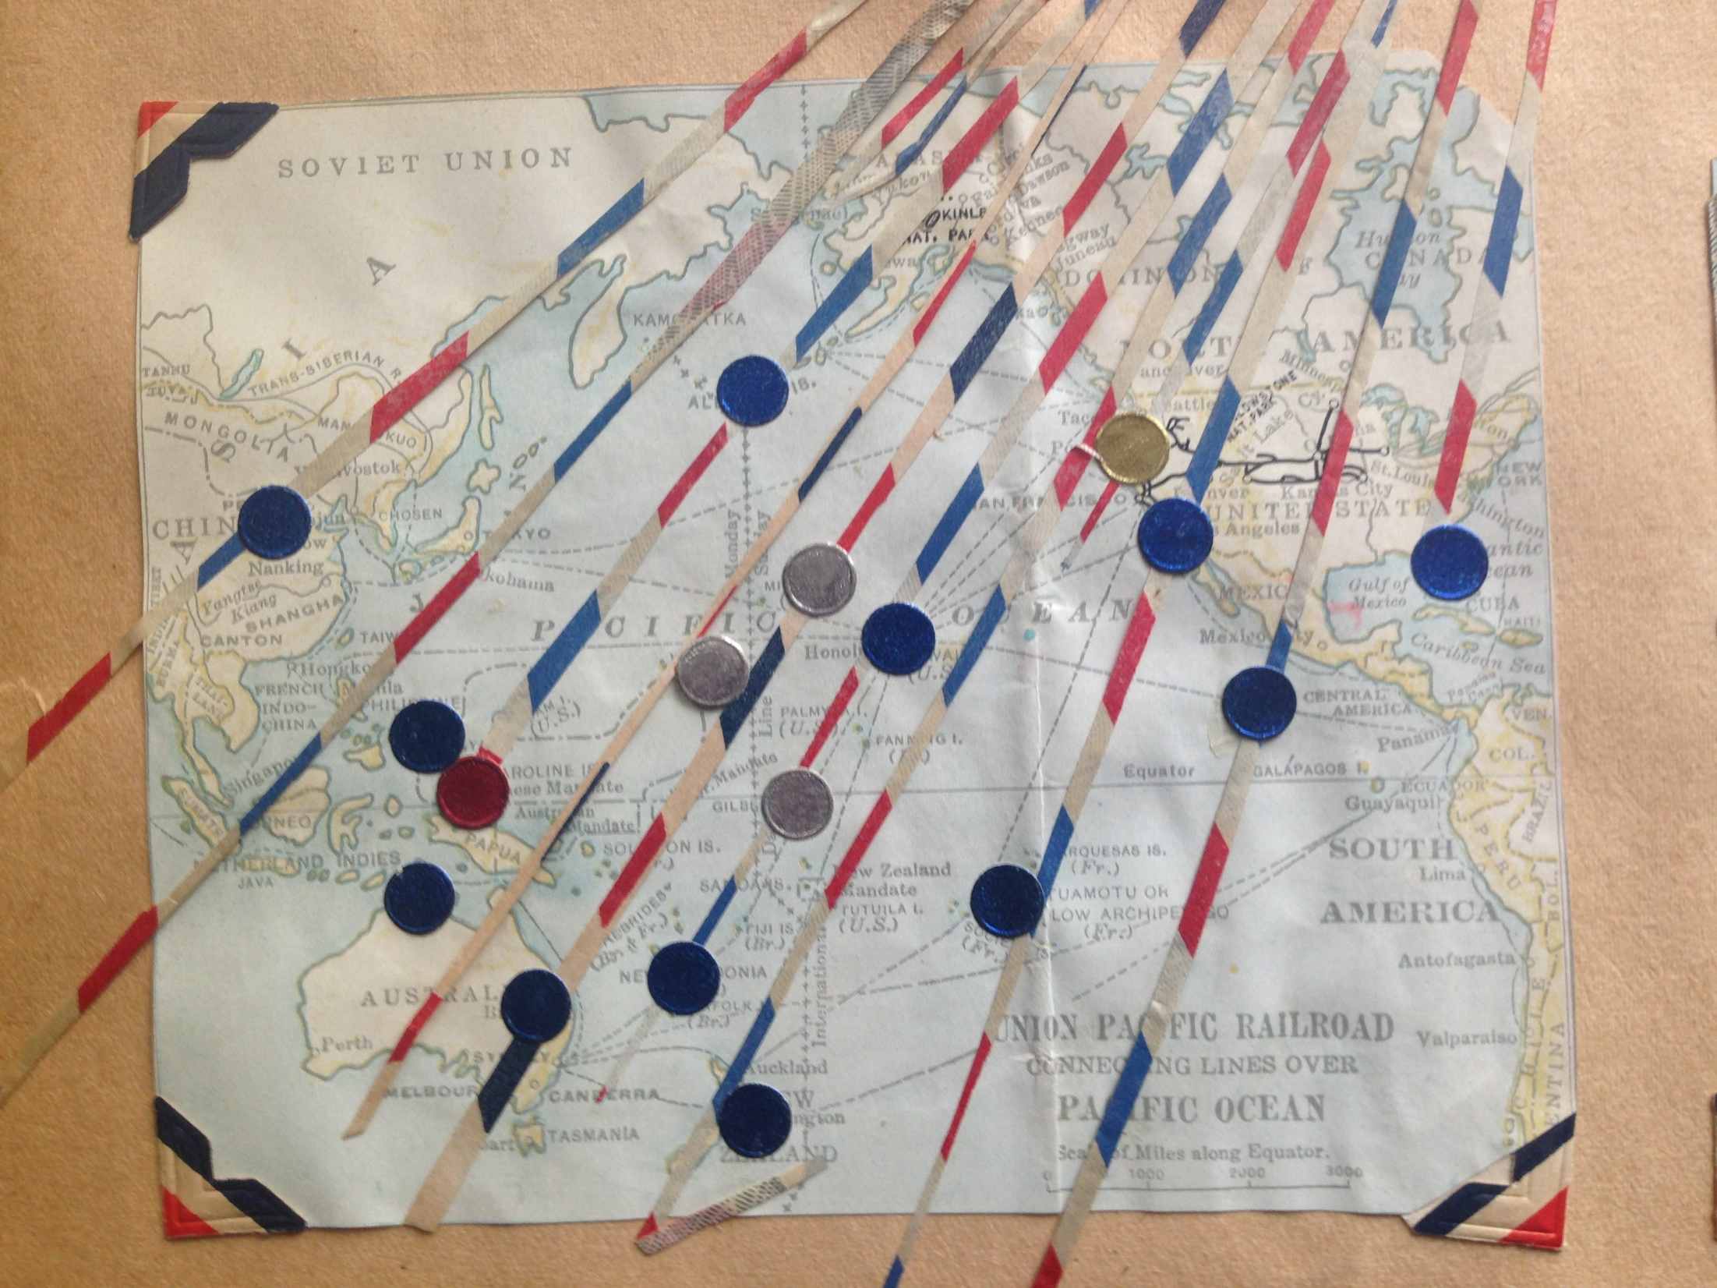

Slide 15
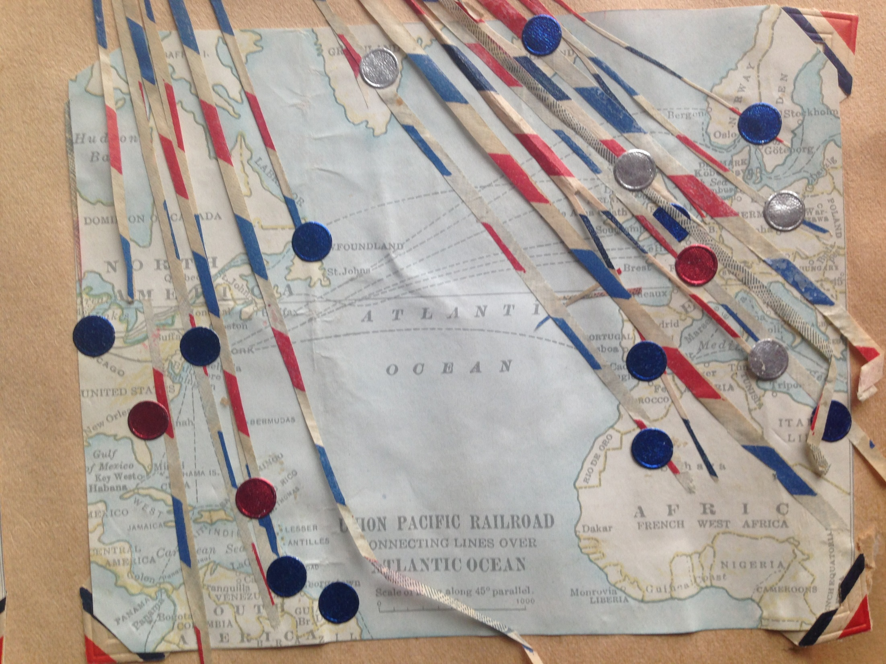

Slide 16
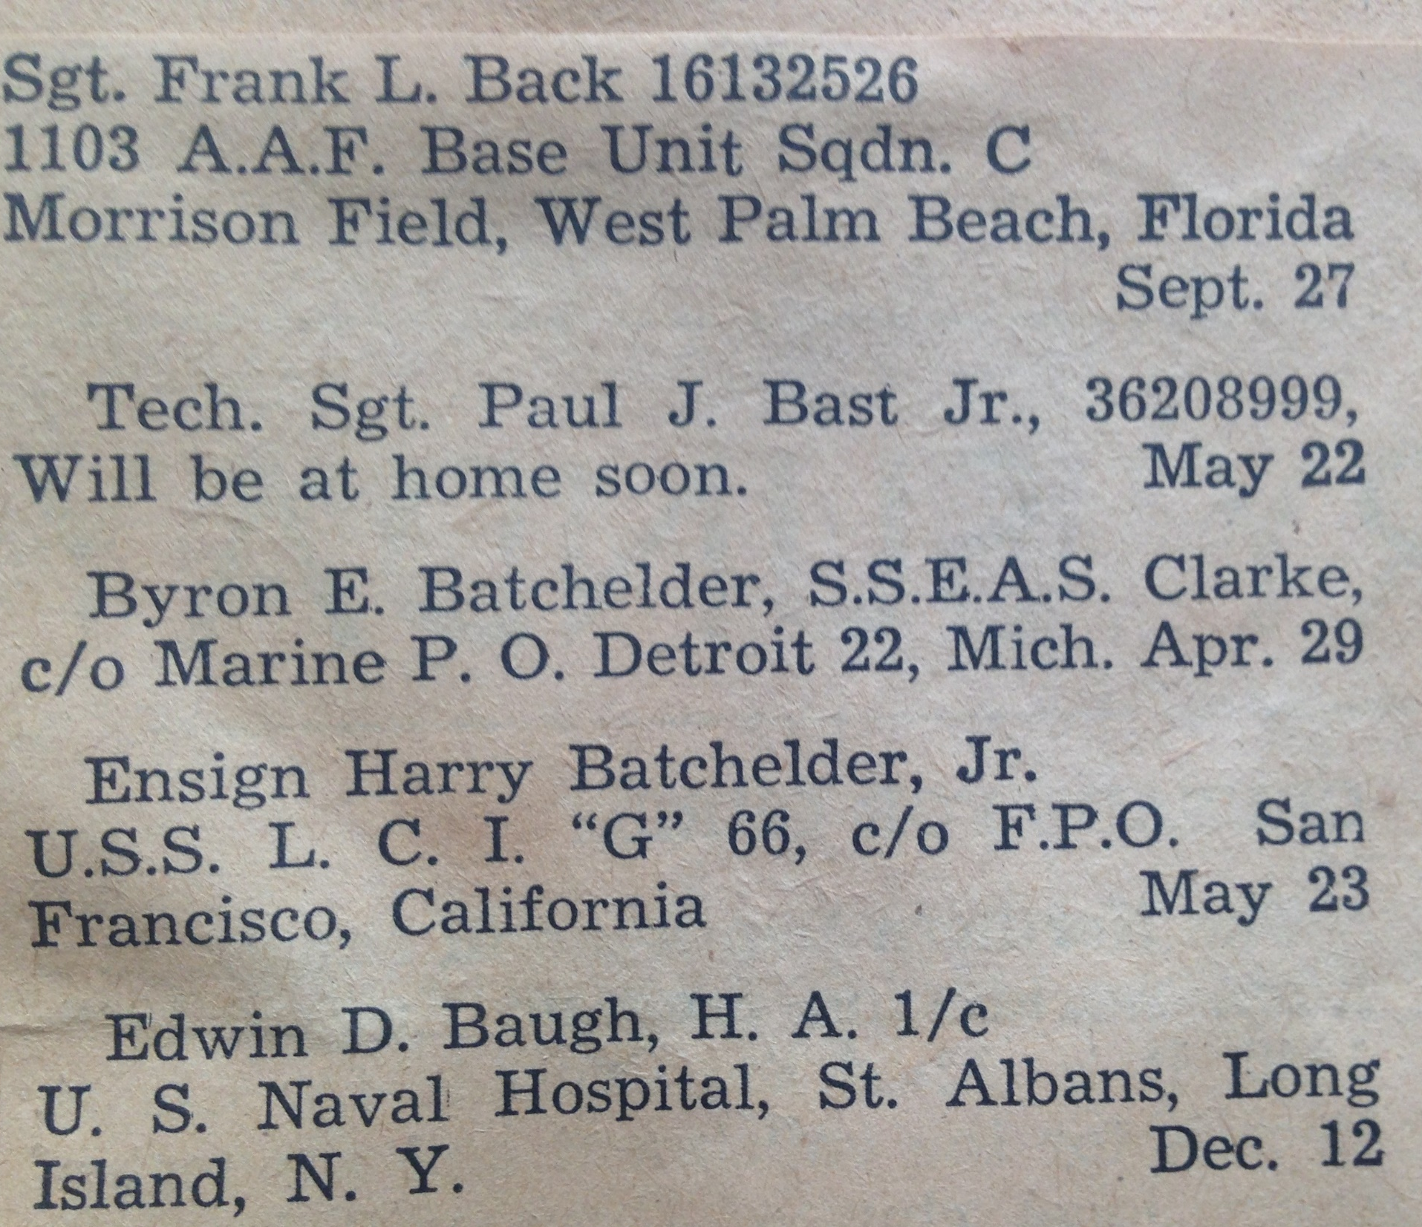

Slide 19
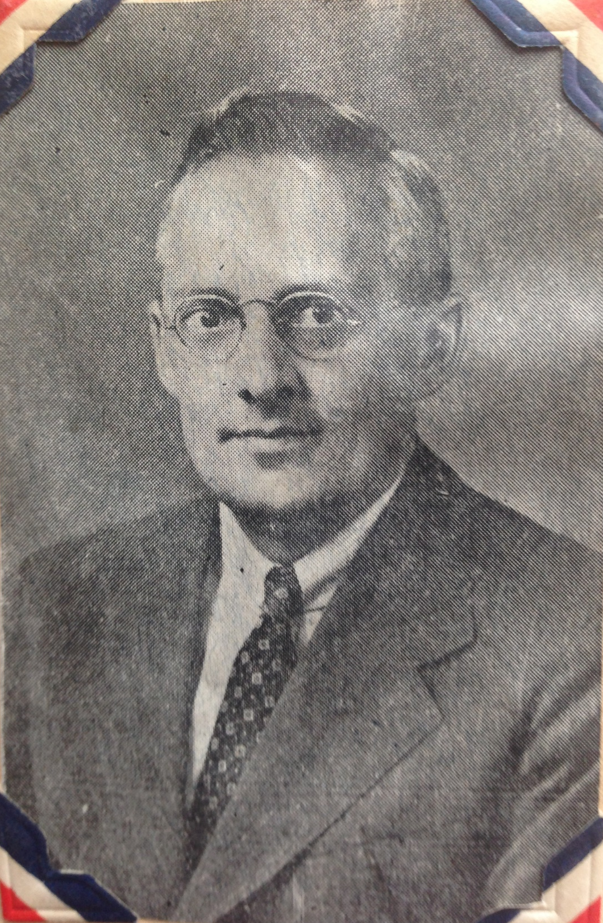

Slide 20
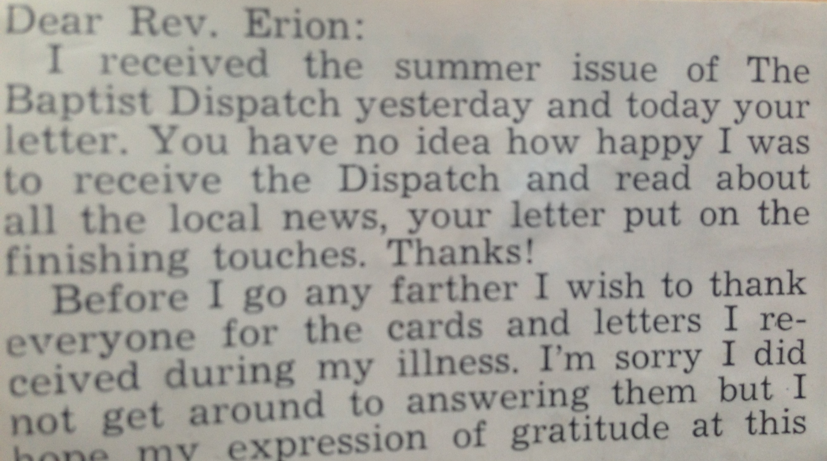

Slide 21
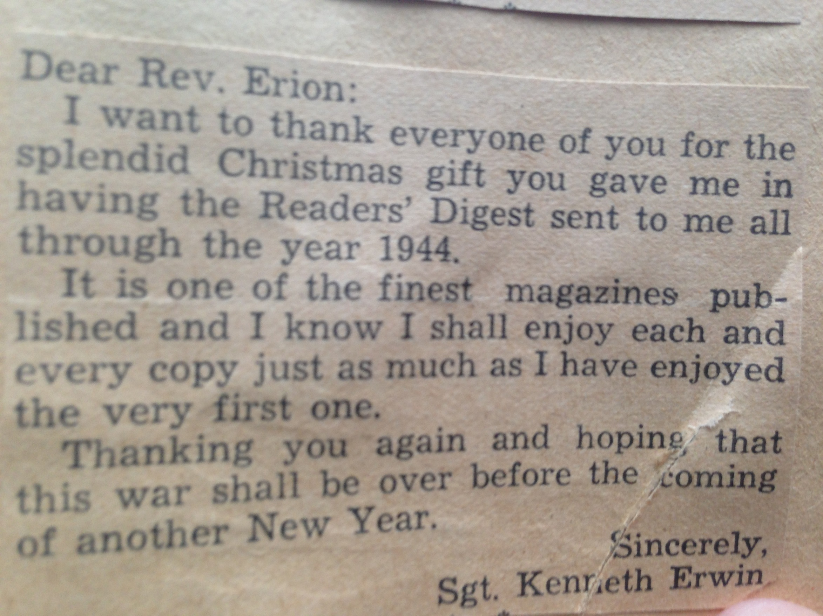

Slide 22
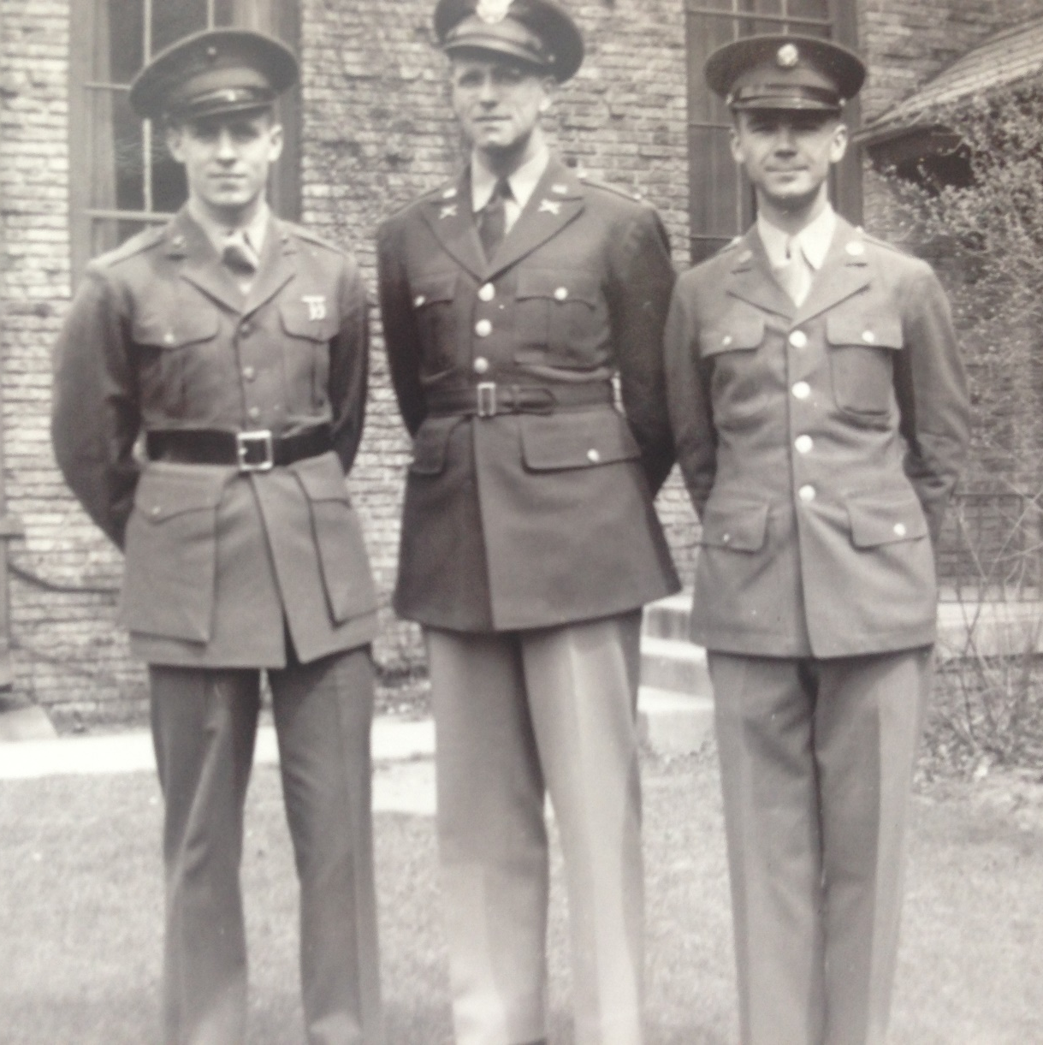
WW II Memory Book
?/?/ Charles Dahl
Sgt Paul Bast, Jr.
Lt Dorothy Keech

Slide 23
Jay Roth/Rev Erion

Slide 25
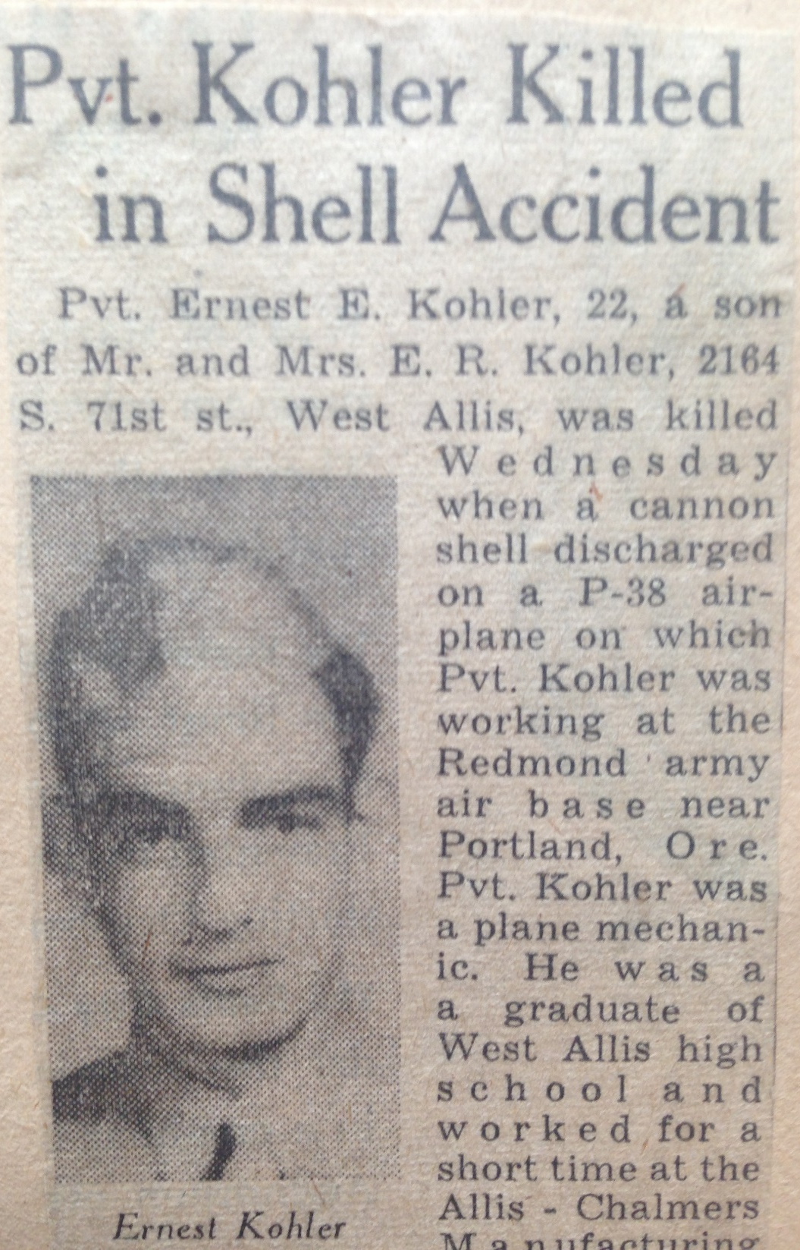

Slide 26
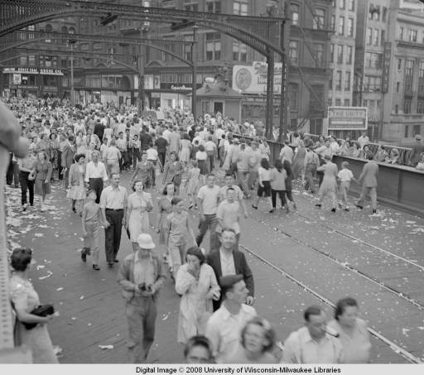
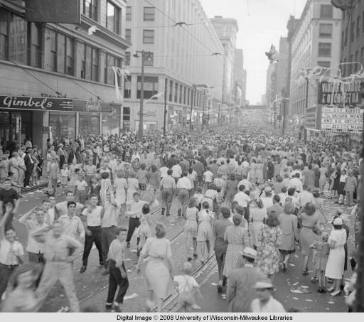
V J DAY 1945
(Victory Japan Day)
Wisconsin Ave Bridge
West Wisconsin Ave

Slide 27
Pastors of Greenfield Baptist Church
Rev F. F. Parsons 1912-1922
Rev A. L. MacMillan 1922-1925
Rev Andrew. B . Martin 1925-1930
Rev Earl Foster 1931-1931
Rev Ralph Compere 1931-1932
Rev Fred Erion 1934-1945
Rev Raymond Pierson 1945-1946
Rev Alfred S. Davis 1946-1952
Rev Alex G. Sinclair 1953-1966
Rev Merlin W. Bradley 1966-1978

Slide 28
Our Story:
First Baptist Church of West Allis
End of history 24

