Slide 1
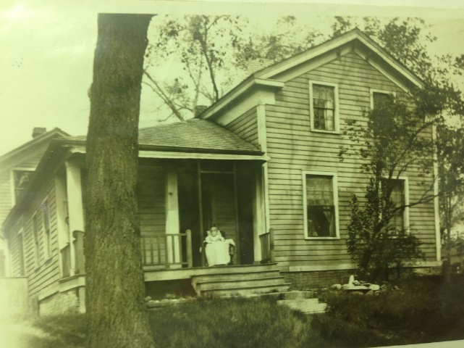
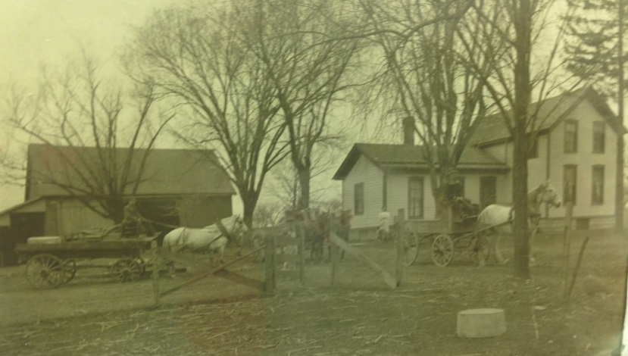
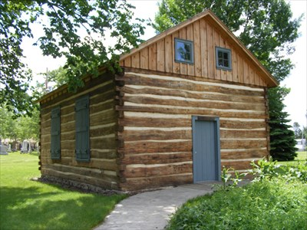
Our Story:
First Baptist Church of West Allis
7A. Rev. Paul Conrad

Slide 2
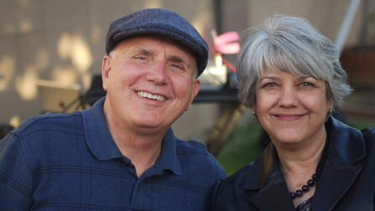

Slide 3
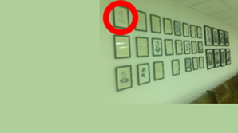

Slide 4
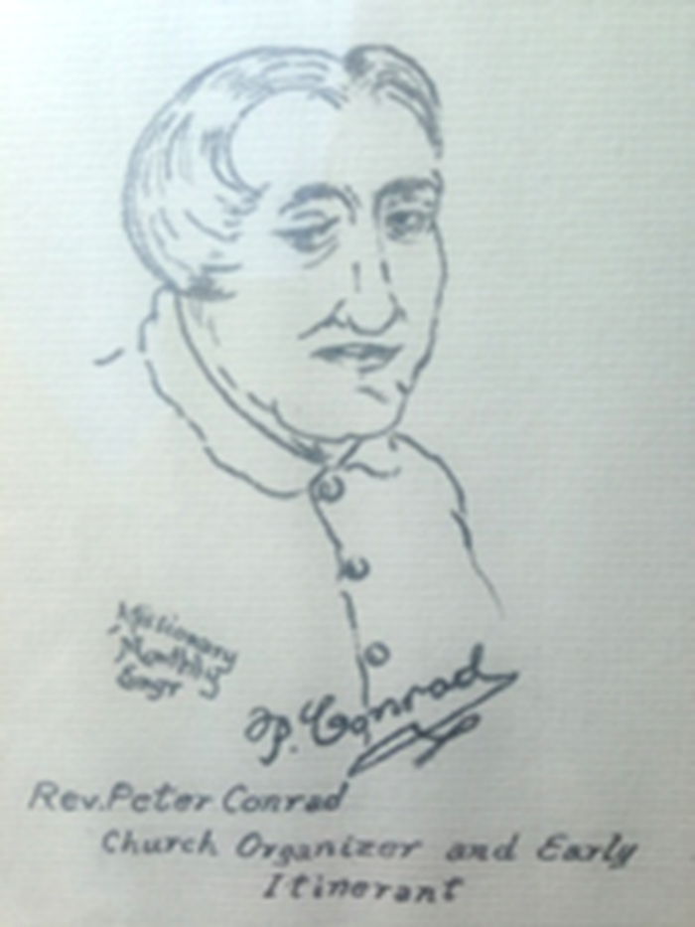

Slide 5
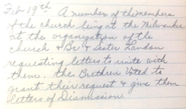

Slide 6
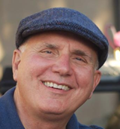

Slide 7
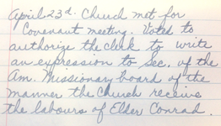

Slide 9
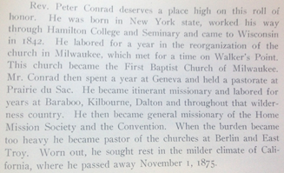

Slide 10
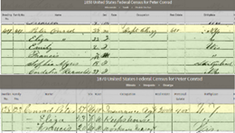

Slide 11
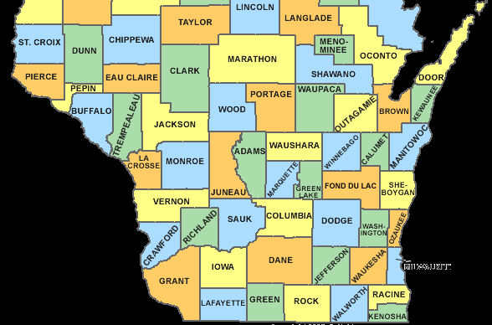
Churches Served
Kilbourne
Berlin
Dalton
Baraboo
Prairie du Sac
Milwaukee
Honey Creek
East Troy
Geneva

Slide 12
Our Story:
First Baptist Church of West Allis
End of history 7A

