Slide 1
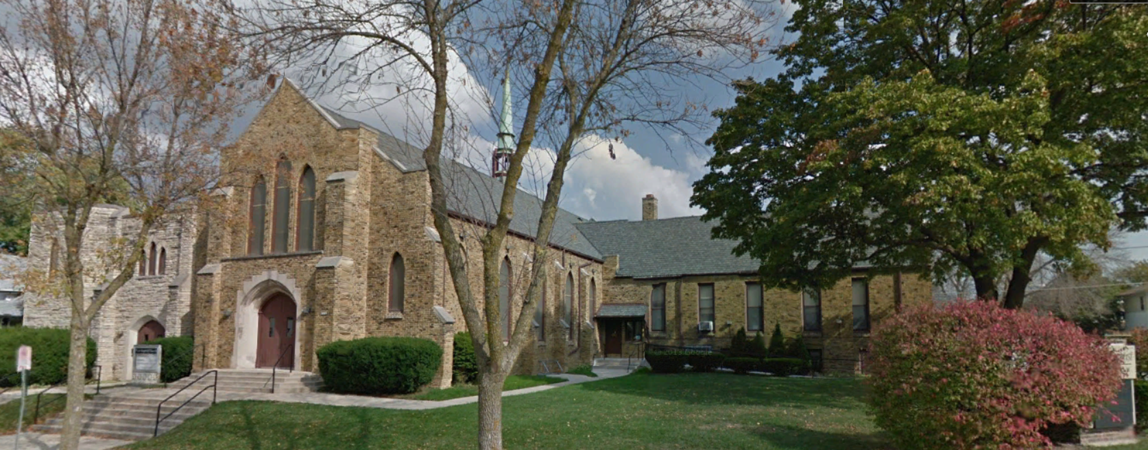
Our Story:
First Baptist Church of West Allis
36. Open Questions

Slide 2
70 Av
Summit

Slide 5
1st Street

Slide 6
Fairview Ave/Canal St/Milwaukee River
1st Street

Slide 7
City of West Allis

Slide 8
City of West Allis

Slide 9
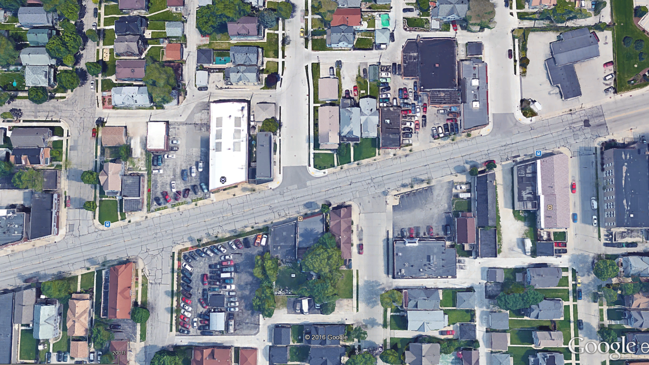
56th Street
57th Street
58th Street

Slide 10
77th Street
76th Street
City of West Allis

Slide 11
95th Street
94th Street
93rd Street
City of West Allis

Slide 12
Township 6 North (Township of Greenfield) Section 4

Slide 13
Township 6 North (Township of Greenfield) Section 4
6 5 4 3 2 1
7 8 9 10 11 12
18 17 16 15 14 13
19 20 21 22 23 24
30 29 28 27 26 25
31 32 33 34 34 36

Slide 14
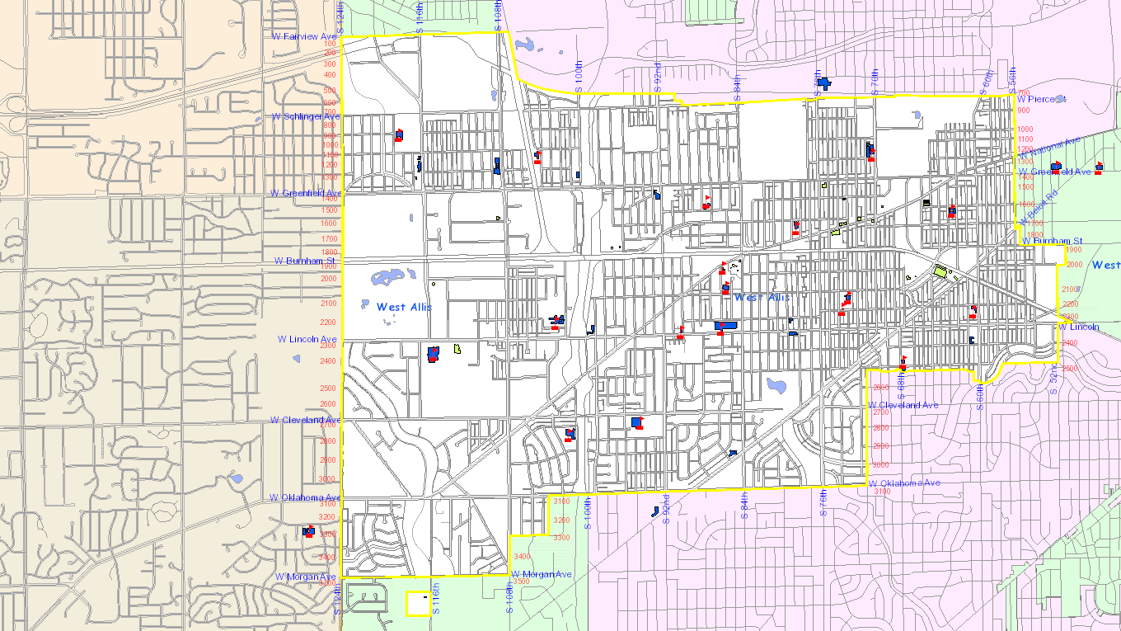

Slide 16
Our Story:
First Baptist Church of West Allis
End of history 36

